Slide 1

Basic Details of the Team and Problem Statement
Ministry/Organization Name/Student Innovation: National Technical Research Organisation,(NTRO)
PS Code: SIH1456
Problem Statement Title: Speech to text transcription for Indian languages. The problem entails transcription in the native script and then translation to English. The languages of interest are Hindi, Indian English, Urdu, Bengali, Punjabi.
Team Name: Virtual Innovatives
Team Leader Name: Justine Biju Paul
Institute Code (AISHE): C-11767
Institute Name: Mar Baselios Christian College of Engineering and Technology, Peerumedu - 685 531
Theme Name: Miscellaneous

Slide 2
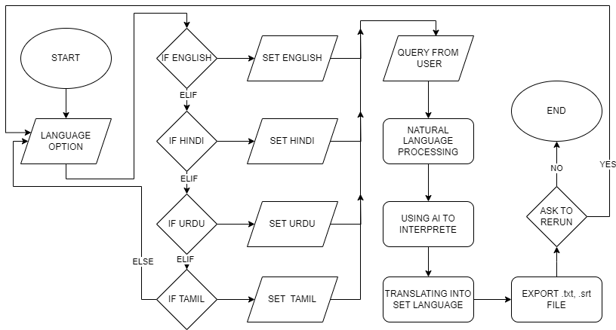
Idea/Approach Details
Our idea is that to create a software that can uses existing AI or develop an AI to translate and transcribe.
It would have high accuracy of translating and transcribing.
In addition to that we can use an integrate an virtual assistant with it which can also be able to do chat in certain regional language.
It would can be also used in many more sectors of industry and in various field of area.
Technology stacks used here:
Natural Language Processing and Machine Learning
Speech Recognizer.
Flutter
Django
Python Text to Speech.

Slide 3
Idea/Approach Details
Describe your Use Cases here
Describe your Dependencies / Show stopper here
We can take an existing open source program and create an API link or create an AI that can linked with our software to get translation and transcribing.
Our software will be created using python and Whisper AI’s API.
Whisper AI is an open source AI developed by OpenAI and the advantages of that is we will get many foreign languages and also Hindi, Tamil, Urdu, Arabic.
We can also use to make a chatbot or virtual assistant by giving API interaction between.
In psychiatry it will be helpful for patients to deal with loneliness and stress, in entertainment field it can be use for entertaining, in daily uses it can be also used to make your job easier, etc.….
Dependencies :
Machine Learning
Natural Language Processing(NPL)
Speech Recognition
Stopper:
A good amount of graphics memory for better performance.

Slide 4
Team Member Details
Team Leader Name: Justine Biju Paul
Branch (Btech/Mtech/PhD etc): Btech Stream (ECE, CSE etc): CSE Year (I,II,III,IV): II
Team Member 1 Name: Ajas Mathew
Branch (Btech/Mtech/PhD etc): Btech Stream (ECE, CSE etc): CSE Year (I,II,III,IV): II
Team Member 2 Name: Akhil Sajan Mathew
Branch (Btech/Mtech/PhD etc): Btech Stream (ECE, CSE etc): CSE Year (I,II,III,IV): II
Team Member 3 Name: Nissa Ann Saji
Branch (Btech/Mtech/PhD etc): Btech Stream (ECE, CSE etc): CSE Year (I,II,III,IV): II
Team Member 4 Name: Fardeen Saly
Branch (Btech/Mtech/PhD etc): Btech Stream (ECE, CSE etc): CSE Year (I,II,III,IV): II
Team Member 5 Name: Gayathri Suri Varrier
Branch (Btech/Mtech/PhD etc): Btech Stream (ECE, CSE etc): CSE Year (I,II,III,IV): II
Team Mentor 1 Name: Type Your Name Here
Category (Academic/Industry): Expertise (AI/ML/Blockchain etc): Domain Experience (in years):
Team Mentor 2 Name: Type Your Name Here
Category (Academic/Industry): Expertise (AI/ML/Blockchain etc): Domain Experience (in years):

