Slide 1
Student Performance Prediction Agent
Agent name:
"Student Performance Prediction Agent (SPPA)"
Goal:
Predict student performance (Low / Medium / High) and recommend early interventions before final examinations.
[Your Name] | [Spring 2026] | Group [Group Number]
Artificial Intelligence — Final Examination

Slide 2
Russell & Norvig Environment Analysis
Educational ecosystem: schools, classrooms, homes, examination periods
Agent perceives partial student records and acts via teacher dashboard
Environmental Property |  |  | Reasoning
Observable | Partially Observable ✓ | Fully Observable | Hidden motivation, home stress, undiagnosed learning needs
Deterministic vs Stochastic | Stochastic ✓ | Deterministic | Random Forest outputs probabilities; outcomes are uncertain
Episodic vs Sequential | Sequential ✓ | Episodic | G1/G2 history affects G3; interventions shape future state
Static vs Dynamic | Dynamic ✓ | Static | Grades and absences change throughout the semester
Discrete vs Continuous | Discrete ✓ | Continuous | Decisions: Low / Medium / High performance categories
Single vs Multi-agent | Multi-agent ✓ | Single | Teachers, students, parents, counselors interact

Slide 3
Dataset & Sensors
Source: UCI ML Repository — Student Performance (Cortez & Silva, 2008)
Description: 1,044 records (395 Math + 649 Portuguese), 33 features
Sensors: SIS grades, attendance logs, enrollment forms, study surveys
Target: G3 final grade (0–20) → Low / Medium / High
Issues: 22% Low class imbalance, absences outliers (max 93), self-reported fields
Sample fields | age, sex, studytime | failures, absences, G1, G2 | G3 / Category
Sample rows | 15,F,2 | 18,M,1 | 17,F,4 | failures, absences, G1, G2 | 10/Med · 6/Low · 15/High

Slide 4
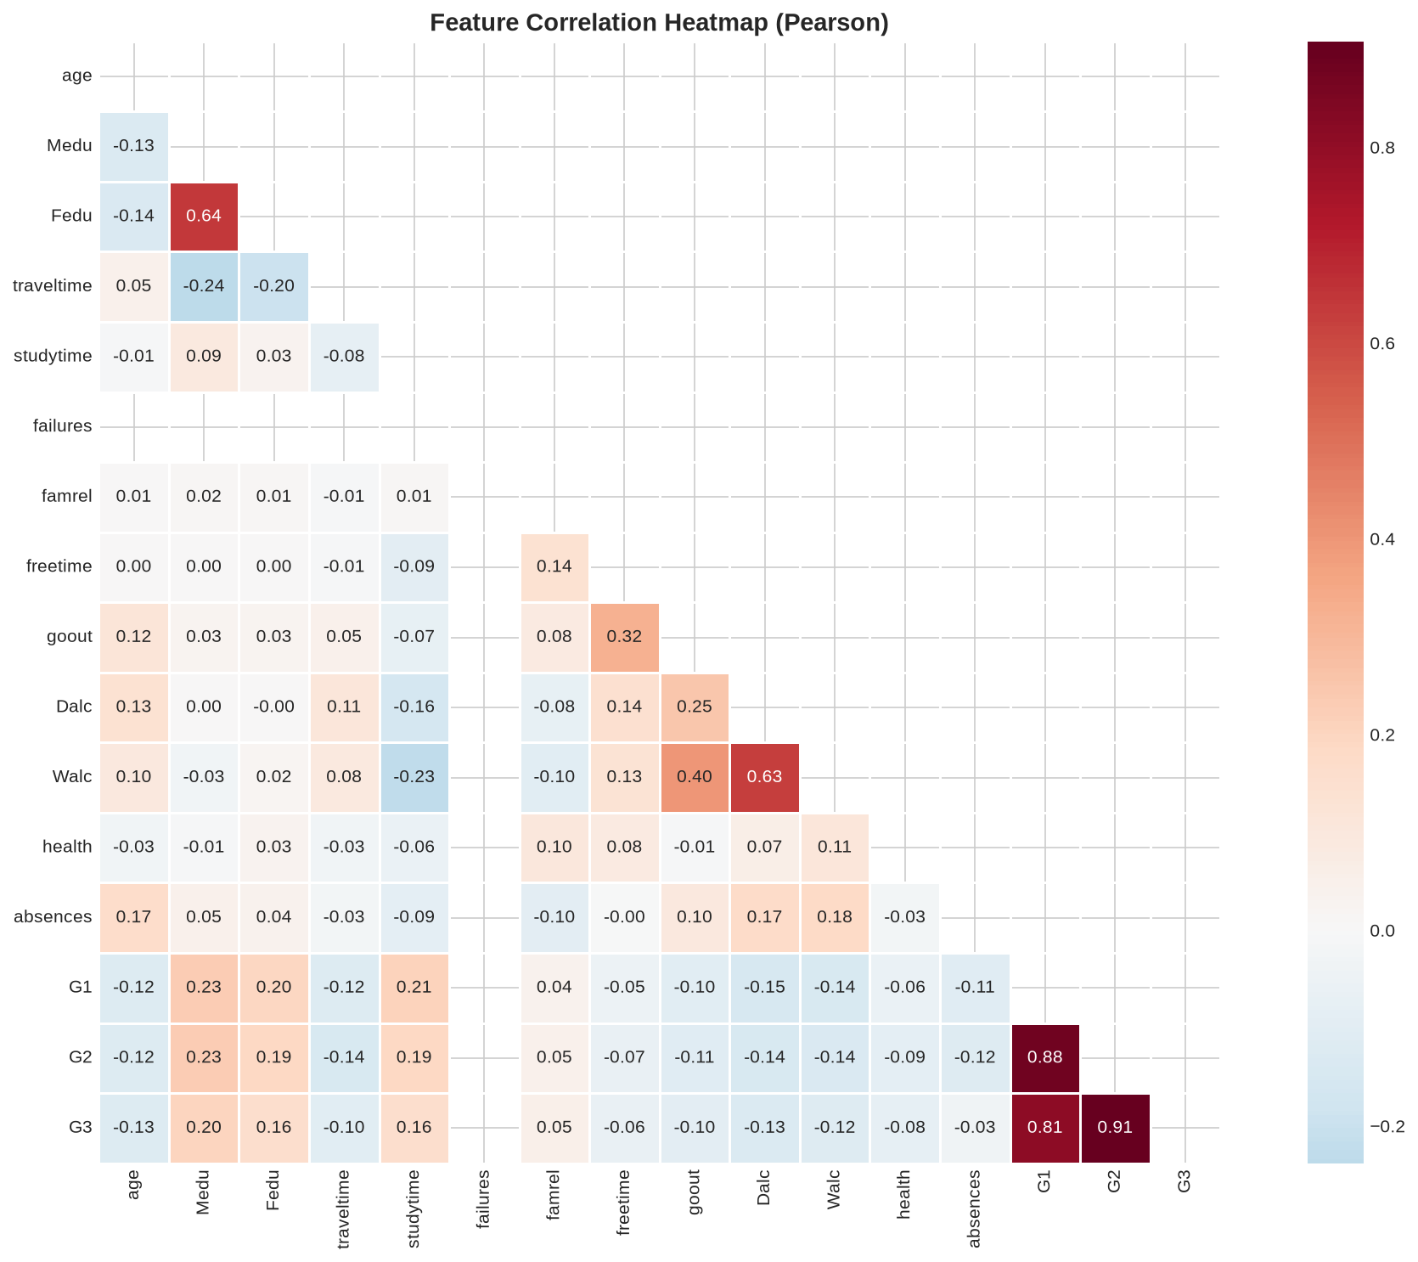
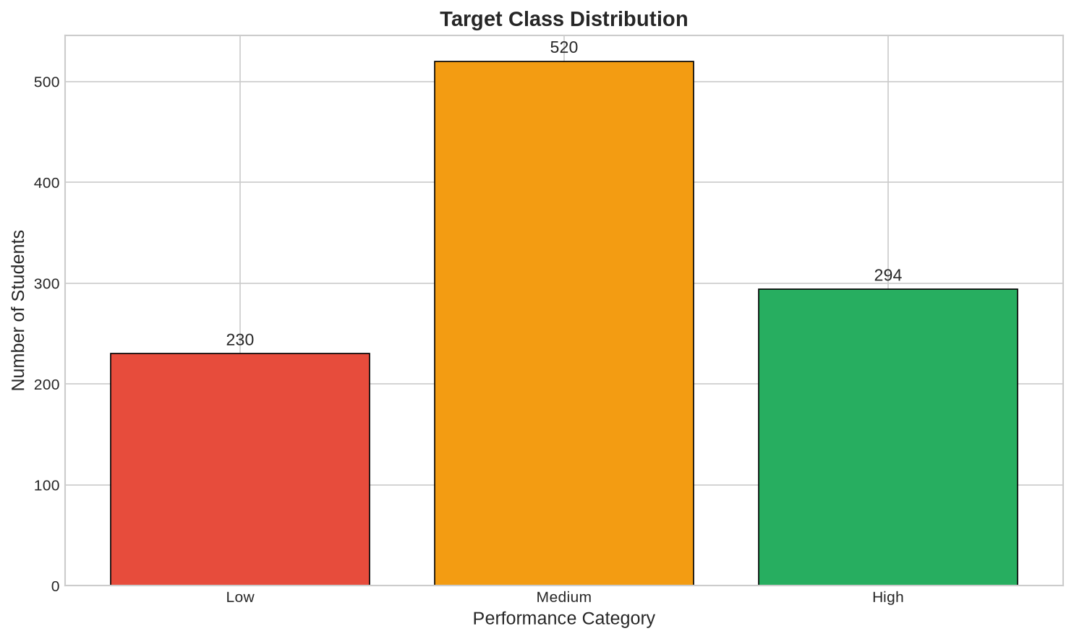
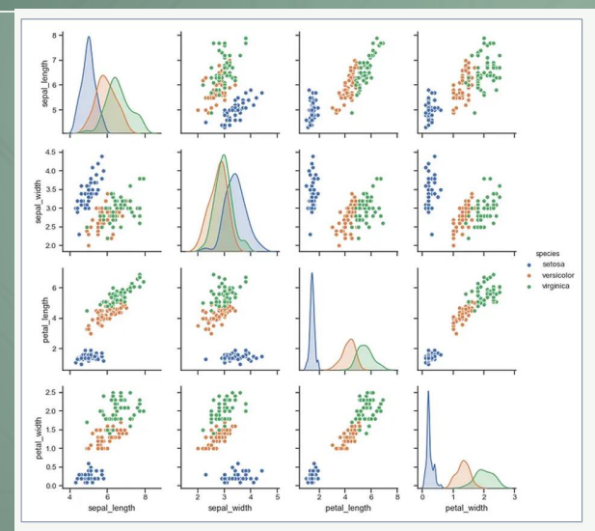
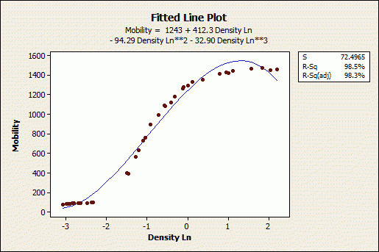
Exploratory Data Analysis
G2 ↔ G3 correlation: r ≈ 0.90 (strongest predictor)
G1 ↔ G3: r ≈ 0.80 | failures ↔ G3: r ≈ -0.35
Mean G3 = 11.9 (σ = 3.2) | 0 missing values
Categories: Low 22% · Medium 50% · High 28%

Slide 5
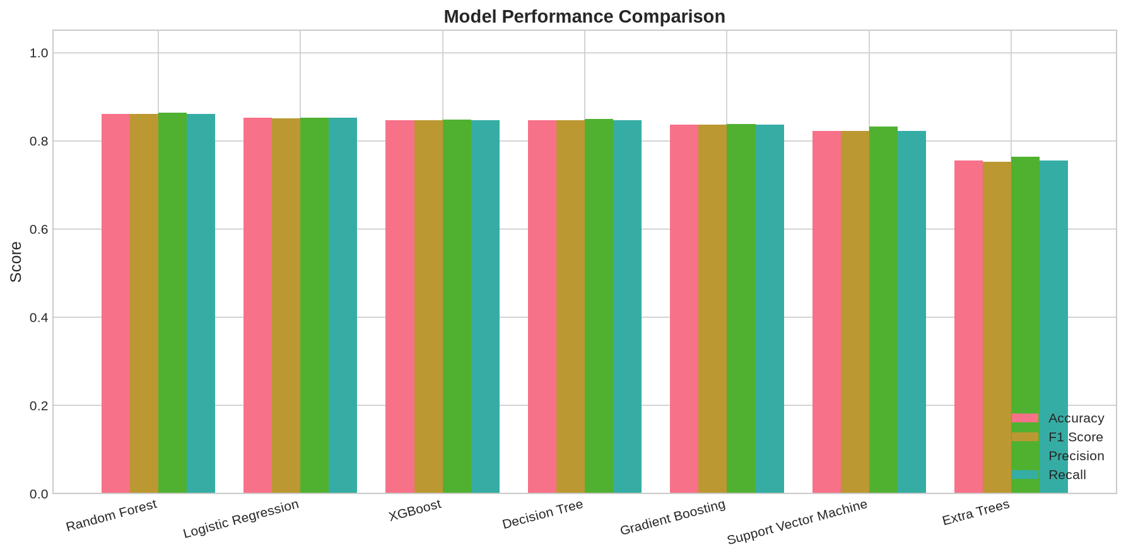
Machine Learning — Learning Component
Type: Supervised Multi-Class Classification
Pipeline: Features → StandardScaler + OneHotEncoder → Random Forest
Best model: Random Forest (200 trees, depth 12, balanced weights)
Compared 7 models — RF wins: F1 = 86.15%, Accuracy = 86.12%
Runners-up: Logistic Regression (85.16%), XGBoost (84.68%)

Slide 6
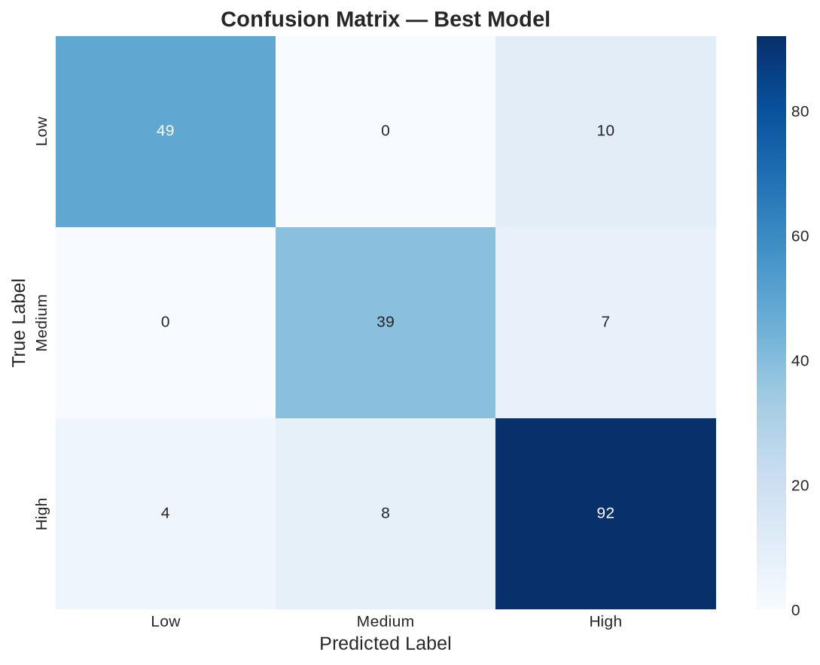
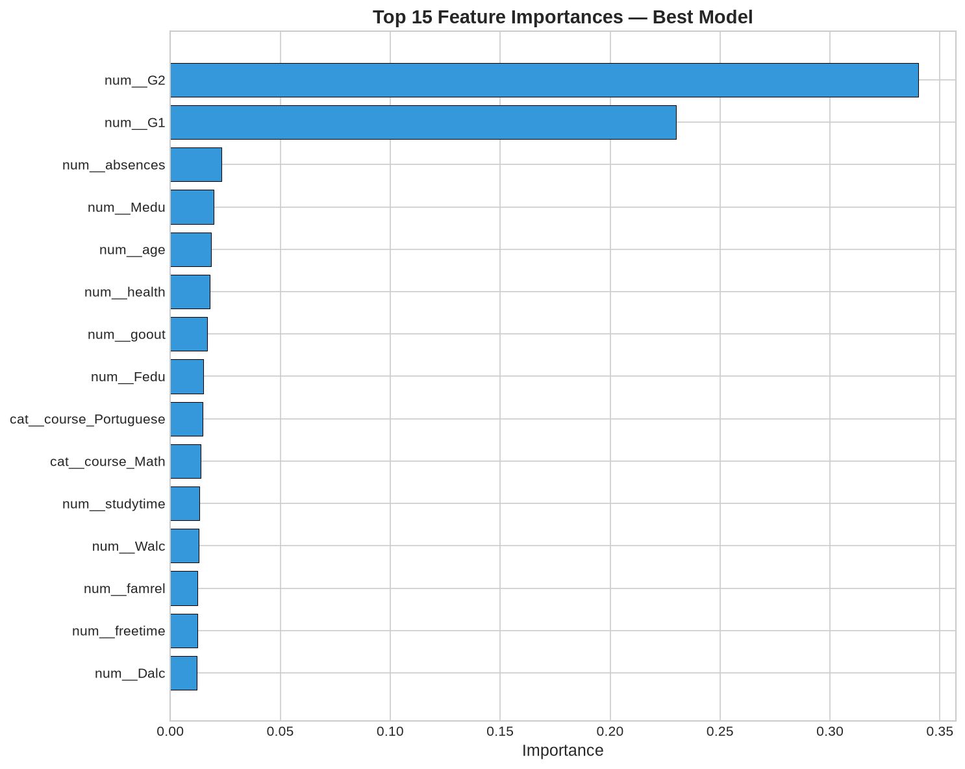
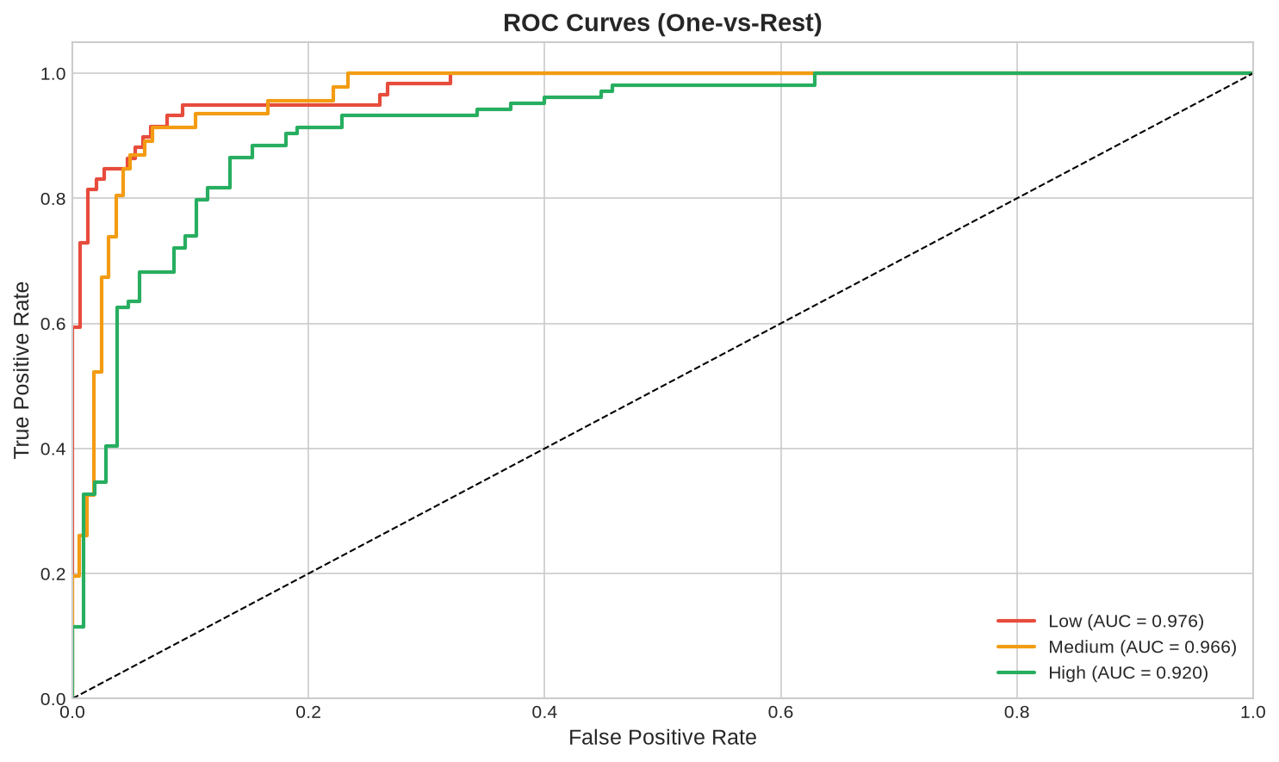
Evaluation Results — Random Forest
Accuracy: 86.12% | Precision: 86.36% | Recall: 86.12%
F1 Score: 86.15% | ROC AUC: 94.61%
CV Accuracy: 84.67% ± 1.95% | Train/Test: 835 / 209
Top predictor: G2 (2nd period grade)
Training: 0.43s | Prediction: 34ms per batch

Slide 7
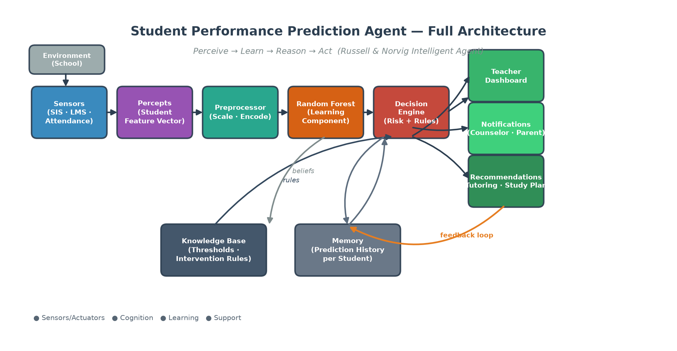
Agent Integration — From Prediction to Action
ML model = Learning Component inside the intelligent agent
Flow: Percepts → Preprocess → RF probabilities → Risk engine → Actions
Dashboard scores 1,044 students: 233 HIGH · 525 MEDIUM · 286 LOW priority
Actions: counseling, tutoring, parent alerts, teacher dashboard CSV
Components: Sensors, Knowledge Base, Decision Engine, Memory, Actuators
Limitations: Portuguese data only, ~14% error, privacy & bias concerns
Future: SHAP explainability, real-time analytics, LLM parent reports
Thank you — Questions welcome.

