Slide 1
Recommendation Systems

Slide 2
Content-based → item metadata, location, age, gender, …
Food
French
Good
Food
French
Good
User 1
Notes:
Simple recommender: just based on popularity
if a person likes a particular item, he or she will also like an item that is similar to it.

Slide 3
Content-based → item metadata, location, age, gender, …
User 1
Age: 15
Notes:
Simple recommender: just based on popularity
if a person likes a particular item, he or she will also like an item that is similar to it.

Slide 4
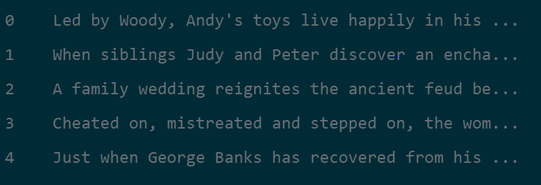
Content-based recommendation for movies
Data base to work with:
Vectorizer :
Create TF-IDF (Term Frequency-Inverse Document Frequency) matrix
Cosine-similarity
Remove stop-words + NaN
Taking the 10 most similar (higher cosine-similarity)
Recommendation
https://www.datacamp.com/community/tutorials/recommender-systems-python
Notes:
In its essence, the TF-IDF score is the frequency of a word occurring in a document, down-weighted by the number of documents in which it occurs. This is done to reduce the importance of words that frequently occur in plot overviews and, therefore, their significance in computing the final similarity score.
Calculate Pairwise cosine similarity to compare all items (independent of magnitude and is relatively easy and fast to calculate) → matrix with all the items.

Slide 5
Adding Credits, Genres, and Keywords
Lowercase + no space ("bread jam" and "traffic jam“).
Vectorizer
Cosine-similarity
Recommendation
https://www.datacamp.com/community/tutorials/recommender-systems-python
Notes:
CountVectorizer() instead of TF-IDF. This is because you do not want to down-weight the actor/director's presence if he or she has acted or directed in relatively more movies. It doesn't make much intuitive sense to down-weight them in this context.
The major difference between CountVectorizer() and TF-IDF is the inverse document frequency (IDF) component which is present in later and not in the former.

Slide 6
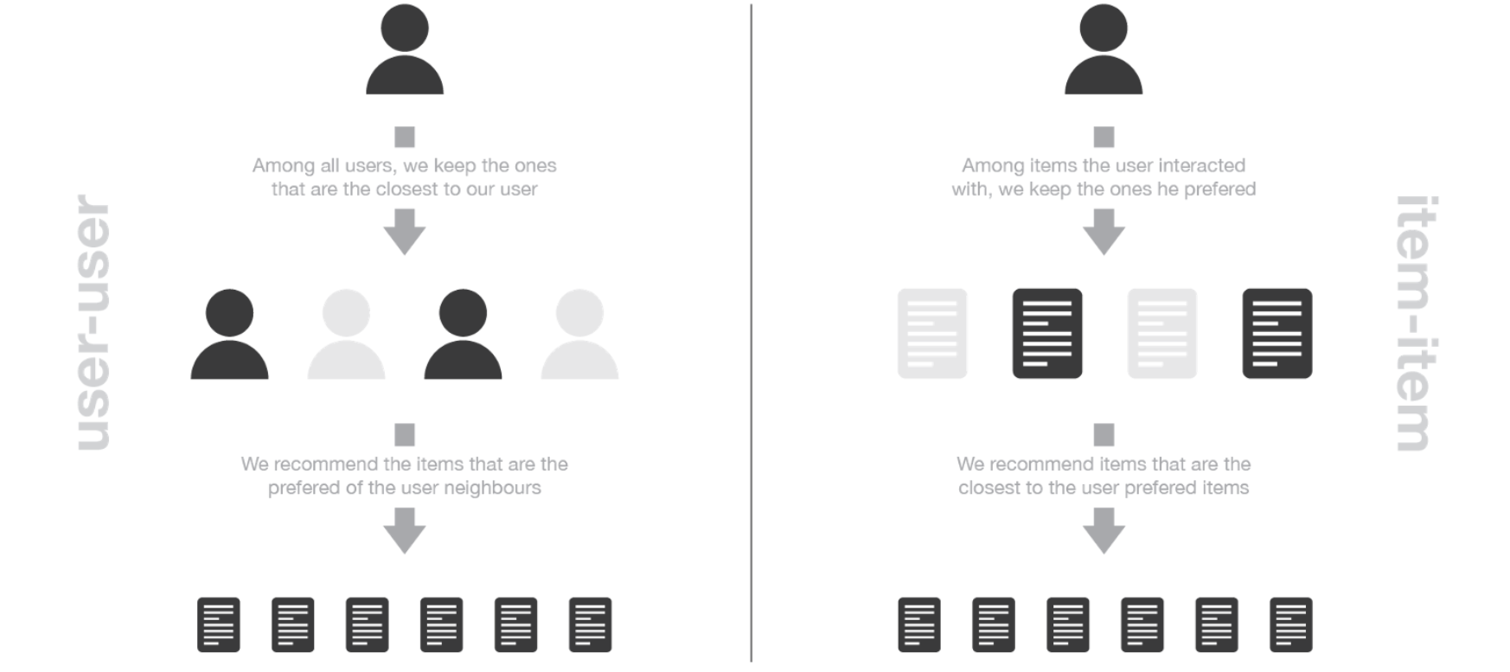
Collaborative-based → previous behaviour of similar user
https://towardsdatascience.com/introduction-to-recommender-systems-6c66cf15ada

Slide 7
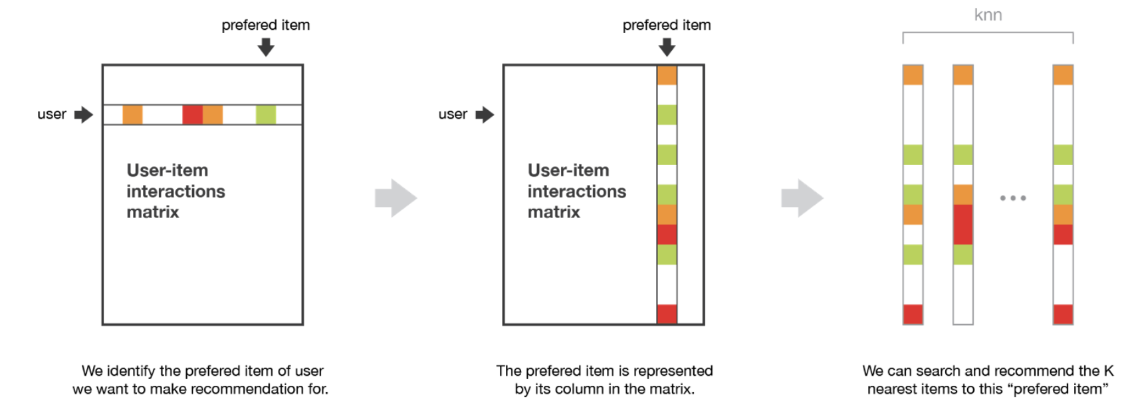
Item-Item
https://towardsdatascience.com/introduction-to-recommender-systems-6c66cf15ada

Slide 8
Pearson similarity
ratings_small (672,9066)
MOVIES
Pearson_similarity(2,3)= 0.98
0 | 3 | 2 | 4 | 0 | 0
2 | 5 | 0 | 0 | 0 | 4
1 | 5 | 4 | 0 | 0 | 3
0 | 0 | 2 | 5 | 0 | 3
0 | 1 | 5 | 2 | 2 | 0
2 | 1 | 3 | 1 | 0 | 1
USERS
Person 3
Person 2
Notes:
measure of the linear dependence or correlation between two variables X and Y.
between +1 and −1 inclusive, where 1 is total positive linear correlation, 0 is no linear correlation, and −1 is total negative linear correlation
measure of the slope of two datasets related by a single line
Pearson correlation and cosine similarity are invariant to scaling, i.e. multiplying all elements by a nonzero constant. Pearson correlation is also invariant to adding any constant to all elements. For example, if you have two vectors X1 and X2, and your Pearson correlation function is called pearson(), pearson(X1, X2) == pearson(X1, 2 * X2 + 3). This is a pretty important property because you often don't care that two vectors are similar in absolute terms, only that they vary in the same way.

Slide 9
Pearson similarity
ratings_small (672,9066)
MOVIES
Pearson_similarity(2,3)= 0.97
0 | 3 | 2 | 4 | 0 | 0
2 | 5 | 0 | 0 | 0 | 4
1 | 3 | 4 | 0 | 0 | 2
0 | 0 | 2 | 5 | 0 | 3
0 | 1 | 5 | 2 | 2 | 0
2 | 1 | 3 | 1 | 0 | 1
USERS
Person 3
Person 2
Notes:
measure of the linear dependence or correlation between two variables X and Y.
between +1 and −1 inclusive, where 1 is total positive linear correlation, 0 is no linear correlation, and −1 is total negative linear correlation
measure of the slope of two datasets related by a single line
Pearson correlation and cosine similarity are invariant to scaling, i.e. multiplying all elements by a nonzero constant. Pearson correlation is also invariant to adding any constant to all elements. For example, if you have two vectors X1 and X2, and your Pearson correlation function is called pearson(), pearson(X1, X2) == pearson(X1, 2 * X2 + 3). This is a pretty important property because you often don't care that two vectors are similar in absolute terms, only that they vary in the same way.

Slide 10
Pearson similarity
ratings_small (672,9066)
MOVIES
Person 5
0 | 3 | 2 | 4 | 0 | 0
2 | 5 | 0 | 0 | 0 | 4
1 | 5 | 4 | 0 | 0 | 3
0 | 0 | 2 | 5 | 0 | 3
0 | 1 | 5 | 2 | 2 | 0
2 | 1 | 3 | 1 | 0 | 1
USERS
Person 1
Pearson_similarity(1,5)= - 0.72
Notes:
measure of the linear dependence or correlation between two variables X and Y.
between +1 and −1 inclusive, where 1 is total positive linear correlation, 0 is no linear correlation, and −1 is total negative linear correlation
measure of the slope of two datasets related by a single line
Pearson correlation and cosine similarity are invariant to scaling, i.e. multiplying all elements by a nonzero constant. Pearson correlation is also invariant to adding any constant to all elements. For example, if you have two vectors X1 and X2, and your Pearson correlation function is called pearson(), pearson(X1, X2) == pearson(X1, 2 * X2 + 3). This is a pretty important property because you often don't care that two vectors are similar in absolute terms, only that they vary in the same way.

Slide 11
Pearson similarity
ratings_small (672,9066)
MOVIES
0 | 3 | 2 | 4 | 0 | 0
2 | 5 | 0 | 0 | 0 | 4
1 | 5 | 4 | 0 | 0 | 3
0 | 0 | 2 | 5 | 0 | 3
0 | 1 | 5 | 2 | 2 | 0
2 | 1 | 3 | 1 | 0 | 1
Pearson_similarity(1,2)= 0
USERS
Notes:
measure of the linear dependence or correlation between two variables X and Y.
between +1 and −1 inclusive, where 1 is total positive linear correlation, 0 is no linear correlation, and −1 is total negative linear correlation
measure of the slope of two datasets related by a single line
Pearson correlation and cosine similarity are invariant to scaling, i.e. multiplying all elements by a nonzero constant. Pearson correlation is also invariant to adding any constant to all elements. For example, if you have two vectors X1 and X2, and your Pearson correlation function is called pearson(), pearson(X1, X2) == pearson(X1, 2 * X2 + 3). This is a pretty important property because you often don't care that two vectors are similar in absolute terms, only that they vary in the same way.

Slide 12
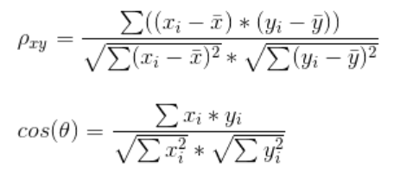
Pearson correlation is cosine similarity between centered vectors.

Slide 13
Recommendation
MOVIES
0 | 3 | 2 | 4 | 0 | 0
2 | 5 | 0 | 0 | 0 | 4
1 | 5 | 4 | 0 | 0 | 3
0 | 0 | 2 | 5 | 0 | 3
0 | 1 | 5 | 2 | 2 | 0
2 | 1 | 3 | 1 | 0 | 1
USERS

Slide 14
Recommendation
MOVIES
0 | 3 | 2 | 4 | 0 | 0
2 | 5 | 0 | 0 | 0 | 4
1 | 5 | 4 | 0 | 0 | 3
0 | 0 | 2 | 5 | 0 | 3
0 | 1 | 5 | 2 | 2 | 0
2 | 1 | 3 | 1 | 0 | 1
Movie 1 :
Recom = (sim(1,2)*rating + sim(1,3)*rating + sim(1,6)*rating)/3
USERS

Slide 15
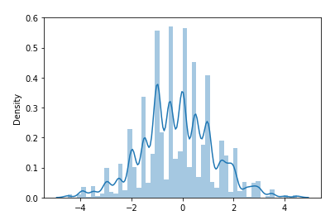
Evaluating
data_test (134,9066)
ratings_small (672,9066)
MOVIES
MOVIES
0 | 4 | 3 | 0 | 1 | 4
3 | 5 | 1 | 2 | 0 | 0
0 | 0 | 3 | 0 | 2 | 4
4 | 0 | 0 | 0 | 5 | 2
2 | 4 | 0 | 0 | 1 | 4
0 | 3 | 1 | 4 | 0 | 4
20%
data_test (134,9006)
USERS
80%
data_train (539,9066)
USERS
10 times with recommendation bound=10
RMSE= 1.35

Slide 16
ratings_small (672,9066)
data_test (134,9066)
MOVIES
MOVIES
0 | 4 | 3 | 0 | 1 | 4
3 | 5 | 1 | 2 | 0 | 0
0 | 0 | 3 | 0 | 2 | 4
4 | 0 | 0 | 0 | 5 | 2
2 | 4 | 0 | 0 | 1 | 4
0 | 3 | 1 | 4 | 0 | 4
20%
data_test (134,9006)
80%
data_train (539,9066)
USERS
10% of the rated movies
USERS
90% of the rated movies
MOVIES
MOVIES
MOVIES
0 | 4 | 3 | 0 | 1 | 0
3 | 0 | 1 | 2 | 0 | 0
0 | 0 | 3 | 0 | 0 | 4
0 | 0 | 0 | 0 | 5 | 2
2 | 0 | 0 | 0 | 1 | 4
0 | 3 | 0 | 4 | 0 | 4
0 | 0 | 0 | 0 | 0 | 4
0 | 5 | 0 | 0 | 0 | 0
0 | 0 | 0 | 0 | 2 | 0
4 | 0 | 0 | 0 | 0 | 0
0 | 4 | 0 | 0 | 0 | 0
0 | 0 | 1 | 0 | 0 | 0
20%
data_test90 (134,9006)
FINAL DATA
80%
data_train (539,9066)
USERS
USERS
USERS
data_test90 (134,9066)
data_test10 (134,9066)

Slide 17
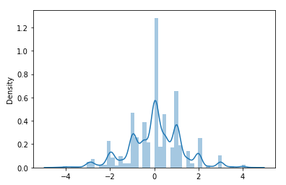
10 times with recommendation bound=10
RMSE = 1.36
MOVIES
20%
data_test90 (134,9006)
FINAL DATA
80%
data_train (539,9066)
USERS

Slide 18
Conclusion → which approach is better?
Content-based
Collaborative-based
Can avoid cold start problem
No specific knowledge about the user needed
Specific knowledge about the user needed
Need for metadata on the items
Can get very time-consuming
Cold start problem

