Slide 1

Exploratory Data Analysis
Go to market insight for cab investment firm
7/17/2023

Slide 2

Background
Due to remarkable growth in the cab industry in last few years and multiple key players in the market, XYZ is planning for an investment in cab industry
Using EDA we will analyze two cab companies to try to determine which is the best company to invest in

Slide 3
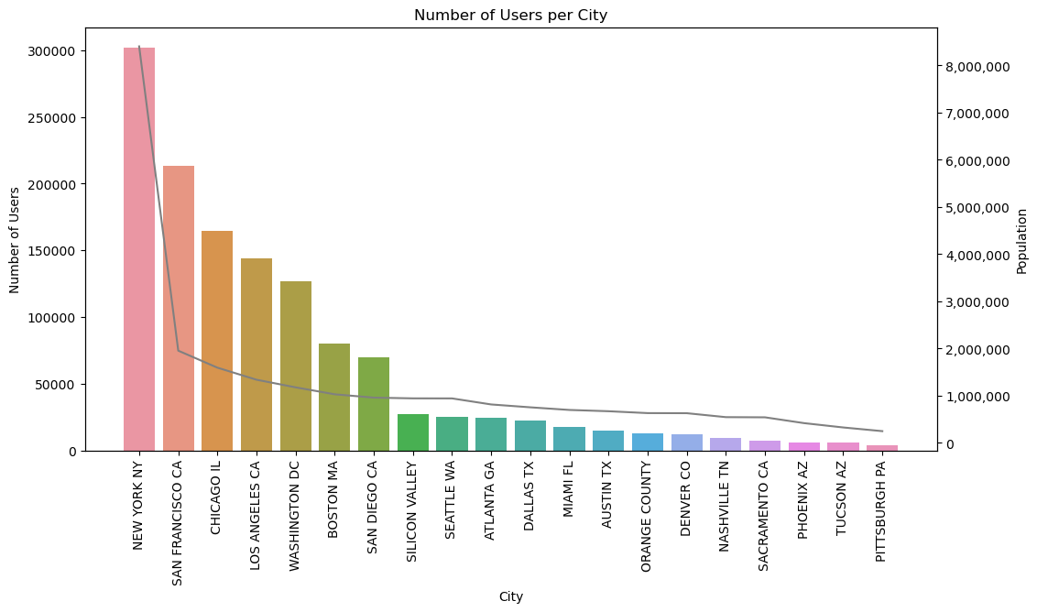
Cab users and population by city
New York (City) has the highest population and the highest number of users
With a strong 70% correlation between population and cab usage, as population decreases so does the number of users for the cab services

Slide 4
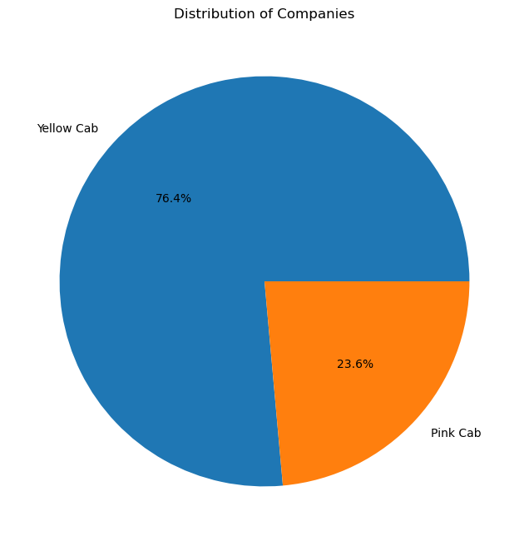
Distribution of companies
Yellow cab has the bigger market share with 76.4% overall

Slide 5
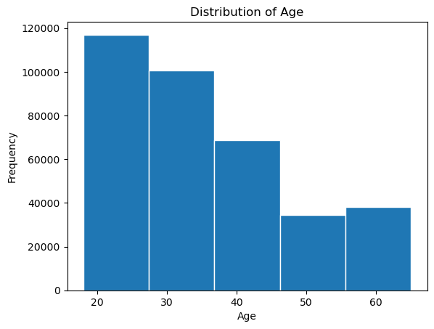
Distribution of age
Overall, the largest age group is around ages 18-28

Slide 6
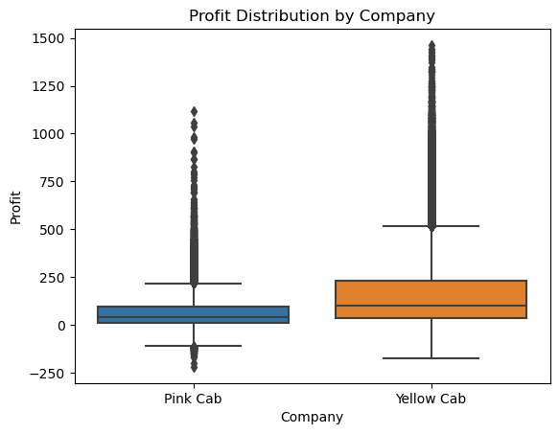
Profit distribution by company
It appears that the pink cab company has some outlier <$0 profit rides, while the outliers for the yellow cab are much higher than the outliers for the pink cab company

Slide 7
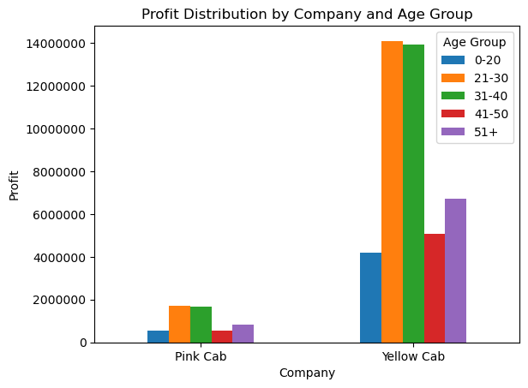
Profit distribution by age and company
The yellow cab company has a much greater amount of profits. Each company has the most profits from the 21-40 age range

Slide 8
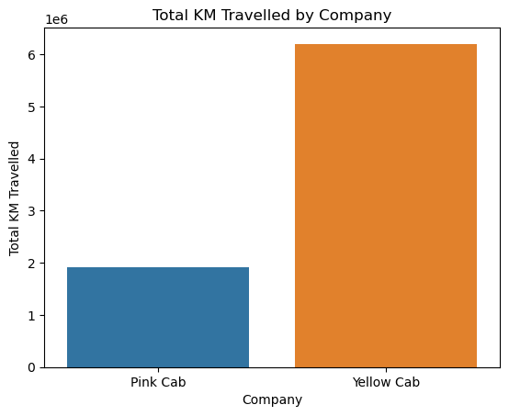
Total distance travelled
Yellow cab company has the most KM travelled

Slide 9
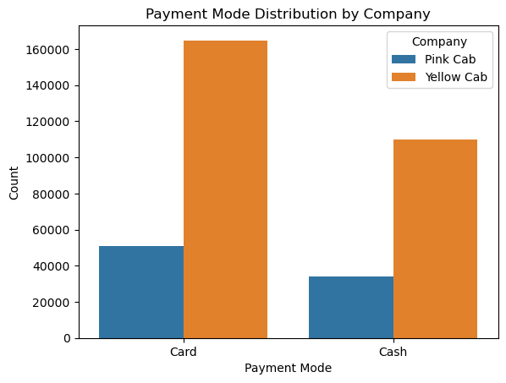
Payment mode distribution
Each company primarily uses card payments

Slide 10
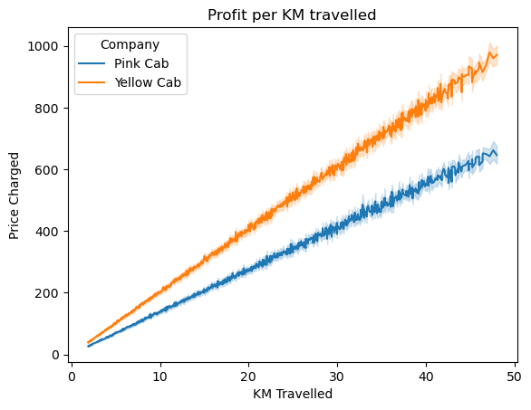
Profit per KM travelled
Yellow cab company has a greater profit per KM traveled

Slide 11
Recommendations
The yellow cab company is the clear winner here as they have:
The largest market share
The greatest profits
The most distance travelled with the highest profit per KM travelled

Slide 12
Additional information
Credit card payments are most commonly used
The youngest age groups are the most frequent riders
As a cities population increases, there is a proportional increase in ridership

Slide 13
Thank You

