Slide 1
Understanding Evolutionary Mutations of SARS-CoV-2
STAT1005 Group 4.2

Slide 2
OUTLINE
01. Introduction
02. General view of mutation
03. Object 1: Specific investigation of
mutation
04. Object 2: Comparison of mutation
between time and location
05. Object 3: Relationship between
external factors and mutation
06. Object 4: Prediction of mutation
rate in China
07. Conclusion and Prospect

Slide 3
05
Object 4:
Relationship between death rate and mutation

Slide 4


Find the effect of mutation rate and death rate
Data & Goals
Data
Used
Goals
Virus genome sequences with the information of location and time
Find the correlation globally
Find the correlation of mutation rate and death rate among countries
Death rate of top 5 countries

Slide 5





Find the effect of mutation rate and death rate
Methodology
Find the correlation of mutation rate and death rate among countries
Find the correlation globally
Calculate the mutation rate of each variants
Calculate the death rate from external data
Using regression analysis
Make comparisons between time and location
Combine the data set
Observe the general trend of death rate in response to the mutation

Slide 6
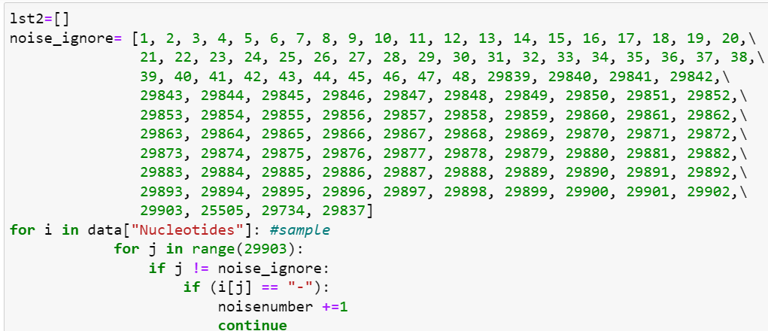
Computation of mutation rate
Noise filtering
Transformation of data

Slide 7
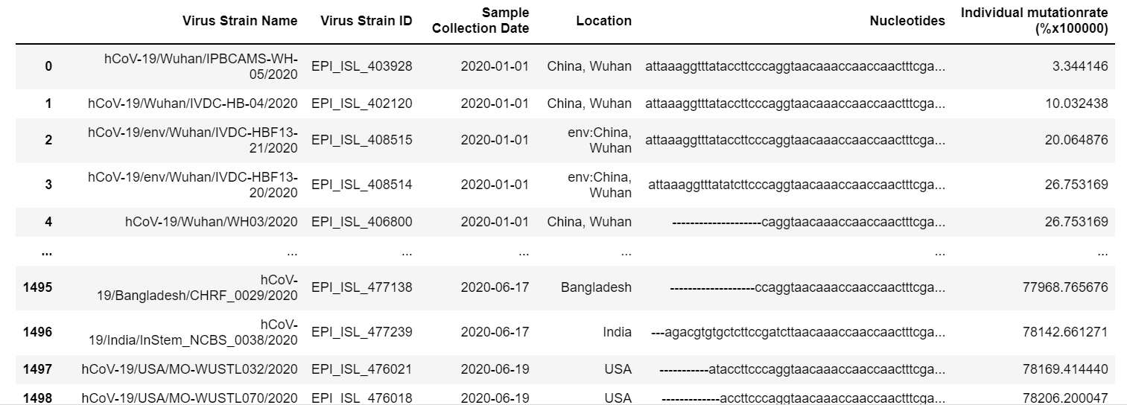
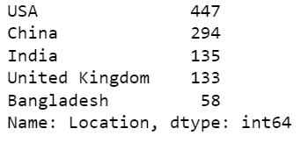
Computation of mutation rate

Slide 8
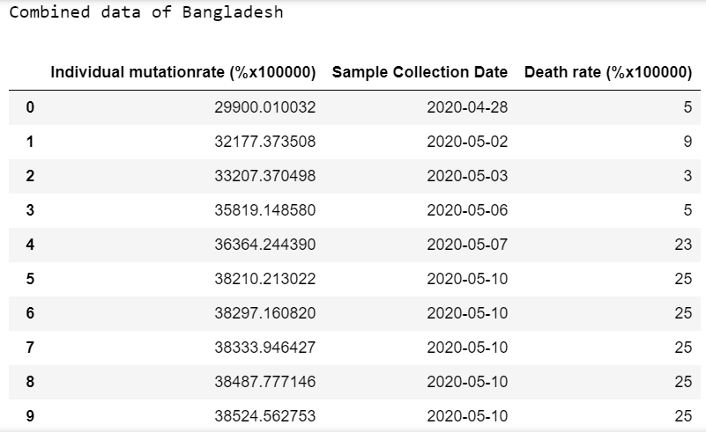
Combine data

Slide 9
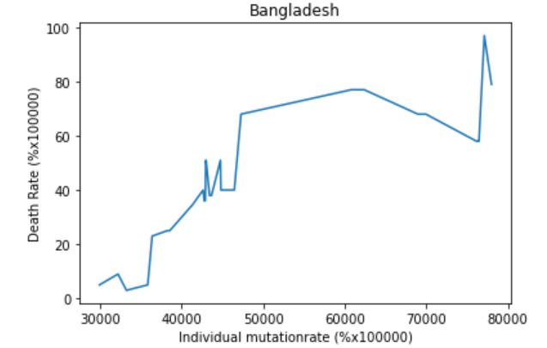
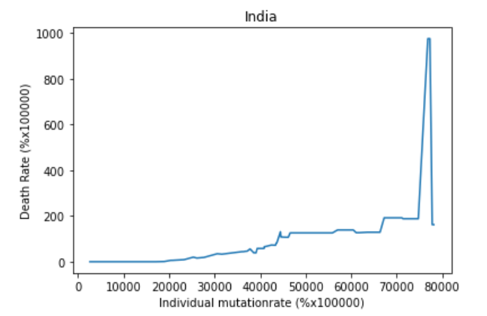
Types of correlation
Increasing type

Slide 10
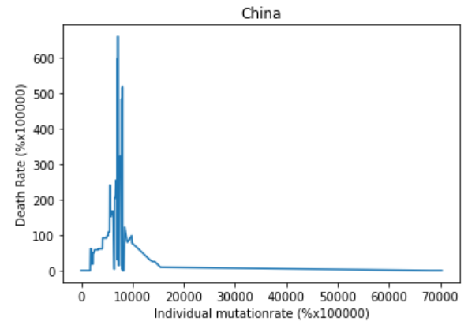
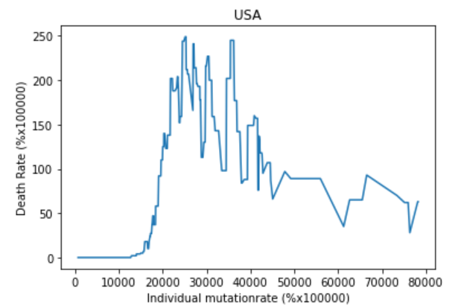
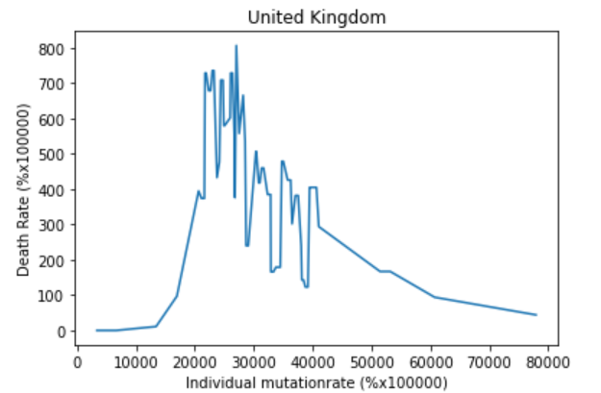
Types of correlation
Recovery type

Slide 11
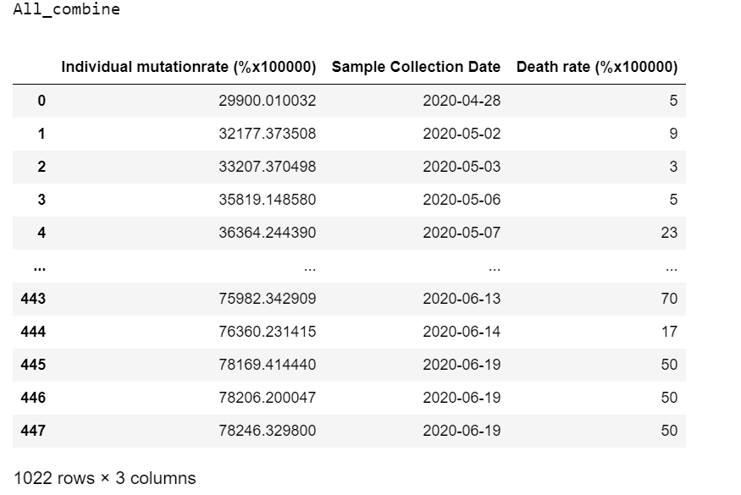
Globally analysis

Slide 12
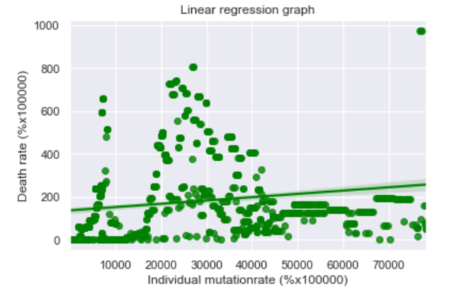
Linear Regression

Slide 13
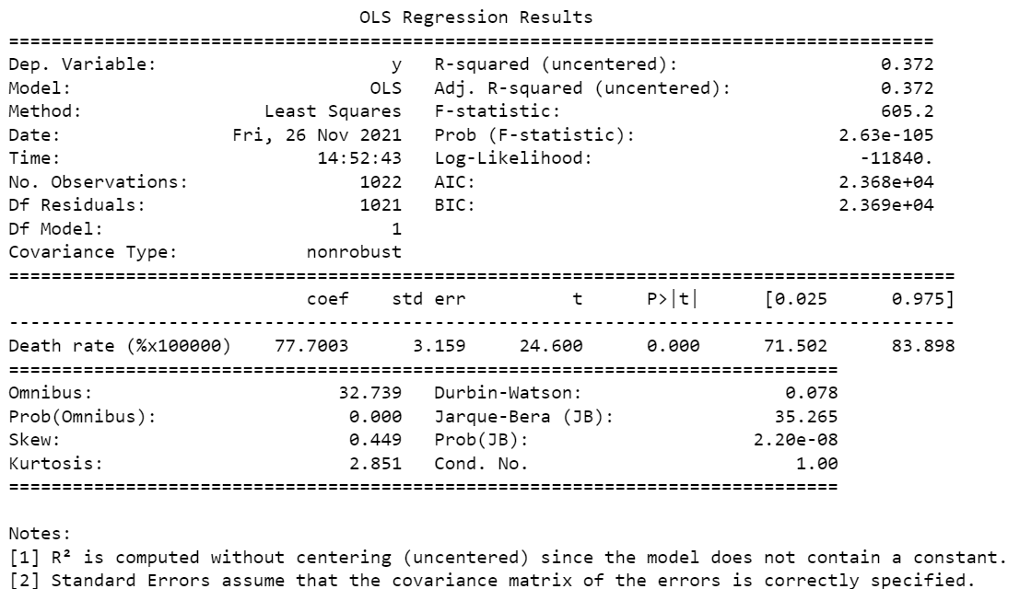
Linear Regression

Slide 14
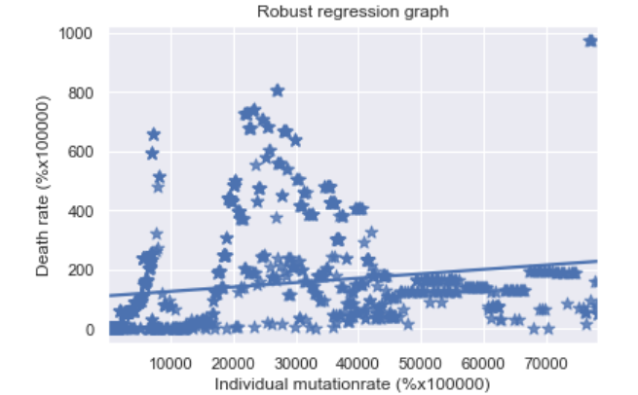
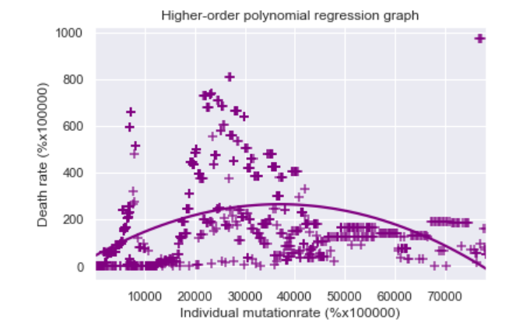
More Models Application
Higher-order
polynomial regression

Slide 15






Summary
Find the effect of mutation rate and death rate
Individual categorization: China USA UK
AS we can observe, these 3 countries has similar pattern of correlation between death rate and mutation rate. As the virus mutate, the death rate will reach to a peak then return to a lower level, which indicate that while the virus mutate, their fitness or harmfulness drop
01
Individual categorization: India Bangladesh
There are similar pattern between these 2 countries. As they death rate keep rising while the virus in their countries mutate. It indicate that the viruses keep on mutating in a trend to obtain a higher fitness which is more harmful to human beings
02

