Slide 1
BeMyMeme
Makers Final Project, a meme dating website.

Slide 2
Concept Brighten the experience of internet dating through the medium of Meme.
What is a meme?
A pervasive thought or thought pattern that replicates itself via cultural means; An expression of values that uses pop culture immagery, e.g…
A meme can portray a thousand words

Slide 3
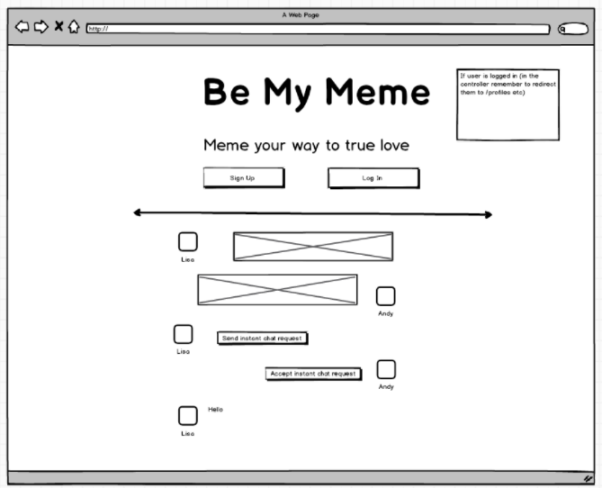
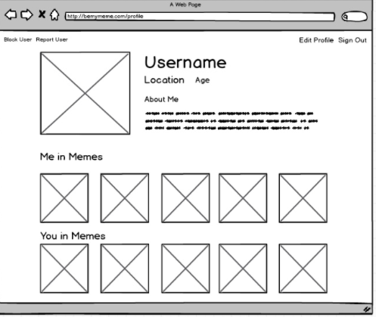
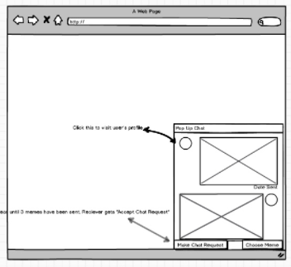
Proof of Concept.
A user navigates to the homepage, they are greeted by a splash screen of what the website is all about!
They can then sign up and create a profile adding memes that describe their personality, Me in Memes!
They can search through profiles of other users, once they see someone they like, they can chat with them in realtime!

Slide 4
Implemented Technologies
Real time chat functionality, new feature of RAILS 5, Implemented through Action Cable
API callbacks from www.imgur.com meme gallaries which updated and stored in the databases for easy access and reliability.

