Slide 1
Tutorial 04: Mutex, Semaphore and Condition Variables
CSCI3150 - Introduction to operating system
Tutor: TAN Xin
xtan22@cse.cuhk.edu.hk

Slide 2
Mutex

Slide 3
Mutex Locks
OS designers build software tools to solve critical section problem
Simplest is mutex lock
Protect a critical section by first acquire() a lock then release() the lock
Boolean variable indicating if lock is available or not
Calls to acquire() and release() must be atomic
Usually implemented via hardware atomic instructions

Slide 4
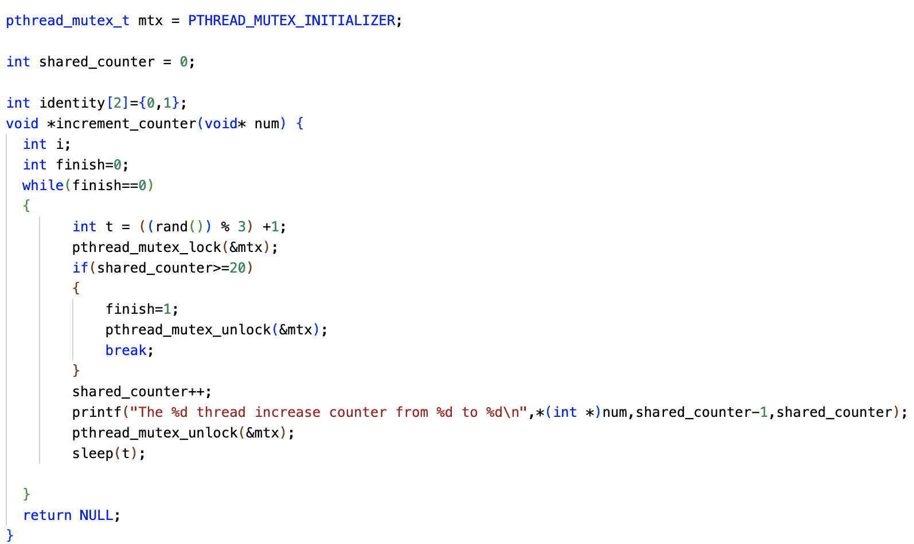
An example
Several threads increase the the counter together
Using a lock to keep order

Slide 5
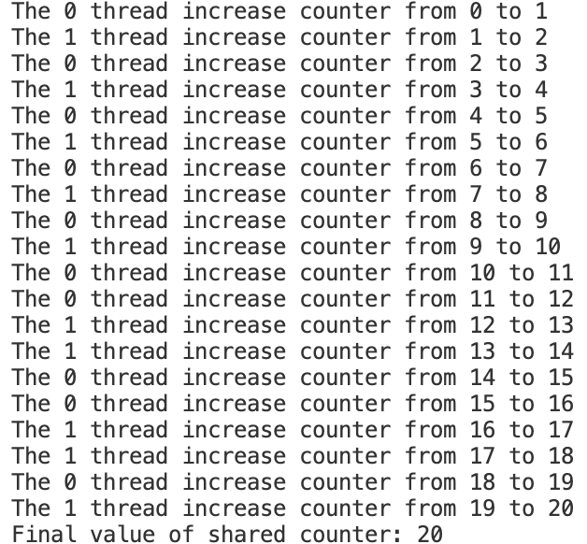
An example
Refer to the lock_thread.c and run the program

Slide 6
Semaphore

Slide 7
Semaphore
Synchronization tool that provides more sophisticated ways (than Mutex locks) for process to synchronize their activities.
Semaphore S – integer variable
Can only be accessed via two indivisible (atomic) operations
wait() and signal()/post()
Originally called P() and V()
Definition of the wait() operation
wait(S) {
while (S <= 0)
; // busy wait
S--;
}
Definition of the signal() operation
signal(S) {
S++;
}

Slide 8
An example
Variables
semaphore mutex; // (initially = 1)
semaphore next; // (initially = 0)
int next_count = 0;
wait(mutex);
…
body of F;
…
if (next_count > 0)
signal(next)
else
signal(mutex);
A binary sem ( serve as a mutex)
A counting sem

Slide 9
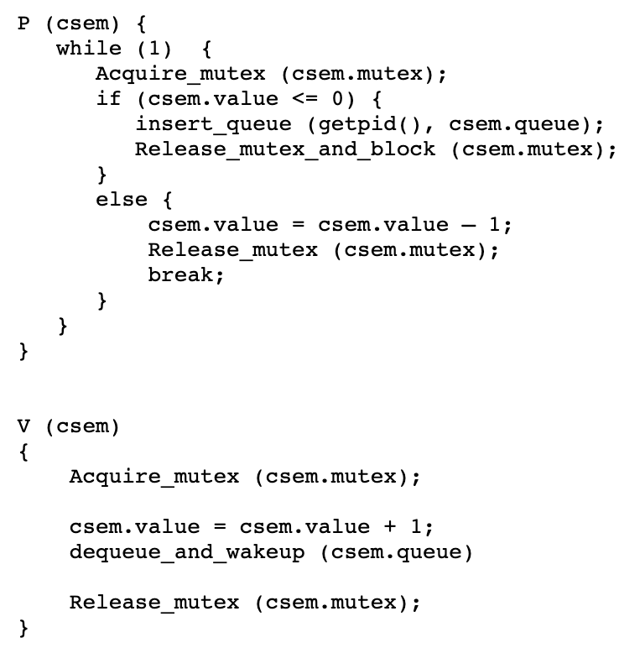
Implementation of a semaphore
wait (csem) {
With the help of the OS, we can implement semaphores so that the calling process will block and wait for the post() operation to "wake it up" making it runnable again.
post (csem)

Slide 10
Condition Variables

Slide 11
Overview
The condition variable is a synchronization primative that provides a queue for threads waiting for a resource.
A thread tests to see if the resource is available. If it is available, it uses it. Otherwise it adds itself to the queue of threads waiting for the resource.
When a thread has finished with a resource, it wakes up exactly one thread from the queue (or none, if the queue is empty). In the case of a sharable resource, a broadcast can be sent to wake up all sleeping threads.

Slide 12
Overview
Condition variables support three operations:
wait - add calling thread to the queue and put it to sleep
signal/post - remove a thread form the queue and wake it up
broadcast - remove and wake-up all threads on the queue
When using condition variables, an additional mutex must be used to protect the critical sections of code that test the lock or change the locks state.

Slide 13
One possible Implementation
Data Structure The condition variable data structure contains a double-linked list to use as a queue. It also contains a semaphore to protect operations on this queue. This semaphore should be a spin-lock since it will only be held for very short periods of time.
struct condition {
proc next; /* doubly linked list implementation of */
proc prev; /* queue for blocked threads */
mutex mx; /*protects queue */
};

Slide 14
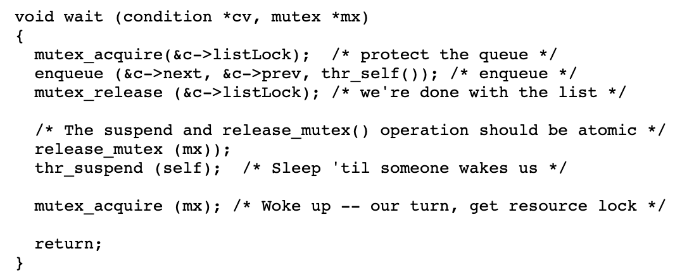
One possible Implementation
wait()
The wait() operation adds a thread to the list and then puts it to sleep. The mutex that protects the critical section in the calling function is passed as a parameter to wait(). This allows wait to atomically release the mutex and put the process to sleep.
If this operation is not atomic and a context switch occurs after the release_mutex (mx) and before the thread goes to sleep, it is possible that a process will signal before the process goes to sleep. When the waiting() process is restored to execution, it will enter the sleep queue, but the message to wake it up will be forever gone.

Slide 15
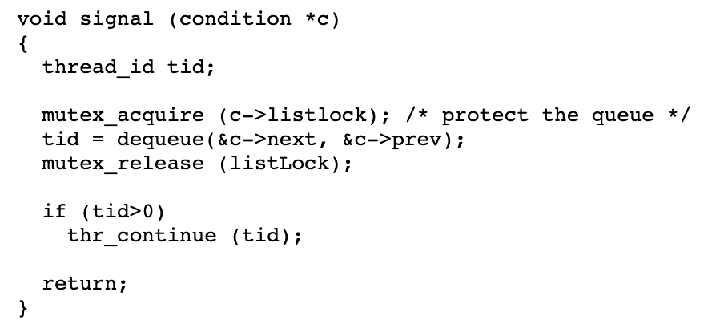
One possible Implementation
signal()
The signal() operation gets the next thread from the queue and wakes it up. If the queue is empty, it does nothing.
Note: after signal(), signaling thread keeps lock, waking thread goes on the queue waiting for the lock.

Slide 16
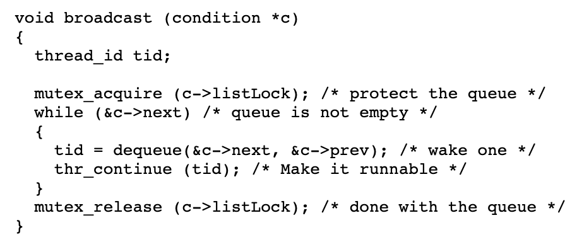
One possible Implementation
broadcast()
The broadcast operation wakes up every thread waiting for a particular resource. This generally makes sense only with sharable resources. Perhaps a writer just completed so all of the readers can be awakened.

Slide 17
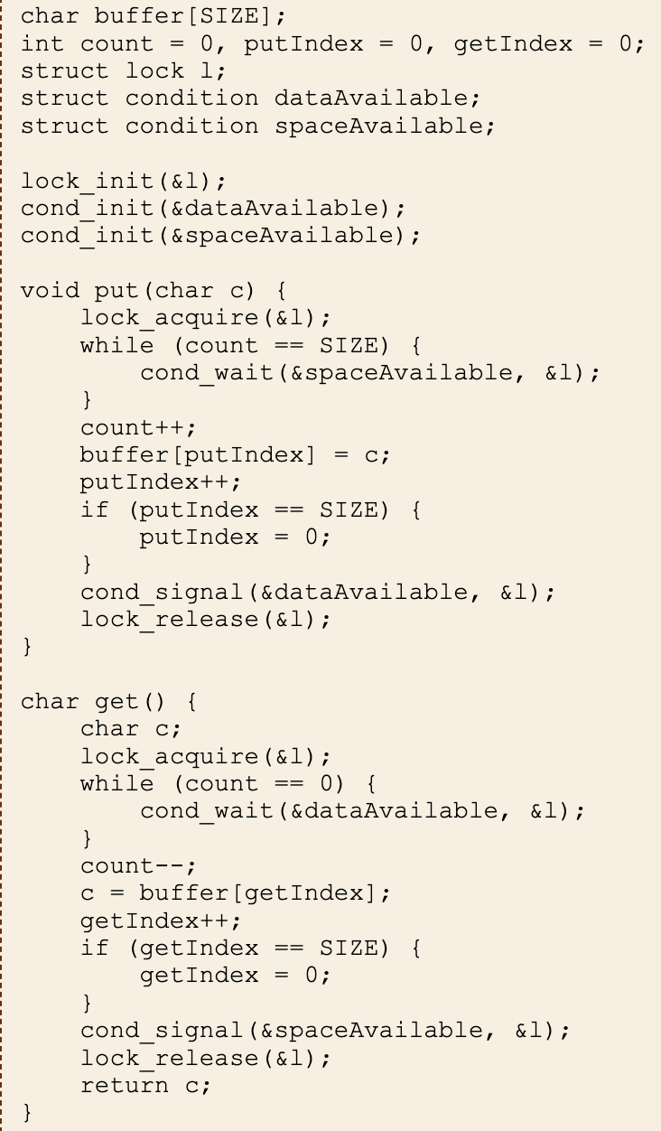
An example for CV
Warning: when a thread wakes up after cond_wait there is no guarantee that the desired condition still exists: another thread might have snuck in.

Slide 18
The Dining Philosophers Problem with CV
Five philosophers are sitting in a round table with a bowl of rice in the center. Each philosopher either thinks or eats. There is a single fork in between each of the philosophers. If a philosopher wants to eat, they grab the forks adjacent to them. Before a philosopher decides to eat, they must ensure both forks are available for use before eating. If both forks are available, the philosophers can eat and puts down the forks when finished and starts thinking again. Otherwise, they must wait until the forks are available.
Make sure that a philosopher will only eat if both forks are available aka picking them up in the critical region.
There will be 5 philosophers created and each philosopher will assigned a thread.
A function pickup_forks() will be invoked whenever a philosopher wished to eat and philosophers will be alternating between thinking and eating.
When the philosopher is finished eating, the forks will be returned using the return_forks() method.
Conditional variable are used as a locking mechanism for data integrity with the help of Pthreads mutex locks. The mutex locks will be responsible to allow access to the shared data for the threads.

Slide 19
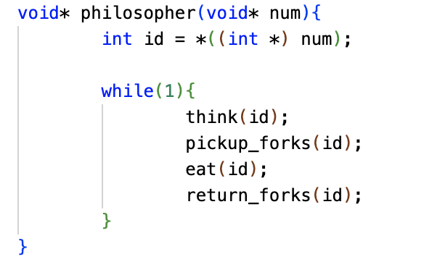
The Dining Philosophers Problem with CV
Each Philosopher has three states: Thinking, Hungry, Eat
Philosopher threads follow the loops:
Initially, all philosophers are thinking.
Then, they become hungry after a few seconds.
So, they try to pick up the forks. If succeed, they begin to eat.
After eating for a few seconds, they begin thinking again.

Slide 20
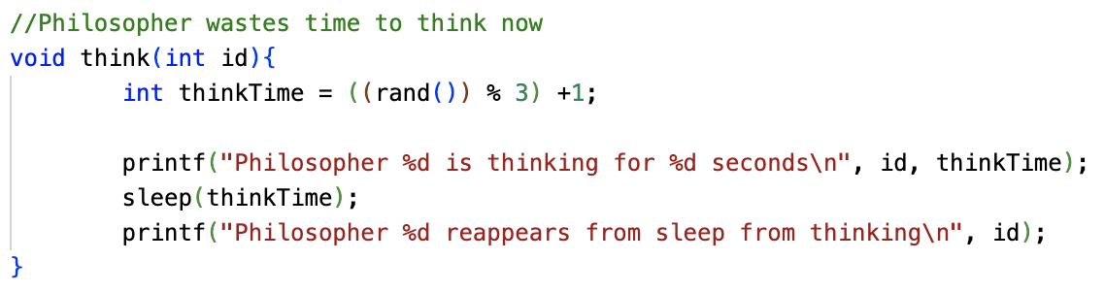
The Dining Philosophers Problem with CV
Thinking function with a random period

Slide 21
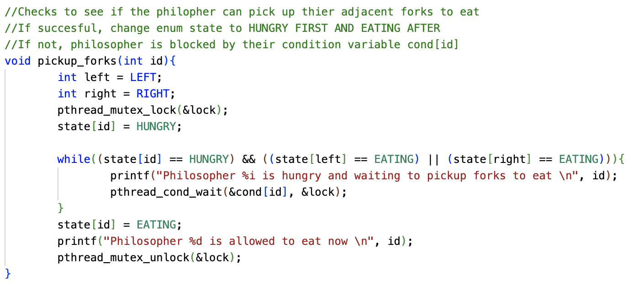
The Dining Philosophers Problem with CV
Set the state as hungry
Try to test the state of the left and right people. If the requirement does not meet, call the cond_wait()

Slide 22
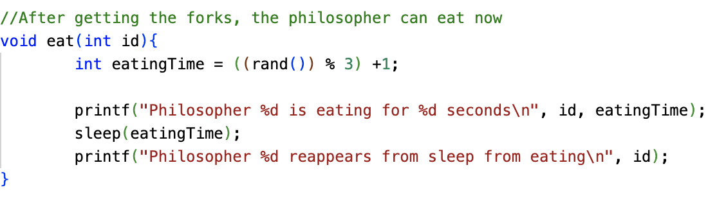
The Dining Philosophers Problem with CV
Eating function

Slide 23
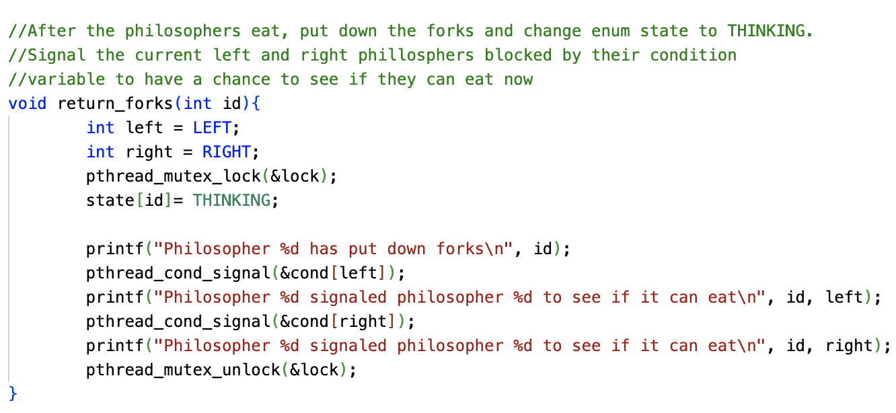
The Dining Philosophers Problem with CV
Return forks and signal the adjacent people.
The adjacent people then have a chance to see if they can eat now

Slide 24
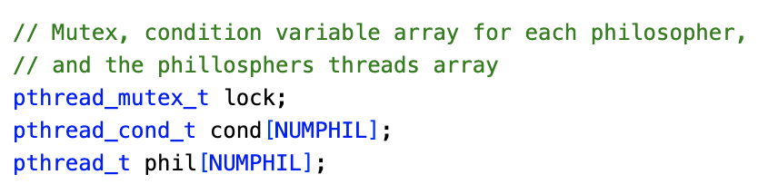
The Dining Philosophers Problem with CV
The mutex and cv declaration

Slide 25
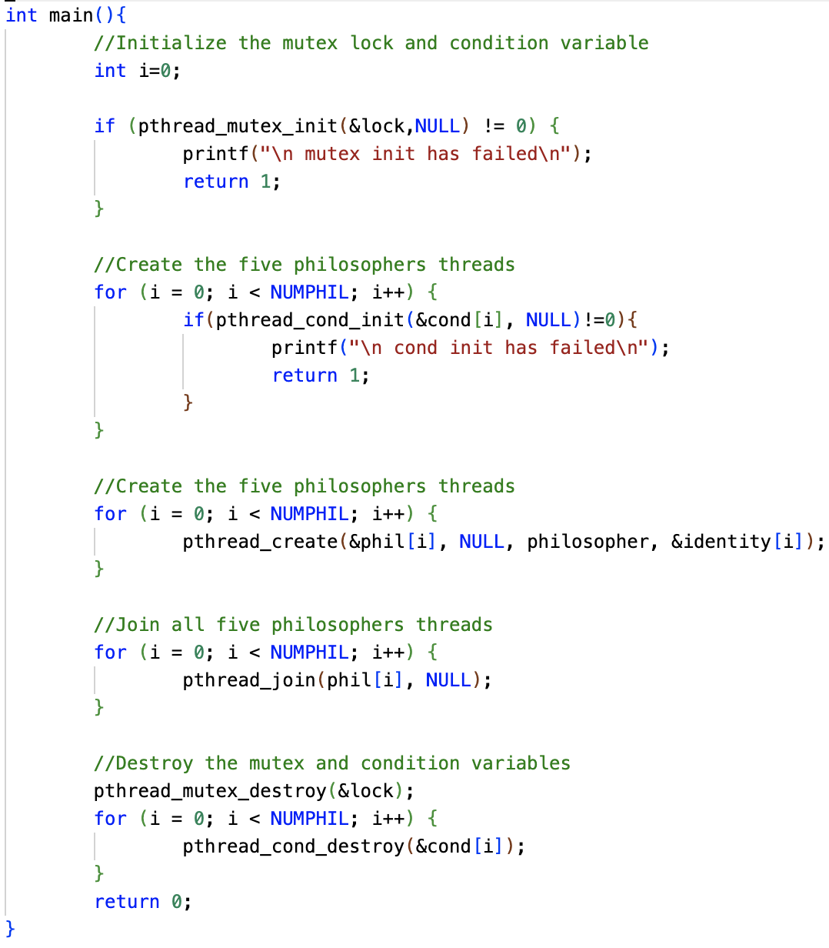
The Dining Philosophers Problem with CV
The main function
Initialize the mutex and cvs for each philosophers
Create the threads for each philsopher
Join all threads
Destroy the mutex and cv

Slide 26
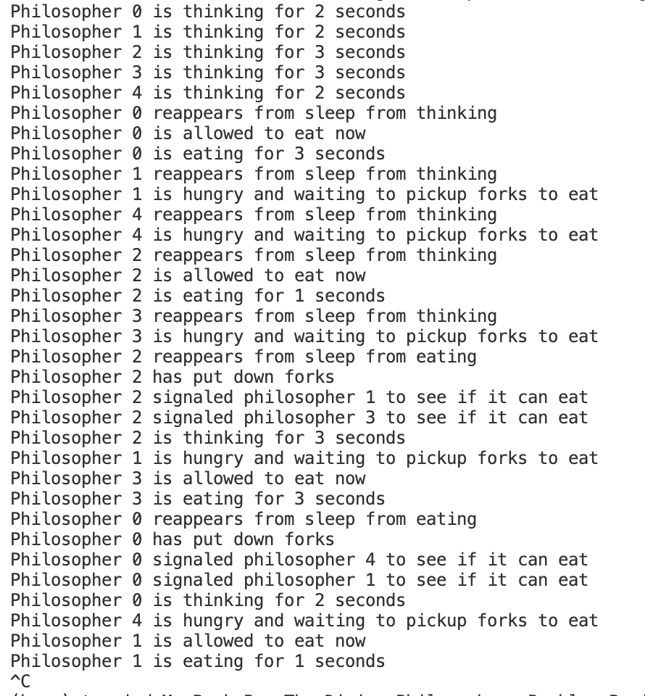
The Dining Philosophers Problem with CV
Refer to the diningproblem.c and check the implementation with cv and mutex
Compile and run the program

Slide 27
Q & A
Any questions?

