Slide 1
Tutorial 04: Semaphore, Mutex && MLFQ Scheduling
CSCI3150 - Introduction to operating system
Tutor: TAN Xin
xtan22@cse.cuhk.edu.hk

Slide 2
Semaphore, Mutex

Slide 3
Background
Processes can execute concurrently
May be interrupted at any time, partially completing execution
Concurrent access to shared data may result in data inconsistency
Maintaining data consistency requires mechanisms to ensure the orderly execution of cooperating processes
Illustration of the problem:
Suppose that we wanted to provide a solution to the consumer-producer problem that fills all the buffers. We can do so by having an integer counter that keeps track of the number of full buffers. Initially, counter is set to 0. It is incremented by the producer after it produces a new buffer and is decremented by the consumer after it consumes a buffer.

Slide 4
Critical Section Problem
Consider system of n processes {p₀, p₁, … p_{n-1}}
Each process has critical section segment of code
Process may be changing common variables, updating table, writing file, etc
When one process in critical section, no other may be in its critical section
Critical section problem is to design protocol to solve this
Each process must ask permission to enter critical section in entry section, may follow critical section with exit section, then remainder section

Slide 5
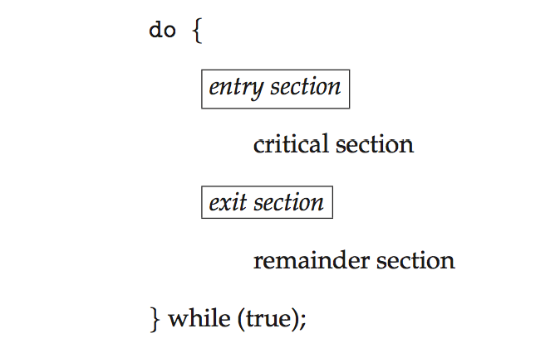
Critical Section
General structure of process P_{i}
A critical section (CS) is a sequence of instructions that can be executed by at most one process at the same time.

Slide 6
Solution to Critical-Section Problem --three conditions
1. Mutual Exclusion - If process P_{i} is executing in its critical section, then no other processes can be executing in their critical sections
2. Progress - If no process is executing in its critical section and there exist some processes that wish to enter their critical section, then the selection of the processes that will enter the critical section next cannot be postponed indefinitely. (Thus, one of the waiting processes can enter its critical section)
3. Bounded Waiting - A bound must exist on the number of times that other processes are allowed to enter their critical sections after a process has made a request to enter its critical section and before that request is granted
Assume that each process executes at a nonzero speed
No assumption concerning relative speed of the n processes
The purpose of this condition is to make sure that every process gets the chance to actually enter its critical section so that no process starves forever

Slide 7
Progress VS Bounded Waiting
Progress does not imply Bounded Waiting: Progress says a process can enter with a finite decision time. It does not say which process can enter, and there is no guarantee for bounded waiting.
Bounded Waiting does not imply Progress: Even through we have a bound, all processes may be locked up in the enter section (i.e., failure of Progress).
Therefore, Progress and Bounded Waiting are independent of each other.

Slide 8
Mutex Locks
Previous solutions are complicated and generally inaccessible to application programmers
OS designers build software tools to solve critical section problem
Simplest is mutex lock
Protect a critical section by first acquire() a lock then release() the lock
Boolean variable indicating if lock is available or not
Calls to acquire() and release() must be atomic
Usually implemented via hardware atomic instructions
But this solution requires busy waiting
This lock therefore called a spinlock

Slide 9
acquire() and release()
acquire() { while (!available)
; /* busy wait */
available = false;
}
release() {
available = true;
}
do {
acquire lock
critical section
release lock
remainder section
} while (true);

Slide 10
Semaphore
Synchronization tool that provides more sophisticated ways (than Mutex locks) for process to synchronize their activities.
Semaphore S – integer variable
Can only be accessed via two indivisible (atomic) operations
wait() and signal()
Originally called P() and V()
Definition of the wait() operation
wait(S) {
while (S <= 0)
; // busy wait
S--;
}
Definition of the signal() operation
signal(S) {
S++;
}

Slide 11
Semaphore Usage
Counting semaphore – integer value can range over an unrestricted domain
Binary semaphore – integer value can range only between 0 and 1
Same as a mutex lock
Can solve various synchronization problems
Consider P₁ and P₂ that require S₁ to happen before S₂
Create a semaphore “synch” initialized to 0
P1:
S₁;
signal(synch);
P2:
wait(synch);
S₂;
Can implement a counting semaphore S as a binary semaphore

Slide 12
An example
Variables
semaphore mutex; // (initially = 1)
semaphore next; // (initially = 0)
int next_count = 0;
wait(mutex);
…
body of F;
…
if (next_count > 0)
signal(next)
else
signal(mutex);
A binary sem ( serve as a mutex)
A counting sem

Slide 13
MLFQ scheduling

Slide 14
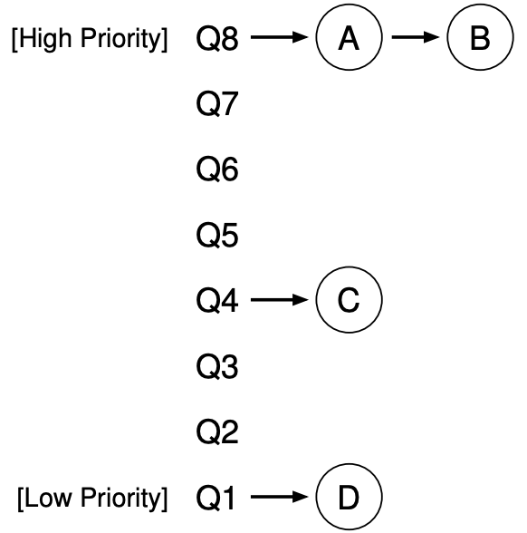
Concept
An example (refer to OSTEP, https://pages.cs.wisc.edu/~remzi/OSTEP/cpu-sched-mlfq.pdf)

Slide 15
MLFQ Scheduling Rules
Rule 1: If Priority(A) > Priority(B), A runs (B doesn’t).
Rule 2: If Priority(A) = Priority(B), A & B run in round-robin fashion using the time slice (quantum length) of the given queue.
Rule 3: When a job enters the system, it is placed at the highest priority (the topmost queue). For the jobs arriving at the same time, schedule the job with smallest pid first.
Rule 4: Once a job uses up its time allotment at a given level (regardless of how many times it has given up the CPU), its priority is reduced (i.e., it moves down one queue and will be at the tail of the target queue, which means it will be scheduled last).
Rule 5: After some time period S, move all the jobs in the system to the topmost queue, and sort all the jobs by pid. The job with the smallest pid will be scheduled first.

Slide 16
Process information
ProcessNum N
pid:X1, arrival_time:X11, execution_time:X12
pid:X2, arrival_time:X21, execution_time:X22
…
pid:XN, arrival_time:XN1, execution_time:XN2
Notes:
Here, the first line denotes there are N processes to be scheduled, and from the second line to the (N+1)th line, each shows the pid (process id), arrival time and execution time of a process with the format like “pid:X1, arrival_time:X11, execution_time:X12”. The time unit here is millisecond (ms).

Slide 17
Queue information
QueueNum n
Period_S S
Time_Slice_QN Xn Allotmenttime_QN Yn
...
Time_Slice_Q2 X2 Allotmenttime_Q2 Y2
Time_Slice_Q1 X1 Allotmenttime_Q1 Y1
Priority
High
Low
Notes:
Here, the first line denotes the number of queues we will use in the scheduler, the second line denotes the period S to move up all jobs to the topmost queue (Rule 5), the third line denotes the time slice for Queue n that is the topmost queue with the highest priority (the smallest time slice), and the subsequent lines define other queues with descending order in terms of priority. The time unit here is millisecond (ms).

Slide 18
MLFQ Scheduling Example
While executing MLFQ scheduling, we need to figure out the processes in different queues during the whole procedure, and the order of these processes.
Given the example of process and queue information:
ProcessNum 5
pidnum:123, arrival_time:60, execution_time:90
pidnum:13, arrival_time:70, execution_time:100
pidnum:1023, arrival_time:10, execution_time:160
pidnum:12, arrival_time:80, execution_time:28
pidnum:36, arrival_time:10, execution_time:10
QueueNum 3
Period_S 300
Time_Slice_Q3 10 Allotmenttime_Q3 30
Time_Slice_Q2 40 Allotmenttime_Q2 80
Time_Slice_Q1 60 Allotmenttime_Q1 120

Slide 19
Demo of MLFQ Scheduling
ProcessNum 5
pidnum:123, arrival_time:60, execution_time:90
pidnum:13, arrival_time:70, execution_time:100
pidnum:1023, arrival_time:10, execution_time:160
pidnum:12, arrival_time:80, execution_time:28
pidnum:36, arrival_time:10, execution_time:10
At the beginning (time 0): No process
High Priority
Tail
Head
Q3
Q2
QueueNum 3
Period_S 300
Time_Slice_Q3 10 Allotmenttime_Q3 30
Time_Slice_Q2 40 Allotmenttime_Q2 80
Time_Slice_Q1 60 Allotmenttime_Q1 120
Q1
Low Priority
Time
Schedule
Time
0

Slide 20
Demo of MLFQ Scheduling
ProcessNum 5
pidnum:123, arrival_time:60, execution_time:90
pidnum:13, arrival_time:70, execution_time:100
pidnum:1023, arrival_time:10, execution_time:160
pidnum:12, arrival_time:80, execution_time:28
pidnum:36, arrival_time:10, execution_time:10
At time 10: Process 36 and 1023 arrive (Rule 3)
High Priority
Tail
Head
PID: 1023
RT: 160
PID: 36
RT: 10
Q3
Q2
QueueNum 3
Period_S 300
Time_Slice_Q3 10 Allotmenttime_Q3 30
Time_Slice_Q2 40 Allotmenttime_Q2 80
Time_Slice_Q1 60 Allotmenttime_Q1 120
Q1
Low Priority
Time
Schedule
Time
0
10

Slide 21
Demo of MLFQ Scheduling
ProcessNum 5
pidnum:123, arrival_time:60, execution_time:90
pidnum:13, arrival_time:70, execution_time:100
pidnum:1023, arrival_time:10, execution_time:160
pidnum:12, arrival_time:80, execution_time:28
pidnum:36, arrival_time:10, execution_time:10
At time 20: Process 36 finishes first slice in Q3
High Priority
Tail
Head
PID: 1023
RT: 160
PID: 36
RT: 0
Q3
Q2
QueueNum 3
Period_S 300
Time_Slice_Q3 10 Allotmenttime_Q3 30
Time_Slice_Q2 40 Allotmenttime_Q2 80
Time_Slice_Q1 60 Allotmenttime_Q1 120
Q1
Low Priority
Time
Schedule
36
Time
0
10
20

Slide 22
Demo of MLFQ Scheduling
ProcessNum 5
pidnum:123, arrival_time:60, execution_time:90
pidnum:13, arrival_time:70, execution_time:100
pidnum:1023, arrival_time:10, execution_time:160
pidnum:12, arrival_time:80, execution_time:28
pidnum:36, arrival_time:10, execution_time:10
At time 30: Process 1023 finishes first slice in Q3
High Priority
Tail
Head
PID: 1023
RT: 150
Q3
Q2
QueueNum 3
Period_S 300
Time_Slice_Q3 10 Allotmenttime_Q3 30
Time_Slice_Q2 40 Allotmenttime_Q2 80
Time_Slice_Q1 60 Allotmenttime_Q1 120
Q1
Low Priority
Time
Schedule
36
1023
Time
0
10
20
30

Slide 23
Demo of MLFQ Scheduling
ProcessNum 5
pidnum:123, arrival_time:60, execution_time:90
pidnum:13, arrival_time:70, execution_time:100
pidnum:1023, arrival_time:10, execution_time:160
pidnum:12, arrival_time:80, execution_time:28
pidnum:36, arrival_time:10, execution_time:10
At time 40: Process 1023 finishes second slice in Q3
High Priority
Tail
Head
PID: 1023
RT: 140
Q3
Q2
QueueNum 3
Period_S 300
Time_Slice_Q3 10 Allotmenttime_Q3 30
Time_Slice_Q2 40 Allotmenttime_Q2 80
Time_Slice_Q1 60 Allotmenttime_Q1 120
Q1
Low Priority
Time
Schedule
36
1023
1023
Time
0
10
20
30
40

Slide 24
Demo of MLFQ Scheduling
ProcessNum 5
pidnum:123, arrival_time:60, execution_time:90
pidnum:13, arrival_time:70, execution_time:100
pidnum:1023, arrival_time:10, execution_time:160
pidnum:12, arrival_time:80, execution_time:28
pidnum:36, arrival_time:10, execution_time:10
At time 50: Process 1023 finishes third slice in Q3
Process 1023 moves down
High Priority
Tail
Head
PID: 1023
RT: 130
Q3
Q2
QueueNum 3
Period_S 300
Time_Slice_Q3 10 Allotmenttime_Q3 30
Time_Slice_Q2 40 Allotmenttime_Q2 80
Time_Slice_Q1 60 Allotmenttime_Q1 120
Q1
Low Priority
Time
Schedule
36
1023
1023
1023
Time
0
10
20
30
40
50

Slide 25
Demo of MLFQ Scheduling
ProcessNum 5
pidnum:123, arrival_time:60, execution_time:90
pidnum:13, arrival_time:70, execution_time:100
pidnum:1023, arrival_time:10, execution_time:160
pidnum:12, arrival_time:80, execution_time:28
pidnum:36, arrival_time:10, execution_time:10
At time 60: Process 123 arrives
High Priority
Tail
PID: 123
RT: 90
Head
Q3
PID: 1023
RT: 120
Q2
QueueNum 3
Period_S 300
Time_Slice_Q3 10 Allotmenttime_Q3 30
Time_Slice_Q2 40 Allotmenttime_Q2 80
Time_Slice_Q1 60 Allotmenttime_Q1 120
Q1
Low Priority
Time
Schedule
36
1023
1023
1023
1023
Time
0
10
20
30
40
50
90

Slide 26
Demo of MLFQ Scheduling
ProcessNum 5
pidnum:123, arrival_time:60, execution_time:90
pidnum:13, arrival_time:70, execution_time:100
pidnum:1023, arrival_time:10, execution_time:160
pidnum:12, arrival_time:80, execution_time:28
pidnum:36, arrival_time:10, execution_time:10
At time 70: Process 13 arrives
High Priority
Tail
PID: 13
RT: 100
Head
PID: 123
RT: 90
Q3
PID: 1023
RT: 110
Q2
QueueNum 3
Period_S 300
Time_Slice_Q3 10 Allotmenttime_Q3 30
Time_Slice_Q2 40 Allotmenttime_Q2 80
Time_Slice_Q1 60 Allotmenttime_Q1 120
Q1
Low Priority
Time
Schedule
36
1023
1023
1023
1023
Time
0
10
20
30
40
50
90

Slide 27
Demo of MLFQ Scheduling
ProcessNum 5
pidnum:123, arrival_time:60, execution_time:90
pidnum:13, arrival_time:70, execution_time:100
pidnum:1023, arrival_time:10, execution_time:160
pidnum:12, arrival_time:80, execution_time:28
pidnum:36, arrival_time:10, execution_time:10
At time 80: Process 12 arrives
High Priority
Tail
PID: 12
RT: 28
Head
PID: 13
RT: 100
PID: 123
RT: 90
Q3
PID: 1023
RT: 100
Q2
QueueNum 3
Period_S 300
Time_Slice_Q3 10 Allotmenttime_Q3 30
Time_Slice_Q2 40 Allotmenttime_Q2 80
Time_Slice_Q1 60 Allotmenttime_Q1 120
Q1
Low Priority
Time
Schedule
36
1023
1023
1023
1023
Time
0
10
20
30
40
50
90

Slide 28
Demo of MLFQ Scheduling
ProcessNum 5
pidnum:123, arrival_time:60, execution_time:90
pidnum:13, arrival_time:70, execution_time:100
pidnum:1023, arrival_time:10, execution_time:160
pidnum:12, arrival_time:80, execution_time:28
pidnum:36, arrival_time:10, execution_time:10
At time 90: Process 1023 finishes first slice in Q2
High Priority
Tail
PID: 12
RT: 28
PID: 13
RT: 100
PID: 123
RT: 90
Head
Q3
PID: 1023
RT: 90
Q2
QueueNum 3
Period_S 300
Time_Slice_Q3 10 Allotmenttime_Q3 30
Time_Slice_Q2 40 Allotmenttime_Q2 80
Time_Slice_Q1 60 Allotmenttime_Q1 120
Q1
Low Priority
Time
Schedule
36
1023
1023
1023
1023
Time
0
10
20
30
40
50
90

Slide 29
Demo of MLFQ Scheduling
ProcessNum 5
pidnum:123, arrival_time:60, execution_time:90
pidnum:13, arrival_time:70, execution_time:100
pidnum:1023, arrival_time:10, execution_time:160
pidnum:12, arrival_time:80, execution_time:28
pidnum:36, arrival_time:10, execution_time:10
At time 100: Process 123 finishes first slice in Q3
High Priority
Tail
PID: 12
RT: 28
PID: 13
RT: 100
PID: 123
RT: 80
Head
Q3
PID: 1023
RT: 90
Q2
QueueNum 3
Period_S 300
Time_Slice_Q3 10 Allotmenttime_Q3 30
Time_Slice_Q2 40 Allotmenttime_Q2 80
Time_Slice_Q1 60 Allotmenttime_Q1 120
Q1
Low Priority
Time
Schedule
36
1023
1023
1023
1023
123
Time
0
10
20
30
40
50
90
100

Slide 30
Demo of MLFQ Scheduling
ProcessNum 5
pidnum:123, arrival_time:60, execution_time:90
pidnum:13, arrival_time:70, execution_time:100
pidnum:1023, arrival_time:10, execution_time:160
pidnum:12, arrival_time:80, execution_time:28
pidnum:36, arrival_time:10, execution_time:10
At time 110: Process 13 finishes first slice in Q3
High Priority
Tail
PID: 123
RT: 80
PID: 12
RT: 28
PID: 13
RT: 90
Head
Q3
PID: 1023
RT: 90
Q2
QueueNum 3
Period_S 300
Time_Slice_Q3 10 Allotmenttime_Q3 30
Time_Slice_Q2 40 Allotmenttime_Q2 80
Time_Slice_Q1 60 Allotmenttime_Q1 120
Q1
Low Priority
Time
Schedule
36
1023
1023
1023
1023
123
13
Time
0
10
20
30
40
50
90
100
110

Slide 31
Demo of MLFQ Scheduling
ProcessNum 5
pidnum:123, arrival_time:60, execution_time:90
pidnum:13, arrival_time:70, execution_time:100
pidnum:1023, arrival_time:10, execution_time:160
pidnum:12, arrival_time:80, execution_time:28
pidnum:36, arrival_time:10, execution_time:10
At time 120: Process 12 finishes first slice in Q3
High Priority
Tail
PID: 13
RT: 90
PID: 123
RT: 80
PID: 12
RT: 18
Head
Q3
PID: 1023
RT: 90
Q2
QueueNum 3
Period_S 300
Time_Slice_Q3 10 Allotmenttime_Q3 30
Time_Slice_Q2 40 Allotmenttime_Q2 80
Time_Slice_Q1 60 Allotmenttime_Q1 120
Q1
Low Priority
Time
Schedule
36
1023
1023
1023
1023
123
13
12
Time
0
10
20
30
40
50
90
100
110
120

Slide 32
Demo of MLFQ Scheduling
ProcessNum 5
pidnum:123, arrival_time:60, execution_time:90
pidnum:13, arrival_time:70, execution_time:100
pidnum:1023, arrival_time:10, execution_time:160
pidnum:12, arrival_time:80, execution_time:28
pidnum:36, arrival_time:10, execution_time:10
At time 130: Process 123 finishes second slice in Q3
High Priority
Tail
PID: 12
RT: 18
PID: 13
RT: 90
PID: 123
RT: 70
Head
Q3
PID: 1023
RT: 90
Q2
QueueNum 3
Period_S 300
Time_Slice_Q3 10 Allotmenttime_Q3 30
Time_Slice_Q2 40 Allotmenttime_Q2 80
Time_Slice_Q1 60 Allotmenttime_Q1 120
Q1
Low Priority
Time
Schedule
36
1023
1023
1023
1023
123
13
12
123
Time
0
10
20
30
40
50
90
100
110
120
130

Slide 33
Demo of MLFQ Scheduling
ProcessNum 5
pidnum:123, arrival_time:60, execution_time:90
pidnum:13, arrival_time:70, execution_time:100
pidnum:1023, arrival_time:10, execution_time:160
pidnum:12, arrival_time:80, execution_time:28
pidnum:36, arrival_time:10, execution_time:10
At time 140: Process 13 finishes second slice in Q3
High Priority
Tail
PID: 123
RT: 70
PID: 12
RT: 18
PID: 13
RT: 80
Head
Q3
PID: 1023
RT: 90
Q2
QueueNum 3
Period_S 300
Time_Slice_Q3 10 Allotmenttime_Q3 30
Time_Slice_Q2 40 Allotmenttime_Q2 80
Time_Slice_Q1 60 Allotmenttime_Q1 120
Q1
Low Priority
Time
Schedule
36
1023
1023
1023
1023
123
13
12
123
13
Time
0
10
20
30
40
50
90
100
110
120
130
140

Slide 34
Demo of MLFQ Scheduling
ProcessNum 5
pidnum:123, arrival_time:60, execution_time:90
pidnum:13, arrival_time:70, execution_time:100
pidnum:1023, arrival_time:10, execution_time:160
pidnum:12, arrival_time:80, execution_time:28
pidnum:36, arrival_time:10, execution_time:10
At time 150: Process 12 finishes second slice in Q3
High Priority
Tail
PID: 13
RT: 80
PID: 123
RT: 70
PID: 12
RT: 8
Head
Q3
PID: 1023
RT: 90
Q2
QueueNum 3
Period_S 300
Time_Slice_Q3 10 Allotmenttime_Q3 30
Time_Slice_Q2 40 Allotmenttime_Q2 80
Time_Slice_Q1 60 Allotmenttime_Q1 120
Q1
Low Priority
Time
Schedule
36
1023
1023
1023
1023
123
13
12
123
13
12
Time
0
10
20
30
40
50
90
100
110
120
130
140
150

Slide 35
Demo of MLFQ Scheduling
ProcessNum 5
pidnum:123, arrival_time:60, execution_time:90
pidnum:13, arrival_time:70, execution_time:100
pidnum:1023, arrival_time:10, execution_time:160
pidnum:12, arrival_time:80, execution_time:28
pidnum:36, arrival_time:10, execution_time:10
At time 160: Process 123 finishes third slice in Q3
High Priority
Tail
PID: 12
RT: 8
PID: 13
RT: 80
PID: 123
RT: 60
Head
Q3
PID: 1023
RT: 90
Q2
QueueNum 3
Period_S 300
Time_Slice_Q3 10 Allotmenttime_Q3 30
Time_Slice_Q2 40 Allotmenttime_Q2 80
Time_Slice_Q1 60 Allotmenttime_Q1 120
Q1
Low Priority
Time
Schedule
36
1023
1023
1023
1023
123
13
12
123
13
12
123
0
10
20
30
40
50
90
100
110
120
130
140
150
160

Slide 36
Demo of MLFQ Scheduling
ProcessNum 5
pidnum:123, arrival_time:60, execution_time:90
pidnum:13, arrival_time:70, execution_time:100
pidnum:1023, arrival_time:10, execution_time:160
pidnum:12, arrival_time:80, execution_time:28
pidnum:36, arrival_time:10, execution_time:10
At time 170: Process 13 finishes third slice in Q3
High Priority
Tail
PID: 12
RT: 8
PID: 13
RT: 70
Head
Q3
PID: 123
RT: 60
PID: 1023
RT: 90
Q2
QueueNum 3
Period_S 300
Time_Slice_Q3 10 Allotmenttime_Q3 30
Time_Slice_Q2 40 Allotmenttime_Q2 80
Time_Slice_Q1 60 Allotmenttime_Q1 120
Q1
Low Priority
36
1023
1023
1023
1023
123
13
12
123
13
12
123
13
0
10
20
30
40
50
90
100
110
120
130
140
150
160
170

Slide 37
Demo of MLFQ Scheduling
ProcessNum 5
pidnum:123, arrival_time:60, execution_time:90
pidnum:13, arrival_time:70, execution_time:100
pidnum:1023, arrival_time:10, execution_time:160
pidnum:12, arrival_time:80, execution_time:28
pidnum:36, arrival_time:10, execution_time:10
At time 178: Process 12 finishes
High Priority
Tail
PID: 12
RT: 0
Head
Q3
PID: 13
RT: 70
PID: 123
RT: 60
PID: 1023
RT: 90
Q2
QueueNum 3
Period_S 300
Time_Slice_Q3 10 Allotmenttime_Q3 30
Time_Slice_Q2 40 Allotmenttime_Q2 80
Time_Slice_Q1 60 Allotmenttime_Q1 120
Q1
Low Priority
36
1023
1023
1023
1023
123
13
12
123
13
12
123
13
12
10
20
30
40
50
90
100
110
120
130
140
150
160
170
178

Slide 38
Demo of MLFQ Scheduling
ProcessNum 5
pidnum:123, arrival_time:60, execution_time:90
pidnum:13, arrival_time:70, execution_time:100
pidnum:1023, arrival_time:10, execution_time:160
pidnum:12, arrival_time:80, execution_time:28
pidnum:36, arrival_time:10, execution_time:10
At time 218: Process 1023 finishes second slice in Q2
High Priority
Tail
Head
Q3
PID: 13
RT: 70
PID: 123
RT: 60
PID: 1023
RT: 50
Q2
QueueNum 3
Period_S 300
Time_Slice_Q3 10 Allotmenttime_Q3 30
Time_Slice_Q2 40 Allotmenttime_Q2 80
Time_Slice_Q1 60 Allotmenttime_Q1 120
Q1
Low Priority
36
1023
1023
1023
1023
123
13
12
123
13
12
123
13
12
1023
20
30
40
50
90
100
110
120
130
140
150
160
170
178
218

Slide 39
Demo of MLFQ Scheduling
ProcessNum 5
pidnum:123, arrival_time:60, execution_time:90
pidnum:13, arrival_time:70, execution_time:100
pidnum:1023, arrival_time:10, execution_time:160
pidnum:12, arrival_time:80, execution_time:28
pidnum:36, arrival_time:10, execution_time:10
At time 258: Process 123 finishes first slice in Q2
High Priority
Tail
Head
Q3
PID: 13
RT: 70
PID: 123
RT: 20
Q2
QueueNum 3
Period_S 300
Time_Slice_Q3 10 Allotmenttime_Q3 30
Time_Slice_Q2 40 Allotmenttime_Q2 80
Time_Slice_Q1 60 Allotmenttime_Q1 120
PID: 1023
RT: 50
Q1
Low Priority
1023
1023
1023
1023
123
13
12
123
13
12
123
13
12
1023
123
30
40
50
90
100
110
120
130
140
150
160
170
178
218
258

Slide 40
Demo of MLFQ Scheduling
ProcessNum 5
pidnum:123, arrival_time:60, execution_time:90
pidnum:13, arrival_time:70, execution_time:100
pidnum:1023, arrival_time:10, execution_time:160
pidnum:12, arrival_time:80, execution_time:28
pidnum:36, arrival_time:10, execution_time:10
At time 298: Process 13 finishes first slice in Q2
High Priority
Tail
Head
Q3
PID: 123
RT: 20
PID: 13
RT: 30
Q2
QueueNum 3
Period_S 300
Time_Slice_Q3 10 Allotmenttime_Q3 30
Time_Slice_Q2 40 Allotmenttime_Q2 80
Time_Slice_Q1 60 Allotmenttime_Q1 120
PID: 1023
RT: 50
Q1
Low Priority
1023
1023
1023
1023
123
13
12
123
13
12
123
13
12
1023
123
13
40
50
90
100
110
120
130
140
150
160
170
178
218
258
298

Slide 41
Demo of MLFQ Scheduling
ProcessNum 5
pidnum:123, arrival_time:60, execution_time:90
pidnum:13, arrival_time:70, execution_time:100
pidnum:1023, arrival_time:10, execution_time:160
pidnum:12, arrival_time:80, execution_time:28
pidnum:36, arrival_time:10, execution_time:10
At time 300: Move all process to topmost level queue
Sort with pid.
High Priority
Tail
Head
Q3
PID: 13
RT: 30
PID: 123
RT: 18
Q2
QueueNum 3
Period_S 300
Time_Slice_Q3 10 Allotmenttime_Q3 30
Time_Slice_Q2 40 Allotmenttime_Q2 80
Time_Slice_Q1 60 Allotmenttime_Q1 120
PID: 1023
RT: 50
Q1
Low Priority
1023
1023
1023
1023
123
13
12
123
13
12
123
13
12
1023
123
13
123
50
90
100
110
120
130
140
150
160
170
178
218
258
298
300

Slide 42
Demo of MLFQ Scheduling
ProcessNum 5
pidnum:123, arrival_time:60, execution_time:90
pidnum:13, arrival_time:70, execution_time:100
pidnum:1023, arrival_time:10, execution_time:160
pidnum:12, arrival_time:80, execution_time:28
pidnum:36, arrival_time:10, execution_time:10
At time 310: Process 13 finishes first slice in Q3
High Priority
Tail
PID: 1023
RT: 50
PID: 123
RT: 18
PID: 13
RT: 20
Head
Q3
Q2
QueueNum 3
Period_S 300
Time_Slice_Q3 10 Allotmenttime_Q3 30
Time_Slice_Q2 40 Allotmenttime_Q2 80
Time_Slice_Q1 60 Allotmenttime_Q1 120
Q1
Low Priority
1023
1023
1023
1023
123
13
12
123
13
12
123
13
12
1023
123
13
123
13
90
100
110
120
130
140
150
160
170
178
218
258
298
300
310

Slide 43
Demo of MLFQ Scheduling
ProcessNum 5
pidnum:123, arrival_time:60, execution_time:90
pidnum:13, arrival_time:70, execution_time:100
pidnum:1023, arrival_time:10, execution_time:160
pidnum:12, arrival_time:80, execution_time:28
pidnum:36, arrival_time:10, execution_time:10
At time 320: Process 123 finishes first slice in Q3
High Priority
Tail
PID: 13
RT: 20
PID: 1023
RT: 50
PID: 123
RT: 8
Head
Q3
Q2
QueueNum 3
Period_S 300
Time_Slice_Q3 10 Allotmenttime_Q3 30
Time_Slice_Q2 40 Allotmenttime_Q2 80
Time_Slice_Q1 60 Allotmenttime_Q1 120
Q1
Low Priority
1023
1023
1023
123
13
12
123
13
12
123
13
12
1023
123
13
123
13
123
100
110
120
130
140
150
160
170
178
218
258
298
300
310
320

Slide 44
Demo of MLFQ Scheduling
ProcessNum 5
pidnum:123, arrival_time:60, execution_time:90
pidnum:13, arrival_time:70, execution_time:100
pidnum:1023, arrival_time:10, execution_time:160
pidnum:12, arrival_time:80, execution_time:28
pidnum:36, arrival_time:10, execution_time:10
At time 330: Process 1023 finishes first slice in Q3
High Priority
Tail
PID: 123
RT: 8
PID: 13
RT: 20
PID: 1023
RT: 40
Head
Q3
Q2
QueueNum 3
Period_S 300
Time_Slice_Q3 10 Allotmenttime_Q3 30
Time_Slice_Q2 40 Allotmenttime_Q2 80
Time_Slice_Q1 60 Allotmenttime_Q1 120
Q1
Low Priority
1023
1023
1023
13
12
123
13
12
123
13
12
1023
123
13
123
13
123
1023
110
120
130
140
150
160
170
178
218
258
298
300
310
320
330

Slide 45
Demo of MLFQ Scheduling
ProcessNum 5
pidnum:123, arrival_time:60, execution_time:90
pidnum:13, arrival_time:70, execution_time:100
pidnum:1023, arrival_time:10, execution_time:160
pidnum:12, arrival_time:80, execution_time:28
pidnum:36, arrival_time:10, execution_time:10
At time 340: Process 13 finishes second slice in Q3
High Priority
Tail
PID: 1023
RT: 40
PID: 123
RT: 8
PID: 13
RT: 10
Head
Q3
Q2
QueueNum 3
Period_S 300
Time_Slice_Q3 10 Allotmenttime_Q3 30
Time_Slice_Q2 40 Allotmenttime_Q2 80
Time_Slice_Q1 60 Allotmenttime_Q1 120
Q1
Low Priority
1023
1023
1023
12
123
13
12
123
13
12
1023
123
13
123
13
123
1023
13
120
130
140
150
160
170
178
218
258
298
300
310
320
330
340

Slide 46
Demo of MLFQ Scheduling
ProcessNum 5
pidnum:123, arrival_time:60, execution_time:90
pidnum:13, arrival_time:70, execution_time:100
pidnum:1023, arrival_time:10, execution_time:160
pidnum:12, arrival_time:80, execution_time:28
pidnum:36, arrival_time:10, execution_time:10
At time 348: Process 123 finishes
High Priority
Tail
PID: 13
RT: 10
PID: 1023
RT: 40
PID: 123
RT: 0
Head
Q3
Q2
QueueNum 3
Period_S 300
Time_Slice_Q3 10 Allotmenttime_Q3 30
Time_Slice_Q2 40 Allotmenttime_Q2 80
Time_Slice_Q1 60 Allotmenttime_Q1 120
Q1
Low Priority
1023
1023
1023
123
13
12
123
13
12
1023
123
13
123
13
123
1023
13
123
130
140
150
160
170
178
218
258
298
300
310
320
330
340
348

Slide 47
Demo of MLFQ Scheduling
ProcessNum 5
pidnum:123, arrival_time:60, execution_time:90
pidnum:13, arrival_time:70, execution_time:100
pidnum:1023, arrival_time:10, execution_time:160
pidnum:12, arrival_time:80, execution_time:28
pidnum:36, arrival_time:10, execution_time:10
At time 358: Process 1023 finishes second slice in Q3
High Priority
Tail
PID: 13
RT: 10
PID: 1023
RT: 30
Head
Q3
Q2
QueueNum 3
Period_S 300
Time_Slice_Q3 10 Allotmenttime_Q3 30
Time_Slice_Q2 40 Allotmenttime_Q2 80
Time_Slice_Q1 60 Allotmenttime_Q1 120
Q1
Low Priority
1023
1023
1023
13
12
123
13
12
1023
123
13
123
13
123
1023
13
123
1023
140
150
160
170
178
218
258
298
300
310
320
330
340
348
358

Slide 48
Demo of MLFQ Scheduling
ProcessNum 5
pidnum:123, arrival_time:60, execution_time:90
pidnum:13, arrival_time:70, execution_time:100
pidnum:1023, arrival_time:10, execution_time:160
pidnum:12, arrival_time:80, execution_time:28
pidnum:36, arrival_time:10, execution_time:10
At time 368: Process 13 finishes
High Priority
Tail
PID: 1023
RT: 30
PID: 13
RT: 0
Head
Q3
Q2
QueueNum 3
Period_S 300
Time_Slice_Q3 10 Allotmenttime_Q3 30
Time_Slice_Q2 40 Allotmenttime_Q2 80
Time_Slice_Q1 60 Allotmenttime_Q1 120
Q1
Low Priority
1023
1023
1023
12
123
13
12
1023
123
13
123
13
123
1023
13
123
1023
13
150
160
170
178
218
258
298
300
310
320
330
340
348
358
368

Slide 49
Demo of MLFQ Scheduling
ProcessNum 5
pidnum:123, arrival_time:60, execution_time:90
pidnum:13, arrival_time:70, execution_time:100
pidnum:1023, arrival_time:10, execution_time:160
pidnum:12, arrival_time:80, execution_time:28
pidnum:36, arrival_time:10, execution_time:10
At time 378: Process 1023 finishes third slice in Q3
Process 1023 moves down
High Priority
Tail
PID: 1023
RT: 20
Head
Q3
Q2
QueueNum 3
Period_S 300
Time_Slice_Q3 10 Allotmenttime_Q3 30
Time_Slice_Q2 40 Allotmenttime_Q2 80
Time_Slice_Q1 60 Allotmenttime_Q1 120
Q1
Low Priority
1023
1023
1023
123
13
12
1023
123
13
123
13
123
1023
13
123
1023
13
1023
160
170
178
218
258
298
300
310
320
330
340
348
358
368
378

Slide 50
Demo of MLFQ Scheduling
ProcessNum 5
pidnum:123, arrival_time:60, execution_time:90
pidnum:13, arrival_time:70, execution_time:100
pidnum:1023, arrival_time:10, execution_time:160
pidnum:12, arrival_time:80, execution_time:28
pidnum:36, arrival_time:10, execution_time:10
At time 398: Process 1023 finishes
High Priority
Tail
Head
Q3
PID: 1023
RT: 0
Q2
QueueNum 3
Period_S 300
Time_Slice_Q3 10 Allotmenttime_Q3 30
Time_Slice_Q2 40 Allotmenttime_Q2 80
Time_Slice_Q1 60 Allotmenttime_Q1 120
Q1
Low Priority
1023
1023
1023
13
12
1023
123
13
123
13
123
1023
13
123
1023
13
1023
1023
170
178
218
258
298
300
310
320
330
340
348
358
368
378
398

Slide 51

Output Format of MLFQ Scheduling
Assume that scheduling begins at time 0, and write down the result in the following format:
1. The time slot is beginning with the earliest arrival_time. x-y denotes the time interval starting at time x and end at time y (Commonly the time interval is the time slice of current queue. If one process finishes without using the whole time slice, the time interval will be the time it used, and the smallest time interval is 1 ms.)
2. Arrival Time is the arrival_time for the process in the given information.
3. Remaining Time is the length of time of which the process still needs to finish.

Slide 52
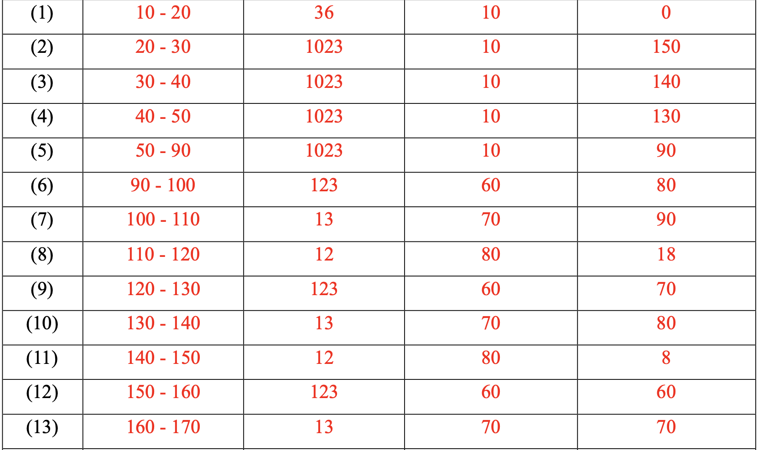
Example of Scheduling Result
1023
1023
1023
13
12
1023
123
13
123
13
123
1023
13
123
1023
13
1023
1023
170
178
218
258
298
300
310
320
330
340
348
358
368
378
398

Slide 53
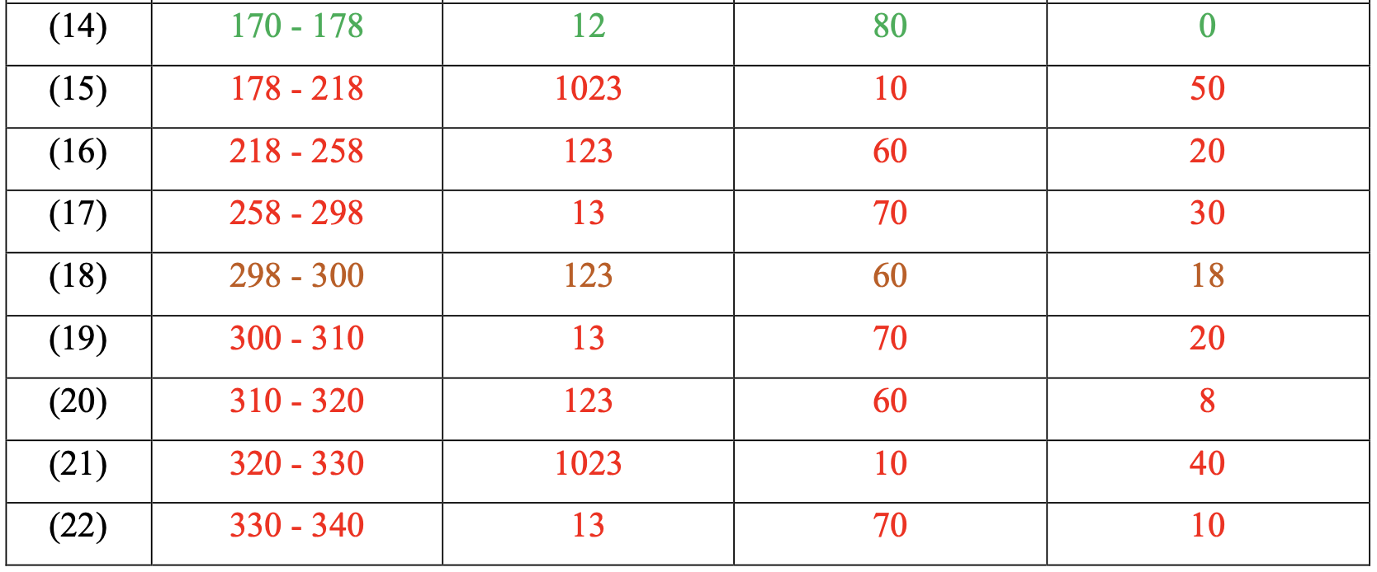
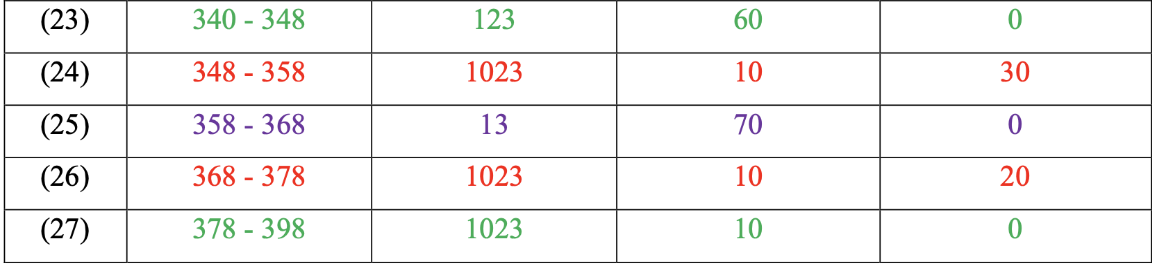
Example of Scheduling Result
1023
1023
1023
13
12
1023
123
13
123
13
123
1023
13
123
1023
13
1023
1023
170
178
218
258
298
300
310
320
330
340
348
358
368
378
398

Slide 54
Q & A
Any questions?

