Slide 1
Operating Systems CSCI 3150
Lecture 5: Synchronization (I) -- Critical region and lock
Hong Xu

Slide 2
Review of last lecture
Multithreading is also very useful for applications
Efficient multithreading requires fast primitives
Processes are too heavyweight
Solution is to separate threads from processes
Kernel-level threads much better, but still significant overhead
User-level threads even better, but not well integrated with OS
Now, how do we get our threads to correctly cooperate with each other?
Synchronization…

Slide 3
Synchronization: why?
A running computer has multiple processes and each process may have multiple threads
Need proper sequencing
Analogy: two people talking at the same time
Threads
User
space
Process
Kernel space

Slide 4
A simple game
Two volunteers to play two threads
Producer: produce 1 snack bar per iteration
Step1: increment the counter on the board
Step2: put one cookie on the table
Consumer:
Step1: read the counter LOUD
Step2a: if the counter is zero, go back to step1
Step2b: if the counter is nonzero, take a snack bar from the table
Step 3: decrement counter on the board
Rule: only one should “operate” at any time
You are the OS
You decide who should operate, who should freeze
Can you get them into “trouble” before snack bars run out?

Slide 5
A simple game (cont.)
Producer: produce 1 cookie per iteration
Step1: increment the counter on the board
Step2: put one snack bar on the table
Consumer:
Step1: read the counter LOUD
Step2a: if the counter is zero, go back to step1
Step2b: if the counter is nonzero, take a cookie from the table
Step 3: decrement counter on the board
Switch to consumer,
what will happen?
Switch to producer,
what will happen?

Slide 6
Data races
Why are we having this problem?
Reason:
concurrency
data sharing
What are shared in this game?
Share the counter
Share the cookie

Slide 7
Shared Resources
The problem is that two concurrent threads (or processes) accessed a shared resource without any synchronization
Known as a race condition (memorize this buzzword)
We need mechanisms to control access to these shared resources in the face of concurrency
So we can reason about how the program will operate
Shared data structure
Buffers, queues, lists, hash tables, etc.

Slide 8
What is data race?
A race occurs when correctness of the program depends on one thread reaching point x before another thread reaches point y

Slide 9


2003 Northeast blackout is caused by data race

Slide 10
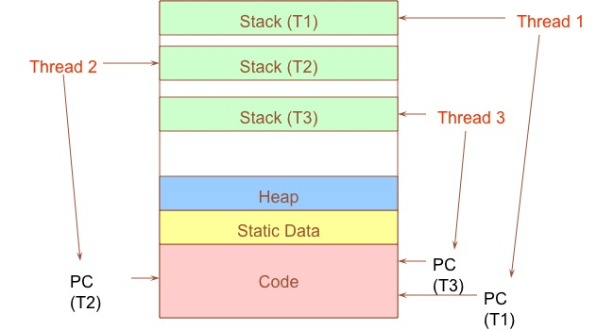
When are resources shared?
Local variables are not shared (private)
Stored on the stack
Each thread has its own stack
Never pass/share/store a pointer to a local variable on the stack for thread T1 to another thread T2
Global variables and static objects are shared
Stored in the static data segment, accessible by any thread
Dynamic objects and other heap objects are shared
Allocated from heap with malloc/free or new/delete
Accesses to shared data need to be synchronized

Slide 11
Why synchronize?
Interleaving by an access from another thread to the same shared data between two subsequent accesses can result in errors
Write X
Write X
Read X

Slide 12

Analogy
Synchronization is like traffic signals
Each thread is like a car----it can make progress independently with its own speed
Road or intersection is the shared resource
https://www.youtube.com/watch?v=ho1cxThxEy8

Slide 13
Classic Example
Suppose we have to implement a function to handle withdrawals from a bank account:
withdraw (account, amount) {
balance = get_balance(account);
balance = balance – amount;
put_balance(account, balance);
return amount;
}
Now suppose that you and your significant other share a bank account with a balance of $1000.
Then you each go to separate ATM machines and simultaneously withdraw $100 from the account.

Slide 14
Example Continued
We’ll represent the situation by creating a separate thread for each person to do the withdrawals
These threads run on the same bank machine:
What’s the problem with this implementation?
Think about potential schedules of these two threads
withdraw (account, amount) {
balance = get_balance(account);
balance = balance – amount;
put_balance(account, balance);
return amount;
}
withdraw (account, amount) {
balance = get_balance(account);
balance = balance – amount;
put_balance(account, balance);
return amount;
}

Slide 15
Interleaved Schedules
The problem is that the execution of the two threads can be interleaved:
What is the balance of the account now?
Is the bank happy with our implementation?
What if this is not withdraw, but deposit?
balance = get_balance(account);
balance = balance – amount;
Execution sequence seen by CPU
balance = get_balance(account);
balance = balance – amount;
put_balance(account, balance);
Context switch
put_balance(account, balance);

Slide 16
How Interleaved Can It Get?
How contorted can the interleavings be?
We'll assume that the only atomic operations are reads and writes of words
Some architectures don't even give you that!
We'll assume that a context switch can occur at any time
We'll assume that you can delay a thread as long as you like as long as it's not delayed forever
............... get_balance(account);
balance = get_balance(account);
balance = ...................................
balance = balance – amount;
balance = balance – amount;
put_balance(account, balance);
put_balance(account, balance);

Slide 17
Mutual Exclusion
We want to use mutual exclusion to synchronize access to shared resources
This allows us to have larger atomic blocks
Code that uses mutual exclusion to synchronize its execution is called a critical region (or critical section)
Only one thread at a time can execute in the critical region
All other threads are forced to wait on entry
When a thread leaves a critical region, another can enter
Example: sharing your bathroom with housemates

Slide 18
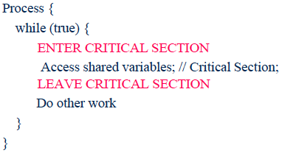
Critical Region (Critical Section)
What requirements would you place on a critical section?

Slide 19
Critical Region Requirements (apply to both thread and process)
Mutual exclusion (mutex)
No other thread must execute within the critical region while a thread is in it
2) Progress
A thread in the critical region will eventually leave the critical region
If some thread T is not in the critical region, then T cannot prevent some other thread S from entering the critical region
3) Bounded waiting (no starvation)
If some thread T is waiting on the critical region, then T should only have wait for a bounded number of other threads to enter and leave the critical region
4) No assumption
No assumption may be made about the speed or number of CPUs

Slide 20
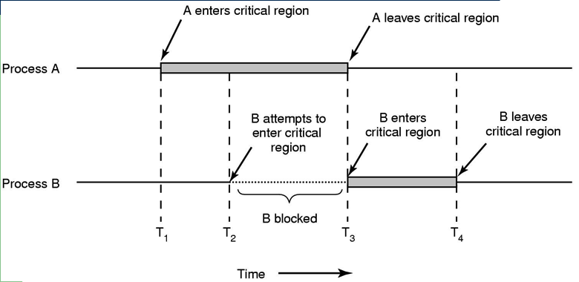
Critical Region Illustrated

Slide 21
Mechanisms For Building Critical Sections
Atomic read/write
Can it be done?
Locks
Primitive, minimal semantics, used to build others
Semaphores
Basic, easy to get the hang of, but hard to program with
Monitors
High-level, requires language support, operations implicit
Messages
Simple model of communication and synchronization based on atomic transfer of data across a channel
Direct application to distributed systems
Messages for synchronization are straightforward (once we see how the others work)

Slide 22
Mutual Exclusion with Atomic Read/Writes: First Try
int turn = 1;
while (true) { while (turn != 1) ; critical region turn = 2; outside of critical region }
while (true) { while (turn != 2) ; critical region turn = 1; outside of critical region }
This is called alternation
It satisfies mutex:
If blue is in the critical region, then turn == 1 and if yellow is in the critical region then turn == 2 (why?)
(turn == 1) ≡ (turn != 2)
It violates progress: the thread could go into an infinite loop outside of the critical section, which will prevent the yellow one from entering.
Easy to use? (what if more than 2 threads? what if we don’t know how many threads?)

Slide 23
Locks
A lock is an object in memory providing two operations
acquire(): before entering the critical region
release(): after leaving a critical region
Threads pair calls to acquire() and release()
Between acquire()/release(), the thread holds the lock
acquire() does not return until any previous holder releases
What can happen if the calls are not paired?
Locks can spin (a spinlock) or block (a mutex)

Slide 24
Using Locks
What happens when blue tries to acquire the lock?
Why is the “return” outside the critical region? Is this OK?
What happens when a third thread calls acquire?
acquire(lock);
balance = get_balance(account);
balance = balance – amount;
withdraw (account, amount) {
acquire(lock);
balance = get_balance(account);
balance = balance – amount;
put_balance(account, balance);
release(lock);
return amount;
}
acquire(lock);
Critical Region
put_balance(account, balance);
release(lock);
balance = get_balance(account);
balance = balance – amount;
put_balance(account, balance);
release(lock);

Slide 25
Implementing Locks (1)
How do we implement locks? Here is one attempt:
This is called a spinlock because a thread spins waiting for the lock to be released
Does this work?
struct lock {
int held = 0;
}
void acquire (lock) {
while (lock->held);
lock->held = 1;
}
void release (lock) {
lock->held = 0;
}
busy-wait (spin-wait) for lock to be released

Slide 26
Implementing Locks (2)
No. Two independent threads may both notice that a lock has been released and thereby acquire it.
struct lock {
int held = 0;
}
void acquire (lock) {
while (lock->held);
lock->held = 1;
}
void release (lock) {
lock->held = 0;
}
A context switch can occur here, causing a race condition

Slide 27
Implementing Locks (3)
The problem is that the implementation of locks has critical sections, too
How do we stop the recursion?
The implementation of acquire/release must be atomic
An atomic operation is one which executes as though it could not be interrupted
Code that executes “all or nothing”
How do we make them atomic?
Need help from hardware
Atomic instructions (e.g., test-and-set)
Disable/enable interrupts (prevents context switches)

Slide 28
Atomic Instructions: Test-And-Set
The semantics of test-and-set are:
Record the old value
Set the value to TRUE
Return the old value
Hardware executes it atomically!
When executing test-and-set on “flag”
What is value of flag afterwards if it was initially False? True?
What is the return result if flag was initially False? True?
bool test_and_set (bool *flag) {
bool old = *flag;
*flag = True;
return old;
}

Slide 29
Using Test-And-Set
Here is our lock implementation with test-and-set:
When will the while return? What is the value of held?
Does it work? What about multiprocessors?
struct lock {
int held = 0;
}
void acquire (lock) {
while (test-and-set(&lock->held));
}
void release (lock) {
lock->held = 0;
}

Slide 30
Problems with Spinlocks
The problem with spinlocks is that they are wasteful
If a thread is spinning on a lock, then the thread holding the lock cannot make progress
Solution 1:
If cannot get the lock, call thread_yield to give up the CPU
Solution 2: sleep and wakeup
When blocked, go to sleep
Wakeup when it is OK to retry entering the critical region

Slide 31
Disabling Interrupts
Another implementation of acquire/release is to disable interrupts:
Note that there is no state associated with the lock
Can two threads disable interrupts simultaneously?
struct lock {
}
void acquire (lock) {
disable interrupts;
}
void release (lock) {
enable interrupts;
}

Slide 32
On Disabling Interrupts
Disabling interrupts blocks notification of external events that could trigger a context switch (e.g., timer)
This is what OS161 uses as its primitive
In a “real” system, this is only available to the kernel
Why?
Disabling interrupts is insufficient on a multiprocessor
Back to atomic instructions

Slide 33
Critical regions without hardware support?
So far, we have seen how to implement critical regions (lock) with hardware support
Atomic instruction
Disabling interrupt
Can we implement lock without HW support?
Software only solution?
Yes, but…
Complicated (easy to make mistake)
Poor performance
Production OSes use hardware support

Slide 34
Mutex without hardware support: Peterson's Algorithm
int turn = 1;
bool try1 = false, try2 = false;
while (true) { try1 = true; turn = 2; while (try2 && turn != 1) ; critical section try1 = false; outside of critical section }
while (true) { try2 = true; turn = 1; while (try1 && turn != 2) ; critical section try2 = false; outside of critical section }
Did I execute “turn=2” before thread 2 executed “turn=1”?
Has thread 2 executed “try2=true?”. If not, I am safe. If yes, let’s see…
Does it work?
Yes!
Try all possible interleavings

Slide 35
Summarize Where We Are
Goal: Use mutual exclusion to protect critical sections of code that access shared resources
Method: Use locks (spinlocks or disable interrupts)
Problem: Critical sections can be long
Spinlocks:
Threads waiting to acquire lock spin in test-and-set loop
Wastes CPU cycles
Longer the CS, the longer the spin
Greater the chance for lock holder to be interrupted
acquire(lock)
…
Critical section
…
release(lock)
Disabling Interrupts:
Should not disable interrupts for long periods of time
Can miss or delay important events (e.g., timer, I/O)

Slide 36
If you only remember one thing from this lecture…
When you have concurrency & shared resources, protect your critical region with synchronization primitives (e.g., locks, semaphore (next lecture), etc.)
You don’t want to go to that crazy intersection in Russia.

