Slide 1
Basic reviews: Linux, git, gcc, and C programming
CSCI3150 Introduction to Operating Systems, Spring 2023
Shaofeng Wu
wsf123@link.cuhk.edu.hk
Jan 12, 2023

Slide 2


Course & Contact Information
Course page
Piazza
TAs:
Shaofeng Wu@CSE
Xin Tan@CSE
Qin Luo@CSE
Tutorials(same content)
Thu 2:30pm – 3:15pm, SHB 904
Thu 5:30pm – 6:15pm, SHB 123

Slide 3
Release of Assignment 1
Topic: implementation of simple shell
Due date: 18:00:00 p.m., Mon, Feb 13th (~32 days)
Please check related materials on blackboard
Background knowledge support: tutorial 1 & 2

Slide 4
Overview
Linux
C programming
Gcc & Makefile
Git
Notes:
We will cover the following contents in today’s tutorial

Slide 5

Linux
- Concepts
A family of Unix-like operating systems
A lot of “distributions”(“versions”, “flavors”)
Ubuntu, Fedora, …
Glossaries
GNU/Linux
Kernel and OS
CLI and GUI
Why Linux?
Open-source
Community support
Notes:
Already discussed in class, just briefly talk about the concepts and give you more concrete tips on getting your hands on using linux.
What is a linux
Why linux? What is the advantages of linux compared with Mac OS and windows

Slide 6
Linux
- Access linux
There are basically two ways to access Linux
Local: use local machine, i.e. your PC, to install Linux
Remote: use ssh to access remote linux servers
Notes:
Already discussed in class, just briefly talk about the concepts and give you more concrete tips on getting your hands on using linux.
What is a linux
Why linux? What is the advantages of linux compared with Mac OS and windows

Slide 7
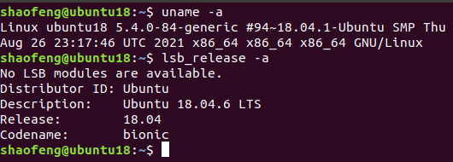
Linux
- Access linux(quick demo)
Locally access Linux: VirtualBox as an example
Download VirtualBox: https://www.virtualbox.org/wiki/Downloads
Download a ubuntu 18.04 image: Ubuntu 18.04.6 LTS (Bionic Beaver)
Check this guide for setting up your Linux VM: https://ubuntu.com/tutorials/how-to-run-ubuntu-desktop-on-a-virtual-machine-using-virtualbox
Note: adjust the amount of resources you allocate to the VM according to the capacity of your PC to avoid host starvation
Notes:
Already discussed in class, just briefly talk about the concepts and give you more concrete tips on getting your hands on using linux.
What is a linux
Why linux? What is the advantages of linux compared with Mac OS and windows

Slide 8
Linux
- Access linux
Problems you may encounter with VirtualBox and Ubuntu
Cannot copy from host and paste in VM, VM window is too small, …
Require add-on support to be manually installed(a lot of tutorials online)
Cannot open terminal by clicking or keyboard shortcut(ctrl+alt+t)
Use another terminal tool(i.e. xterm) and input “gnome-terminal”
Check and search the error message online(stackoverflow, google, …)
Account not in sudoers file
Input “su -” to switch to root
Alternatives for local access(please google detailed guide by yourself)
Use docker on your PC
Install a Linux distribution on your PC
Other questions can be searched with google(most questions relating linux set up can actually be found on the Internet) or asked on piazza
Notes:
Already discussed in class, just briefly talk about the concepts and give you more concrete tips on getting your hands on using linux.
What is a linux
Why linux? What is the advantages of linux compared with Mac OS and windows

Slide 9
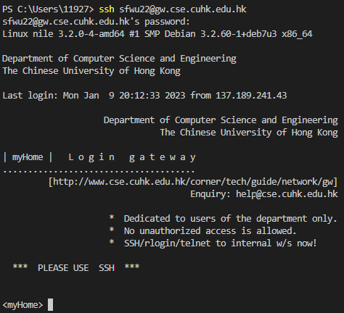
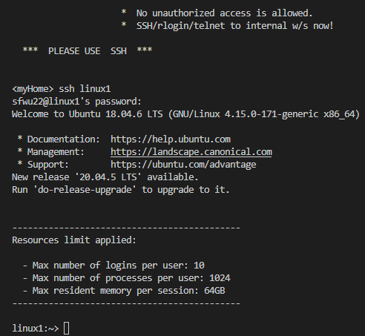
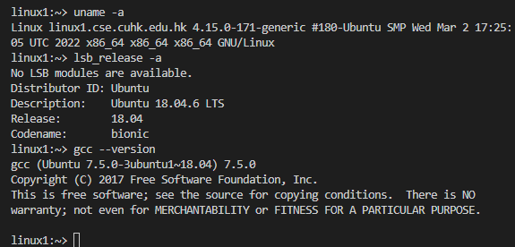
Linux
- Access linux(quick demo)
Remotely access Linux: CSE servers
Find a ssh client: putty, xshell, …
Input command “ssh YourUnixName@gw.cse.cuhk.edu.hk” and enter your password
Wait for prompt, then input “ssh linux[code]”, “[code]” could be 1~16
You can use “uname –a”, “lsb_release -a” and “gcc --version” to check for kernel version, ubuntu version and gcc version of the server.
ssh to gateway
ssh to linux server
connected
Notes:
Already discussed in class, just briefly talk about the concepts and give you more concrete tips on getting your hands on using linux.
What is a linux
Why linux? What is the advantages of linux compared with Mac OS and windows

Slide 10


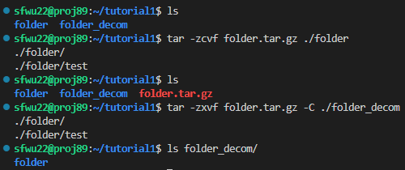
Linux
- Useful commands
Basic commands: cd, ls, ps, rm, mv, cp, cat, touch, mkdir…
To download some packages, i.e. git
apt-get install [package name]
To download resources from an url
wget [URL]
To transmit files from one host to another
scp [options] [username]@[ip address]:[remote_path_to_file] [local_path]
To compress/decompress files
file.tar.gz: .tar is the packing format of the folder, and .gz is a compressed format of the folder
-z for gzip, -c/-x for pack/unpack, -v for log, -f for file name
Pack and compress: tar –zcvf folder.tar.gz ./folder
Decompress and depack: tar –zxvf folder.tar.gz
Check man page for more details!
Notes:
Already discussed in class, just briefly talk about the concepts and give you more concrete tips on getting your hands on using linux.
What is a linux
Why linux? What is the advantages of linux compared with Mac OS and windows

Slide 11
C Programming
- Review
We have four examples covering the following aspects:
Structures: example1.c, example2.c
Memory allocation: example3.c
File I/O: example4.c
together with a slide from last year for reviewing C programming basics.
Directly use gcc examplex.c to compile and try with these simple examples.
Please check course page for downloading sources
Notes:
After setting linux, coding
Boring about these basics, so check if you forget and also search online. In this tutorial, I will discuss something that most students may not notice about C programming.

Slide 12
C Programming
- Additional tips: good project
// hellomain.c
#include “hellomake.h”
int main() {
// call a function in another file
myPrintHello();
return(0);
}
// hellofunc.c
#include <stdio.h>
void myPrintHello() {
// print content
printf("Hello from myPrintHello()!\n");
return;
}
What does a good project look like?
Comments are as important as code
Coding style
No unified standard
One possible style: https://www.gnu.org/prep/standards/html_node/Writing-C.html
Keep good source code structure
Use different .c to hold functions for different purposes
Defining structures in the right place
Public ones should be defined in headers(.h)
Private ones should be defined in .c
Use Makefile or other compiling tools to manage dependencies
…
Notes:
Only basics requirements,

Slide 13
/* list_example.c */
/* This is an example of using linux kernel list macros */
#include "list.h"
#include <stdio.h>
#include <stdlib.h>
typedef struct _my_list
{
struct list_head list;
}my_list;
typedef struct _my_list_entries{
int data;
struct list_head list_entry;
}my_list_entry;
int main(){
struct _my_list list1;
struct _my_list_entries entry1,entry2,entry3;
entry1.data = 1;
entry2.data = 2;
entry3.data = 3;
struct _my_list_entries *pentry, *tmp;
INIT_LIST_HEAD(&list1.list);
list_add(&entry1.list_entry,&list1.list);
list_add(&entry2.list_entry,&list1.list);
list_add(&entry3.list_entry,&list1.list);
list_for_each_entry_safe(pentry,tmp,&list1.list,list_entry){
printf("%d ",pentry->data);
}
printf("\n");
/* output: 3 2 1 */
return 0;
}
C Programming
- Additional tips: useful libraries
C is a little bit “low-level”
Try to use “wheels” to speed up and optimize your development of a “car”
One useful library example: Linux kernel list
The “list.h” is extracted from Linux source code, but you can use its APIs to link your structures in a list
Structure and APIs
struct list_head
INIT_LIST_HEAD(ptr)
list_add(struct list_head *new, struct list_head *head)
list_for_each_entry_safe(pos, n, head, member)
…
Other libraries
string.h
tailq
…
Check course website for the example’s source code
Notes:
Speed up – people have already implemented it for you
Optimize – the library may have good implementations. For example, list.h is implemented in macros, which will be very efficient

Slide 14

Gcc
- Concepts and basic usage
GNU Compiler Collections(gcc): optimized compilers for several languages(C, C++, …)
Quick usage: compiling and execute a C program
// hellomain.c
#include “hellomake.h”
int main() {
// call a function in another file
myPrintHello();
return(0);
}
// hellofunc.h
void myPrintHello();
// hellofunc.c
#include <stdio.h>
void myPrintHello() {
printf("Hello from myPrintHello()!\n");
return;
}
Notes:
Already discussed in class, just briefly talk about the concepts and give you more concrete tips on getting your hands on using linux.
What is a linux
Why linux? What is the advantages of linux compared with Mac OS and windows

Slide 15
Makefile
- Concepts and basic usage
Why use make system for compiling?
Easy compilation: make [targets] to represent a complex command
Manage dependencies: specify sources, headers, …
Automated linkage: relink when corresponding sources are updated
Makefile: rules for make command targets
Writing a Makefile
target ... : prerequisites ...
command
...
...
Target: objective file, executable, lable
Prerequisites: the dependencies of the target(files or other targets)
Command: the command for the target(arbitrary shell commands)
Notes:
Already discussed in class, just briefly talk about the concepts and give you more concrete tips on getting your hands on using linux.
What is a linux
Why linux? What is the advantages of linux compared with Mac OS and windows

Slide 16

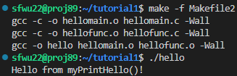

Approach 2:
Makefile
- Basic usage
CC=gcc
OBJ=hellomain.o hellofunc.o
CFLAGS=-Wall
hello: $(OBJ)
$(CC) -o hello $(OBJ) $(CFLAGS)
hellomain.o: hellomain.c hellofunc.h
$(CC) -c -o hellomain.o hellomain.c $(CFLAGS)
hellofunc.o: hellofunc.c
$(CC) -c -o hellofunc.o hellofunc.c $(CFLAGS)
clean:
rm -rf hello *.o
Makefile for the example project
Approach 1:
hello: hellomain.c hellofunc.c
gcc -o hello hellomain.c hellofunc.c -Wall
clean:
rm -rf hello *.o
Make with Makefile1 and run
Make with Makefile2 and run
Modify hellofunc.c and make again. Only modified dependencies will be executed again.
Extended reading:
use cmake to generate Makefile for you: https://cmake.org/cmake/help/latest/
Notes:
Already discussed in class, just briefly talk about the concepts and give you more concrete tips on getting your hands on using linux.
What is a linux
Why linux? What is the advantages of linux compared with Mac OS and windows

Slide 17

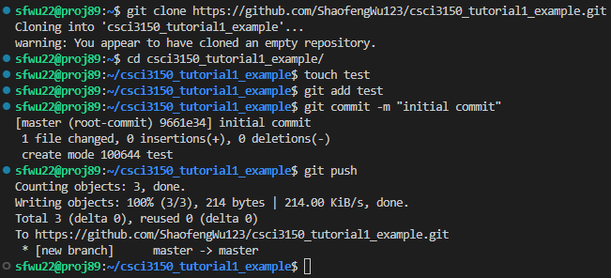
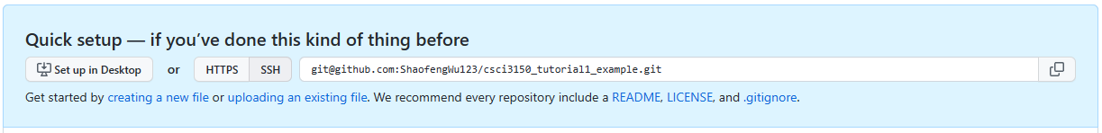
Git
- Concepts and basic usage(quick demo)
What is Git?
A version control tool
Github
An online source code hosting service that uses git
Using github and git to host your codes and collaborate with your group mates
Go to github and create a repo
Git clone the repo on your local machine
Git add
Git commit
Git push
Next time you start coding, git pull to get latest updates from collaborators
Reference: https://www.git-scm.com/book/en/v2

Slide 18
Thanks for your attention!
Q&A

Slide 19
Backup slides

