Slide 1
Tutorial for Assignment One:
Background Knowledge and Code Walk
CSCI3150 Introduction to Operating Systems, Spring 2023
Shaofeng Wu
wsf123@link.cuhk.edu.hk
Jan 19, 2023

Slide 2
Assignment Overview
In assignment one, you are required to implement a simple shell program.
Before you start coding, you need to know:
How to compile and run the program?
How does the framework we provided work?
The behavior of a real shell
The code logic of our program
How to verify that your program really works?
Today’s tutorial will take about 30 minutes

Slide 3
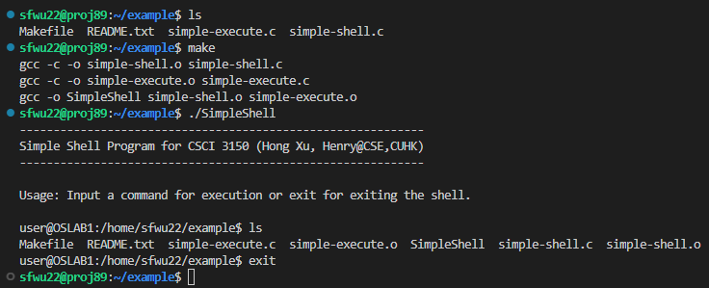
Compile and Run
How to compile and run
Use “make” command to compile
Use “./SimpleShell” to run your compiled program
Note: The source code we provided is incomplete
You can successfully compile with the sources we provide, but the program only supports one command “exit”
Your task is to add other commands to the incomplete framework, or implement in your own framework
Example of compiling and running the program

Slide 4
Compile and Run
- About the Makefile
CC=gcc
OBJ=simple-shell.o simple-execute.o
SimpleShell: $(OBJ)
$(CC) -o SimpleShell $(OBJ)
simple-shell.o: simple-shell.c
$(CC) -c -o simple-shell.o simple-shell.c
simple-execute.o: simple-execute.c
$(CC) -c -o simple-execute.o simple-execute.c
clean:
rm *.o SimpleShell
It is OK to modify this Makefile for your convenience
We will use the original version of Makefile when grading

Slide 5
Background
- Shell behaviors (quick demo)
Shell is?
A computer program that exposes an operating system's services to a human user or other programs
Each shell is a process
Use “echo $$” to check the process id
Use “ps –aux | grep PID” to check the process information
The shell that most people talk about is bash shell

Slide 6
Background
- Shell behaviors (quick demo)
An important feature of Linux shell
Builtin commands: cd, echo, …
Executed in the main process of shell
External commands: ls, find, …
Key difference
Builtin commands are executed in main process of shell
External commands are executed in a child process of the shell
Disclaimer: for bash shell, for single command
Notes:
So why does this difference matter? We will provide more explanations

Slide 7
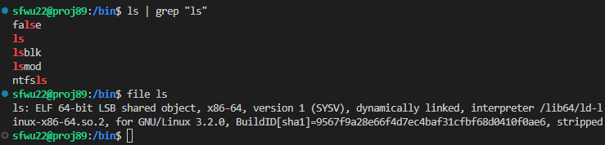
Background
- External commands (quick demo)
External commands are executed in a child process with their own pre-built binaries
Where are these binaries?
In “/bin”, “/usr/bin”, etc., they have binaries for different purposes
One take-away here: your own binary can also be a command
Notes:
Show “sudo find –name xxx” with “top” command

Slide 8
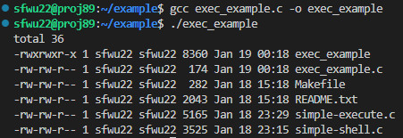
Background
- External commands
System call for executing binaries in a process
int execvp(const char *file, char *const argv[])
Notes
execvp() replaces the current process image with a new process image
The first argument should point to the filename associated with the file being executed
The second argument should be the entire command
The array of pointers must be terminated by a NULL pointer
/* exec_example.c */
#include <stdlib.h>
#include <unistd.h>
int main(){
char *file_name = "ls";
char *argv[3] = {"ls","-l",NULL};
execvp(file_name,argv);
return 0;
}

Slide 9
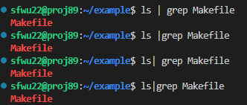

Background
- Pipe
Shell has the following meta characters
\ / < > ! $ % ^ & * | { } [ ] " ' ` ~ ;
Pipe(|) is a feature that Linux shell provides to redirect command output to another command(use “man 7 pipe” in your shell to check details)
Notes
Space before and after pipe
In bash shells, space before and after pipe does not affect semantics(we do not require this in asg1)
Several pipes
Builtin commands with pipes: builtin commands will be executed in child process in this case
(this behavior is required in asg1)

Slide 10

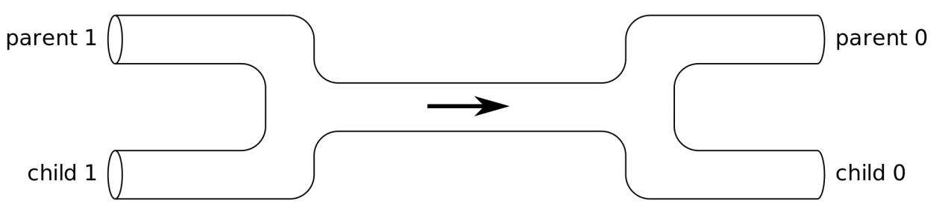
Background
- Pipe
System call for pipe creation
int pipe(int pipefd[2])
Pipe characteristics
Unidirectional
“Half-duplex”
Byte-stream
How does the reader know EOF?
IPC between related processes(fork())
Notes for correctly using pipe
Always close the un-used read/write end of a pipe
fork()
close()

Slide 11
Code Walk
- What you have before coding
Directory structure
src
Makefile: specify make rules
README.txt: explanations and some test cases
simple-shell.c: no need to modify
simple-execute.c: your workspace here

Slide 12
int main(void)
{
/* Print some welcoming info here */
/* Initialize space here*/
/* The main loop for shell */ while(1){
//Print the prompt
getcwd(dir_buf,128);
printf("user@OSLAB1:%s$ ",dir_buf);
fflush(stdout);
// Intialize command line & command args
memset(cmd_line, 0 , MAX_LINE_SIZE);
memset(cmd_args, 0 , MAX_ARG_NUM);
//Read the input command line
if( ( char_num = shell_read_line(cmd_line)) <= 0 ){
//If no argument or too many arguments, no execution and continue
continue;
}else{
//Get the arguments
if( (argc = get_line_args(cmd_line, cmd_args)) <= 1){
//"NULL" as the input or have error
printf("Error: Not effective command.\n");
continue;
}
if ( (status = shell_execute(cmd_args, argc)) < 0 )
break;
}
}
/* Free Initialized spaces*/
return 0;
}
Code Walk
- simple-shell.c
In simple-shell.c
main() function
Command and argument parsers
int shell_read_line(char *);
int get_line_args(char *, char **);
Check details in source code and a documentation we provide on course website

Slide 13
Code Walk
- simple-execute.c
/* shell_execute - Function to execute the command with specified command content and command arguments.
* @args String array with command and its arguments.
* @argc Total number of strings including the command, its arguments and the NULL in the end
*/
int shell_execute(char ** args, int argc){
int child_pid, wait_return, status;
/* Execute built-in commands */
/* exit */
if(strcmp(args[0], "exit") == 0 ){
return -1;
}
/* TODO: cd */
/* Non-built-in commands. These commands should be executed in a child process so the parent process can continue to invoke other commands */
/* One command without pipe */
if((child_pid = fork()) < 0){
printf("fork() error \n");
}
else if(child_pid == 0 ){
/* TODO: execute the command and check if the command is correctly executed */
}
/* TODOs: one pipe and two pipes */
/* wait for child process to terminate */
while((wait_return = wait(&status)) > 0);
return 0;
}
In simple-shell.c
int shell_execute(char ** args, int argc);
Arguments
Args: pointer to the pointer array of parsed command
Argc: number of parsed items
For example, input “ls –l” and enter
Args = {“ls”, “-l”}
Argc = 3
Return value
0 for next loop(normal execution)
-1 for break loop(error or exit)

Slide 14
Code Walk
- simple-execute.c
/* shell_execute - Function to execute the command with specified command content and command arguments.
* @args String array with command and its arguments.
* @argc Total number of strings including the command, its arguments and the NULL in the end
*/
int shell_execute(char ** args, int argc){
int child_pid, wait_return, status;
/* Execute built-in commands */
/* exit */
if(strcmp(args[0], "exit") == 0 ){
return -1;
}
/* TODO: cd */
/* Non-built-in commands. These commands should be executed in a child process so the parent process can continue to invoke other commands */
/* One command without pipe */
if((child_pid = fork()) < 0){
printf("fork() error \n");
}
else if(child_pid == 0 ){
/* TODO: execute the command and check if the command is correctly executed */
}
/* TODOs: one pipe and two pipes */
/* wait for child process to terminate */
while((wait_return = wait(&status)) > 0);
return 0;
}
In simple-shell.c
Code logic:
Single builtin command
In main process
Single external command
In child process
Multiple commands with pipes
Each one in one child process
Hint
Use what we have mentioned in this tutorial: execvp(), pipe()
And other necessary system calls: dup2(), close(), …
to implement your simple shell

Slide 15
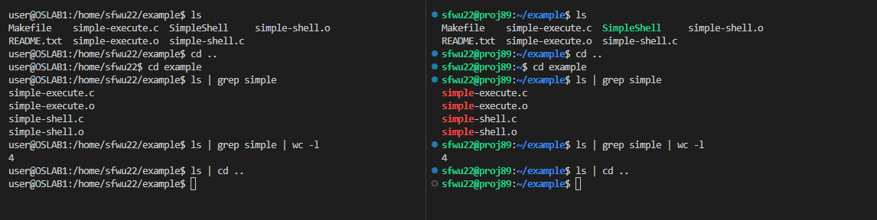
Verify Your Program
Basic test cases are provided in README.txt
Compare the result of your program with results from bash shell
Bash shell commands are a superset of our simple shell
The grading will be testcase-based
The compilation passes, you get its point
One test case passes, you get the point of this test case
SimpleShell
Bash shell

Slide 16
Thanks for your attention!
Q&A

Slide 17
Quiz Session - 1

