Slide 1
Operating Systems CSCI 3150
Lecture 6: Synchronization (II) -- Semaphores and Monitors
Hong Xu
https://github.com/henryhxu/CSCI3150

Slide 2
Higher-Level Synchronization
We looked at using locks to provide mutual exclusion
Locks work, but they have some drawbacks when critical regions are long
Spinlocks – inefficient
Disabling interrupts – can miss or delay important events
Instead, we want synchronization mechanisms that
Block waiters
Leave interrupts enabled inside the critical section
Look at two common high-level mechanisms
Semaphores: binary (mutex) and counting
Monitors: mutexes and condition variables
Use them to solve common synchronization problems

Slide 3

Semaphores
Semaphores are an abstract data type that provide mutual exclusion to critical region
Semaphores can also be used as atomic counters
More later
Semaphores are integers that support two operations:
wait(semaphore): decrement, block until semaphore is open
Also P(), after the Dutch word for test, or down()
signal(semaphore): increment, allow another thread to enter
Also V() after the Dutch word for increment, or up()
That's it! No other operations – not even just reading its value – exist
P and V are probably the most unintuitive names you encounter in this course
and you have Edsger W. Dijkstra to thank to LOL
Semaphore safety property: the semaphore value is always greater than or equal to 0
Dijkstra

Slide 4
Blocking in Semaphores
Associated with each semaphore is a queue of waiting processes/threads
When P() is called by a thread:
If semaphore is open (> 0), thread continues
If semaphore is closed, thread blocks on queue
Then V() opens the semaphore:
If a thread is waiting on the queue, the thread is unblocked
What if multiple threads are waiting on the queue?
If no threads are waiting on the queue, the signal is remembered for the next thread
In other words, V() has “history” (c.f., condition vars later)
This “history” is a counter

Slide 5
Semaphores in OS161
P(sem) {
Disable interrupts;
while (sem->count == 0) {
thread_sleep(sem); /* current thread
will sleep on this sem */
}
sem->count--;
Enable interrupts;
}
V(sem) {
Disable interrupts;
sem->count++;
thread_wakeup (sem); /* this will wake
up all the threads waiting on this
sem. Why wake up all threads? */
Enable interrupts;
}
thread_sleep() assumes interrupts are disabled
Note that interrupts are disabled only to enter/leave critical section
How can it sleep with interrupts disabled?
What happens if “while (sem->count ==0)” is an “if (sem->count != 0)”?
Notes:
- What happens if “while (sem->count ==0)” is an “if (sem->count != 0)”?
- A: Need to check if other threads have already used up the resources

Slide 6
Semaphore Types
Semaphores come in two types
Mutex semaphore (or binary semaphore)
Represents single access to a resource
Guarantees mutual exclusion to a critical section
Counting semaphore (or general semaphore)
Represents a resource with many units available, or a resource that allows certain kinds of unsynchronized concurrent access (e.g., reading)
Multiple threads can pass the semaphore (P)
Number of threads determined by the semaphore “count”
mutex has count = 1, counting has count = N

Slide 7
Using Semaphores
Use is similar to our locks, but semantics are different
struct Semaphore {
int value;
Queue q;
} S;
withdraw (account, amount) {
P(S);
balance = get_balance(account);
balance = balance – amount;
put_balance(account, balance);
V(S);
return balance;
}
P(S);
balance = get_balance(account);
balance = balance – amount;
P(S);
Threads block
P(S);
critical section
put_balance(account, balance);
V(S);
…
V(S);
It is undefined which thread runs after a signal
…
V(S);

Slide 8
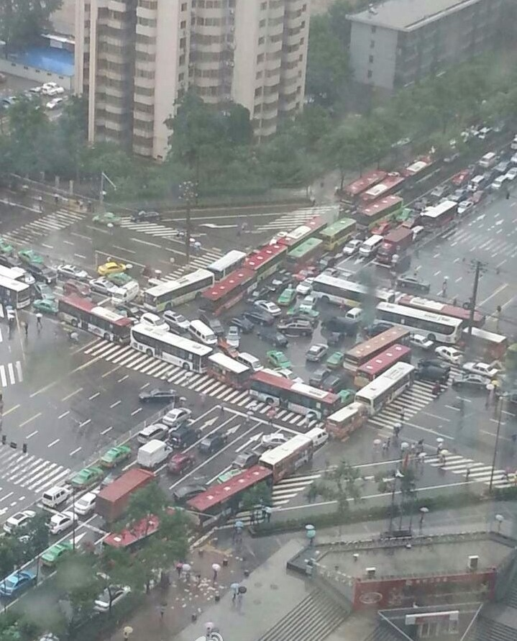

Possible Deadlocks with Semaphores
Example:
Thread 1:
P(S);
P(Q);
.. ..
V(Q);
V(S);
Thread 2:
P(Q);
P(S);
.. ..
V(S);
V(Q);
share two mutex semaphores S and Q
S:= 1; Q:=1;

Slide 9
Semaphore Summary
Semaphores can be used to solve any of the traditional synchronization problems
However, they have some drawbacks
They are essentially shared global variables
Can potentially be accessed anywhere in program
No connection between the semaphore and the data being controlled by the semaphore
No control or guarantee of proper usage
Sometimes hard to use and prone to bugs
Another approach: Use programming language support

Slide 10
Monitors
A monitor is a programming language construct that controls access to shared data
Synchronization code added by compiler, enforced at runtime
Why is this an advantage?
A monitor is a module that encapsulates
Shared data structures
Procedures that operate on the shared data structures
Synchronization between concurrent threads that invoke the procedures
A monitor protects its data from unstructured access
It guarantees that threads accessing its data through its procedures interact only in legitimate ways

Slide 11
Monitor Semantics
A monitor guarantees mutual exclusion
Only one thread can execute any monitor procedure at any time (the thread is “in the monitor”)
If a second thread invokes a monitor procedure when a first thread is already executing one, it blocks
So the monitor has to have a wait queue…
If a thread within a monitor blocks, another one can enter
Condition Variable
What are the implications in terms of parallelism in monitor?

Slide 12
Account Example
withdraw(amount)
balance = balance – amount;
Monitor account {
double balance;
double withdraw(amount) {
balance = balance – amount;
return balance;
}
}
Threads block waiting to get into monitor
withdraw(amount)
withdraw(amount)
return balance (and exit)
balance = balance – amount
return balance;
When first thread exits, another can enter. Which one is undefined.
balance = balance – amount;
return balance;
Hey, that was easy
But what if a thread wants to wait inside the monitor?

Slide 13
Condition Variables
A condition variable is associated with a condition needed for a thread to make progress once it is in the monitor.
Monitor M {
... monitored variables
Condition c;
void enter_mon (...) {
if (extra property not true) wait(c); waits outside of the monitor's mutex
do what you have to do
if (extra property true) signal(c); brings in one thread waiting on condition
}

Slide 14
Condition Variables
Condition variables support three operations:
Wait – release monitor lock, wait for C/V to be signaled
So condition variables have wait queues, too
Signal – wakeup one waiting thread
Broadcast – wakeup all waiting threads
Condition variables are not boolean objects
“if (condition_variable) then” … does not make sense
“if (num_resources == 0) then wait(resources_available)” does
An example will make this more clear

Slide 15
Condition Vars != Semaphores
Condition variables != semaphores
However, they each can be used to implement the other
Access to the monitor is controlled by a lock
wait() blocks the calling thread, and gives up the lock
To call wait, the thread has to be in the monitor (hence has lock)
Semaphore::P just blocks the thread on the queue
signal() causes a waiting thread to wake up
If there is no waiting thread, the signal is lost
Semaphore::V increases the semaphore count, allowing future entry even if no thread is waiting
Condition variables have no history

Slide 16
Locks and Condition Vars
A C.V. allows a thread to be signaled when some condition is satisfied. By itself, mutex (and lock) doesn’t do this.
A queue of items to work on
Use a lock to ensure mutex to access the queue
Need C.V. to tell a consumer thread that the queue is non-empty or empty
Otherwise, threads have to poll the queue…

Slide 17
Using Semaphores
We’ve looked at a simple example for using synchronization
Mutual exclusion while accessing a bank account
Now we’re going to use semaphores to look at more interesting examples
Readers/Writers
Bounded Buffers (after we discuss Monitor)

Slide 18
Readers/Writers Problem
Readers/Writers Problem:
An object is shared among several threads
Some threads only read the object, others only write it
We can allow multiple readers but only one writer
Let #r be the number of readers, #w be the number of writers
Safety: (#r ≥ 0) ∧ (0 ≤ #w ≤ 1) ∧ ((#r > 0) ⇒ (#w = 0))
How can we use semaphores to control access to the object to implement this protocol?

Slide 19
First write operational code
reader {
read;
}
writer {
Write;
}
Does it work?
Why?

Slide 20
First attempt: one mutex semaphore
// exclusive writer or reader
Semaphore w_or_r = 1;
reader {
P(w_or_r); // lock out writers
read;
V(w_or_r); // up for grabs
}
writer {
P(w_or_r); // lock out readers
Write;
V(w_or_r); // up for grabs
}
Does it work?
Why?
Which condition is satisfied and
which is not?
(#r ≥ 0)
(0 ≤ #w ≤ 1)
((#r > 0) ⇒ (#w = 0))

Slide 21
Second attempt: add a counter
int readcount = 0; // record #readers
Semaphore w_or_r = 1; // mutex semaphore
reader {
readcount++;
if (readcount == 1){
P(w_or_r); // lock out writers
}
read;
readcount--;
if (readcount == 0){
V(w_or_r); // up for grabs
}
}
writer {
P(w_or_r); // lock out readers
Write;
V(w_or_r); // up for grabs
}
Does it work?
readcount is a shared variable,
who protects it?
Thread 1: Thread 2:
reader {
readcount++;
reader {
readcount++;
if (readcount == 1){
P(w_or_r);
}
if (readcount == 1){
P(w_or_r);
}
context switch
A context switch can happen, a writer can come in since no reader locked the semaphore!
Notes:
idea: use a counter to count the # of readers.
readcount++;
readcount++;
if (readcount == 1) // at this moment, readcount == 2…

Slide 22
Readers/Writers Real Solution
Use three variables
int readcount – number of threads reading object
Semaphore mutex – control access to readcount
Semaphore w_or_r – exclusive writing or reading

Slide 23
Readers/Writers
// number of readers
int readcount = 0;
// mutual exclusion to readcount
Semaphore mutex = 1;
// exclusive writer or reader
Semaphore w_or_r = 1;
writer {
P(w_or_r); // lock out readers
Write;
V(w_or_r); // up for grabs
}
reader {
P(mutex); // lock readcount
readcount += 1; // one more reader
if (readcount == 1)
P(w_or_r); // synch w/ writers
V(mutex); // unlock readcount
Read;
P(mutex); // lock readcount
readcount -= 1; // one less reader
if (readcount == 0)
V(w_or_r); // up for grabs
V(mutex); // unlock readcount}
}
Why do readers use mutex?
What if the V(mutex) is above “if (readcount == 1)”?

Slide 24
But it still has a problem…
// number of readers
int readcount = 0;
// mutual exclusion to readcount
Semaphore mutex = 1;
// exclusive writer or reader
Semaphore w_or_r = 1;
writer {
P(w_or_r); // lock out readers
Write;
V(w_or_r); // up for grabs
}
reader {
P(mutex); // lock readcount
readcount += 1; // one more reader
if (readcount == 1)
P(w_or_r); // synch w/ writers
V(mutex); // unlock readcount
Read;
P(mutex); // lock readcount
readcount -= 1; // one less reader
if (readcount == 0)
V(w_or_r); // up for grabs
V(mutex); // unlock readcount}
}

Slide 25

Problem: Starvation
What if a writer is waiting, but readers keep coming, the writer is starved

Slide 26
Semaphore Questions
Are there any problems that can be solved with counting semaphores that cannot be solved with mutex semaphores?
If a system provides only mutex semaphores, can you use it to implement a counting semaphores?
When to use counting semaphore?
Problem needs a counter
The maximum value is known (bounded)

Slide 27
Monitor Readers and Writers
Will have four methods: StartRead, StartWrite, EndRead and EndWrite
Monitored data: nr (number of readers) and nw (number of writers) with the monitor invariant
(nr ≥ 0) ∧ (0 ≤ nw ≤ 1) ∧ ((nr > 0) ⇒ (nw = 0))
Two conditions:
canRead: nw = 0
canWrite: (nr = 0) ∧ (nw = 0)

Slide 28
Monitor Readers and Writers
Monitor RW { int nr = 0, nw = 0; Condition canRead, canWrite;
void StartRead () {
while (nw != 0) do wait(canRead);
nr++;
}
void EndRead () {
nr--;
}
void StartWrite {
while (nr != 0 || nw != 0) do wait(canWrite);
nw++;
}
void EndWrite () {
nw--;
}
} // end monitor
broadcast(canRead); signal(canWrite);
if (nr == 0) signal(canWrite);

Slide 29
Monitor Readers and Writers
Is there any priority between readers and writers?
What if you wanted to ensure that a waiting writer would have priority over new readers?

Slide 30
Bounded Buffer
Problem: There is a set of resource buffers shared by producer and consumer threads
Producer inserts resources into the buffer set
Output, disk blocks, memory pages, processes, etc.
Consumer removes resources from the buffer set
Whatever is generated by the producer
Producer and consumer execute at different rates
No serialization of one behind the other
Tasks are independent (easier to think about)
The buffer set allows each to run without explicit handoff
Safety:
Sequence of consumed values is prefix of sequence of produced values
If nc is number consumed, np number produced, and N the size of the buffer, then 0 ≤ np − nc ≤ N

Slide 31
Bounded Buffer (2) – functional code
producer {
while (1) {
Produce new resource;
Add resource to an empty buffer;
}
}
consumer {
while (1) {
Remove resource from a full buffer;
Consume resource;
}
}

Slide 32
Bounded Buffer (3)
Use three semaphores:
empty – count of empty buffers
Counting semaphore
empty = N – (np – nc)
full – count of full buffers
Counting semaphore
np - nc = full
mutex – mutual exclusion to shared set of buffers
Binary semaphore

Slide 33
Bounded Buffer (4)
Semaphore mutex = 1; // mutual exclusion to shared set of buffers
Semaphore empty = N; // count of empty buffers (all empty to start)
Semaphore full = 0; // count of full buffers (none full to start)
producer {
while (1) {
Produce new resource;
P(empty); // wait for empty buffer
P(mutex); // lock buffer list
Add resource to an empty buffer;
V(mutex); // unlock buffer list
V(full); // note a full buffer
}
}
consumer {
while (1) {
P(full); // wait for a full buffer
P(mutex); // lock buffer list
Remove resource from a full buffer;
V(mutex); // unlock buffer list
V(empty); // note an empty buffer
Consume resource;
}
}

Slide 34
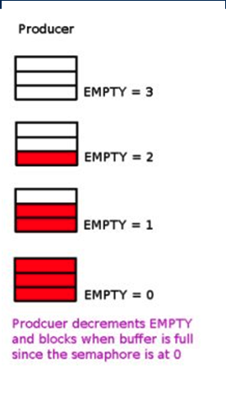
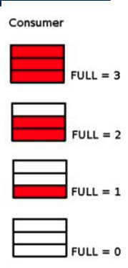
Bounded Buffer (5)
Consumer decrements FULL and blocks when buffer has no item since the semaphore FULL is at 0

Slide 35
Bounded Buffer (6)
Why we need both “empty” and “full” semaphores?
Semaphore mutex = 1; // mutual exclusion to shared set of buffers
Semaphore empty = N; // count of empty buffers (all empty to start)
Semaphore full = 0; // count of full buffers (none full to start)
producer {
while (1) {
Produce new resource;
P(empty); // wait for empty buffer
P(mutex); // lock buffer list
Add resource to an empty buffer;
V(mutex); // unlock buffer list
V(full); // note a full buffer
}
}
consumer {
while (1) {
P(full); // wait for a full buffer
P(mutex); // lock buffer list
Remove resource from a full buffer;
V(mutex); // unlock buffer list
V(empty); // note an empty buffer
Consume resource;
}
}
More consumers “remove resource” than actually produced!

Slide 36
Monitor Bounded Buffer
Monitor bounded_buffer {
Resource buffer[N];
// Variables for indexing buffer
// monitor invariant involves these vars
Condition not_full; // space in buffer
Condition not_empty; // value in buffer
void put_resource (Resource R) {
while (buffer array is full)
wait(not_full);
Add R to buffer array;
signal(not_empty);
}
Resource get_resource() {
while (buffer array is empty)
wait(not_empty);
Get resource R from buffer array;
signal(not_full);
return R;
}
} // end monitor
What happens if no threads are waiting when signal is called?
Signal is lost

Slide 37
Monitor Queues
Monitor bounded_buffer {
Condition not_full;
…other variables…
Condition not_empty;
void put_resource () {
…wait(not_full)…
…signal(not_empty)…
}
Resource get_resource () {
…
}
}
Waiting to enter
Waiting on condition variables
Executing inside the monitor

Slide 38
Summary
Semaphores
P()/V() implement blocking mutual exclusion
Also used as atomic counters (counting semaphores)
Can be inconvenient to use
Monitors
Synchronizes execution within procedures that manipulate encapsulated data shared among procedures
Only one thread can execute within a monitor at a time
Relies upon high-level language support
Condition variables
Used by threads as a synchronization point to wait for events
Inside monitors
https://github.com/henryhxu/CSCI3150

