Slide 1
EHRSQL: A Practical Text-to-SQL Benchmark for Electronic Health Records
Justin Quach

Slide 2
Introduction
Generate SQL queries from electronic health data
Answer time-sensitive questions (question answering)
Distinguishes answerable and unanswerable queries (in this case, the query will generate NULL)
Perform evaluations with varying threshold values

Slide 3
Motivation
Potentially use patient information to make better clinical decisions (less prone to errors in decision-making)
Potentially be able to perform real-life deployment of question answering with the use of SQL queries
Potentially be able to do quick lookup-times to generate accurate SQL queries given a question template

Slide 4
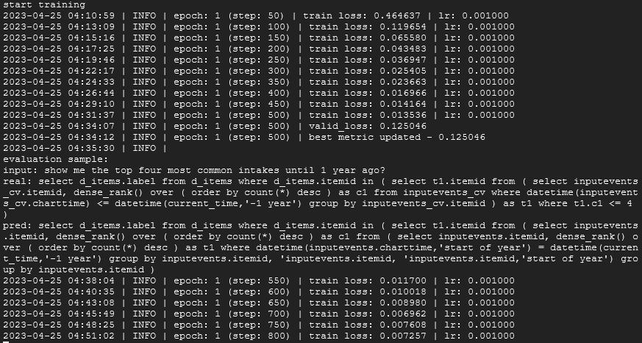
Brief Set-up

Slide 5
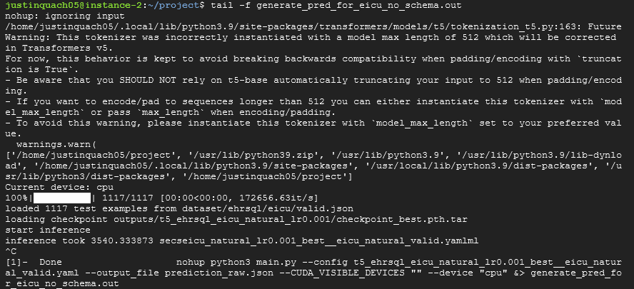
Brief Set-up (Cont.)

Slide 6
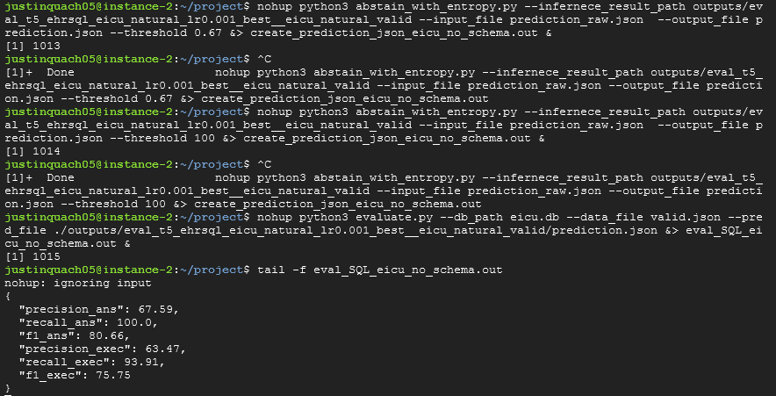
Brief Set-up (Cont.)

Slide 7
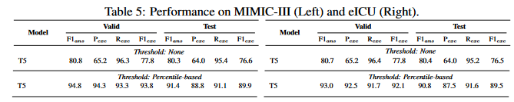




Findings
100000 steps
Threshold Value:
-1 (none)
100000 steps
Threshold Value:
0.67 (percentile-based)
100000 steps
Threshold Value:
-1 (none)
100000 steps
Threshold Value:
0.67 (percentile-based)

Slide 8
Conclusion
It is possible to reproduce this paper to the extent of which is possible
I was unable to make use of the T5 + Schema due to not having access to an API_KEY for the prompt codex
Users can test different threshold values and see which one best fits their current hospital needs (refer to my GitHub for more information on the varying threshold values)
Since these questions reflect actual hospital needs, the resulting SQL queries can generate accurate SQL tables
These tables can provide insightful information on how to approach patient care and improve their electronic health record database

