Slide 1
Climatological Change of Temperature mean, extremes, and autocorrelation by region

Slide 2
Temperature Change Metrics |  | Why
Mean temperature |  | Most widely used metrics for studying climate change
Lowest temperature | Temperature value | General trend of climate, animals rely on cold temperature
 | Extremely cold days | Public opinion
Highest temperature | Temperature value
 | Extremely hot days | Impact animal and agriculture
 | Unseasonably hot days in winter | Animal Hibernation, public opinion
Winter and Summer temperature autocorrelation | Two days | Higher temperature autocorrelation prolongs heat wave or cold snaps and increase animal extinction risk[1]
 | Four days

Slide 3
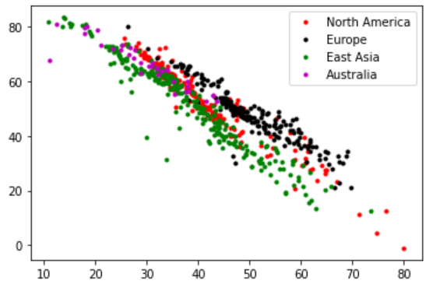
Mean Temperature
Mean Temp (F)
Latitude
Take away: Mean temp reduce almost linearly wrt latitude. Different continents follow slightly different trend.

Slide 4
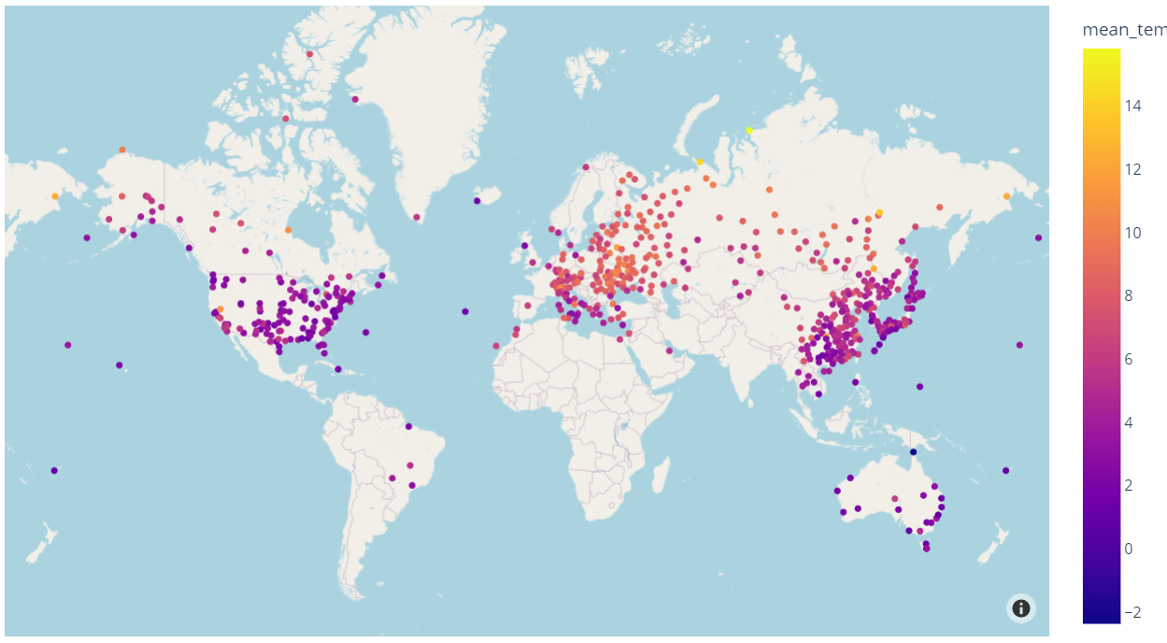
Mean Temperature Trend

Slide 5
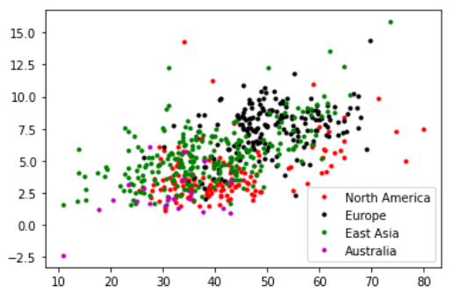
Mean Temperature Trend
 | North America | Europe | Asia | Australia
change per century | 4.0 | 7.5 | 5.3 | 2.3
Percentage of station with trend (p>0.05) | 79% | 98% | 96% | 63%
Different than NA |  | 4.5e-44 | 3.4e-9 | 2.4e-4
Take away:
North America less than Europe and Asia, but faster than Australia
Longitude might be one contribution factor

Slide 6
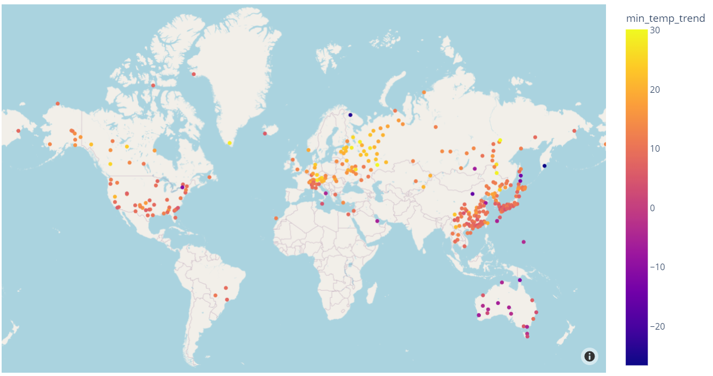
Lowest Temperature Trend

Slide 7
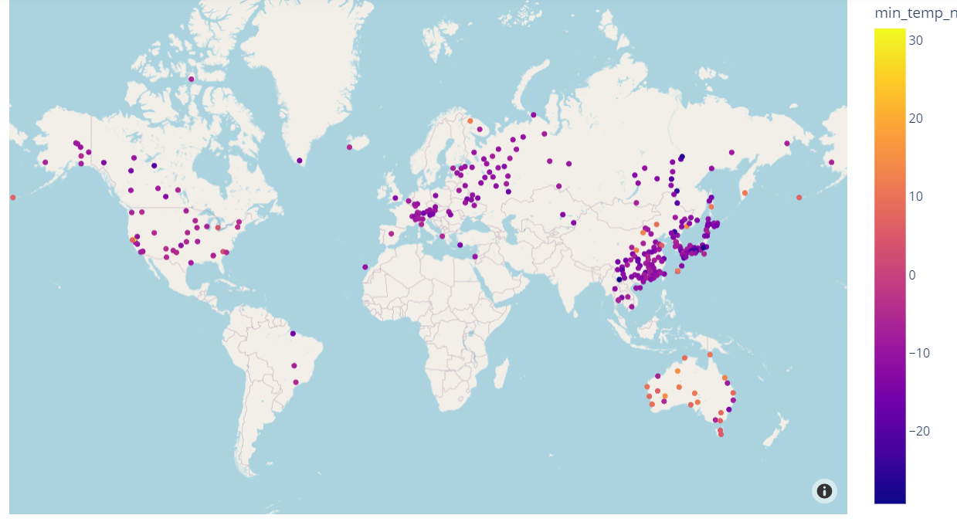
Trend of extremely cold days

Slide 8
Lowest Temperature Trend
 |  | North America | Europe | Asia | Australia
Lowest Temperature Value | change per century | 11.4 | 16.4 | 10.3 | -1.6
 | Percentage of station with trend (p>0.05) | 32% | 45% | 63% | 51%
 | Different than NA |  | 7.6e-5 | 0.23 | 1.7e-12
Trend of Extreme Low Temperature Days | change per century | -5.7 | -9.6 | -10.9 | 5.4
 | Percentage of station with trend (p>0.05) | 25% | 36% | 64% | 71%
 | Different than NA |  | 3e-4 | 6.8e-6 | 1.4e-7
Take away:
Reduction of extremely cold days globally and increment of lowest temperature
Europe’s reduction of extremely cold days faster than other continents, with Australia the opposite.

Slide 9
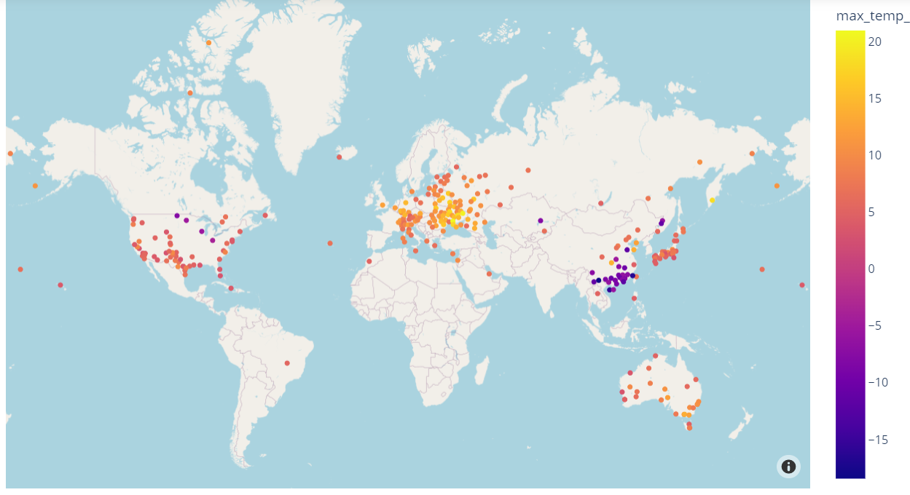
Highest Temperature Trend

Slide 10
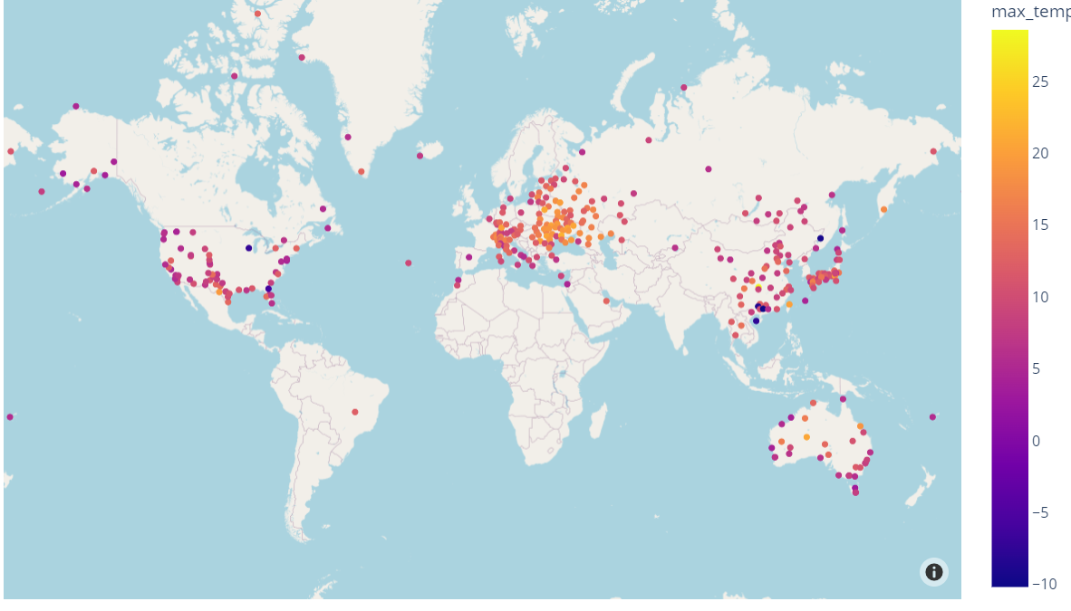
Trend of extremely hot days

Slide 11
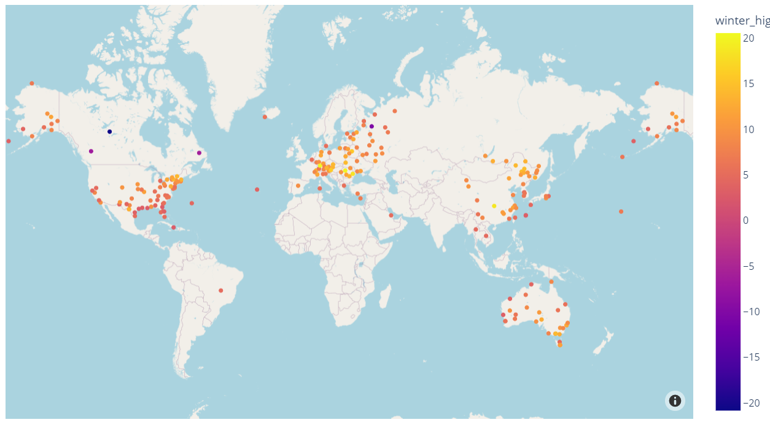
Trend of highest winter temperature

Slide 12
Highest Temperature Trend
 |  | North America | Europe | Asia | Australia
High Temperature Value | change per century | 5.1 | 10.8 | 1.54 | 8.0
 | Percentage of station with trend (p<0.05) | 32% | 65% | 29% | 77%
 | Different than NA |  | 2.4e-20 | 2.5e-3 | 2.8e-4
Trend of Extreme Hot Days | change per century | 8.0 | 13.6 | 9.8 | 9.0
 | Percentage of station with trend (p>0.05) | 40% | 74% | 40% | 91.4%
 | Different than NA |  | 3.7e-8 | 0.014 | 0.23
Winter High | change per century | 6.5 | 9.5 | 9.2
 | Percentage of station with trend (p>0.05) | 37% | 36% | 18%
 | Different than NA |  | 3.6e-4 | 2.9e-3

Slide 13
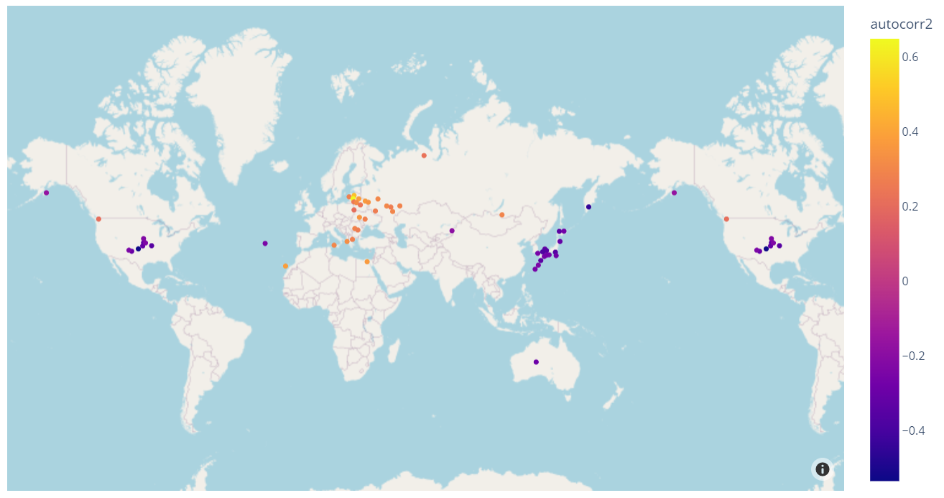
Dec-Feb Temperature Autocorrelation (lag 2)

Slide 14
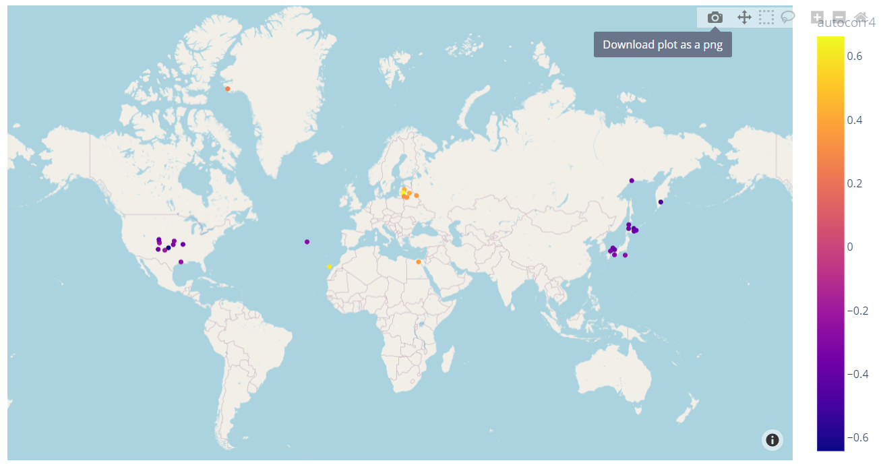
Dec-Feb Temperature Autocorrelation (lag 4)

Slide 15
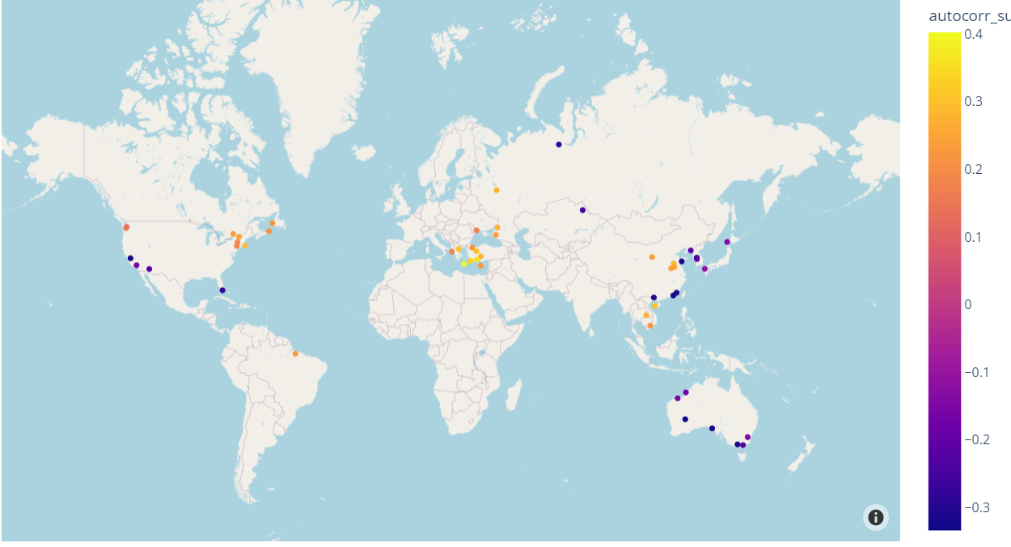
Jun-Aug Temperature Autocorrelation (lag 2)

Slide 16
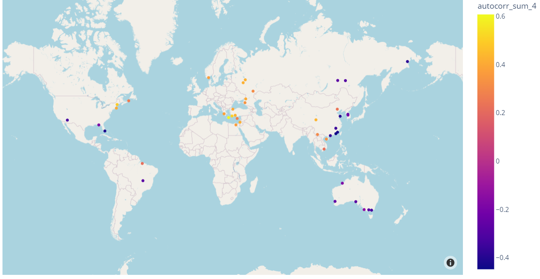
Jun-Aug Temperature Autocorrelation (lag 4)

Slide 17
Temperature Autocorrelation
 |  | North America | Europe | Asia | Australia
Dec-Feb Lag 2 | change per century | -0.24 | 0.32 | -0.27 | -0.29
 | Percentage of station with trend (p>0.05) | 5.3% | 13% | 8% | 3%
 | Different than NA |  | 1.33e-13 | 0.68
Dec-Feb Lag 4 | change per century | -0.27 | 0.41 | -0.37
 | Percentage of station with trend (p>0.05) | 6% | 4% | 5%
 | Different than NA |  | 8.3e-7 | 0.122
Jun-Aug Lag 2 | change per century | 0.07 | 0.23 | -0.03 | -0.23
 | Percentage of station with trend (p>0.05) | 7% | 7% | 7% | 20%
 | Different than NA |  | 0.03 | 0.25 | 0.003
Jun-Aug Lag 4 | change per century | 0.04 | 0.4 | -0.13 | -0.24
 | Percentage of station with trend (p>0.05) | 3% | 8% | 6% | 17%
 | Different than NA |  | 0.003 | 0.33 | 0.12

Slide 18
Di Cecco, G.J., Gouhier, T.C. Increased spatial and temporal autocorrelation of temperature under climate change. Sci Rep 8, 14850 (2018). https://doi.org/10.1038/s41598-018-33217-0

