Slide 1
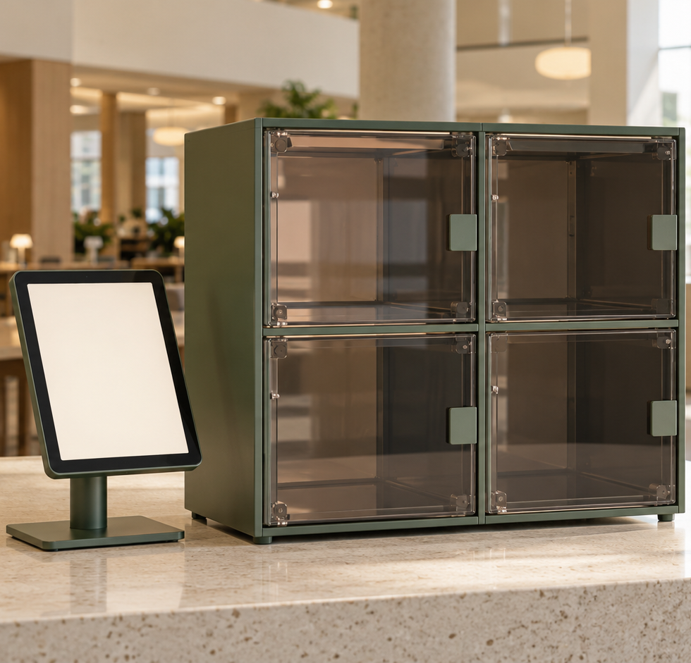
Found
AI-assisted campus
lost and found
iPad terminal, Raspberry Pi
and four storage compartments
COMP728 · Assessment 2
Final project presentation · October 2026
AI-generated concept illustration
Notes:
Presenter 1, slides 1–3, total 3 minutes. Slide 1 target: 30 seconds.
English script: Our project is Found, a fixed lost-and-found station for a university campus. Visitors use a shared iPad to register a found item or describe something they have lost. A Raspberry Pi manages the records and four storage compartments. Cloud AI helps describe and search the items. We focus on the complete handover, including what happens when a request fails.
中文提示：这是固定站点终端，不是给每位学生安装的个人 App。封面是概念图，不是实物照片。
Sources: https://github.com/Justmao1/Found/blob/main/README.md
Repository snapshot: f0921903a2f17b1053a8f8b560ee1696e4ea99e7, accessed 22 October 2026. Assessment source: Assessment Two Brief-3(1)(2).pdf, Presentation section. All test counts are reported by repository verification records, not rerun for this deck.

Slide 2
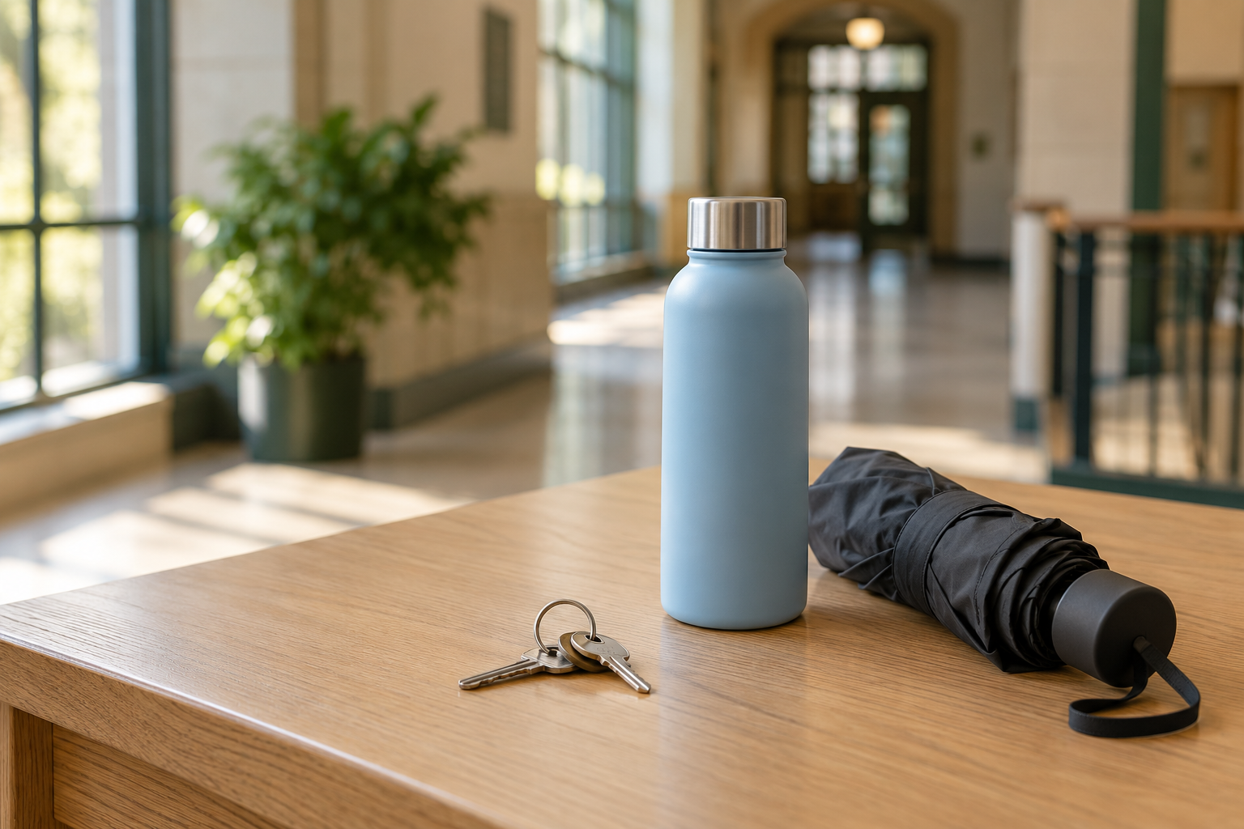
The campus lost-and-found problem
Finding the right item
A person may remember a colour or a feature, but not the exact category name.
Completing the handover
A searchable record also needs a known storage location and an explicit collection step.
AI-generated illustration
Design goal: help visitors register, find and retrieve an item at one station.
02
Notes:
Presenter 1. Slide 2 target: 65 seconds.
English script: The starting problem is a mismatch between how people describe lost belongings and how staff record them. Someone may remember a grey bottle with a folding handle rather than a category or an inventory number. A photo with short appearance tags gives the search a useful reference. But finding a candidate on a screen is only one part of recovery. We also need to know which compartment contains it and when collection has finished. Our design therefore connects digital search to a physical handover at one shared station. These are design motivations, not findings from a campus survey.
Sources: https://github.com/Justmao1/Found/blob/main/README.md
Repository snapshot: f0921903a2f17b1053a8f8b560ee1696e4ea99e7, accessed 22 October 2026. Assessment source: Assessment Two Brief-3(1)(2).pdf, Presentation section. All test counts are reported by repository verification records, not rerun for this deck.

Slide 3
The visitor journey
Two tasks share one inventory and one compartment workflow
FOUND AN ITEM
Take a photo
Save and tag
Allocate a slot
Place and confirm
LOST AN ITEM
Speak or type
Compare matches
Confirm and unlock
Collect and confirm
Visitors confirm physical completion. AI suggestions alone do not prove ownership.
03
Notes:
Presenter 1. Slide 3 target: 85 seconds.
English script: A finder takes and confirms a photo. The server saves it first, then generates appearance tags. After successful recognition, the app requests a compartment and displays its number. The visitor puts the item inside, closes the door and confirms completion. Only then does the item enter the collectible inventory. For retrieval, a visitor speaks or types a description, compares the candidate photographs and explicitly chooses their item. The app requests unlocking, then asks them to confirm removal and closure. The server marks the item collected and frees its compartment together. We rely on the visitor for physical confirmation because the current build has no door or presence sensor. The AI suggests candidates but does not establish legal ownership.
Sources: https://github.com/Justmao1/Found/blob/main/docs/locker-flow.md
Repository snapshot: f0921903a2f17b1053a8f8b560ee1696e4ea99e7, accessed 22 October 2026. Assessment source: Assessment Two Brief-3(1)(2).pdf, Presentation section. All test counts are reported by repository verification records, not rerun for this deck.

Slide 4
System architecture and data flow
The Raspberry Pi connects the visitor interface, cloud AI and physical storage
Wi-Fi
HTTPS + JSON
HTTPS
Model API
Shared iPad
SwiftUI + camera + mic
Raspberry Pi 4B
Python API + SQLite
Alibaba Cloud AI
Vision, search and ASR
GPIO control
0.5-second pulse
S8050 drivers
4-channel relay + locks
Local: photos, tags, inventory and operation state
04
Notes:
Presenter 2, slides 4–6, total 3 minutes. Slide 4 target: 70 seconds.
English script: The iPad is a native SwiftUI interface. It captures photos and short voice descriptions and calls the Raspberry Pi over trusted local HTTPS. The Pi runs a Python API and stores photos, tags and compartment operations in SQLite. It sends a photo to the vision service to obtain short tags. Search compares the visitor description with existing tags and notes, so it does not upload the photos again. Speech recognition converts a short recording into editable text. Cloud keys remain on the Pi. GPIO controls the relay driver, while the database tracks the associated operation. This implementation uses HTTPS and direct GPIO, rather than MQTT.
Sources: https://github.com/Justmao1/Found/blob/main/lost-found-box/README.md
Repository snapshot: f0921903a2f17b1053a8f8b560ee1696e4ea99e7, accessed 22 October 2026. Assessment source: Assessment Two Brief-3(1)(2).pdf, Presentation section. All test counts are reported by repository verification records, not rerun for this deck.

Slide 5
Hardware choices and control boundary
Component | Purpose and design choice
iPad camera and microphone | One accessible station for capture and visitor input
Raspberry Pi 4 Model B | Local API, persistent records and GPIO control
Four relays and electric locks | One physical location per stored item
S8050 transistor drivers | Invert GPIO HIGH into the relay’s LOW trigger
01: BCM17 02: BCM26 03: BCM13 04: BCM5
No door or item sensor: an unlock command cannot confirm that an item moved.
05
Notes:
Presenter 2. Slide 5 target: 60 seconds.
English script: We chose a shared iPad because it already provides the camera, microphone and a large interface. The Raspberry Pi combines a local server with GPIO, and SQLite avoids a separate database service. Four relay channels map directly to four compartments. Each channel uses an S8050 transistor because the relay input is active LOW. The GPIO sends a single half-second HIGH pulse through this driver. BCM pins seventeen, twenty-six, thirteen and five control compartments one to four. A thirty-second cooldown limits repeated activation. The important measurement boundary is physical: neither GPIO readback nor a successful API response tells us whether a door opened or an item moved.
Sources: https://github.com/Justmao1/Found/blob/main/lost-found-box/README.md
Repository snapshot: f0921903a2f17b1053a8f8b560ee1696e4ea99e7, accessed 22 October 2026. Assessment source: Assessment Two Brief-3(1)(2).pdf, Presentation section. All test counts are reported by repository verification records, not rerun for this deck.

Slide 6
Prototype iterations
Each stage added a capability and exposed a new design requirement
01
Photo registration
Save photos reliably
and retry without duplicates
02
AI tagging and search
Use short visual features
and validate candidate IDs
03
Native iPad station
Separate visitor sessions
and restrict staff tools
04
Four-compartment flow
Persist operations before
unlocking and confirm completion
06
Notes:
Presenter 2. Slide 6 target: 50 seconds.
English script: We built the system incrementally. First, we completed the photograph and storage path, including duplicate-safe retries. Next, we added short AI tags and natural-language search, with checks that every returned candidate exists in the real inventory. The native iPad station then introduced separate visitor sessions and device-authenticated staff tools. Finally, four-compartment storage added persistent operation records and recovery after interruption. These changes shifted our attention from a successful screen response to a consistent record of a physical handover. Software tests cover the new workflow, while a complete real-device acceptance cycle remains necessary.
Sources: https://github.com/Justmao1/Found/blob/main/verification/README.md
Repository snapshot: f0921903a2f17b1053a8f8b560ee1696e4ea99e7, accessed 22 October 2026. Assessment source: Assessment Two Brief-3(1)(2).pdf, Presentation section. All test counts are reported by repository verification records, not rerun for this deck.

Slide 7
Validation evidence collected so far
Repository verification records, updated 22 October 2026
Evidence | Recorded result | What it covers
Python backend suite | 99 tests passed | HTTP, persistence and locker logic
Swift core suite | 42 tests passed | Data contracts and request handling
Native iOS suite | 51 tests passed | Session state, retries and recovery
Swift–Python locker integration | 10 checks passed | Capacity, replay, collection and reuse
GPIO tests used simulated drivers. These counts do not measure search accuracy.
07
Notes:
Presenter 3, slides 7–9, total 3 minutes. Slide 7 target: 60 seconds.
English script: Our available evidence is mainly functional verification. The latest repository records report ninety-nine Python backend tests, forty-two Swift core tests, fifty-one native iOS tests and ten cross-language locker checks. These are separate test suites, so we do not combine them into a single performance metric. They cover persistence, duplicate requests, capacity, session isolation and interrupted operations. The GPIO drivers in these tests are simulated. We also have a documented live Pi deployment and earlier cloud searches, but these checks are not equivalent to a week of user operation or a measured retrieval accuracy.
Sources: https://github.com/Justmao1/Found/blob/main/verification/README.md
Repository snapshot: f0921903a2f17b1053a8f8b560ee1696e4ea99e7, accessed 22 October 2026. Assessment source: Assessment Two Brief-3(1)(2).pdf, Presentation section. All test counts are reported by repository verification records, not rerun for this deck.

Slide 8
Early search observations and data insights
Documented live cloud searches on 14 October used an inventory of four records
Search description | Documented response
Grey cup with a folding handle, Chinese | Returned the cup
Beige toy with a red scarf, English | Returned the toy
Black phone absent from the inventory | Returned no candidate
Insight
Useful tags support descriptive lookup. Missing details in a tag can hide a valid match.
Three examples cannot establish accuracy. A continuous one-week dataset is not supplied.
08
Notes:
Presenter 3. Slide 8 target: 65 seconds.
English script: The historical verification log includes three real cloud searches against four records. A Chinese description of a grey cup with a folding handle returned the cup. An English description of a beige toy with a red scarf returned the toy. A black phone that was absent from the inventory returned no candidate. These examples show that descriptive and multilingual lookup can work. They do not establish an accuracy percentage because the sample is tiny and not a controlled evaluation. Search depends on the recorded tags and notes, so an unrecorded feature may fail to retrieve the item. The supplied materials do not contain continuous one-week data, which is required for the report.
Sources: https://github.com/Justmao1/Found/blob/main/lost-found-box/VERIFICATION.md
Repository snapshot: f0921903a2f17b1053a8f8b560ee1696e4ea99e7, accessed 22 October 2026. Assessment source: Assessment Two Brief-3(1)(2).pdf, Presentation section. All test counts are reported by repository verification records, not rerun for this deck.

Slide 9
Limitations and next steps
Current limitation | Next step
No door or item sensing | Add door contacts and validate physical completion
AI matching does not prove ownership | Add a staff-assisted claim verification step
Trusted LAN, no backend user roles | Add server authentication and access controls
No continuous one-week evaluation dataset | Log real sessions and assess search and retrieval
Immediate acceptance task
Run camera / voice / cloud with all four real locks, then verify opening and reclosure.
09
Notes:
Presenter 3. Slide 9 target: 55 seconds.
English script: Our immediate next step is to complete a real-device acceptance run with the camera, voice, cloud and all four locks. We must observe actual opening, item placement, retrieval and reclosure. Door contacts would improve physical observability, while a staff-assisted claim process would address ownership checks. For deployment beyond a trusted classroom LAN, backend authentication and role separation are needed. Evaluation also needs a continuous week of real sessions with timestamps, query outcomes, errors and human-verified completion. The current repository documents functional behavior and a deployed backend, but we still need that operating evidence before drawing broader conclusions.
Sources: https://github.com/Justmao1/Found/blob/main/verification/README.md
Repository snapshot: f0921903a2f17b1053a8f8b560ee1696e4ea99e7, accessed 22 October 2026. Assessment source: Assessment Two Brief-3(1)(2).pdf, Presentation section. All test counts are reported by repository verification records, not rerun for this deck.

Slide 10
Live demonstration
3 minutes · One complete deposit and retrieval cycle
Time | Stage | Visible evidence
0:00–0:20 | Station ready | Show four free compartments and the connection
0:20–1:10 | Register and deposit | Photograph, inspect tags, unlock, place and confirm
1:10–2:10 | Find and retrieve | Describe, compare, confirm, unlock and collect
2:10–2:40 | Check consistency | Show collected item and compartment free again
2:40–3:00 | Close | Explain one failure or recovery safeguard
Compulsory backup: record this same full cycle and keep the video ready offline.
10
Notes:
Demo lead. Target: 3 minutes.
演示前：确认 iPad、树莓派网络和证书；云配置与余额可用；四路接线和实物动作已验收；空柜状态与实物一致；准备一个无敏感信息的物品。先录制同一完整流程的备用视频并保存在本地，现场保持可立即播放。本 PPT 不包含录像，不能将概念配图当作演示证据。
Live narration: We start with the available compartments. I take a photo and check the generated tags. The app assigns a compartment. I place the item inside, close the door and confirm. Now I describe the item as someone who lost it. I compare the candidate photo, confirm my choice, retrieve the item and confirm closure. The compartment becomes free again.
If failure occurs: switch immediately to the genuine backup recording. Describe whether the cause is network, AI or hardware and avoid claiming a successful physical cycle.
Sources: https://github.com/Justmao1/Found/blob/main/docs/locker-flow.md
Repository snapshot: f0921903a2f17b1053a8f8b560ee1696e4ea99e7, accessed 22 October 2026. Assessment source: Assessment Two Brief-3(1)(2).pdf, Presentation section. All test counts are reported by repository verification records, not rerun for this deck.

Slide 11
Questions and discussion
3 minutes
How do we know
the handover is complete?
Current answer: a persistent operation record and explicit visitor confirmation
Next improvement: independent door sensing and stronger claim verification
11
Notes:
Q&A target: 3 minutes. Useful answers:
1. Why no MQTT? The current prototype has one local controller, synchronous HTTPS workflows and direct GPIO. MQTT would be a future multi-station design choice, not a current implementation.
2. Is AI an ownership check? No. Visitors compare candidates and confirm, and stronger staff-assisted verification is future work.
3. Does a 200 response prove the door opened? No. Current hardware has no physical feedback.
4. What about failures? A stable request ID prevents repeated pulses. Uncertain operations retain the slot for staff inspection.
5. Where is the one-week study? It is not present in the supplied repository and must be supplied from genuine logs.
6. Are test counts accuracy? No. They describe distinct functional test suites.
Sources: https://github.com/Justmao1/Found/blob/main/README.md
Repository snapshot: f0921903a2f17b1053a8f8b560ee1696e4ea99e7, accessed 22 October 2026. Assessment source: Assessment Two Brief-3(1)(2).pdf, Presentation section. All test counts are reported by repository verification records, not rerun for this deck.

Slide 12
Protocol choices
Appendix · Current implementation
Link | Protocol / format | Reason
iPad to Raspberry Pi | Wi-Fi, HTTPS, JSON | Request / response flow and verified TLS
Pi to cloud vision / search | HTTPS, JSON | Server-side model calls and credentials
iPad voice capture | 16 kHz mono PCM WAV | Short recordings for server-side ASR
Pi to relay drivers | BCM GPIO, 0.5 s HIGH | Direct local actuation through S8050
Local persistence | SQLite transactions | Keep inventory and operation state consistent
MQTT, BLE and door-state telemetry are not part of the current prototype.
12
Notes:
备用页：协议以当前 README 和代码为准。云端视觉默认 qwen3-vl-plus，语音 qwen3-asr-flash。iPad 只在用户确认后搜索，后端不保存语音文件或转写日志。语音仍会发送至云端处理。Key 仅在服务端。
Sources: https://github.com/Justmao1/Found/blob/main/lost-found-box/README.md
Repository snapshot: f0921903a2f17b1053a8f8b560ee1696e4ea99e7, accessed 22 October 2026. Assessment source: Assessment Two Brief-3(1)(2).pdf, Presentation section. All test counts are reported by repository verification records, not rerun for this deck.

Slide 13
One-week evaluation record
Appendix · Measurement plan, not collected results
Measure | Record per session | Analysis after 7 continuous days
Search quality | Query, target ID and ranked candidates | Top-1 / top-5 recall on labelled queries
Task completion | Start, finish, outcome and intervention | Completion rate and median duration
Service reliability | Latency, error stage and retry count | Median / p95 latency and failure rate
Physical consistency | Assigned slot and observed movement | Mismatch rate against staff inspection
Use real timestamps and ground truth. Separate empty-inventory queries from retrieval tests.
13
Notes:
此页是待执行的实测记录方案，不是结果。Ass2 报告要求至少一周数据。应连续记录七天，每条带匿名会话 ID、时间戳、设备/模型版本、目标物品、实际候选、分配格口、物理观察与异常。记录 sample size 与失败/中断，不将重试重复计为独立成功。延迟的 p95 需要足够样本并注明样本量。无目标查询单列，以检查错误匹配。当前无门传感器，格口一致性需工作人员实物核查，不可从 GPIO 电平推断。
Sources: https://github.com/Justmao1/Found/blob/main/README.md
Repository snapshot: f0921903a2f17b1053a8f8b560ee1696e4ea99e7, accessed 22 October 2026. Assessment source: Assessment Two Brief-3(1)(2).pdf, Presentation section. All test counts are reported by repository verification records, not rerun for this deck.

Slide 14
Interrupted-operation recovery
Appendix · Software state never substitutes for physical inspection
Reserve slot
and save request
Send one pulse
Await visitor
confirmation
Failure or restart
Uncertain operation
Keep compartment reserved
Staff checks the real compartment, then resolves the record without another pulse.
14
Notes:
Idempotency: same request UUID returns the existing operation. It does not repeat opening. Distinct UUIDs cannot bypass an unfinished operation on the same item or slot. Crash recovery preserves the slot and requires inspection. Staff resolve changes records without a GPIO pulse. SQLite and a physical actuator cannot share an atomic transaction. If the outcome is uncertain, the system conservatively retains the compartment rather than guessing. Current staff API still relies on the trusted LAN.
Sources: https://github.com/Justmao1/Found/blob/main/docs/locker-flow.md
Repository snapshot: f0921903a2f17b1053a8f8b560ee1696e4ea99e7, accessed 22 October 2026. Assessment source: Assessment Two Brief-3(1)(2).pdf, Presentation section. All test counts are reported by repository verification records, not rerun for this deck.

Slide 15
Assessment structure and sources
Appendix · 9 minutes of talks, 3 minutes of demo, 3 minutes of Q&A
Segment | Slides | Allocation
Presenter 1: motivation and journey | 1–3 | 3 minutes
Presenter 2: hardware and platform | 4–6 | 3 minutes
Presenter 3: data insights and future work | 7–9 | 3 minutes
Live demo, then questions | 10–11 | 3 + 3 minutes
Source material
Ass2 brief: Presentation and Final Project Report sections
Found repository: README, backend README, locker flow and verification records
Past project booklets: course context only. Proposal template: structure only.
15
Notes:
Source URLs:
https://github.com/Justmao1/Found
https://github.com/Justmao1/Found/blob/main/README.md
https://github.com/Justmao1/Found/blob/main/lost-found-box/README.md
https://github.com/Justmao1/Found/blob/main/lost-found-box/VERIFICATION.md
https://github.com/Justmao1/Found/blob/main/verification/README.md
https://github.com/Justmao1/Found/blob/main/docs/locker-flow.md
Local source: Assessment Two Brief-3(1)(2).pdf, pages 1–2.
Two generated conceptual illustrations use the built-in image-generation tool. They are not actual prototype or inventory photographs. Model version cannot be selected or verified in the exposed tool. Prompts: (1) premium editorial photograph of a compact forest-green two-by-two translucent acrylic four-compartment lost-and-found cabinet and blank tablet in a university library lobby; (2) pale-blue bottle, keys and charcoal umbrella on a light oak university counter, natural morning light, no text or logos.
Team size was not specified. The 3-presenter split fits the stated 15-minute budget: 9 talk + 3 demo + 3 Q&A. If the team has a different number of members, confirm allocation with the lecturer. Presenter names have not been invented. The compulsory backup video must be recorded by the team.
Sources: https://github.com/Justmao1/Found/blob/main/README.md
Repository snapshot: f0921903a2f17b1053a8f8b560ee1696e4ea99e7, accessed 22 October 2026. Assessment source: Assessment Two Brief-3(1)(2).pdf, Presentation section. All test counts are reported by repository verification records, not rerun for this deck.

