Slide 1
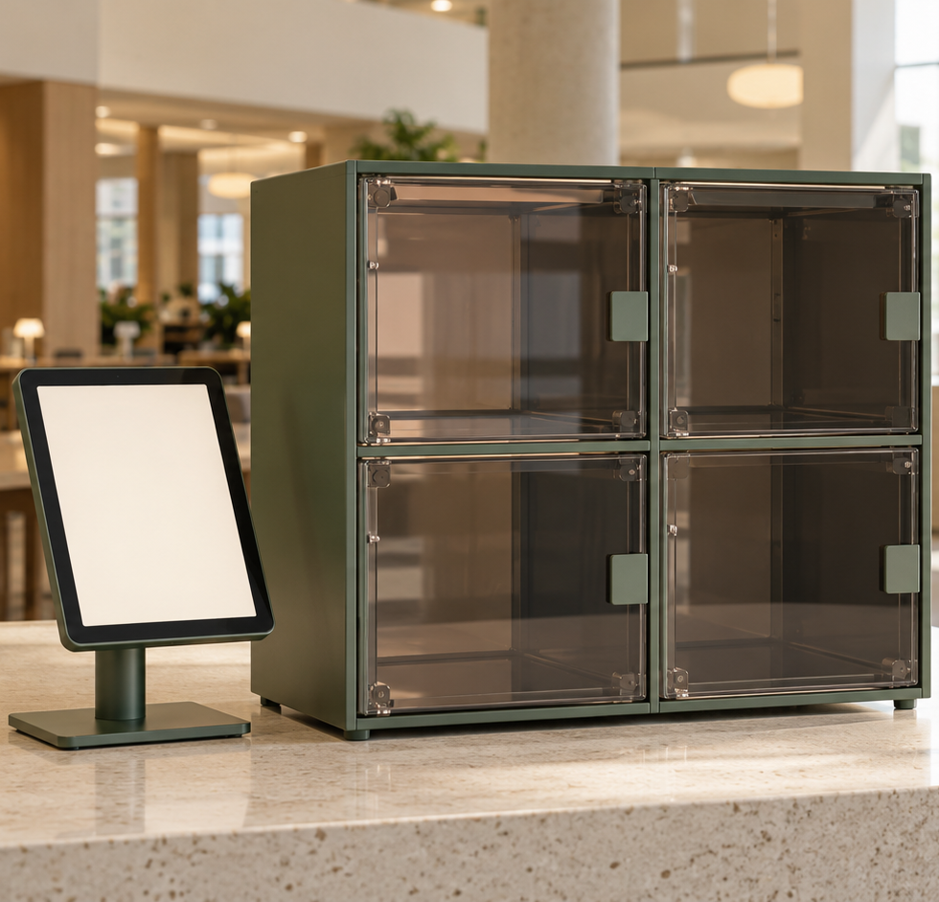
Found
AI-assisted campus
lost and found
iPad terminal, Raspberry Pi
and four storage compartments
COMP728 · Assessment 2
Final project presentation · October 2026
AI-generated concept illustration
Notes:
Member 1, slides 1–2: 90 seconds. Slide 1: 20 seconds.
English script: Found is a shared campus lost-and-found station. Our goal is to help someone who remembers a belonging by its appearance to find it, then complete a clear physical handover. We connect an iPad, a Raspberry Pi and four storage compartments.
中文提示：先讲用户要完成的事情，不展开技术。全场 10 分钟，含演示及问答。封面为概念图，不是实物照片。
Sources: https://github.com/Justmao1/Found/blob/main/README.md
Assessment Two Brief-3(1)(2).pdf. This version follows the latest team instruction: 10 minutes total for four members. Allocation: 6 minutes talk + 3 minutes demo + 1 minute Q&A. The earlier written brief used 15 minutes. A genuine backup video remains compulsory. Counts are repository-reported software tests, not newly rerun or field accuracy.

Slide 2
Two visitor tasks, one clear handover
A finder needs a simple drop-off. An owner needs confidence that the candidate is theirs.
I FOUND SOMETHING
I LOST SOMETHING
1
Photograph and review
1
Speak or type a description
2
See tags and assigned compartment
2
Compare candidate photo and details
3
Place, close and confirm
3
Retrieve, close and confirm
Designed for a shared station
Large task choices, editable voice input, visible compartment numbers and a clear Finish step
02
Notes:
Member 1. Slide 2: 70 seconds.
English script: We designed around two visitors. The finder should not need to write a detailed inventory record. They take a photo, review it and see the short appearance tags and assigned compartment. They place the item inside, close the door and confirm. The owner can speak or type, edit the description and compare candidate photos before choosing an item. We show a large compartment number and keep the next physical action visible. A clear Finish step resets the station for the next visitor. These interface decisions aim to reduce uncertainty and unnecessary typing. They still need real user testing rather than an assumed improvement percentage.
中文提示：强调主类别与颜色、外形细节，不能把 AI 候选等同所有权证明。
Sources: https://github.com/Justmao1/Found/blob/main/README.md
Assessment Two Brief-3(1)(2).pdf. This version follows the latest team instruction: 10 minutes total for four members. Allocation: 6 minutes talk + 3 minutes demo + 1 minute Q&A. The earlier written brief used 15 minutes. A genuine backup video remains compulsory. Counts are repository-reported software tests, not newly rerun or field accuracy.

Slide 3
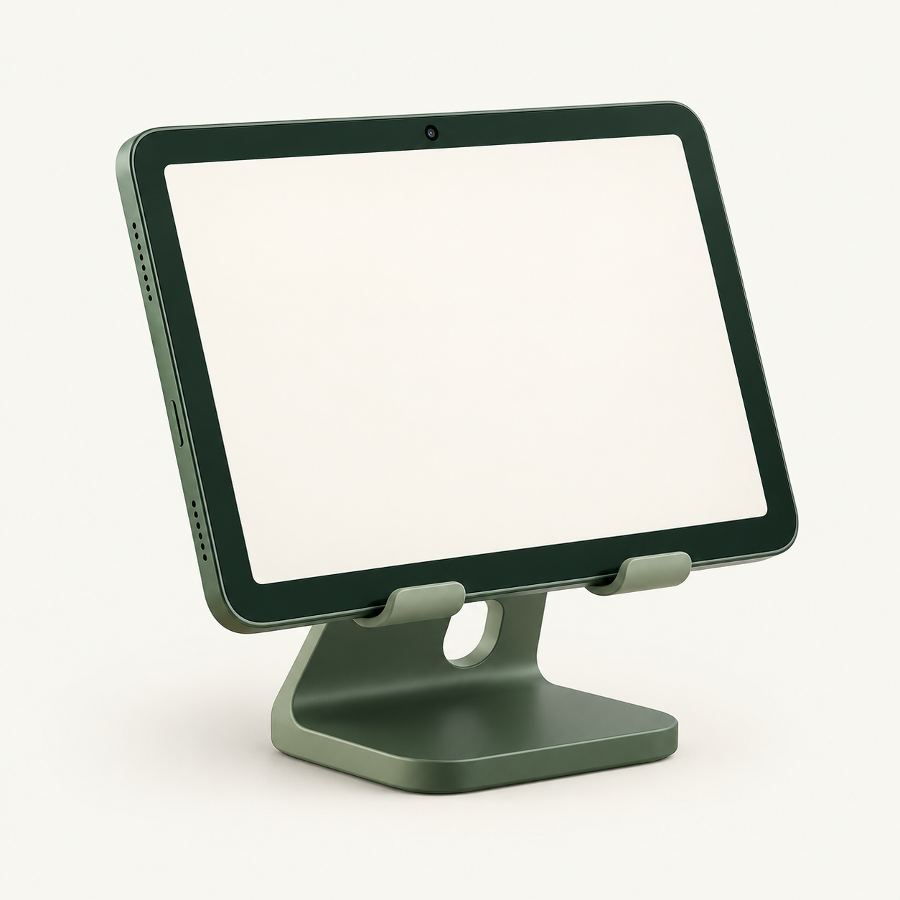
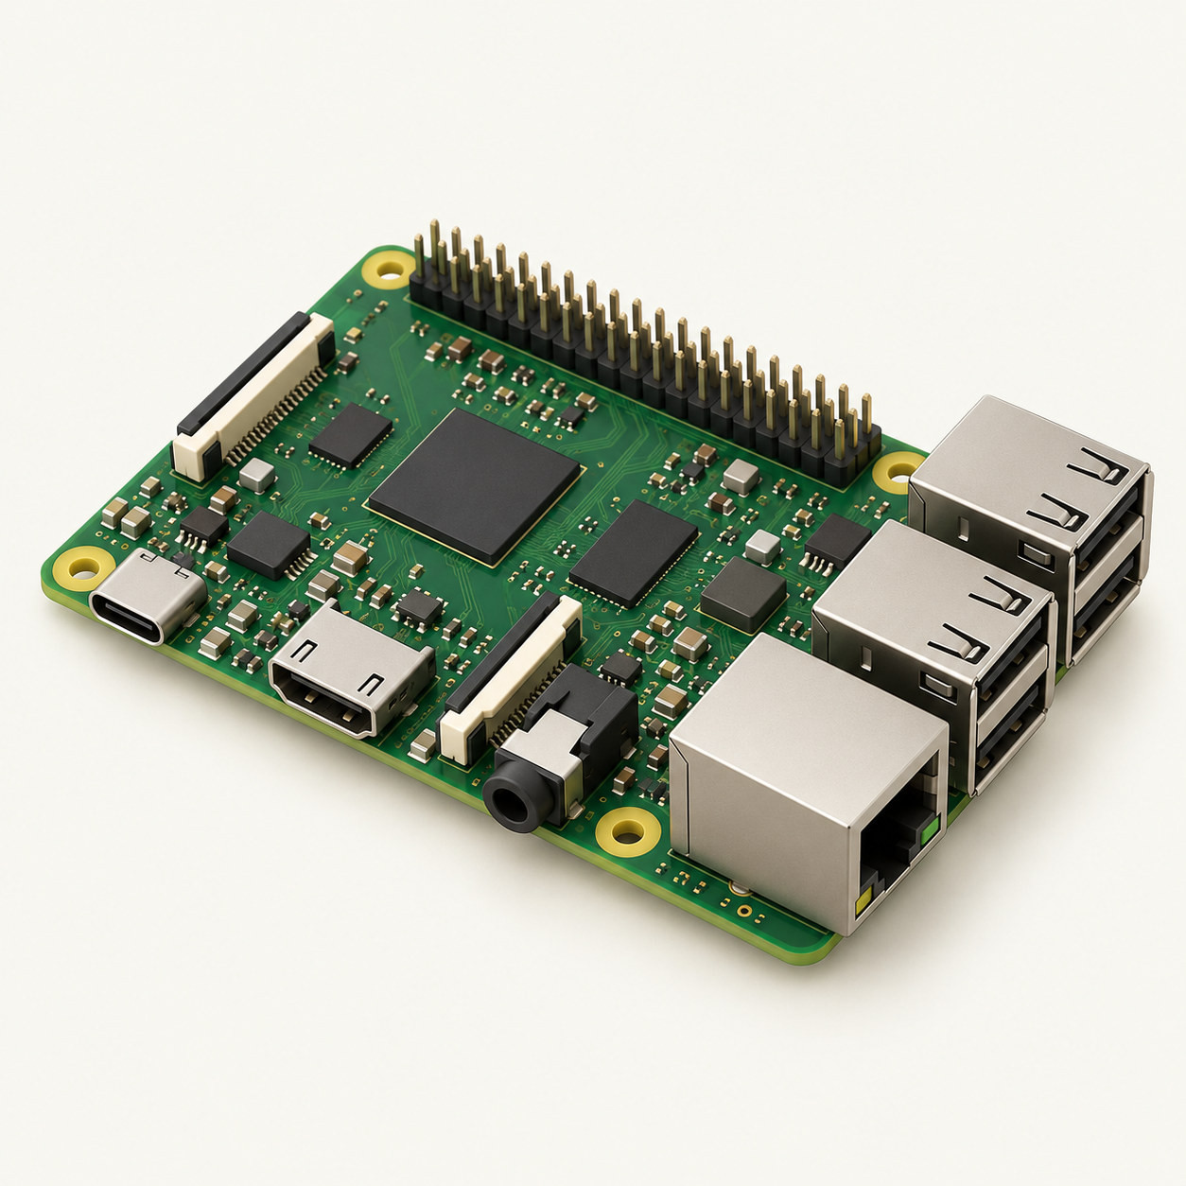

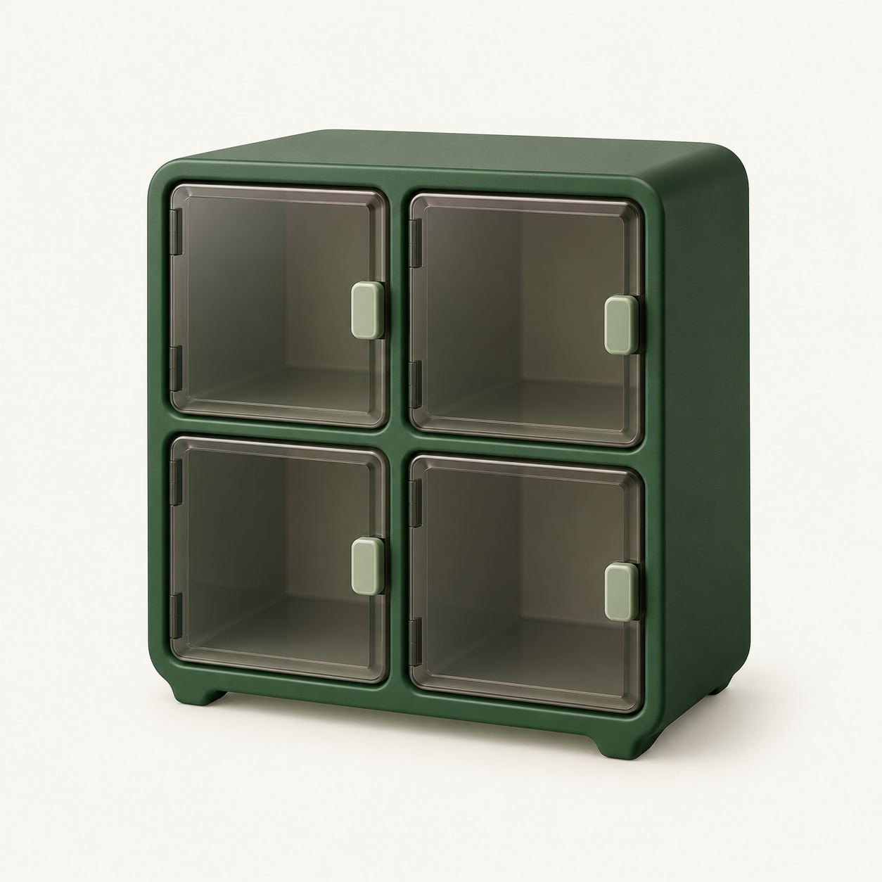
System architecture and data flow
A shared iPad connects to local control and cloud AI through the Raspberry Pi
Wi-Fi
HTTPS
HTTPS + JSON
Model API
Shared iPad
Raspberry Pi 4B
Cloud AI
SwiftUI, camera and mic
Python API + SQLite
Vision, search and ASR
GPIO control
Four compartments
0.5-second pulse
S8050 drivers, relays and locks
Local storage keeps photos, tags, inventory and operation records together.
03
Notes:
Member 2. Slide 3: 90 seconds.
English script: The architecture has three digital parts and one physical output. The native iPad app uses SwiftUI and supplies the camera, microphone and large visitor interface. It sends requests over local Wi-Fi with HTTPS and JSON. The Raspberry Pi runs the Python API and SQLite database. It keeps photos, tags, available inventory and locker operations together. Cloud AI supplies visual tags, semantic comparison and speech transcription. The documented defaults are Qwen3-VL-Plus and Qwen3-ASR-Flash, with keys stored only on the server. Search uses existing tags and notes rather than uploading photographs again. Finally, GPIO signals pass through transistor drivers to the relay module and electric locks. The Pi manages when an operation may occur, but it cannot observe door movement because this build has no door sensor.
Sources: https://github.com/Justmao1/Found/blob/main/lost-found-box/README.md
Assessment Two Brief-3(1)(2).pdf. This version follows the latest team instruction: 10 minutes total for four members. Allocation: 6 minutes talk + 3 minutes demo + 1 minute Q&A. The earlier written brief used 15 minutes. A genuine backup video remains compulsory. Counts are repository-reported software tests, not newly rerun or field accuracy.

Slide 4
Control circuit: one channel
The same S8050 interface repeats for all four LOW-trigger relay inputs
C
S8050
NPN transistor
Raspberry Pi
GPIO output
Relay input IN1
Active LOW
1 kΩ
B
GND
E
10 kΩ
B–E pull-down
Relay logic GND
Shared control ground: Pi GND, transistor E and relay logic GND
GPIO HIGH (3.3 V) for 0.5 s pulls IN LOW. GPIO LOW is the idle command.
04
Notes:
Member 3, slides 4–5: 90 seconds. Slide 4: 50 seconds.
English script: This is one control channel, repeated four times. The GPIO reaches the transistor base through a one-kilohm resistor. A ten-kilohm resistor pulls the base towards the emitter ground. The S8050 collector connects to the relay input, while the emitter shares the Pi and relay logic ground. A HIGH pulse turns the transistor on and pulls the active-LOW relay input low. After half a second, GPIO returns LOW. This separates the software control signal from the lock supply current. It still does not prove that a door has moved.
Diagram is a functional B/C/E connection diagram, not a transistor package pin-layout drawing. The actual S8050 package pin order must be checked against its part datasheet. Project documentation specifies 1 kΩ base and 10 kΩ B–E resistors for the recorded setup. Raspberry Pi GPIO HIGH is 3.3 V, per official documentation: https://www.raspberrypi.com/documentation/computers/raspberry-pi.html . GPIO labels use BCM numbering.
Sources: https://github.com/Justmao1/Found/blob/main/lost-found-box/VERIFICATION.md
Assessment Two Brief-3(1)(2).pdf. This version follows the latest team instruction: 10 minutes total for four members. Allocation: 6 minutes talk + 3 minutes demo + 1 minute Q&A. The earlier written brief used 15 minutes. A genuine backup video remains compulsory. Counts are repository-reported software tests, not newly rerun or field accuracy.

Slide 5
Four-channel lock power distribution
Functional layout for power-to-unlock locks. Use each device’s rated supply and contact limits.
Relay 01
COM / NO
Lock 01 + / −
Lock DC supply
+
Relay 02
COM / NO
Lock 02 + / −
−
Relay 03
COM / NO
Lock 03 + / −
Positive feed
branches to 4 COMs
Relay 04
COM / NO
Lock 04 + / −
Parallel return to DC negative
Relay-module DC+ / DC− powers the module. COM / NO switches each lock circuit.
05
Notes:
Member 3. Slide 5: 40 seconds.
English script: The load side uses four parallel branches. For a power-to-unlock lock, the positive supply feeds each relay COM terminal. The normally open contact supplies that lock when the relay activates, and each negative lead returns to the supply. The relay module also needs its correctly rated DC-plus and DC-minus supply connection. Those power terminals have a different purpose from the COM and NO contact terminals. GPIO controls the module input through the transistor; the lock current comes from the load supply.
This is a proposed functional contact/power arrangement for the described power-to-unlock mechanism, not a verified as-built wiring photograph. Supply voltage, current rating, lock polarity, module DC input rating and suppression components are not specified in the supplied files and are not invented here. Do not assume the module and lock have the same rated voltage. The drawing omits package pin order and any manufacturer-specific protection circuitry. Do not infer galvanic isolation from the diagram.
Channel mapping: 01=BCM17/physical11, 02=BCM26/physical37, 03=BCM13/physical33, 04=BCM5/physical29.
Sources: https://github.com/Justmao1/Found/blob/main/lost-found-box/README.md
Assessment Two Brief-3(1)(2).pdf. This version follows the latest team instruction: 10 minutes total for four members. Allocation: 6 minutes talk + 3 minutes demo + 1 minute Q&A. The earlier written brief used 15 minutes. A genuine backup video remains compulsory. Counts are repository-reported software tests, not newly rerun or field accuracy.

Slide 6
A usable experience when something goes wrong
The visitor needs a clear next action and confidence that the station has kept their place
Visitor situation | Current response
All four compartments are full | Pause new deposits and show availability
Voice input fails or is unsuitable | Keep the description editable and allow typing
Photo saves but AI tagging fails | Keep the photo and offer tagging retry
Lock outcome is uncertain | Keep the slot reserved for staff inspection
A visitor finishes or times out | Clear session inputs and reset the shared screen
Shared-terminal privacy
Finish clears the previous visitor’s task. Backend role-based access remains future work.
06
Notes:
Member 4, slides 6–7: 90 seconds. Slide 6: 50 seconds.
English script: We also considered the moment when a visitor cannot finish normally. A full cabinet pauses deposits rather than accepting an item without space. Voice has an editable text alternative. A tagging failure keeps the saved photo so the visitor does not need to submit it again. If a lock request becomes uncertain, the system keeps the compartment reserved for staff inspection. Finish or idle timeout resets the visitor screen. This reduces accidental exposure to the next user. It is a session boundary, not a claim of complete backend privacy. Stronger server authorization and ownership checks remain future work.
Sources: https://github.com/Justmao1/Found/blob/main/README.md
Assessment Two Brief-3(1)(2).pdf. This version follows the latest team instruction: 10 minutes total for four members. Allocation: 6 minutes talk + 3 minutes demo + 1 minute Q&A. The earlier written brief used 15 minutes. A genuine backup video remains compulsory. Counts are repository-reported software tests, not newly rerun or field accuracy.

Slide 7
Evidence and the next user study
Functional checks support the workflow. Field performance still needs real measurements.
Documented checks
User-focused next steps
Suite | Reported result
Python backend | 99 passed
Swift core | 42 passed
Native iOS | 51 passed
Locker HTTP integration | 10 checks passed
Measure the whole task
Seven continuous days of query outcomes, task time and staff interventions
Observe real handovers
Validate all four doors, then add door or item sensing
Strengthen ownership checks
Introduce staff-assisted claims and backend access control
GPIO tests used simulated drivers. Historical search examples are too few to establish accuracy.
07
Notes:
Member 4. Slide 7: 40 seconds.
English script: The repository reports ninety-nine backend tests, forty-two Swift core tests, fifty-one native tests and ten locker integration checks. They verify software behavior with simulated GPIO, not retrieval accuracy. Earlier live searches show that descriptive lookup is feasible, but the sample is too small for a rate. Next, we need seven continuous days of real sessions, measuring whether users find the right item, finish the task and need staff help. We also need complete real-door acceptance and stronger ownership and server access checks.
Reported live searches on 14 October: a grey folding-handle cup description matched the cup, a beige toy with red scarf matched the toy, an absent black phone returned no candidate. Inventory had four records. These are qualitative examples only. The latest recorded backend deployment is not a completed four-door physical acceptance run. All source citations: https://github.com/Justmao1/Found/blob/main/verification/README.md and https://github.com/Justmao1/Found/blob/main/lost-found-box/VERIFICATION.md .
Sources: https://github.com/Justmao1/Found/blob/main/verification/README.md
Assessment Two Brief-3(1)(2).pdf. This version follows the latest team instruction: 10 minutes total for four members. Allocation: 6 minutes talk + 3 minutes demo + 1 minute Q&A. The earlier written brief used 15 minutes. A genuine backup video remains compulsory. Counts are repository-reported software tests, not newly rerun or field accuracy.

Slide 8
Live demo and questions
3-minute full cycle, followed by 1 minute of Q&A
Time | Lead | What the audience sees
0:00–0:45 | Member 1 | Show availability, photograph and review an item
0:45–1:30 | Member 2 | Check tags, unlock, deposit and confirm closure
1:30–2:15 | Member 3 | Describe the item, compare and request retrieval
2:15–3:00 | Member 4 | Collect, confirm and show the compartment free
Backup video ready offline
Questions: physical confirmation, interrupted requests, privacy and ownership
08
Notes:
DEMO: 3 minutes, then Q&A: 1 minute. Four members each lead one 45-second stage. Total timed presentation: Member 1 slides 1–2 (90s), Member 2 slide3 (90s), Member3 slides4–5 (90s), Member4 slides6–7 (90s), demo180s, Q&A60s =600s. Each member has135s of planned speaking before the shared Q&A.
Before demo: verify actual camera, AI, microphone, network, TLS, four real lock channels and physical reclosure. This deck does not contain a demo recording. Record a genuine full-cycle backup and keep it ready offline. The 30-second per-lock cooldown needs attention when rehearsing the retrieval timing.
现场台词：1. We start with the available compartments and photograph the item. 2. I check the tags, deposit the item, close the door and confirm. 3. I describe and compare the item, then request retrieval. 4. I collect it, close the door and confirm. The compartment is free again.
Q&A: An API response and GPIO level do not prove door opening. Manual completion is current, sensing is future. Repeated UUIDs do not repeat pulses. An uncertain request keeps its slot. AI matching does not prove ownership. Staff device authentication does not replace backend authorization. A genuine one-week operational study is still missing.
Generated icon prompts: isolated matte forest-green and ivory illustrations of tablet, Raspberry Pi style board, cloud service and 2x2 locker. Icons are raster assets, while diagram topology, labels and circuits are native editable objects.
Sources: https://github.com/Justmao1/Found/blob/main/docs/locker-flow.md
Assessment Two Brief-3(1)(2).pdf. This version follows the latest team instruction: 10 minutes total for four members. Allocation: 6 minutes talk + 3 minutes demo + 1 minute Q&A. The earlier written brief used 15 minutes. A genuine backup video remains compulsory. Counts are repository-reported software tests, not newly rerun or field accuracy.

