Slide 1
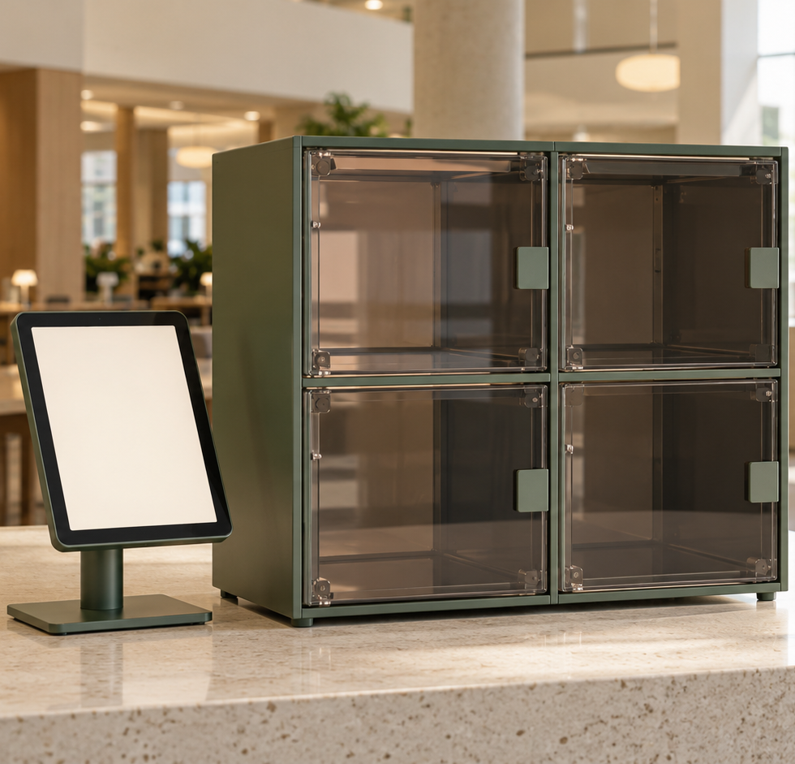
1. Introduction
Found
AI-assisted campus
lost and found
iPad terminal, Raspberry Pi
and four storage compartments
Register, search and retrieve
COMP728 · Assessment 2
Final project presentation · October 2026
AI-generated concept illustration
Notes:
Member 1, slides 1–2: 90 seconds. Slide 1: 20 seconds.
English script: Found is a shared campus lost-and-found station. A finder registers a photograph, and an owner describes and compares an item before retrieval. Our prototype links an iPad and cloud AI to a Raspberry Pi and four storage compartments. We focus on a clear digital record and a consistent physical handover.
封面是概念图，不是实物照片。六个要求的对应：1简介=第1页；2文献与动机=第2页；3研究设计=第3–5页；4数据与分析=第6页；5结论及6局限与未来=第7页；第8页演示及问答。
Sources: https://github.com/Justmao1/Found/blob/main/README.md
Assessment Two Brief-3(1)(2).pdf. This version follows the latest team instruction: 10 minutes total for four members. Allocation: 6 minutes talk + 3 minutes demo + 1 minute Q&A. The earlier written brief used 15 minutes. A genuine backup video remains compulsory. Counts are repository-reported software tests, not newly rerun or field accuracy.

Slide 2
2. Literature survey and motivation
Prior work informs the link between item descriptions, records and physical storage
Research | What it contributes | Implication for Found
Said et al. (2026) [1] QR-enabled lost and found | QR records, Arduino-controlled lockers and status LEDs | Connect the digital record to a physical compartment
Radford et al. (2021) [2] Vision–language learning | Visual concepts learned from paired images and text | Explore descriptive lookup using appearance
Our research question
Can one shared station connect appearance-based search to a consistent four-compartment handover?
[1] IJRISS 10(3), 3882–3893 [2] ICML 2021, PMLR 139, 8748–8763
02
Notes:
Member 1. Slide 2: 70 seconds.
English script: Two strands of research shaped the project. Said and colleagues describe a campus lost-and-found system using QR records, Arduino-controlled compartments and visual status feedback. It shows the value of linking a record to physical storage. Radford and colleagues show that image–text learning can associate natural-language concepts with visual content. That supports descriptive search as a design direction. Our question is whether a shared station can connect appearance-based lookup to a consistent handover. The finder should not need to write a full description, and the owner should be able to compare photos before confirming. The literature informs these choices. It does not prove the performance of our prototype.
[1] Said, M. A. M., Misran, M. H., Othman, M. A., Shairi, N. A., Zabri, S. N., Ruslan, E., Salleh, A., & Idris, M. Z. (2026). IoT Enhanced Lost and Found System in FTKEK Using QR Code Technology. International Journal of Research and Innovation in Social Science, 10(3), 3882–3893. https://doi.org/10.47772/IJRISS.2026.100300289 . Primary author institution copy: https://eprints.utem.edu.my/id/eprint/29938/ .
[2] Radford, A. et al. (2021). Learning Transferable Visual Models From Natural Language Supervision. ICML, PMLR 139, 8748–8763. https://proceedings.mlr.press/v139/radford21a.html .
Interpretation boundary: the research question is our inference and project scope, not an assertion that prior papers lack all these features. CLIP is conceptual background; Found implements documented server-side Qwen APIs, not a CLIP embedding index. No external performance percentages are transferred into this project.
Sources: https://github.com/Justmao1/Found/blob/main/README.md
Assessment Two Brief-3(1)(2).pdf. This version follows the latest team instruction: 10 minutes total for four members. Allocation: 6 minutes talk + 3 minutes demo + 1 minute Q&A. The earlier written brief used 15 minutes. A genuine backup video remains compulsory. Counts are repository-reported software tests, not newly rerun or field accuracy.

Slide 3
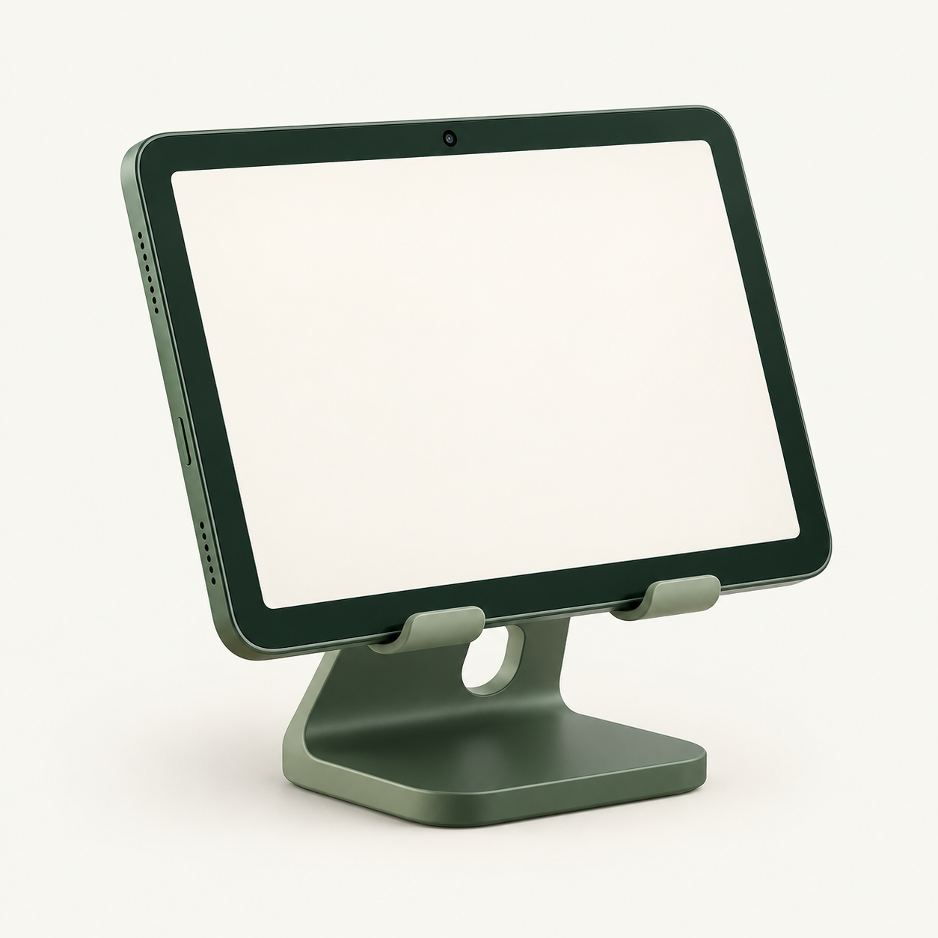
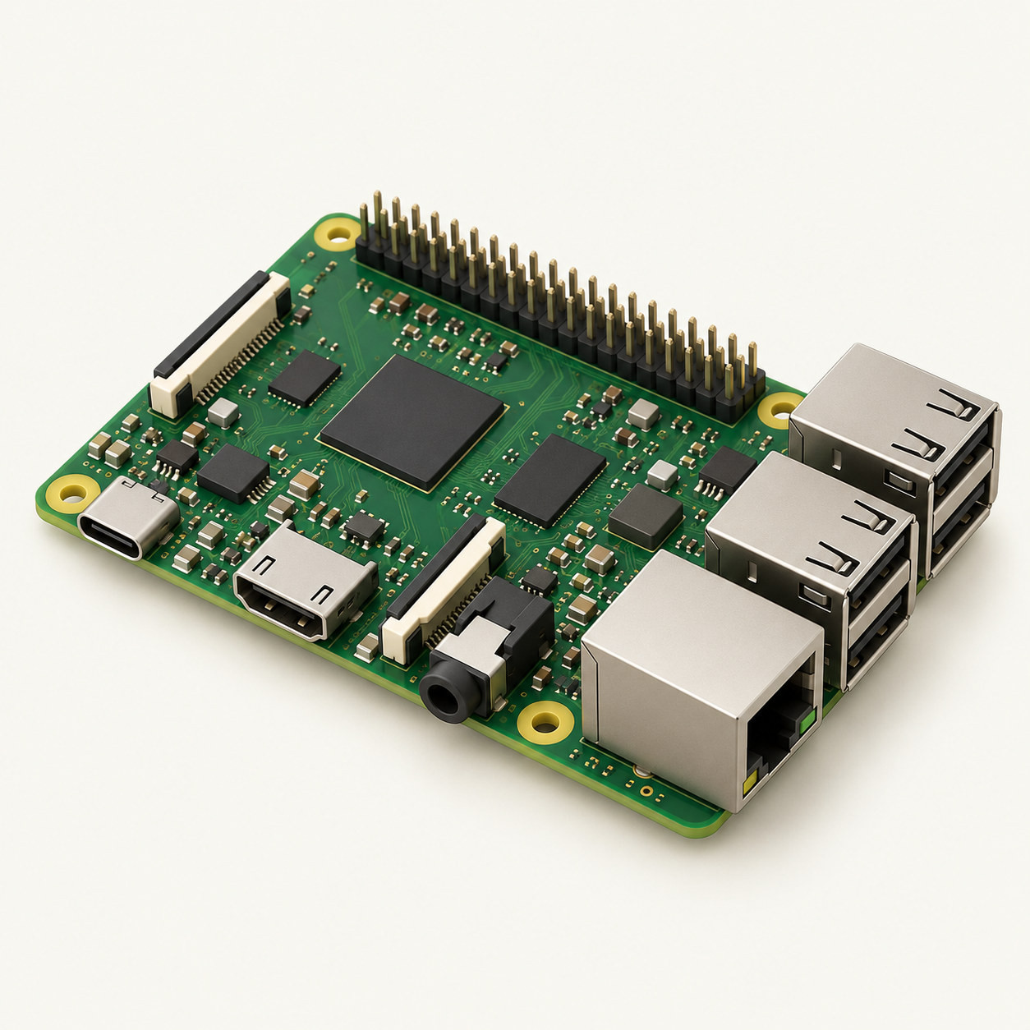

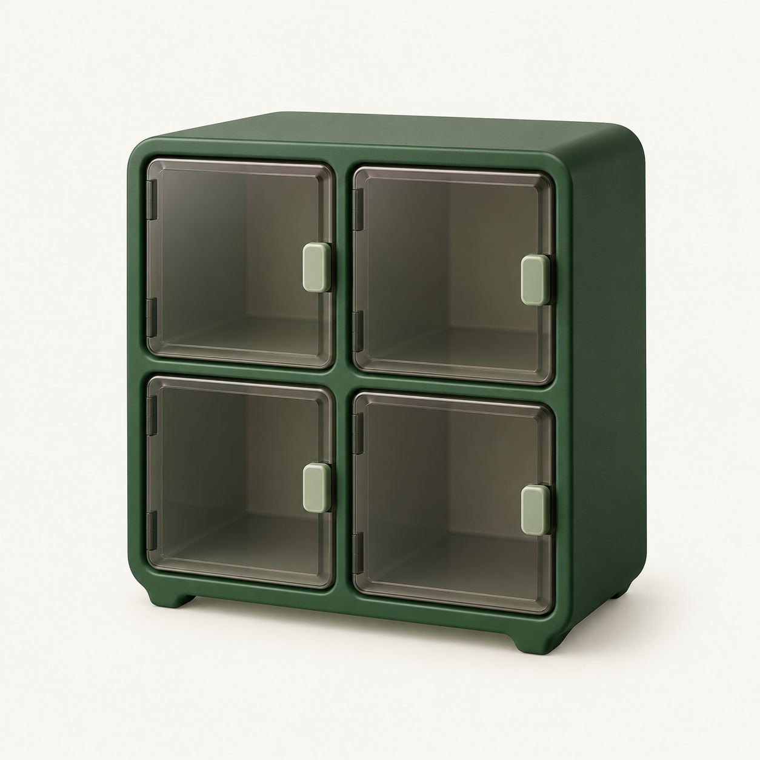
3. Research design: architecture
A shared iPad connects to local control and cloud AI through the Raspberry Pi
Wi-Fi
HTTPS
HTTPS + JSON
Model API
Shared iPad
Raspberry Pi 4B
Cloud AI
SwiftUI, camera and mic
Python API + SQLite
Vision, search and ASR
GPIO control
Four compartments
0.5-second pulse
S8050 drivers, relays and locks
Choice: reuse iPad camera / mic and Pi server / GPIO. No door sensor in this prototype.
03
Notes:
Member 2, slides 3–4: 90 seconds. Slide 3: 50 seconds.
English script: We reuse the iPad camera and microphone as input devices, with SwiftUI as the visitor interface. The Raspberry Pi combines the Python API, SQLite storage and GPIO control, so one controller manages the local state. The iPad uses Wi-Fi, HTTPS and JSON. The Pi calls cloud vision, semantic search and speech transcription over HTTPS. This avoids running the large models locally, while keeping credentials on the server. GPIO reaches the locks through S8050 drivers and the relay module. We currently have no door or item sensor, so the visitor confirms physical completion.
Hardware justification: iPad supplies existing capture peripherals and a large shared interface; Pi 4B supplies local compute, persistent storage and GPIO; four relay channels map to four slots; S8050 inverts the control for active-LOW relay inputs. Current backend is a Python standard-library service, not an unimplemented FastAPI deployment. Cloud AI defaults are qwen3-vl-plus and qwen3-asr-flash. Photos, tags and inventory stay in local SQLite. Search submits labels/notes rather than retransmitting inventory photos.
Sources: https://github.com/Justmao1/Found/blob/main/lost-found-box/README.md
Assessment Two Brief-3(1)(2).pdf. This version follows the latest team instruction: 10 minutes total for four members. Allocation: 6 minutes talk + 3 minutes demo + 1 minute Q&A. The earlier written brief used 15 minutes. A genuine backup video remains compulsory. Counts are repository-reported software tests, not newly rerun or field accuracy.

Slide 4
3. Research design: circuit structure
A transistor interface controls the relay input. The relay contacts switch the lock supply.
CONTROL SIDE
LOAD SIDE: ONE OF FOUR
C
Rated lock DC supply
S8050 NPN
Pi GPIO
B
Relay IN
LOW trigger
+
−
1 kΩ
Relay COM / NO
GND
10 kΩ
E
Logic GND
Electric lock + / −
HIGH pulse: 0.5 s
Shared Pi / E / relay-logic ground
Repeat this load path ×4
BCM mapping: 01 / 17 02 / 26 03 / 13 04 / 5
04
Notes:
Member 2. Slide 4: 40 seconds.
English script: On the control side, a one-kilohm resistor feeds the S8050 base. A ten-kilohm base-to-emitter pull-down gives a defined idle input. The collector pulls the active-LOW relay input low during a half-second GPIO HIGH pulse. The control grounds are shared. On the load side, the relay COM and normally open contact switch the rated supply to a power-to-unlock lock. That contact path repeats four times. Lock current comes from the load supply, while GPIO supplies the control signal.
Editable functional diagram, not a transistor package pinout or verified as-built wiring plan. Each lock branch is in parallel: positive supply to COM, NO to lock positive, lock negative back to the supply. Relay module DC+/DC− separately requires its own correctly rated supply connection. Do not assume relay module and lock have the same voltage. Supply values, current limits and suppression components are not supplied and are not invented. Check package B/C/E order and actual component ratings.
Project sources specify GPIO17 through 1 kΩ to S8050 B; B–E 10 kΩ, E shared ground, C relay IN. GPIO idle LOW, 0.5-second HIGH pulse, 30-second cooldown. Official GPIO reference: https://www.raspberrypi.com/documentation/computers/raspberry-pi.html (3.3 V HIGH). Door feedback is absent. No physical actuation success follows solely from software state.
Sources: https://github.com/Justmao1/Found/blob/main/lost-found-box/VERIFICATION.md
Assessment Two Brief-3(1)(2).pdf. This version follows the latest team instruction: 10 minutes total for four members. Allocation: 6 minutes talk + 3 minutes demo + 1 minute Q&A. The earlier written brief used 15 minutes. A genuine backup video remains compulsory. Counts are repository-reported software tests, not newly rerun or field accuracy.

Slide 5
3. Research design: iterations and protocols
The prototype grew from a reliable photo record into a recoverable four-compartment workflow
1. Photo records
2. AI + search
3. Native station
4. Locker workflow
Save locally
Retry without duplicates
Short appearance tags
Description-based lookup
SwiftUI interface
Separate visitor sessions
Reserve before actuation
Confirm and recover
Stage | Protocol / format | Purpose
iPad to Pi | Wi-Fi, HTTPS, JSON | Capture, search and locker requests
Pi to cloud AI | HTTPS, JSON; WAV for ASR | Tags, semantic matches and voice text
Pi to relay drivers | BCM GPIO, 0.5 s HIGH pulse | One requested unlock operation
SQLite transactions persist state locally. Current implementation does not use MQTT.
05
Notes:
Member 3, slides 5–6: 90 seconds. Slide 5: 40 seconds.
English script: We developed four stages. First, reliable photo records with duplicate-safe retries. Second, short AI tags and description-based search. Third, the native station with separate visitor sessions. Fourth, compartment reservation, single unlock requests and recovery after interruption. The protocols match each link: HTTPS and JSON over Wi-Fi between iPad and Pi, HTTPS to the cloud, and direct BCM GPIO to the relay driver. Voice input uses a short WAV recording. SQLite transactions persist state locally. MQTT is not part of this implementation.
Dates in the verification record: early photo/cloud path on 13–14 October, native iteration on 20–21 October, four-compartment workflow on 22 October. The state progresses from registration through stored to collected only after explicit physical-completion confirmation. Same request IDs do not replay the pulse. Four compartments map to BCM17/26/13/5. GPIO model tests are simulated. Protocols described here reflect the repository, not an earlier unimplemented proposal.
Sources: https://github.com/Justmao1/Found/blob/main/README.md
Assessment Two Brief-3(1)(2).pdf. This version follows the latest team instruction: 10 minutes total for four members. Allocation: 6 minutes talk + 3 minutes demo + 1 minute Q&A. The earlier written brief used 15 minutes. A genuine backup video remains compulsory. Counts are repository-reported software tests, not newly rerun or field accuracy.

Slide 6
4. Data collection and insights
Available pilot observations are separate from the required continuous one-week field study
Pilot: 14 October, 4 inventory records
One-week dataset: pending
Query example | Observed response
Grey cup with folding handle | Cup returned
Beige toy with red scarf | Toy returned
Absent black phone | No candidate
Collect for 7 continuous days
Timestamps, target item, candidate rank, task outcome and staff help
Analyse the real sessions
Top-1 / top-5 recall, completion rate, task time and latency
Interpretation
Report the boundary
The examples support descriptive lookup. Tag omissions can still hide a relevant item.
State dates, sample size and failures. Do not infer accuracy from 3 queries.
06
Notes:
Member 3. Slide 6: 50 seconds.
English script: The supplied evidence includes three live cloud searches from fourteen October against four records. A cup description returned the cup, a toy description returned the toy, and an absent phone returned no candidate. These examples support descriptive lookup, but do not establish accuracy. Search depends on the stored tags and notes, so missing features can hide an item. The required continuous one-week field dataset has not been supplied. We must collect real dates, targets, candidate rankings, outcomes and staff interventions, then calculate recall, completion and timing. This page labels that gap rather than substituting simulated data.
ASS2 REQUIREMENT NOT YET SATISFIED: there is no genuine continuous 7-day operating log in the supplied materials. The system code and test history span multiple dates but that is not a one-week field study. Do not present this evaluation plan as results. The three pilot examples are qualitative, not a 100% success rate, and are not representative.
Suggested real-session fields: anonymous session ID; UTC timestamps; device/model versions; query and known target; ranked candidate IDs; task start/end; manual observed deposit/collection; slot; failure stage; retries; staff intervention. Use labelled target-present queries for top-k recall, and report target-absent queries separately. State sample size, completed and interrupted sessions and day coverage. Median and p95 latency require measured samples. The present hardware cannot infer physical movement from GPIO readback.
Historical pilot source: https://github.com/Justmao1/Found/blob/main/lost-found-box/VERIFICATION.md .
Sources: https://github.com/Justmao1/Found/blob/main/lost-found-box/VERIFICATION.md
Assessment Two Brief-3(1)(2).pdf. This version follows the latest team instruction: 10 minutes total for four members. Allocation: 6 minutes talk + 3 minutes demo + 1 minute Q&A. The earlier written brief used 15 minutes. A genuine backup video remains compulsory. Counts are repository-reported software tests, not newly rerun or field accuracy.

Slide 7
5. Conclusion / 6. Future work and limitations
Current capability, evidence limits and improvements that matter to visitors
Project conclusion
Limitations and future work
Implemented workflow
Current limitation | Next step
No door / item feedback | Add sensing and validate each physical handover
User-asserted ownership | Add staff-assisted claim verification
Trusted LAN prototype | Add backend authentication and roles
No 7-day user dataset | Run the study and report measured results
Photo tagging, descriptive search and persistent four-slot operations
User experience
Visible next actions, editable voice text and session reset
Evidence boundary
Software checks support the logic. Real-door acceptance and field outcomes remain open
07
Notes:
Member 4, slides 7–8: 90 seconds of talk, then the shared demo. Slide 7: 70 seconds.
English script: We implemented the software path from a saved photo and short tags to descriptive search and persistent compartment operations. The shared station gives visitors visible actions, editable speech input and a reset for the next person. The conclusion is bounded: the software checks support the workflow logic, while physical acceptance and sustained field outcomes still need evidence. We currently rely on manual completion because there is no door sensor. Ownership remains a visitor assertion, so a staff-assisted claim step is needed. Backend access also needs stronger authentication beyond a trusted LAN and device staff tools. Finally, the one-week study must measure real visitor outcomes before we claim better recovery or shorter task times.
Repository-reported test suites: 99 Python backend, 42 Swift core, 51 native iOS and 10 locker HTTP integration checks, using simulated GPIO for lock workflows. These are validation evidence, not one-week data or a claim of physical lock operation.
User safeguards already implemented: capacity-aware deposit blocking, saved-photo tagging retry, editable voice/typing, stable command IDs, conservative uncertain-state recovery and visitor task reset. Limitations include no deletion/retention policy, no backend roles, no verified ownership and no independent door feedback. Keep scope appropriate to a trusted classroom prototype.
Sources: https://github.com/Justmao1/Found/blob/main/verification/README.md
Assessment Two Brief-3(1)(2).pdf. This version follows the latest team instruction: 10 minutes total for four members. Allocation: 6 minutes talk + 3 minutes demo + 1 minute Q&A. The earlier written brief used 15 minutes. A genuine backup video remains compulsory. Counts are repository-reported software tests, not newly rerun or field accuracy.

Slide 8
Live demo and questions
3-minute full cycle, followed by 1 minute of Q&A
Time | Lead | What the audience sees
0:00–0:45 | Member 1 | Show availability, photograph and review an item
0:45–1:30 | Member 2 | Check tags, unlock, deposit and confirm closure
1:30–2:15 | Member 3 | Describe the item, compare and request retrieval
2:15–3:00 | Member 4 | Collect, confirm and show the compartment free
Backup video ready offline
Questions: physical confirmation, interrupted requests, privacy and ownership
08
Notes:
Member 4. Slide 8: 20 seconds of introduction. Then start a 3-minute full-cycle demo and finish with 1 minute Q&A.
English introduction: We will now show the same user journey from registration to collection. Each member leads one stage. We have a genuine backup recording ready if the prototype cannot continue.
Timing: member1 slide1 20s + slide2 70s =90s; member2 slide3 50s + slide4 40s =90s; member3 slide5 40s + slide6 50s =90s; member4 slide7 70s + slide8 intro20s =90s. Talks360s + demo180s + Q&A60s =600s. Each member additionally leads 45s of the demo.
Demo: member1 availability/photo/review; member2 tags/deposit/closure; member3 description/comparison/retrieval request; member4 collection/closure/free slot. Rehearse the 30-second lock cooldown. Verify actual four-door movement before presenting. A real full-cycle backup video is compulsory and is not included in this deck. Never use the generated concept image as prototype evidence.
Q&A: data requirement is still pending until genuine 7-day logs are available; software testing is not field data; manual confirmation is not a sensor; AI suggestion is not proof of ownership; uncertain commands retain slots.
Generated pictorial icons remain raster assets. Native labels, tables, circuit diagrams and connectors remain editable. Sources for this deck include the repository, the Ass2 brief and the primary research citations in slide2 notes.
Sources: https://github.com/Justmao1/Found/blob/main/docs/locker-flow.md
Assessment Two Brief-3(1)(2).pdf. This version follows the latest team instruction: 10 minutes total for four members. Allocation: 6 minutes talk + 3 minutes demo + 1 minute Q&A. The earlier written brief used 15 minutes. A genuine backup video remains compulsory. Counts are repository-reported software tests, not newly rerun or field accuracy.

