Slide 1
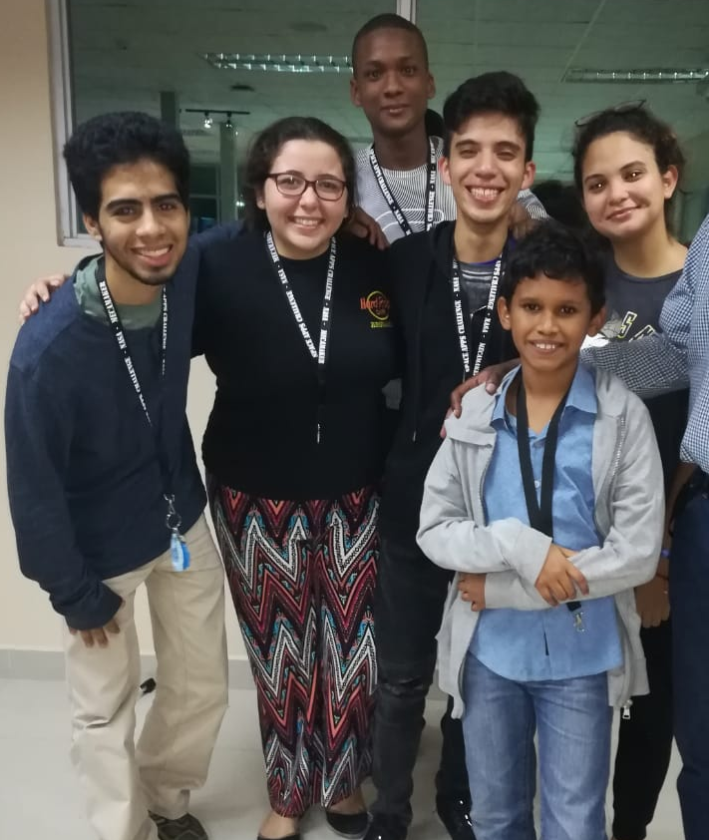
The team: Mars bug bot
Obed González
Pedro Naranjo
Ema Galindo
Carlos Molinar
Caroline Ponce
Justin Peralta

Slide 2
The main problem that our project wants to solve is disinformation, we want our project to be a solution to receive information about the current environmental status of the red planet in real time. The second point we want to solve is the security of the explorer, we want our project to be that tool that accompanies the explorer at all times so that he knows what challenges await him later

Slide 3
At this point you may be wondering what the mars bug bot team propose, we propose a system or a red of intercommunicated sensors that can receive and send signals to each other, in addition to sending signals to the rover or accompanying robot of the astronaut and the base of it. The second point of our project is to make improvements to the rover, mixing the technology of the NASA that is already used in Mars with terrestrial technology, thus having a more interactive function with the astronaut.

Slide 4
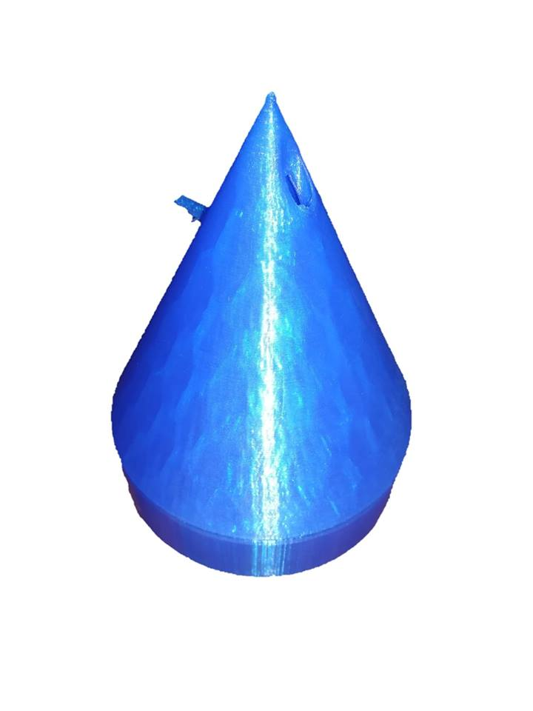
Pyramidal sensors
These will be the deployed and embedded sensors.
There are going to be three types of them: pressure, temperature and radiation sensors.
We decided to make them with the shape of a cone because (as the Egypt pyramids) they are going to be able to reduce the friction from the wind, helping them to survive at a Martian storm.

Slide 5
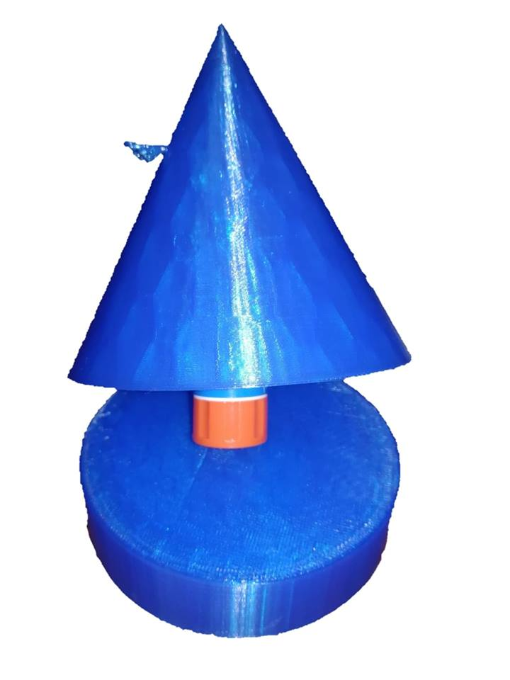
The three kind of cones got the same design with the only difference been their color and the type of sensor each one use, there is a little gate from where the sensors are going to get out to make their job. They will have a drum mechanism that will make them shake themselves to take off all the sand that got over them meanwhile their height increases, the cones will have a light sensor programmed to activate the drummer when the cone is fully covered in dust/sand.

Slide 6
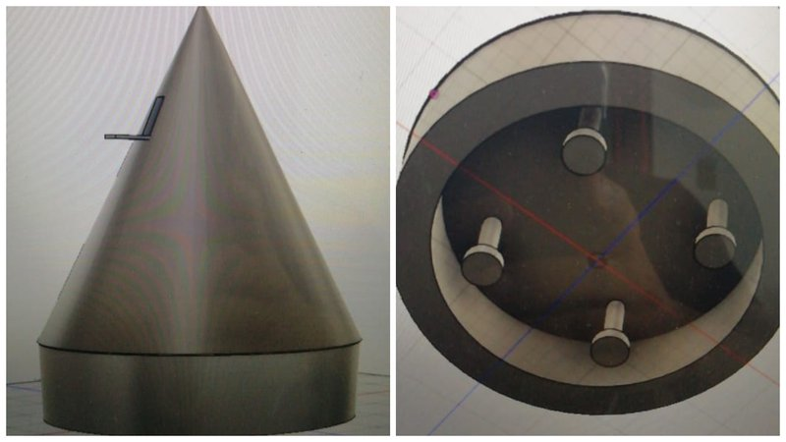
The source of the energy for the cones will be based in flexible solar panels placed in the cone itself with an inner battery to conserve the energy when they get covered by the storm.
The information about the environmental conditions of the planet is going to be sent in real time to the astronaut., they are going to be located at every 110km, plus, they will communicate between them with a radio frequency antenna between the spaceship from the astronaut, the ones themselves and the human.

Slide 7
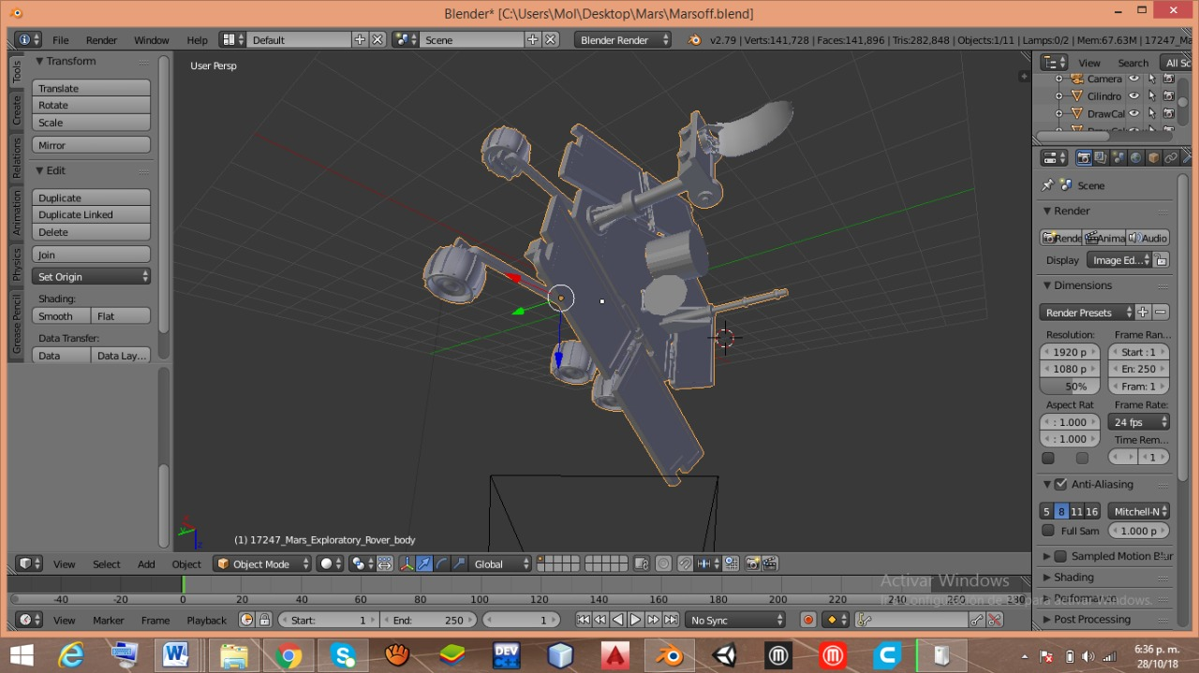
The rover
Part of our project consist in making some modifications and improvements to the spirit rover, it will have a RAD, REMs and Lidar, its energy will be obtained from solar panels. It will have a backup storage source that will be charged with it so that it has energy even in times when you are somewhere with little sunlight or a storm starts. It has a dispenser of "cones" to plant them every 110km when it is not accompanying the astronaut on his martian walks.

Slide 8
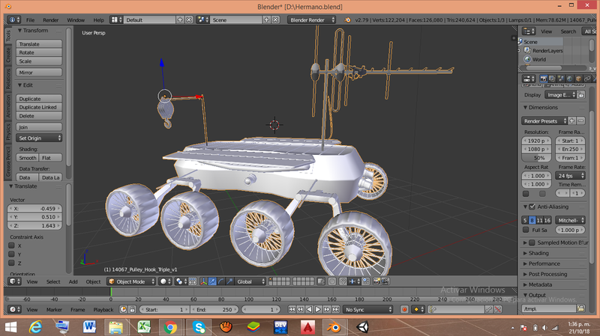
Big brother
Its function is to rescue the improved rover in case it is damaged and transported to the base to be repaired, as well as take care to unearth the cones if damaged.

Slide 9
Big brother
When the rover is in some problem which can no longer return to the base the Big Brother pay off in a rescue mission with the exact location where the rover is and take it back to the base where it will be able to make the necessary repairs so that you can return to your function as an assistant on Mars, all this rescue will be possible since it has a camera system, geolocator, your radio frequency antenna to monitor the mission of the same, along with a hook that will be the means by which execute the mission to take the rover safely to the base. The same function also has, when the sensor cones are a little above the stipulated depth and detect that the position where this is no longer favorable enough to withstand such storms, the Big Brother will be responsible for extracting the sensor cone and place it in a favorable position for it and do not have problems with loss of sensor that would also be lost data readings.

Slide 10
Communication
For the communication we think that the UHF signal can be the right one to our project.
This tecnology using on earth can be very usefull in Mars too, we though that this is the perfect type of signal to our Project because it have a long rang and a stable transmisión.
This way will be use in the communication between the cones, between the cones and humans, between the human and the rover, and with the base, basically we want to do a red of intercommunication in the red planet to be in touch with each point of the planet to know what is happening.
The range of this waves are around 120km, however, to prevent miss calculations for the communication between the cones they are going to be located in a distance between of 110km.

