Slide 1
DIFFERENT TYPES OF NETWORK CONNECTORS

Slide 2
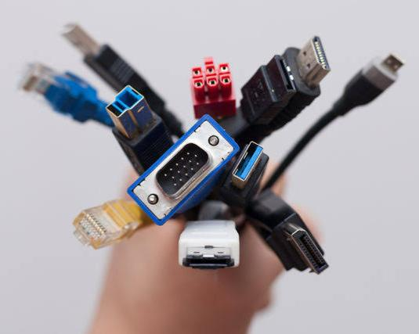
WHAT ARE THE 3 TYPES OF CONNECTORS?
:- Electrical connectors are classified into three types based on their termination ends: board-to-board connectors, cable/wire-to-cable/wire connectors, and cable/wire-to-board connectors

Slide 3
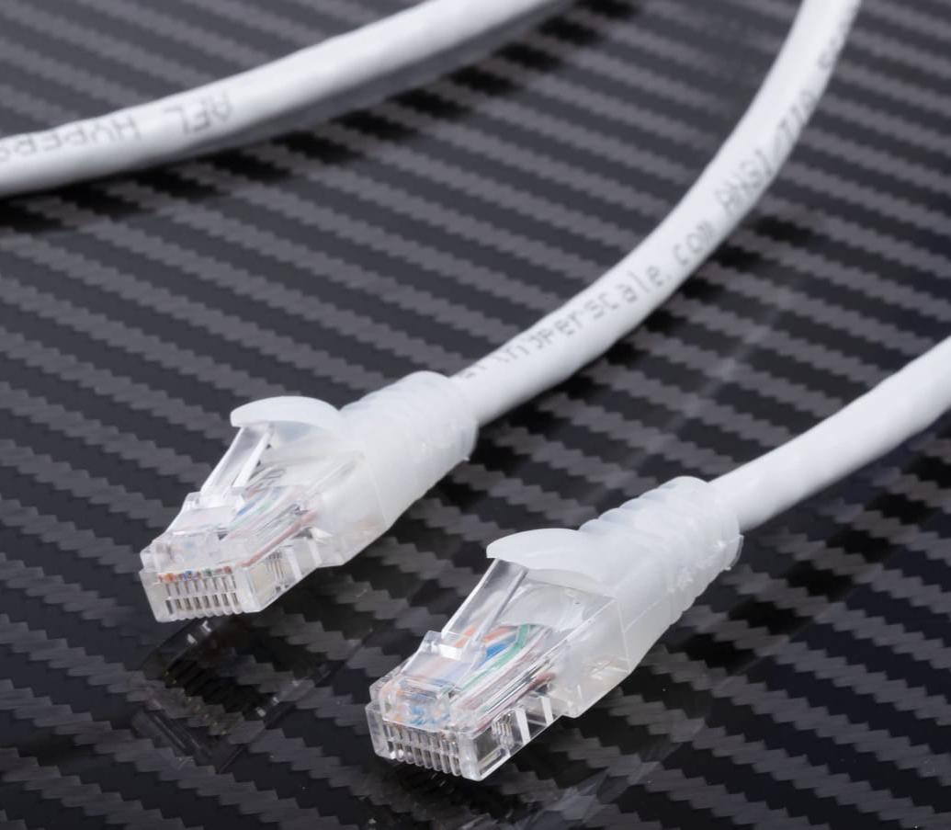
WHAT IS A ETHERNET CABLE USED FOR?
:- An Ethernet cable or Network cable is a cord used to connect devices together on a Network to transfer broadband data. They are used for connecting a laptop or desktop PC to a router, modem, internet hub, or printer, or for connecting any other wired network-capable peripherals together.

Slide 4
WHAT ARE CONNECTORS IN NETWORKING?
:- A connector is a device that terminates a segment of cabling or provides an entry point for network devices such as computers, hubs and routers. These can in turn be differentiated according to their external appearance and connection characteristics. For example, there are plugs or sockets and ports.

Slide 5
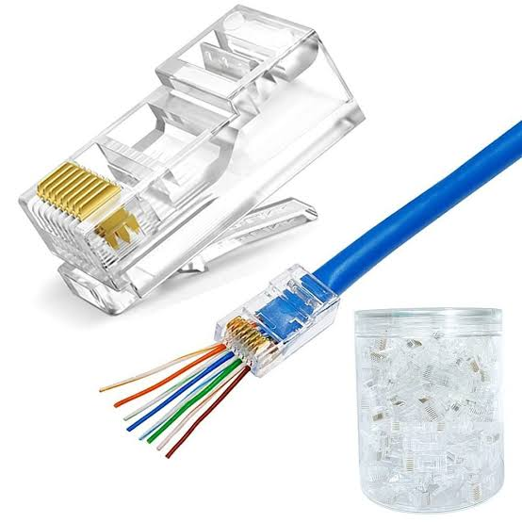
WHAT IS RJ45 CONNECTOR USED FOR?
:- RJ45 connectors are most commonly used to connect one internet-enabled device with another network device. For example, a PC connected to a server, router, modem, smart TV, gaming console, or any device utilizing Ethernet protocol.

Slide 6
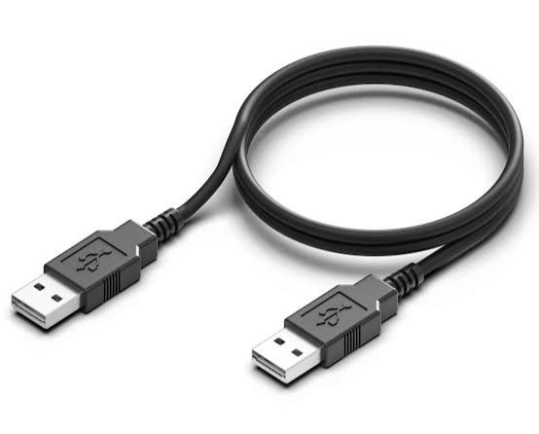
USB CONNECTORS
:- USB connectors are the most familiar to the majority of people. USB (Universal Serial Bus) connector typically join external devices to a personal computer or are used for mobile phone charging. There are adapters that will allow an Ethernet cable to connect directly to a USB port, through this type of setup would be a temporary solution for networking

