Slide 1




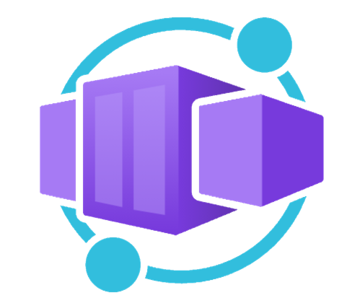




privatecapps
<env>.<region>.azurecontainerapps.io
A
*
Private DNS Zone
privatecapps-vnet ( 10.5.0.0/16)
subnet-caenv-infra-client ( 10.5.64.0/20)
subnet-caenv-infra-backend ( 10.5.32.0/20)
caenv-client
caenv-backend
Greeter
[ http client ]
Ingress IP
Helloer
[ http backend ]
HTTP GET
http://helloer.<env>.<region>.azurecontainerapps.io/connectivity/private
Container Apps Environnement
Container Apps Environnement
Subnet
Subnet
VNet
privatecapps-law
Log Analytics Workspace
Resource Group

