Slide 1
RESEARCH OF BOOSTING ALGORITHMS VERSUS TRADITIONAL METHODS IN CREDIT CARD FRAUD DETECTION ACROSS VARIED DATASETS
Justs Viduss
Transport and Telecommunication Institute

Slide 2
Why This Research Matters
Actuality
Research of Boosting Alghoritms
Addressing a Major Challenge: Credit card fraud poses a significant financial threat.
Advanced Solutions: Tests boosting algorithms known for superior performance.
Practical Impact: Provides data-driven insights to enhance fraud detection systems, adapting to evolving fraud tactics.
Justs Viduss
Notes:
Credit card fraud continues to be a significant financial threat, evolving in complexity and scale. Effective fraud detection not only mitigates financial losses but also protects consumer trust and financial institution integrity.
This research is pivotal as it explores advanced machine learning methods, particularly boosting algorithms, which have demonstrated potential in other fields for superior performance over traditional methods.
By testing these algorithms across varied and realistic datasets, the study provides insights that can lead to more effective fraud detection systems. The results are interesting for developing strategies that keep pace with the changing tactics of fraudsters, making this research directly relevant to anyone involved in financial security and machine learning applications.

Slide 3
Objectives
Objectives
Research of Boosting Alghoritms
Goal: Evaluate and compare the effectiveness of boosting algorithms
Objective: Assess multiple machine learning approaches across three distinct datasets: synthetic, balanced, and highly unbalanced
Key insights: Determine the best-performing algorithms based on F1 score, accuracy, precision, recall to optimize fraud detection strategies
Justs Viduss
Notes:
Research Goal: To conduct a comprehensive analysis and comparison of boosting algorithms against traditional machine learning methods in detecting credit card fraud across various datasets.
Main Objective: To evaluate the effectiveness of boosting algorithms in comparison to traditional techniques, using different types of credit card transaction datasets: a synthetic dataset, a balanced dataset with equal proportions of fraudulent and valid transactions, and a highly unbalanced dataset.
This research addresses the gap in existing studies on machine learning techniques for fraud detection, which have not extensively compared various methods across diverse data conditions. The study's insights aim to inform the optimal choice of algorithms for practical application in detecting credit card fraud, providing valuable recommendations based on performance metrics such as F1 score, accuracy, precision, and recall. This is crucial because the type of dataset can significantly influence the performance of the detection method, impacting its real-world usability.

Slide 4
Outline
Outline
Research of Boosting Alghoritms
Algorithms tested
Datasets
Implementation
Algorithm performance analysis
Conclusions
Justs Viduss

Slide 5
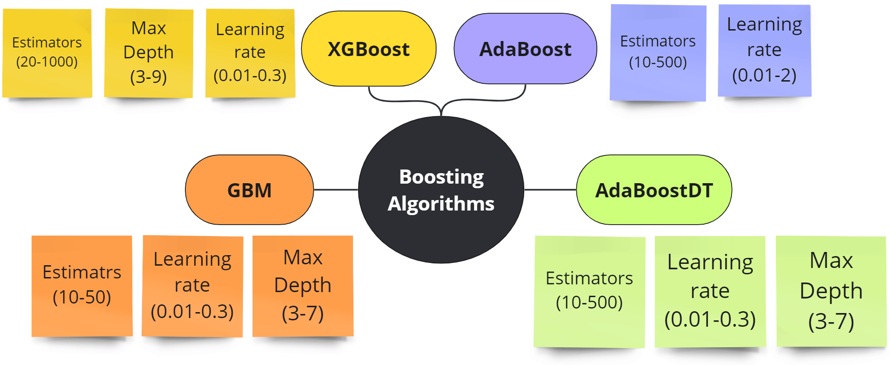
Algorithms tested
Algorithms tested
Research of Boosting Alghoritms
Justs Viduss

Slide 6
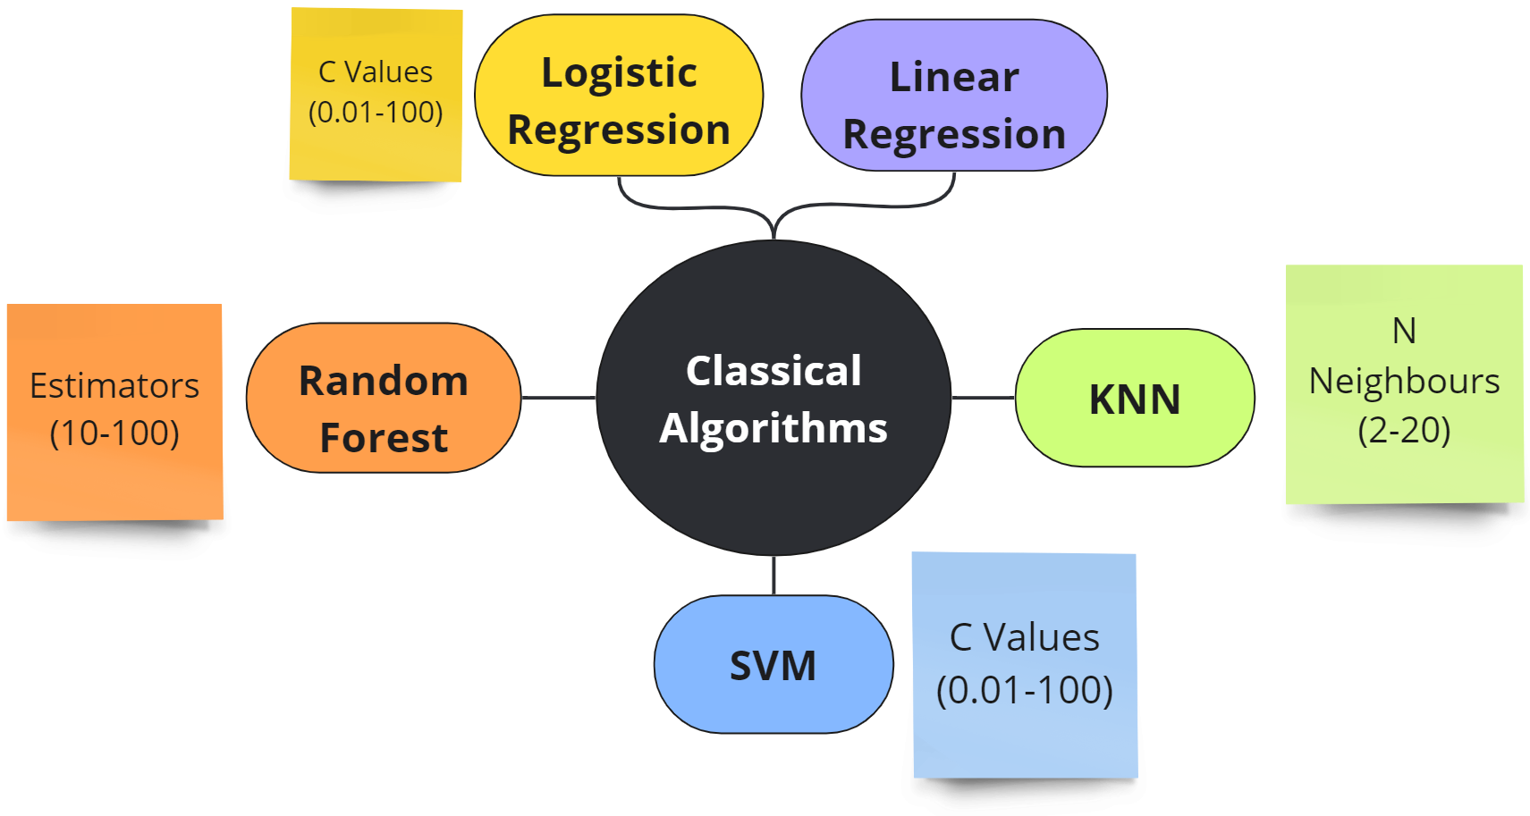
Algorithms tested
Research of Boosting Alghoritms
Justs Viduss

Slide 7
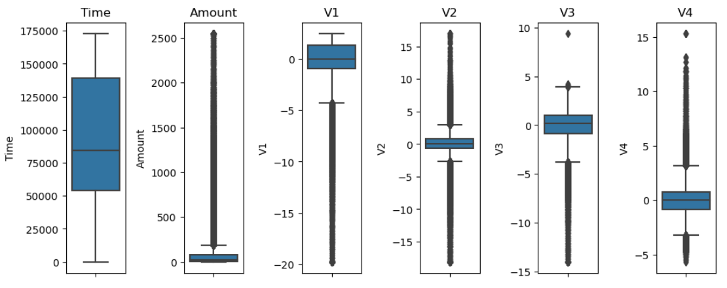
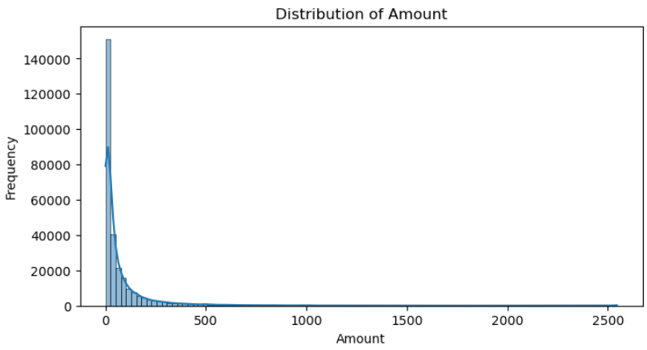
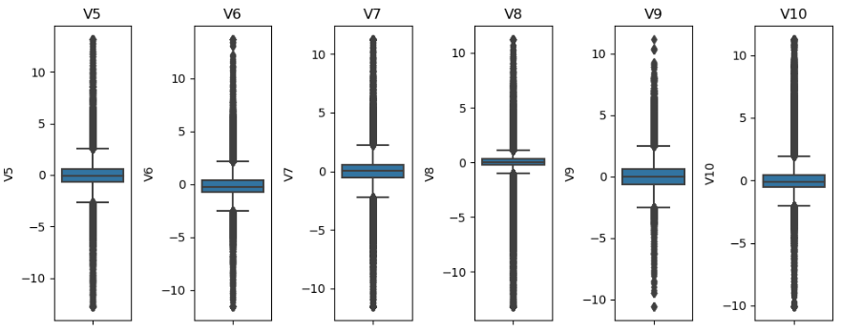
Datasets
Datasets
Research of Boosting Alghoritms
Unballanced dataset: 284k rows, 30 features, 492 fraud cases (0.17%). All features exept time and transaction amount are anonymized using PCA. Source: Kaggle (2018) transactions made by European cardholders in September 2013
Justs Viduss

Slide 8
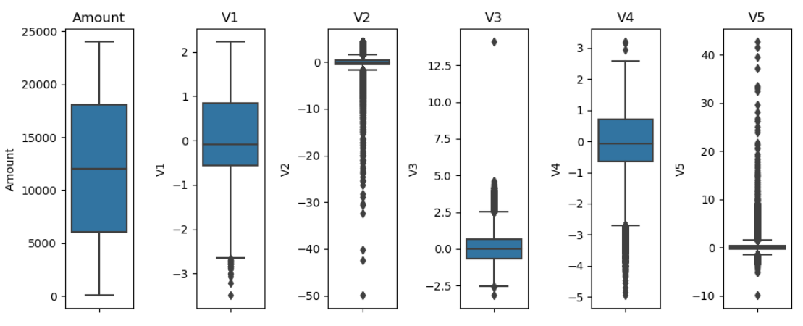
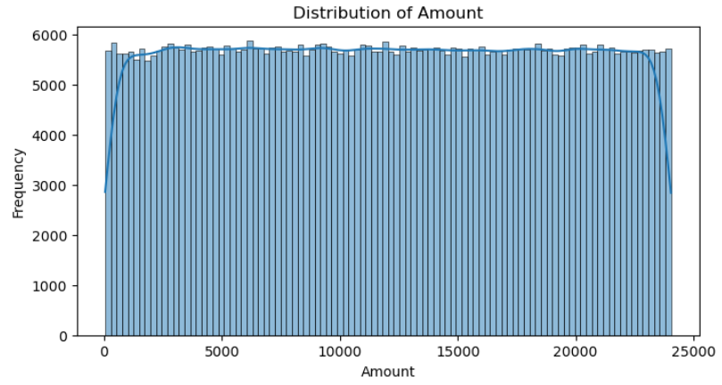
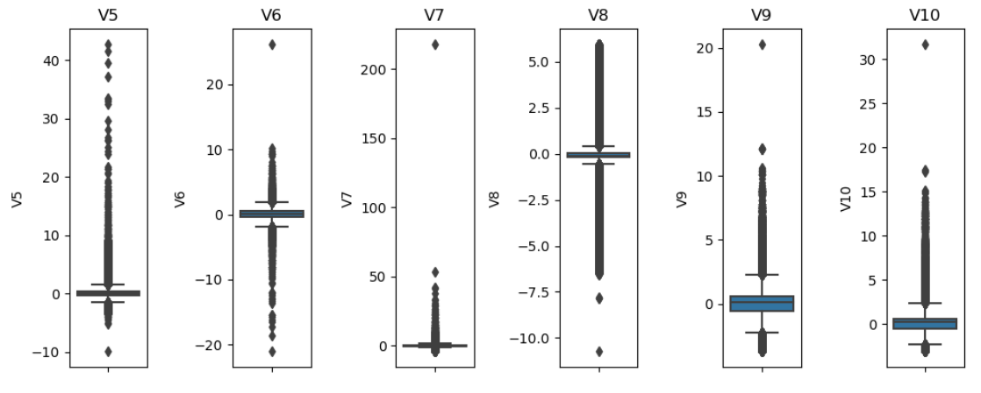
Datasets
Research of Boosting Alghoritms
Ballanced dataset: 568k rows, 29 features, 280k fraud cases (50%). Source: Kaggle (2023). Transactions made by European cardholders in 2023
Justs Viduss

Slide 9
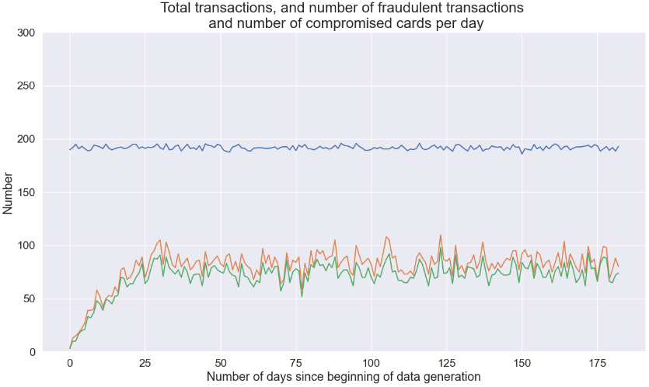
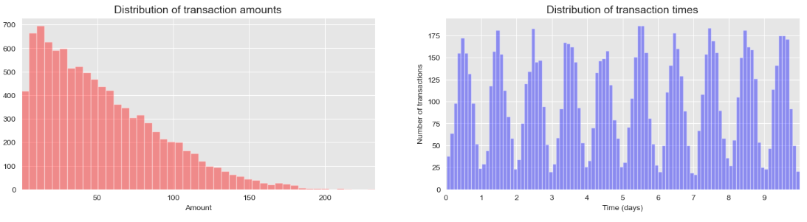
Datasets
Research of Boosting Alghoritms
Synthetic data: Generated with python script, 1.7m rows, 5 features, 14k fraud cases (0.84%)
Justs Viduss

Slide 10
Implementation
Implementation
Research of Boosting Alghoritms
Tools: Python notebooks, Excel
Preprocessing: Data cleaning and preparation for modeling
Parameter tuning: In total 900 semi-automated tests were done
Testing environment: Laptop
10 Core 12th gen Intel CPU
16 GB RAM
Justs Viduss
Notes:
In implementing this research, Python notebooks were used for data preprocessing, algorithm tuning, and testing.
Initially, the data was cleaned and preprocessed to ensure it was suitable for the models.
Then conducted parameter tuning to optimize each algorithm's performance.
All these tasks were performed on a regular work computer, demonstrating that advanced, effective fraud detection can be developed without the need for high-end computing resources. This approach makes research findings accessible and practical for a wide range of applications.

Slide 11
Algorithm performance analysis
Algorithm performance analysis
Research of Boosting Alghoritms
Why each metric was chosen for tests:
Recall when it is critical to catch as many frauds as possible (minimizing false negatives)
Precision when it is crucial to be as accurate as possible in your fraud predictions (minimizing false positives)
F1 Score when you need a balance between precision and recall, and both types of errors are similarly costly
Accuracy only when the classes are somewhat balanced or when you want a general idea of the model's performance across all predictions
Justs Viduss

Slide 12
Recall
Algorithm performance analysis
Research of Boosting Alghoritms
Justs Viduss

Slide 13
Recall
Algorithm performance analysis
Research of Boosting Alghoritms
Justs Viduss

Slide 14
Accuracy
Algorithm performance analysis
Research of Boosting Alghoritms
Justs Viduss

Slide 15
F1 Score
Algorithm performance analysis
Research of Boosting Alghoritms
Justs Viduss

Slide 16
Precision
Algorithm performance analysis
Research of Boosting Alghoritms
Justs Viduss

Slide 17
Conclusions
Conclusions
Research of Boosting Alghoritms
For Fraud detection in real world scenarious AdaBoost has best performance from tested algorithms, and outperforms other Boosting and classical algorithms
Other algorithms perform better in different situations which is interesting for other industries where Accuracy, F1 Score or Precision would be more important
Gradient Boosting Machine might be go to algorithm with uncertain or changing data, as it performed well on both, real and synthetic data
Justs Viduss
Notes:
As Recall is most useful for Fraud detection un mostly in real world scenarious companies, according to these findings it would be recommended to use AdaBoost algorithm as it had the highest Recall of 83,7% on Unballanced dataset and considerably outperforms other algorithms.
Other algorithms might be better to be used for different industries with similar data, for example, F1 Score and Accuracy was the highest for Ballanced and Unballanced data for XGBoost and AdaBoostDT;
Precision was highest for Random Forest which was one of the fastest algorighms in terms of execution time.

Slide 18
Acknowledgements
Acknowledgements
Research of Boosting Alghoritms
The research was supervised by Dr.sc.ing., Professor Nadezda Spiridovska, whose insights and guidance were invaluable throughout the study
Justs Viduss

Slide 19
Thank you
Justs Viduss
viduss.justs@gmail.com

