Slide 1
Control Flow and Side Effects Support in a Framework for Automatic I/O Batching
By Justus Adam
Supervisor: Sebastian Ertel

Slide 2
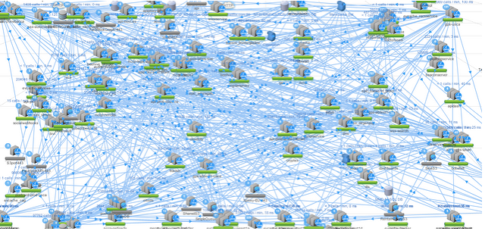
The I/O challenge
Amazon, Facebook, Twitter, Netflix
Server: Service-oriented Architecture
I/O is crucial! ➡ But optimization is difficult!
Server
I/O
Think: Google Blogspot
http://2.bp.blogspot.com/-YkR1Jktns3k/VdE2m2q0NmI/AAAAAAAABoA/4sr9mhqmrQs/s1600/netflix_topology.png

Slide 3
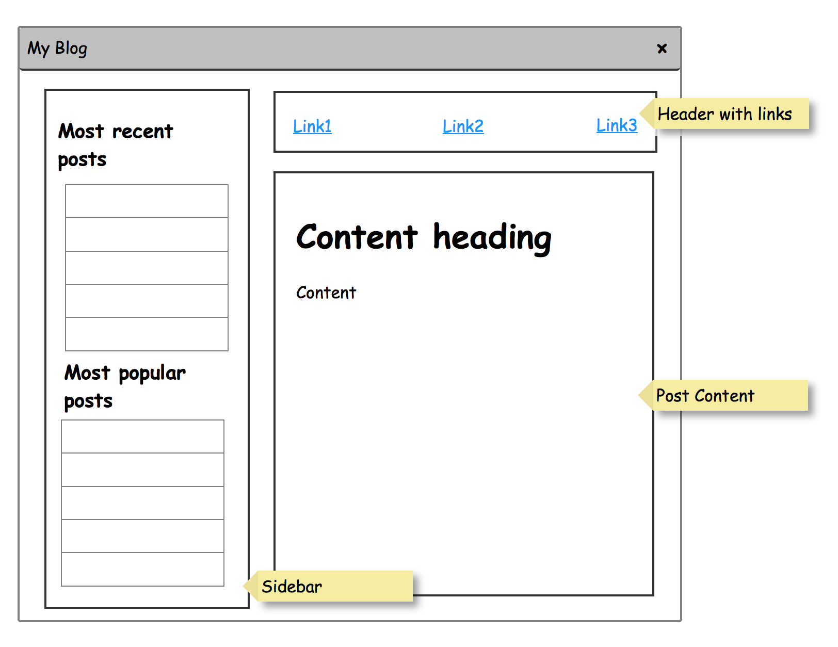
A motivating example
(defn all-with-read-count []
(map (λ id. [id (fetch (ReadCountRequest id))]) (fetch (PostIdsRequest))))
(defn all-with-creation-date []
(map (λ id. [id (fetch (CreationDateRequest id))]) (fetch (PostIdsRequest))))
(defn make-sidebar []
(let [most-read (take 5 (sort-by second (all-with-read-count)))
most-recent (take 5 (sort-by second (all-with-creation-date)))]
[(map first most-read)
(map first most-recent)]))
(defn article [id]
(let [content (fetch (ContentRequest id))
header (fetch (LinksRequest))
sidebar (make-sidebar)]
(make-page content sidebar header)))
$$map\left(f, \left[v_{1},v_{2},…, v_{n}\right]\right)=[f\left(v_{1}\right), f\left(v_{2}\right), …, f\left(v_{n}\right)]$$
fetch
(Content id)
(ContentResponse)
Notes:
- Explain map

Slide 4
A motivating example
(defn all-with-read-count []
(map (λ id. [id (fetch (ReadCountRequest id))]) (fetch (PostIdsRequest))))
(defn all-with-creation-date []
(map (λ id. [id (fetch (CreationDateRequest id))]) (fetch (PostIdsRequest))))
(defn make-sidebar []
(let [most-read (take 5 (sort-by second (all-with-read-count)))
most-recent (take 5 (sort-by second (all-with-creation-date)))]
[(map first most-read)
(map first most-recent)]))
(defn article [id]
(let [sidebar (make-sidebar)
content (fetch (ContentRequest id))
header (fetch (LinksRequest))]
(make-page content sidebar header)))
➡ Lots of I/O!

Slide 5
Manual optimisations
(defn all-with-read-count []
(map (λ id. [id (fetch (ReadCountRequest id))]) (fetch (PostIdsRequest))))
(defn all-with-creation-date []
(map (λ id. [id (fetch (CreationDateRequest id))]) (fetch (PostIdsRequest))))
(defn make-sidebar []
(let [most-read (take 5 (sort-by second (all-with-read-count)))
most-recent (take 5 (sort-by second (all-with-creation-date)))]
[(map first most-read)
(map first most-recent)]))
Optimisation1: Caching
➡ Breaks modularity
Optimisation 2: Batching
➡ Increases code complexity
(defn make-sidebar []
(let [post-ids (fetch (PostIdsRequest))
fetched-results (map (λ id. [id (fetch (ReadCountRequest id) (CreationDateRequest id))]) post-ids)
read-count-results (map (λ res. [(first res) (first (second res))]))
creation-date-results (map (λ res. [(first res) (second (second res))]))
most-read (take 5 (sort-by second read-count-results))
most-recent (take 5 (sort-by second creation-date-results))]
[(map first most-read)
(map first most-recent)]))
Notes:
Op1 -> Breaks modularity
Op 2 -> Increased code complexity

Slide 6
Solutions
Haxl^{[1]}
Haskell library
Applicative Functors
Muse^{[2]}
Clojure library
Runtime AST
Ÿauhau^{[3]}
Dataflow compiler plugin
Compile time program transformation
Control flow
[1] Marlow, Simon, et al. "There is no fork: An abstraction for efficient, concurrent, and concise data access." ACM SIGPLAN Notices. Vol. 49. No. 9. ACM, 2014.
[2] Alexey Kachayev. 2015. ”Reinventing Haxl: Efficient, Concurrent and Concise Data Access.” https://www.youtube.com/watch?v=T-oekV8Pwv8
[3] Ertel, Goens, Adam, Castrillon ”Ÿauhau: Concise Code and Efficient I/O Straight from Dataflow.”

Slide 7
Compile time approach
(defn all-with-read-count []
(map (λ id. [id (fetch (ReadCountRequest id))]) (fetch (PostIdsRequest))))
(defn all-with-creation-date []
(map (λ id. [id (fetch (CreationDateRequest id))]) (fetch (PostIdsRequest))))
(defn make-sidebar []
(let [most-read (take 5 (sort-by second (all-with-read-count)))
most-recent (take 5 (sort-by second (all-with-creation-date)))]
[(map first most-read)
(map first most-recent)]))
(defn article [id]
(let [sidebar (make-sidebar)
content (fetch (ContentRequest id))
header (fetch (LinksRequest))]
(make-page content sidebar header)))
Notes:
- Arrows is data sent, nodes are functions executed

Slide 8

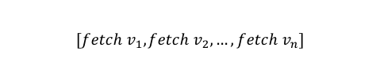
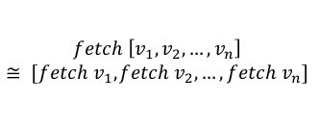

Batching I/O
Accumulative batching
Merge map batching
$$[v_{1},v_{2},…, v_{n}]$$
$$v_{1}$$
$$v_{2}$$
$$v_{n}$$
$$[fetch v_{1},fetch v_{2},…, fetch v_{n}]$$
$$[v_{1},v_{2},…, v_{n}]$$
What about if and complex maps?
$$fetch \left[v_{1},v_{2},…, v_{n}\right]$$
$$≅ [fetch v_{1},fetch v_{2},…, fetch v_{n}]$$

Slide 9
Batching I/O
Accumulative batching
Merge map batching
➡ trivial

Slide 10
Context handling

Slide 11
Context handling
Insert exit node before
Insert enter node after

Slide 12
Conditionals
Notes:
Mention contexts briefly
Mention nested unwinding was part of contribution

Slide 13
Maps

Slide 14
Experiments
Larger rounds
More batching opportunities
Fewer rounds
Lower program execution time

Slide 15
Map experiments
Haxl
Haxl
Yauhau
code generator
statistics
run
Yauhau

Slide 16
Evaluating precomputing

Slide 17
Conclusions and future work
Patterns in control flow structures allow lifting of nodes
Generalized concept called ”Context”
Desired: Formal definition and proof of semantics preservation
Potential optimization: Subgraph batching
Potential extension: Loop/reduce batching
Maps are reduced to batched fetches
Possible improvement: Chunked batches
Precomputing conditional branches can save rounds
Decision on criteria such as
Critical path
Branch imbalance

