Slide 1
Towards Scalable UDTFs in Noria^{[1]}
Contact: Justus Adam, Justus.Adam@tu-dresden.de
Jon Gjengset, Malte Schwarzkopf, Jonathan Behrens, Lara Timbó Araújo, Martin Ek, Eddie Kohler, M. Frans Kaashoek, and Robert Morris. 2018. Noria: dynamic, partially-stateful data-flow for high-performance web applications. OSDI 18.

Slide 2




Research Challenges: Incremental Materialized Views
Incremental recompute on write
Eventually consistent writes
Database
1: Compatibility
2: Efficiency
Materialized views offer fast reads trough aggressive caching
Incremental maintenance makes the slow writes more efficient
Sharded compute nodes with partitioned state
Fast Reads
Cached Results
Challenge 1: Compatibility: Support incremental computations for UDF
Challenge 2: Efficiency: Support sharding (parallelizing and distribution) the UDF or risk being a bottleneck to scaling

Slide 3
Research Challenges: UDFs and State
UDFs are a powerful extension point for databases
Third-party libraries, serialization, conversion
State
Parallelizing
Single-tuple UDF
single input, single output
Aggregation, Set-returning function
multiple inputs or outputs
Table Function
multiple inputs and outputs, only parallelizable with additional knowledge of the function itself
Imperative source language with shared mutable state
Table function and aggregation interfaces, are inherently stateful
The more state is used, the harder it is to parallelize or shard

Slide 4
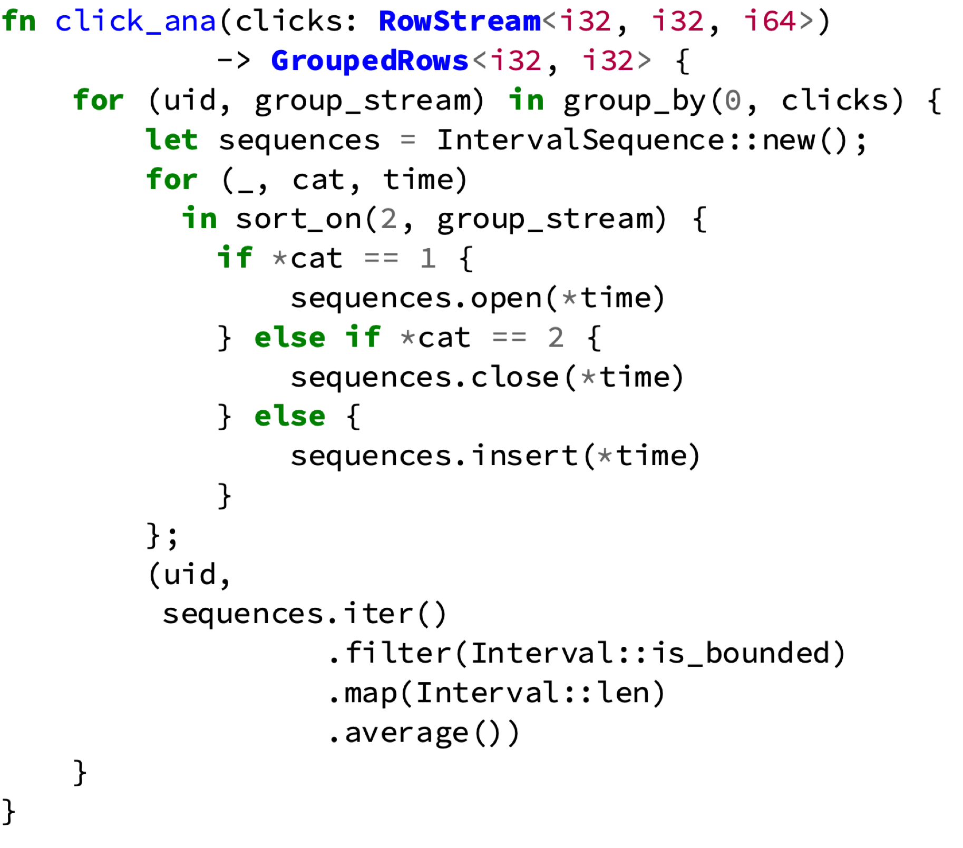


Compilation Target and Strategy
The compilation target, a Noria query, is a graph (network) of stateful operators
Operator state is private, not shared
Communication via message passing
Find state mutations and recursively find dependencies
💡 Use parallelizing compiler (Ohua^{[2,3]}) to split UDF program into
Single “outer” program, without shared state, suitable for transformation into the query graph
Multiple ”inner” programs, using shared state internally, suitable for forming the core of stateful operators
bundle into
stateful operator
outer program to graph
Sebastian Ertel, "Towards Implicit Parallel Programming for Systems." Dissertation, 2019
Sebastian Ertel, Justus Adam, Norman Rink, Andrés Goens, Jeronimo Castrillon, "STCLang: State Thread Composition as a Foundation for Monadic Dataflow Parallelism." Haskell’19.

Slide 5
Incremental Operator State
1: Compatibility
Graph is incremental by construction, if all operators are incremental
We require custom operator state mutations to be reversible
This allows stateful operators to be made incremental automatically
💡 If a previously processed value is deleted, rerun operator computation but revert modifications instead of applying them.

Slide 6
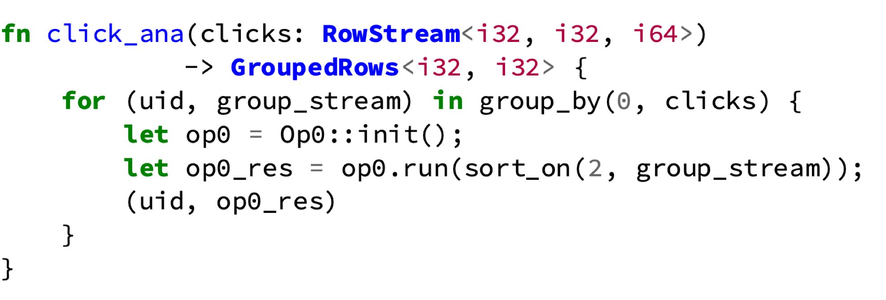
Data Parallelism
Sequence index becomes state partition index
2: Efficiency
State is no longer shared, i.e. only used once
Here is also local to the loop iteration
Outer program after splitting
Straightforward translation
Exploiting loop local state and sequence partitioning
With database primitives (like group_by) the compiler additionally knows how to partition the input and shard the computation
Enables data parallelism

Slide 7
Preliminary Results
Our novel technique can compile a subset of imperative, stateful Rust to incrementally maintained views in a dataflow engine
Supports Single-tuple UDFs, aggregations, table functions and standalone queries
1: Compatibility
Parallelism and sharding is implicit and effortless
For our example query we are able to achieve near linear scaling up to 3 shards.
2: Efficiency
Diminishing returns after 3 shards are likely caused by orchestration overhead starting to dominate the small data size.
Slides: https://justus.science/slides/SIGMOD-SRC-2020.{pdf|pptx}
Poster preprint: https://justus.science/pdfs/SIGMOD-SRC-2020-poster.pdf

