Slide 1
Ohua-Powered, Semi-Transparent UDF’s in the Noria Database
By Justus Adam
Supervisor: Sebastian Ertel, Dirk Habich, Malte Schwarzkopf and Jerónimo Castrillón-Mazo

Slide 2





Motivation
State is useful!
Aggregation
Stateful nodes for efficiency
Windowing
Efficiency
Fundamental
SQL
Intuitive Code
Semi-Transparent
Counting
No Optimisation
No Parallelism
Support?
UDF
Deduplication
Caching

Slide 3
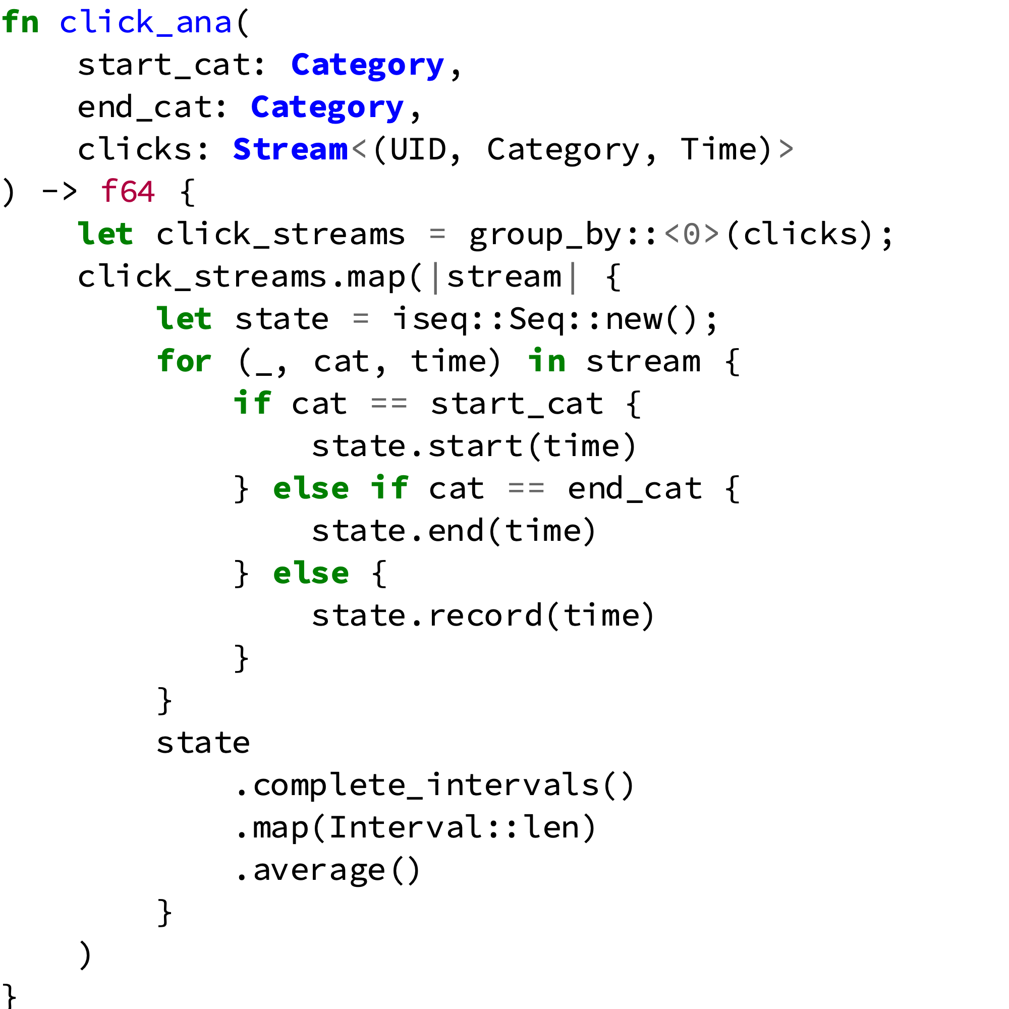
Example UDF – Clickstream Analysis
From SQL/MapReduce¹ paper
Complicated in SQL
Inefficient in SQL
Non trivial but simple
Business query
State is paramount
Contains SQL element
Eric Friedman, Peter Pawlowski, and John Cieslewicz. 2009. SQL/MapReduce: a practical approach to self-describing, polymorphic, and parallelizable user-defined functions. Proc. VLDB Endow. 2, 2 (August 2009), 1402-1413.

Slide 4




Noria
Multicore
Distributed
No UDF Support
Slow Base Table Writes
Read Cascade (Upquery)
Base table (Column Store)
Fast Reads
Partially cached computations (Partial State)
Materialized view
Update propagation (Eventual consistency)
Jon Gjengset et al. 2018. Noria: dynamic, partially-stateful data-flow for high-performance web applications. In Proceedings of the 12th USENIX conference on Operating Systems Design and Implementation (OSDI'18). USENIX Association, Berkeley, CA, USA, 213-231.
Notes:
Dataflow system
Materialized View
Partial State
Fast reads
For Websites
Has no UDF support (yet)

Slide 5
Roadmap
Integrate into Partial State
Ohua Compiled UDF
Query Elements in the UDF
UDF State Design
Pure Ohua Query
Host Integration (Noria)
Compiler Support (Ohua)

Slide 6
Noria Execution Model
uid | Category | Timestamp
1 | start | 1
1 | other | 5
1 | end | 10
1 | other | 3
Base Table
Update Path (Insert)
sign | uid | Category | Timestamp
+ | 1 | other | 3
UDF
INSERT (1, other, 3)
INTO ‘Base Table’;
sign | uid | Click Distance
- | 1 | 2
+ | 1 | 3
uid | Click Distance
1 | 3

Slide 7
Noria Execution Model
uid | Category | Timestamp
1 | start | 1
1 | other | 5
1 | end | 10
1 | other | 3
Base Table
Update Path (Delete)
sign | uid | Category | Timestamp
- | 1 | other | 5
UDF
DELETE (1, other, 3)
FROM ‘Base Table’;
sign | uid | Click Distance
- | 1 | 3
+ | 1 | 2
uid | Click Distance
1 | 2

Slide 8
Noria Execution Model
uid | Category | Timestamp
1 | start | 1
1 | other | 5
1 | end | 10
1 | other | 3
Base Table
On-line inserts
On-line deletes
Order is random
sign | uid | Category | Timestamp
- | 1 | other | 5
UDF
sign | uid | Click Distance
- | 1 | 3
+ | 1 | 2
Commutative
Incremental
Reversible
Operations
uid | Click Distance
1 | 2

Slide 9
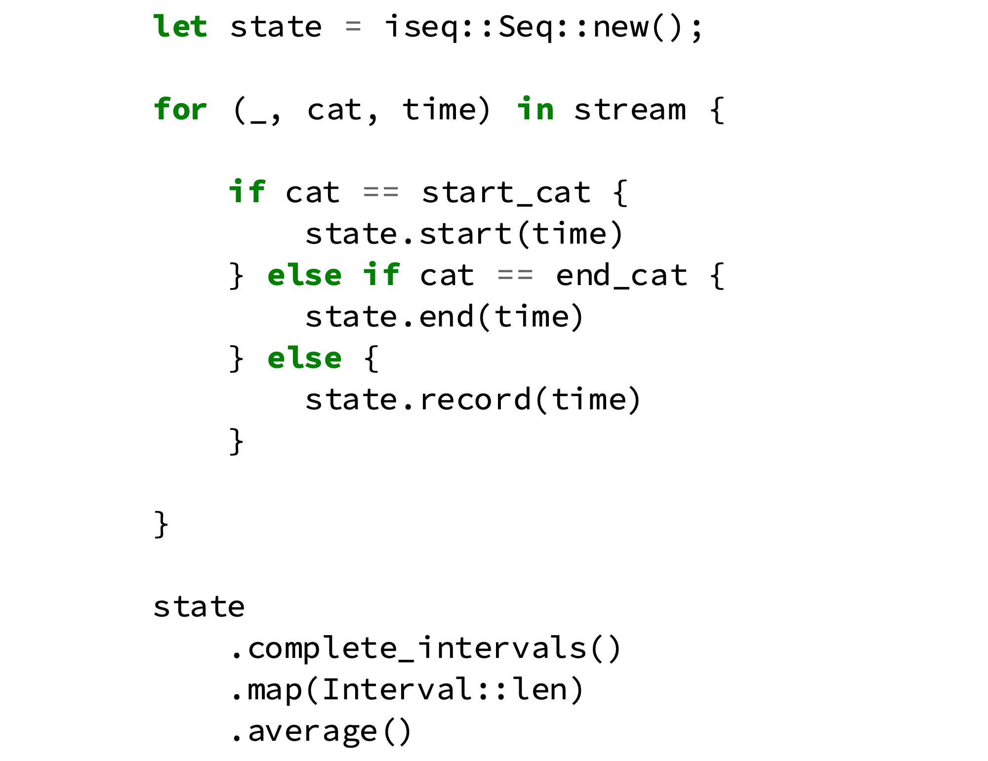
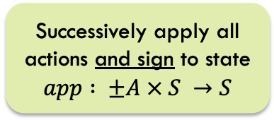
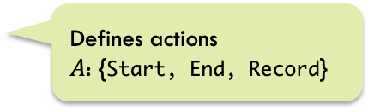
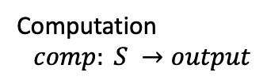

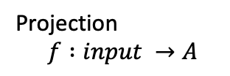

UDF State Design
State $S$
Defines actions
$A$: {Start, End, Record}
Projection
$$f :input →A$$
Affected by sign
Not affected by sign
Successively apply all actions and sign to state
$$app : ±A × S →S$$
Computation
$$comp: S →output$$
$$UDF:[±input] →output$$

Slide 10
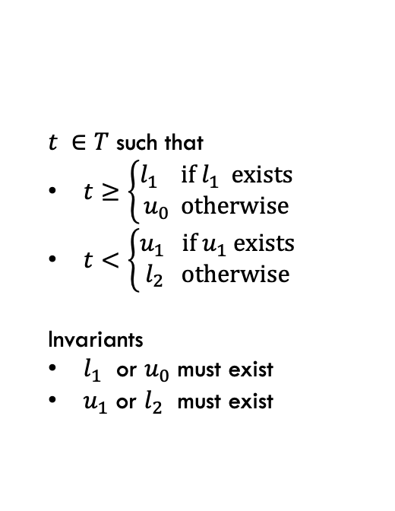

Interval Sequence as State
Base Table
uid | Category | Timestamp
1 | start | 1
1 | other | 5
1 | end | 10
1 | other | 3
$$s: [ \left[l_{0},u_{0}\right), \left[l_{1},u_{1}\right), \left[l_{2},u_{2}\right)]$$
$t ∈T$ such that
$t≥\left\{\begin{aligned}l_{1} \text{if} l_{1} \text{exists} \\ u_{0} \text{otherwise}\end{aligned}\right.$
$t<\left\{\begin{aligned}u_{1} \text{if} u_{1} \text{exists} \\ l_{2} \text{otherwise}\end{aligned}\right.$
Invariants
$l_{1}$ or $u_{0}$ must exist
$u_{1}$ or $l_{2}$ must exist
UDF
[[5,3,10].length()].average() == 3
uid | Click Distance
1 | 3
Merge intervals to maintain

Slide 11
Conclusions
Must be
Reversible
Commutative
Integrate into Partial State
Ohua Compiled UDF
Query Elements in the UDF
UDF State Design
Pure Ohua Query

Slide 12

Partial State integration
Cached Rows
Customizable Addition
Index
(GROUP BY)
uid | Category | Timestamp
1 | start | 1
1 | other | 5
1 | end | 10
UDF State
ancestor
uid:1
uid:2
uid:3
uid | Category | Timestamp
2 | start | 2
2 | end | 55
2 | other | 8
State lookup
$$∅$$
Evicted Entry
(Querying this cascades upstream)
querying node
Notes:
Evicted upstream means evicted downstream

Slide 13
Partial State integration
Cached Rows
Customizable Addition
Index
(GROUP BY)
uid | Category | Timestamp
1 | start | 1
1 | other | 5
1 | end | 10
UDF State
Lookup for processing
ancestor
uid:1
uid:2
uid:3
uid | Category | Timestamp
2 | start | 2
2 | end | 55
2 | other | 8
State lookup
$$∅$$
Evicted Entry
(Querying this cascades upstream)
querying node
Evicted entries aren’t processed

Slide 14
Conclusions
Integrate into Partial State
Ohua Compiled UDF
Query Elements in the UDF
UDF State Design
Pure Ohua Query
To Support
Eviction
Lookups

Slide 15


Manual Implementation
UDF
noria::dataflow::state
noria::dataflow::ops
Computation $comp$
Iteration
Projection $f$
State
Implementation
Operator
Implementation
State Integration
Operator Integration

Slide 16
Manual Implementation
UDF
>30 files touched¹
>3000 lines written¹
3 new mayor data structures
noria::dataflow::state
noria::dataflow::ops
Computation $comp$
Iteration
Projection $f$
State
Implementation
Operator
Implementation
State Integration
What. A. Mess.
Operator Integration
For whole implementation including intermediate prototypes and test code. Approximately 50% used exclusively for UDF.

Slide 17

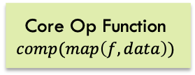

Operator Compilation
UDF Source Code
Code Splitting
Code Recombine
Noria Backend
& Code Gen
Stateful Iteration
Projection $f$
Core Op Function
$$comp(map\left(f,data\right))$$
Operator Integration
Noria Flow API
Computation $comp$
State Integration
state.rs
State
Implementation

Slide 18
Operator Compilation
UDF Source Code
Code Splitting
Code Recombine
Noria Backend
& Code Gen
Stateful Iteration
UDF code in one place
& platform unspecific
Projection $f$
Core Op Function
$$comp(map\left(f,data\right))$$
Operator Integration
Noria Flow API
Computation $comp$
State Integration
state.rs
State
Implementation

Slide 19
Conclusions
Abstraction
Conciseness
Code Locality
Integrate into Partial State
Ohua Compiled UDF
Query Elements in the UDF
UDF State Design
Pure Ohua Query

Slide 20
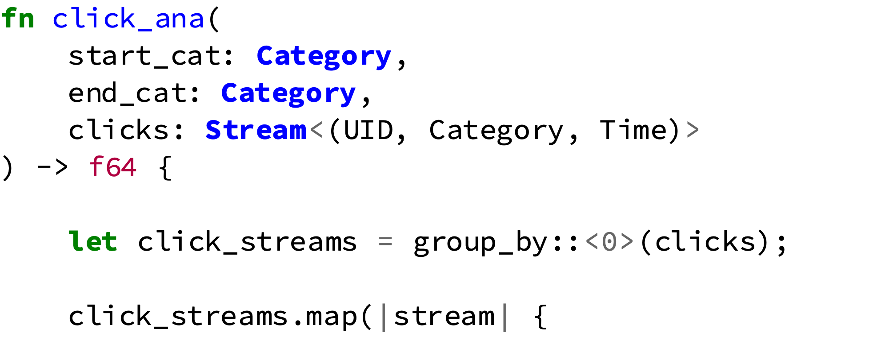
UDF Compilation
UDF Source Coce
Code Splitting
Noria Backend
Signature
Query Integration
Grouping
Noria IR Graph
...
Operator Code
Operator

Slide 21
UDF Compilation
UDF Source Coce
Code Splitting
Noria Backend
SQL-like operations
expressible in Ohua
Signature
Query Integration
Grouping
Noria IR Graph
...
Operator Code
Operator
No SQL necessary

Slide 22
Conclusions
Integrate into Partial State
Ohua Compiled UDF
Query Elements in the UDF
UDF State Design
Pure Ohua Query
Incremental
Reusable
Code Locality

Slide 23
Conclusions
Intuitive
Flexible
Composable
Fast
Must be
Reversible
Commutative
Abstraction
Conciseness
Code Locality
Integrate into Partial State
Ohua Compiled UDF
Query Elements in the UDF
UDF State Design
Pure Ohua Query
To Support
Eviction
Lookups
Incremental
Reusable
Code Locality

Slide 24
Conclusions
Must be
Reversible
Commutative
To Support
Eviction
Lookups
Abstraction
Conciseness
Code Locality
Incremental
Reusable
Code Locality
Integrate into Partial State
Ohua Compiled UDF
Query Elements in the UDF
UDF State Design
Pure Ohua Query
Intuitive
Flexible
Composable
Fast
Additional State Patterns
State builder Toolkit
More Query Elements in Ohua
Multi-State UDF’s
Non-SQL Datatypes

