Slide 1
Project
Portfolio
Justus Liutala · RoboAI Academy Student and AI Data Engineer

Slide 2
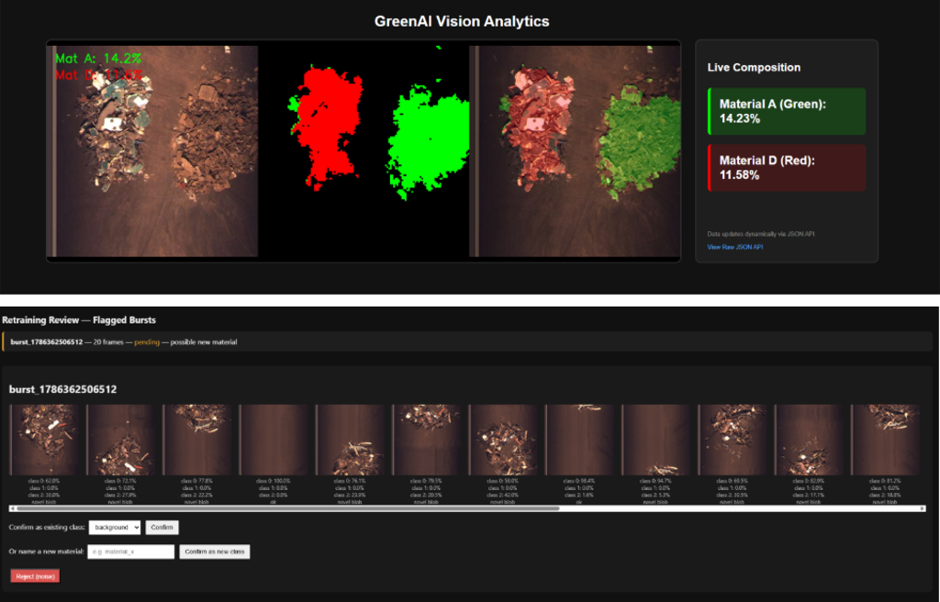
Machine Vision
Deep Learning
Summer Work 2026
92.1%
+27pp
4-ch
<43ms
GreenAIVision
mIoU accuracy
vs baseline
RGB + NIR
per frame
SAMK RoBoAI · Boliden collaboration
PROJECT OVERVIEW
Real-time AI system for Boliden's WEEE recycling conveyor belt. Semantic segmentation classifies every pixel into background, copper-rich cable waste, or shredded PCB fragments — enabling data-driven purity measurement replacing manual estimation.
WHAT I BUILT
Rebuilt the full pipeline from a 65% accuracy prototype: switched to SegFormer B2 transformer with pretrained weights, built a line camera data pipeline with NIR channel integration, adapted the model to 4-channel inference, and built a retraining UI for flagging new materials.
IMPACT
Transforms chaotic scrap into a real-time purity metric — data-driven furnace decisions replacing manual estimation.
STACK
PyTorch · SegFormer B2 · ONNX · FastAPI · WebSocket · Spinnaker SDK · Roboflow
Role: AI/ML Engineer · Model development, dataset pipeline, line camera integration, NIR channel, retraining pipeline

Slide 3
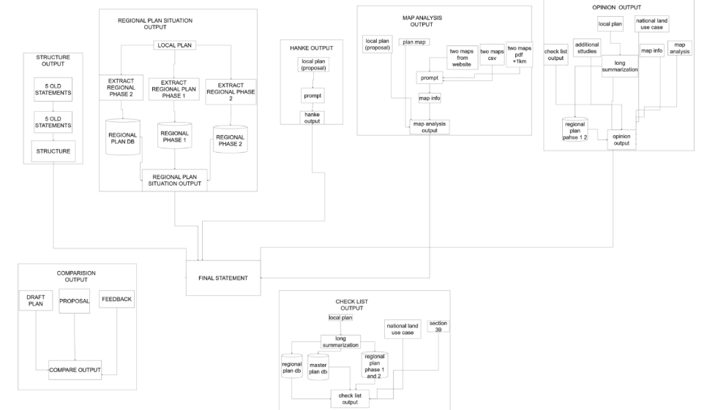
Urban Planning
n8n
AI Handling of
Land Use Documents
RoboAI Academy
PROJECT OVERVIEW
Designed and piloted an AI-supported workflow for reviewing land-use plans within a regional planning authority. Analyzes plan documents and spatial data to assess compliance with regional plans, planning objectives, and legal requirements.
TECHNICAL IMPLEMENTATION
Developed checklist-based evaluation logic and map overlay analysis to support expert statements, identify planning conflicts, and detect regulatory gaps. Runs fully locally in n8n.
SKILLS
AI Decision Support · Spatial Data Analysis · Urban & Regional Planning · Land Use Law (Finland) · GIS & Process Design
Role: Communication Manager · Client communication, prompt engineering, input validation and output evaluation

Slide 4
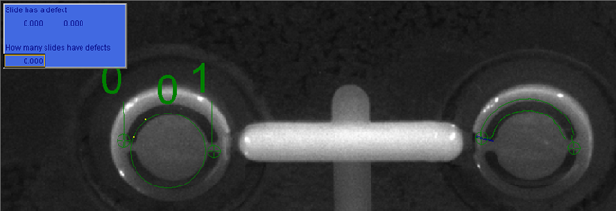
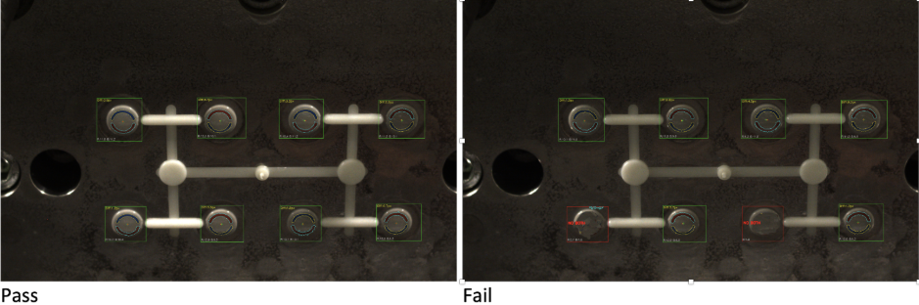
Machine Vision
Machine Vision
Quality Inspection Demo
RoboAI Academy
SYSTEM DEVELOPMENT
Machine vision system for industrial faucet quality inspection. Detects missing markings, surface defects, and line deviations at production line speed.
PLATFORM EVALUATION
Evaluated Cognex, HALCON, and OpenCV. Selected and implemented the Cognex solution based on accuracy and integration requirements.
PIPELINE
Image capture → Defect detection → Automated pass/fail → Data logging.
SKILLS
Machine Vision · Cognex · Image Processing · Quality Control · Industrial Automation
Role: Project Manager · Team management, Cognex solution development, presenting results to client

Slide 5
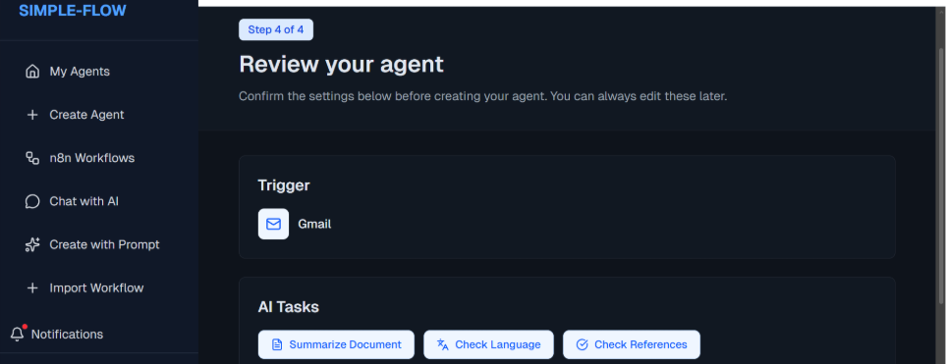
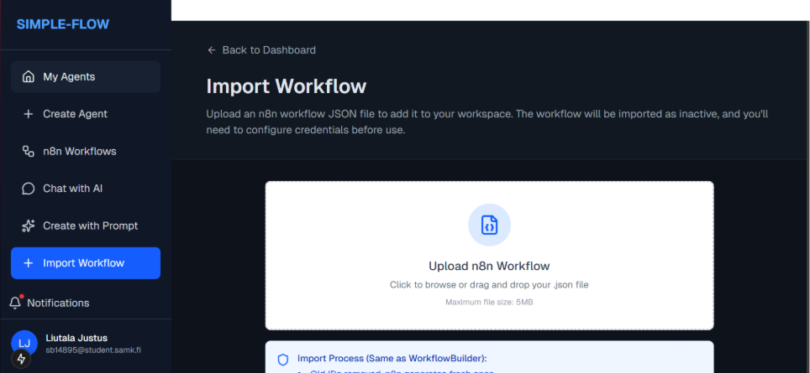
AI Academy
SimpleFlow
RoboAI Academy
PROJECT OVERVIEW
Platform for building AI automation agents for university staff. Enables non-technical users to create workflows for document checking, email responses, and other automated tasks without writing code.
TECHNICAL IMPLEMENTATION
4-step workflow builder on n8n. Frontend: Next.js, React, TypeScript, Tailwind CSS. Backend: FastAPI, PostgreSQL, Prisma. Infrastructure: Docker and Kubernetes managing scalable n8n instances per user with OpenAI API integration.
SKILLS
Next.js · React · TypeScript · FastAPI · PostgreSQL · Docker · Kubernetes · n8n · OpenAI API
Role: Communication Manager · Staff communication, n8n workflow builder, import function and frontend

Slide 6
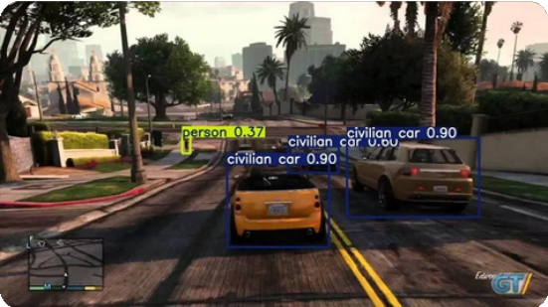
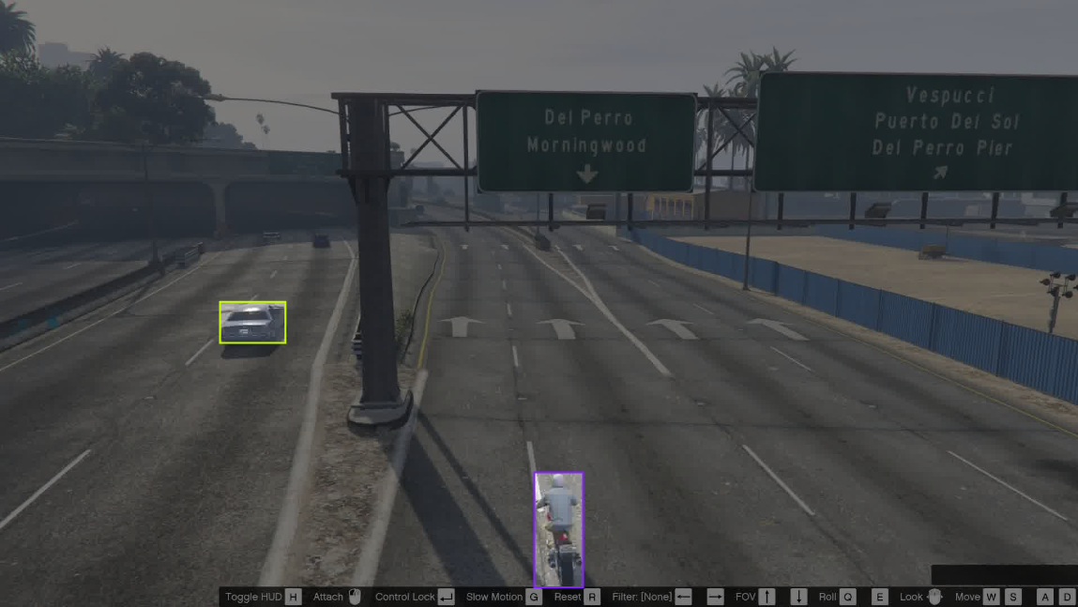
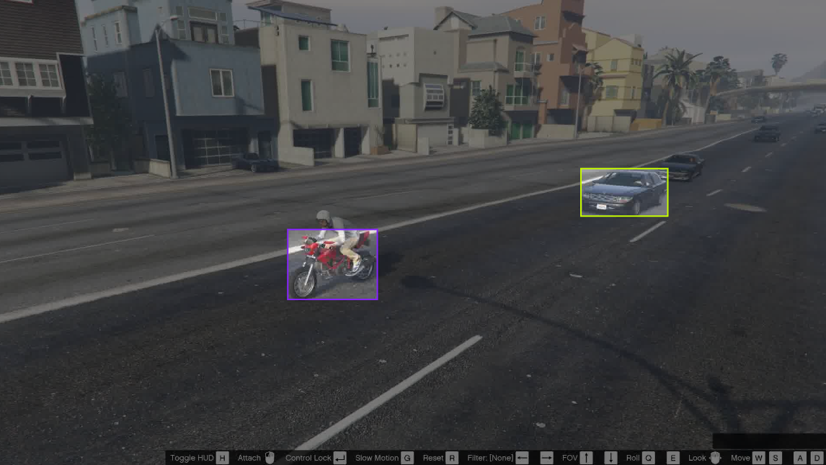
Machine Vision
YOLO
YOLO Object Detection
in Synthetic Environments
Solo Project
PROJECT OVERVIEW
Deep learning object detection system using YOLO to detect vehicles and pedestrians in a synthetic urban environment generated from Grand Theft Auto V — providing realistic training data without real-world data collection.
DATASET ENGINEERING
Image format conversion, annotation processing, and transformation of 3D simulation metadata into 2D bounding boxes. Full pipeline from raw game data to YOLO-compatible training set. Trained and evaluated in Google Colab.
SKILLS
Computer Vision · YOLO · Object Detection · Dataset Engineering · Synthetic Data · Python · Deep Learning
Role: Solo Project · Full pipeline from dataset preparation to model training and evaluation

Slide 7
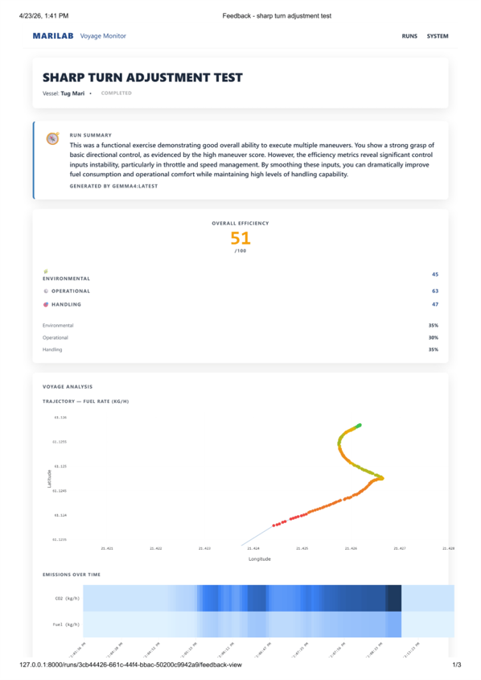
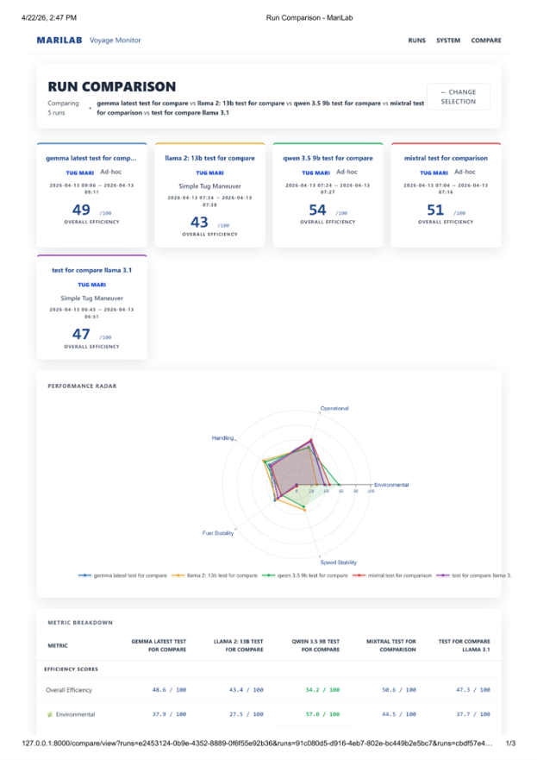
AI Integration
LLM
Maritime
MariLab
Simulator Data Analysis & AI Feedback
RoboAI Academy · Merilogistiikan Tutkimuskeskus
WHAT I BUILT
Extended a real-time tugboat simulator monitoring tool into a full training analysis platform. Built end to end: local LLM integration via Ollama for offline AI coaching feedback, behavioral analytics engine, GPS trajectory heatmaps, and side-by-side run comparison.
KEY TECHNICAL DECISIONS
Chose Ollama for offline LLM operation (no cloud dependency on restricted server). Used Plotly over Mapbox for GPS heatmaps. Fixed a CO₂ calculation bug computing voyage totals from only the last 60 samples instead of full run history.
STACK
Ollama (gemma4) · FastAPI · PostgreSQL · Alembic · Plotly · Podman / systemd
Role: AI Engineer · LLM integration, behavioral analytics, heatmaps, run comparison, Alembic migrations, bug fixes

Slide 8
Hackathons
🥈 2nd Place
🥉 3rd Place
Robotics / Mechanical + Automation
AI / Computer Vision / Ethics
Awarded 2nd place in a multidisciplinary hackathon focused on industrial automation. Designed a gripper using a vacuum-based mechanism for reliably picking metal cylinders from an unsorted container. Emphasised mechanical simplicity and robust object handling in industrial environments.
Awarded 3rd place in a hackathon on assistive technologies and ethical AI. Developed a proof-of-concept AI assistant using a depth camera for fall detection and elderly monitoring, with strong emphasis on privacy preservation by avoiding RGB imaging.
Mechanical Design
Robotics
Vacuum Gripping
Rapid Prototyping
AI
Computer Vision
Depth Perception
Ethical AI
Industrial Automation
Assistive Technologies
Privacy Preservation

