Slide 1

Quizzit

Slide 2
Problem
Students struggle with study motivation, procrastination, and effective knowledge retention.
This leads to cramming, poor academic performance, and wasted learning opportunities.

Slide 3
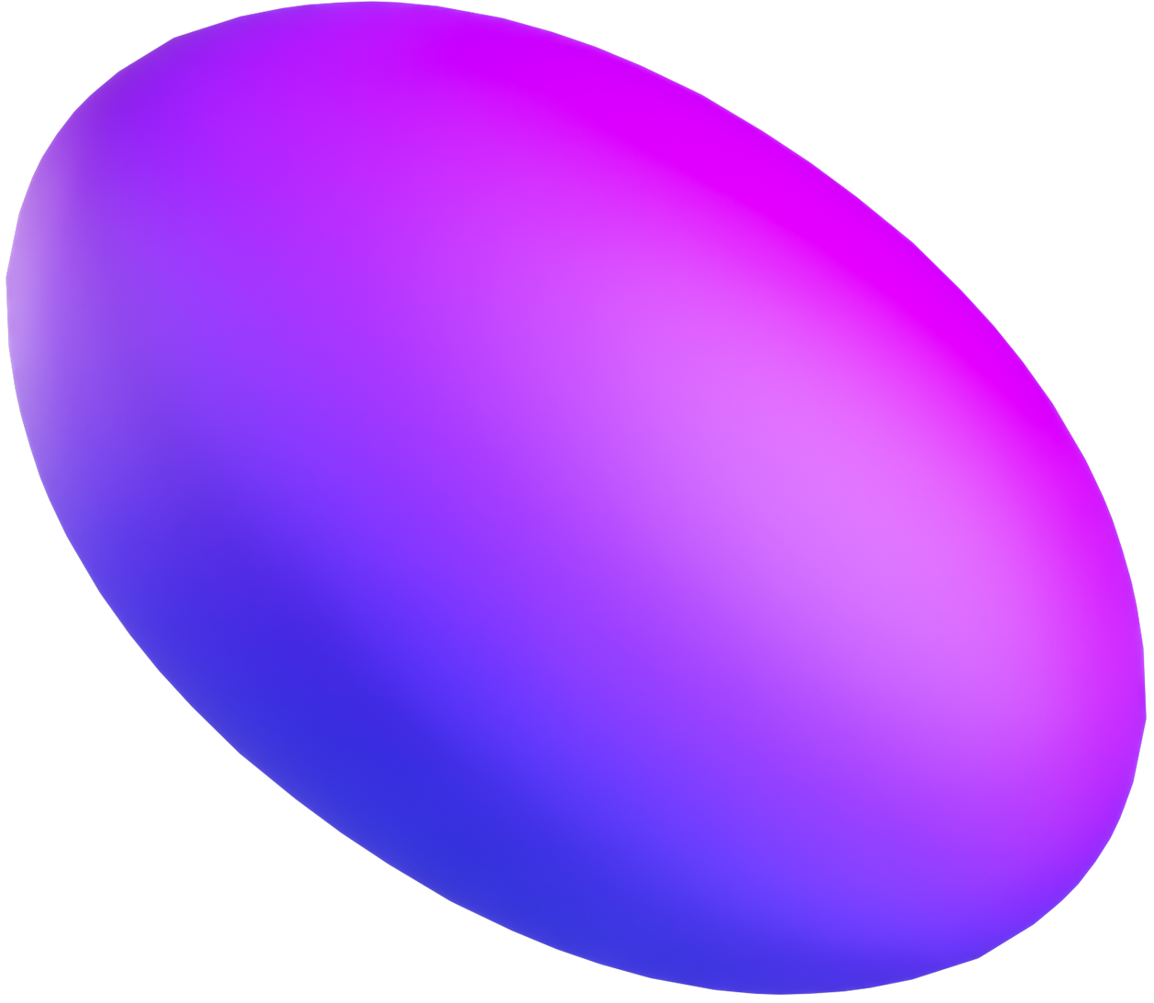
Solution
Quizzit motivates students by using cryptocurrency staking and AI to create personalized quizzes from study materials, featuring a simple pass-or-donate incentive system.

Slide 4




How it works
Step 1
Step 2
Step 3
Step 4
Deposit ETH: Stake your ETH securely via our smart contract.
Upload Materials: Provide your study materials—PDFs, slides, or docs.
AI-Generated Quiz: Let AI challenge you with custom quizzes.
Win or Donate: Pass to reclaim your ETH; fail and donate to charity.

Slide 5
Skin in the Game: Financial incentive creates real accountability
01
02
AI-Powered: Intelligent quiz generation based on your specific materials
Why choose Quizzit?
Blockchain Integration: Secure transactions and transparent process
03
04
Charitable Impact: Failed attempts benefit worthy causes

