Slide 1

The simple shop
Technical presentation

Slide 2
Presentation Plan
General information about the website
Sign in and log out mechanism
Brief information about Filter
Shopping cart and checkout process
Further development

Slide 3








Slide 4



Database

Slide 5
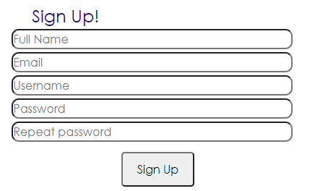
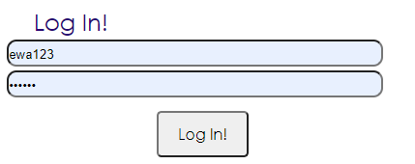
Sign in and log out mechanism
includes\dbh.inc.php – connection to the database
includes\functions.inc.php – the backend file of signup and login form with requirements for filling out etc.
signup.php – signup site, the visible part
login.php - login site, the visible part includes\login.inc.php - connects dbh.inc.php, functions.inc.php, and login.php, triggered by clicking “login!” button, spits out error messages in HTTP header
includes\logout.inc.php – logging out function, destroying the session
includes\signup.inc.php – the same as login.inc.php only for signup

Slide 6
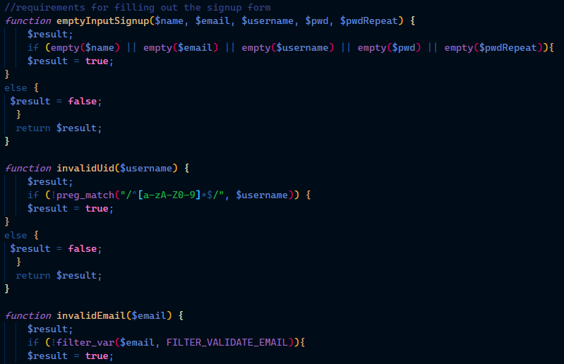
Examples of login/sign up constraints
includes\functions.inc.php file

Slide 7
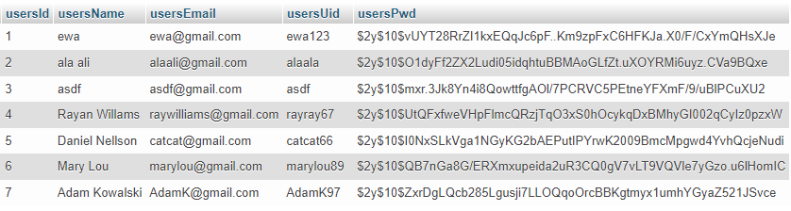
Database for users

Slide 8
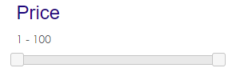
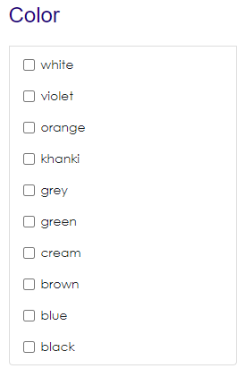
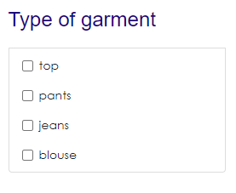
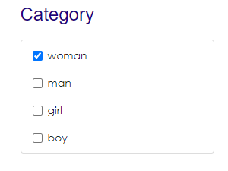
Filtering of products

Slide 9
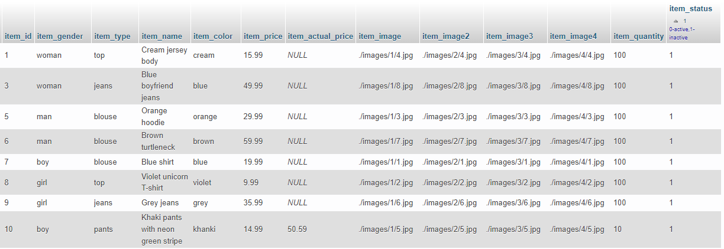
Database for products

Slide 10
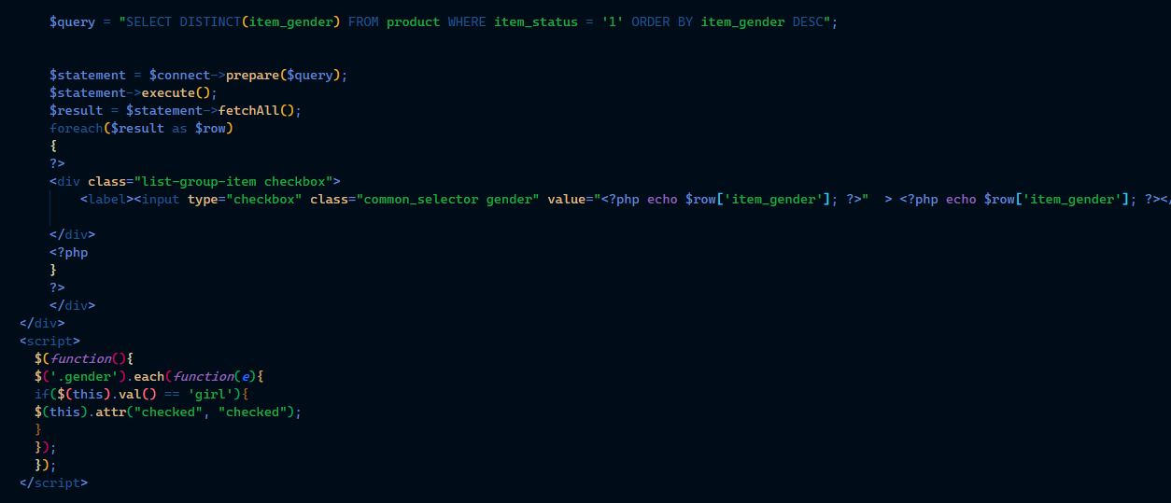
Example of fetching checkbox values

Slide 11
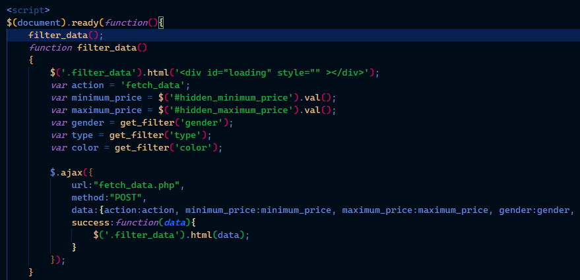
Application of AJAX

Slide 12
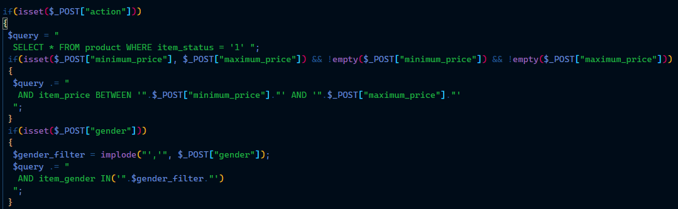
Examples of filtering constraints

Slide 13

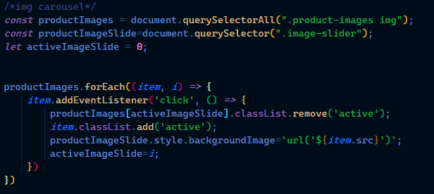
JavaScript code for image carousel

Slide 14
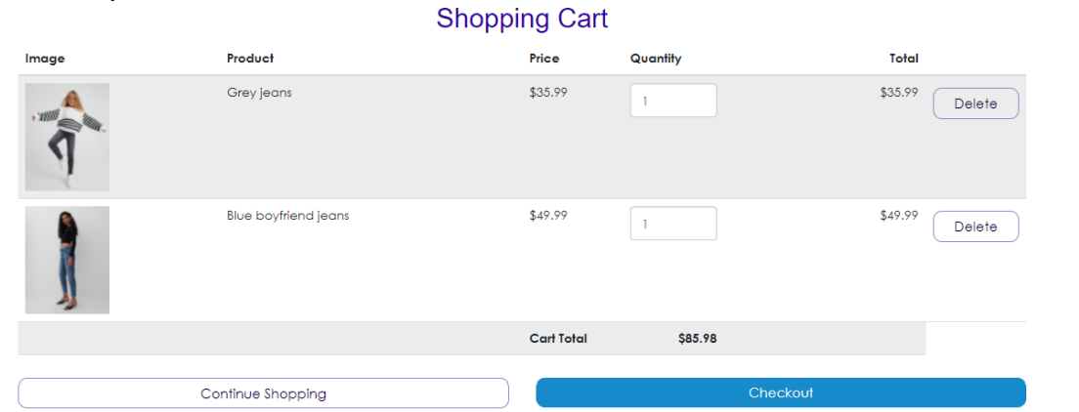
Shopping cart and checkout process
Notes:
,

Slide 15
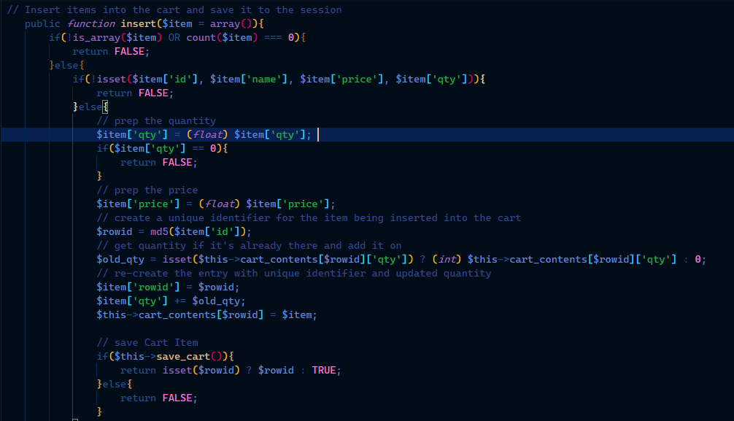

Slide 16
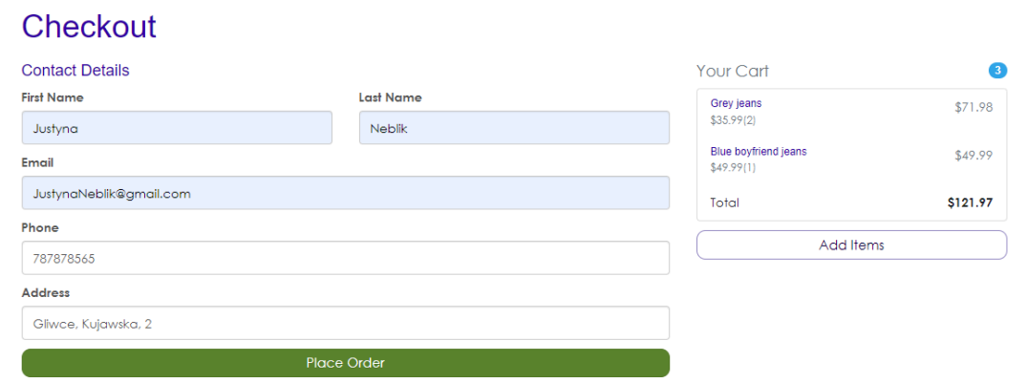

Slide 17
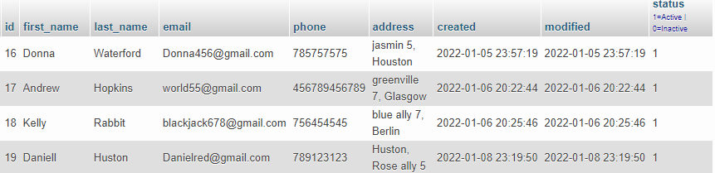
Database for customers

Slide 18
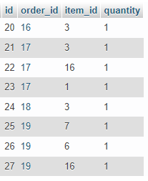
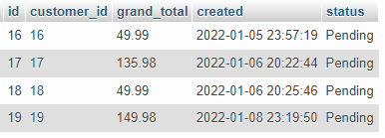
Database for order details
Database for orders

Slide 19
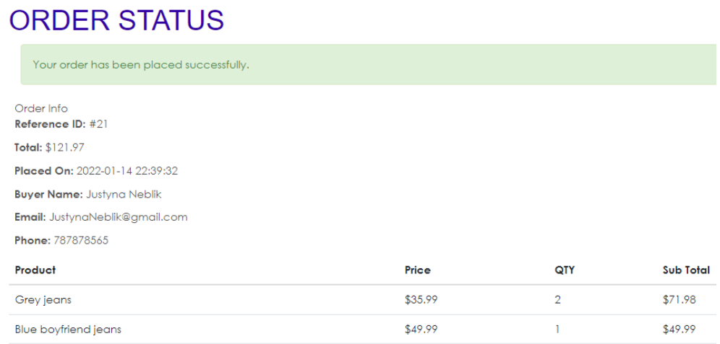

Slide 20

Further development

Slide 21

Thank you for your attention!
Authors : Justyna Neblik Wojciech Obrzut

