Slide 1
Candidate presentation Bioinformatics Task
Justyna Dopierala
Link to GitHub: https://github.com/JustynaDopierala/RT_project

Slide 2
Strategy for task completion (with alignment)
Download TCGA data from GDC and generate TPM matrix (full set of genes ~60,000)
Generate directory structure
Install GDC client for TCGA data download
Generate Annotations file to map sample TCGA sample ID to UUID
Generate a bash script for data download and extract
Inspect data (e.g. header lines to be cut, total n of lines, column index of TPM values)
Generate bash script for TPM matrix generation (full set of genes ~60,000)
Inspect .fa input file
Generate python script (see previous slide)
Output: N of controls, N of genes, N of guides per gene, duplicates, sequence length, etc
Align input fa file to GRCh38
Download and install Bowtie 2 to RT/project/scr/bin (alternatives are BWA or STAR or TopHat)
Download and install samtools from https://www.htslib.org/download/
Download the GTF file (ftp to hgdownload.cse.ucsc.edu)
Download fasta files for unmasked genome GRCH38 from https://ftp.ensembl.org/pub/release-110/fasta/homo_sapiens/dna/
Concatenate FASTA files cat *.fa > genome.fa
Build genome Index and Sort /path-to-bowtie-programs/bowtie2-build genome.fa hg38
Run alignment /path-to-bowtie-programs/bowtie2 -p <# cpu> -x <genome index prefix> <fasta file> > <output_filename.sam>
Output in SAM format or convert BAM to SAM with samtools
Get chromosome location from the SAM file and use GTF file for annotations
Identify gene name and return ENSG ID (based on chromosomal coordinates: start, stop)
Generate custom python script or use samtools

Slide 3
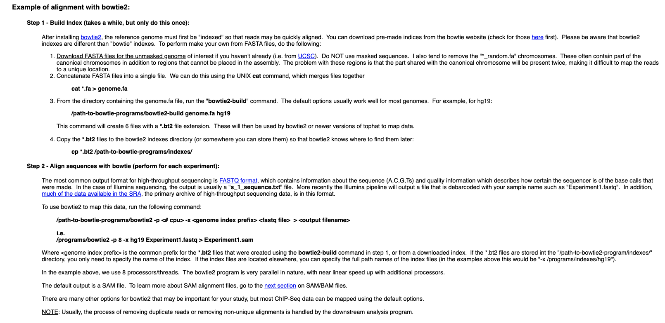
Alignment
Info: http://homer.ucsd.edu/homer/basicTutorial/mapping.html
In bowtie2 for fa input use –f instead of –q
bowtie2 –f –x index_file –f fasta_reads.fasta –S result.sam
Most Popular short read aligners: bowtie : fast, works well bowtie2 : fast, can perform local alignments too BWA - Fast, allows indels, commonly used for genome/exome resequencing Subread - Very fast, (also does splice alignment) STAR - Extremely fast (also does splice alignment, requires at least 30 Gb memory)

Slide 4
What’s completed (no alignment)
Download TCGA data from GDC and generate TPM matrix (full set of genes ~60,000)
For current project download data manually (n=2 files)
Scale up: use GDC client, make Annotations file to map sample ID to UUID
Generate folder structure; place downloads in appropriate directory; inspect data (e.g. header lines to be cut, total n of lines, column index of TPM values)
Generate bash script for file handling and matrix generation (full set of genes ~60,000)
Inspect .fa input file
Generate python script → “2_inspect_fa_file.py” under “RT_align_TCGA/src/code”
Output under “RT_align_TCGA/analysis/3_input_library_inspect”
Write out: N of sequences, sequence length (check if 20), duplicate sequences
Write out: N of unique genes, N of NegCtrl guides, N of PosCtrl guides, N of NegCtrlIn guides
Check if all genes have 4 guides → write out sequence IDs and sequence in fa format for later parse with BLAT (https://genome.ucsc.edu/)
I’m aware many sequences are multimapping. I could identify some checking for high A, T or A+T content, but will miss many without actual alignment and quality scores
Output TCGA matrix (from step 1) using gene list from step 2 as input
Continue in the previous python script
Select rows from the TCGA matrix where gene name is in the list of unique library genes (step 2)
Identify which (if any) genes from the list in step 2 (unique genes) are not in the full TCGA matrix
Build GitHub repo: https://github.com/JustynaDopierala/RT_project
What’s not been completed
No alignments (no installs, no downloads) → SAM file with mapping info has not been generated; reason: code written on company computer (installs are problematic)
Docker has not been used (no experience)
Not connected in a pipeline (scripts need to be run individually); run out of time

Slide 5
Results overview
Results under “RT_project/analysis”
Library composition
The library is made of 77,736 sequences. Sequence length is equal to 20.
3 types of controls are present in the library: NegCtrl (500 guides), NegCtrlIn (80 guides) and PosCtrl (40 guides)
There are 19,281 unique genes in the “library.fa” file
Features
There are no duplicate sequences, but many sequences map to more than one chromosomal location (used BLAT)
Most genes have 4 guide sequences, but 5 genes come with less guides (CT45A2, DEFB107B, SPHAR, USP17L26, USP17L28). Available guides for these 5 genes map to multiple chromosomal locations).
TCGA data and gene selection
TCGA matrix for 2 samples has been generated. TPM has been used for expression level.
Not all of the 19,281 genes in the “library.fa” file are present in the TCGA sample files (match found based on gene name for 18,292; no match found for 1,018 genes). Matching based on ENSG ID would be preferable.

Slide 6
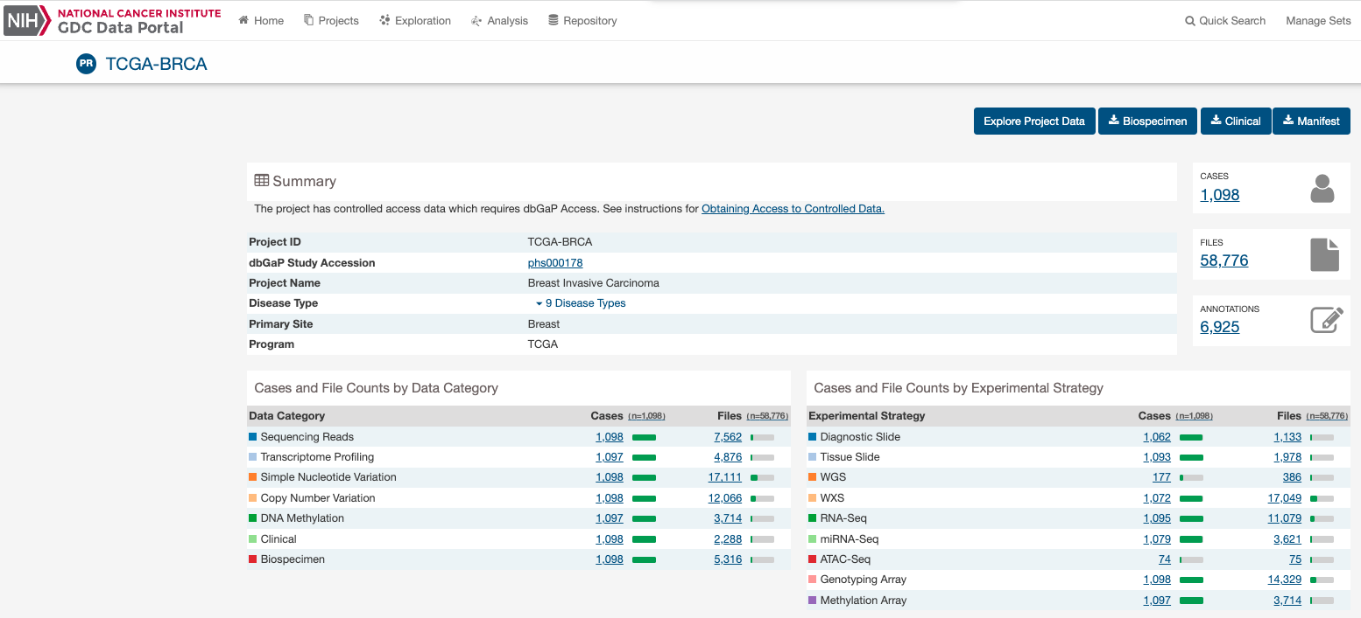
TCGA data download
TCGA-A7-A13D-01A-13R-A12P-07
TCGA-E9-A1RH-11A-34R-A169-07
Identify UUID, find RNA-seq data
UUID
Manually downloaded TCGA samples from GDC
"TCGA-A7-A13D-01A-13R-A12P-07": https://portal.gdc.cancer.gov/files/50c7c034-fccb-4eb1-b8db-e0a5d9e50172
"TCGA-E9-A1RH-11A-34R-A169-07": https://portal.gdc.cancer.gov/files/958813f4-8036-42f7-856d-7a69c4175adc
Install GDC Client to scale up (not done here)
info: https://docs.gdc.cancer.gov/Data_Transfer_Tool/Users_Guide/Data_Download_DTT_UI/
example syntax: gdc-client download 22a29915-6712-4f7a-8dba-985ae9a1f005

Slide 7
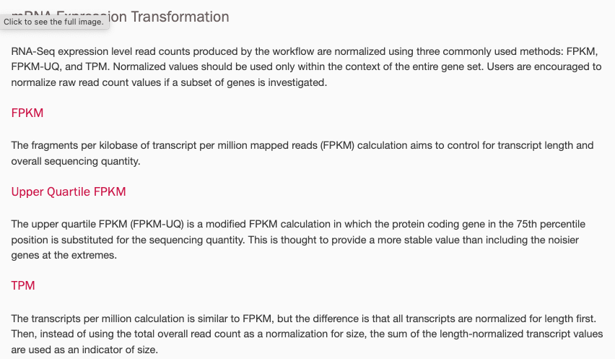
TCGA expression values explained
https://docs.gdc.cancer.gov/Data/Bioinformatics_Pipelines/Expression_mRNA_Pipeline/
Most common choice

Slide 8
Directory set up
Generate directory structure
$ mkdir RT_project
$ mkdir RT_project/data
$ mkdir RT_project/src
$ mkdir RT_project/analysis
$ mkdir RT_project/data/TCGA_data
$ mkdir RT_project/data/TCGA_data/1_downloads
$ mkdir RT_project/data/TCGA_data/2_count_files
$ mkdir RT_project/data/fa_input
$ mkdir RT_project/data/genome
$ mkdir RT_project/analysis/1_TCGA_matrix_full
$ mkdir RT_project/analysis/2_TCGA_matrix_selected
$ mkdir RT_project/analysis/3_input_library_inspect
$ mkdir RT_project/src/bin
$ mkdir RT_project/src/code
Copy data downloads to destination directories (TCGA and library.fa files)
$ scp <local/Downloads/library.fa> <destination/RT_align_TCGA/data/fa_input/>
$ scp <local/Downloads/gdc_download_20231108_215835.525433.tar.gz> <destination/RT_align_TCGA/data/TCGA_data/1_downloads>
$ scp <local/Downloads/gdc_download_20231108_220848.710030.tar.gz> <destination/RT_align_TCGA/data/TCGA_data/1_downloads>

Slide 9
PART 1: TCGA Data
Extract TCGA Data, inspect files and skip FeatureCount lines
Extract TCGA Data
$ cd data/TCGA_data/1_downloads
$dir=”PATH_TO_DIRECTORY"
$for f in "$dir"/*;do
> tar -xvzf $f
>done
Inspect TCGA files
$ less 269c35f0-a4f7-4e30-a69f-f1f3b7b5dace.rna_seq.augmented_star_gene_counts.tsv
Count lines in the count files
$ wc –l 269c35f0-a4f7-4e30-a69f-f1f3b7b5dace.rna_seq.augmented_star_gene_counts.tsv
Keep header and data matrix and write to a separate file (skip FeatureCount lines); write for loop to scale up
$ sed -n '2,2p' 269c35f0-a4f7-4e30-a69f-f1f3b7b5dace.rna_seq.augmented_star_gene_counts.tsv > 269c35f0-a4f7-4e30-a69f-f1f3b7b5dace.tsv
$ sed -n '7,60666p' 269c35f0-a4f7-4e30-a69f-f1f3b7b5dace.rna_seq.augmented_star_gene_counts.tsv >> 269c35f0-a4f7-4e30-a69f-f1f3b7b5dace.tsv
$ sed -n '2,2p' d820ac02-a30e-437b-b20a-3e92705b7b81.rna_seq.augmented_star_gene_counts.tsv > d820ac02-a30e-437b-b20a-3e92705b7b81.tsv
$ sed -n '7,60666p' d820ac02-a30e-437b-b20a-3e92705b7b81.rna_seq.augmented_star_gene_counts.tsv >> d820ac02-a30e-437b-b20a-3e92705b7b81.tsv

Slide 10
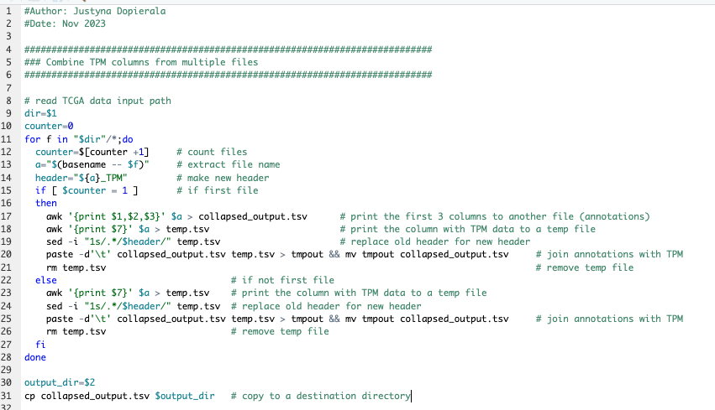
Combine TPM columns from TCGA files
Script: ”1_prepare_full_TCGA_matrix.sh”, provide data_dir and output_dir as command line arguments
Output path ”RT_align_TCGA/analysis/1_TCGA_matrix_full/TCGA_matrix_full.tsv”

Slide 11
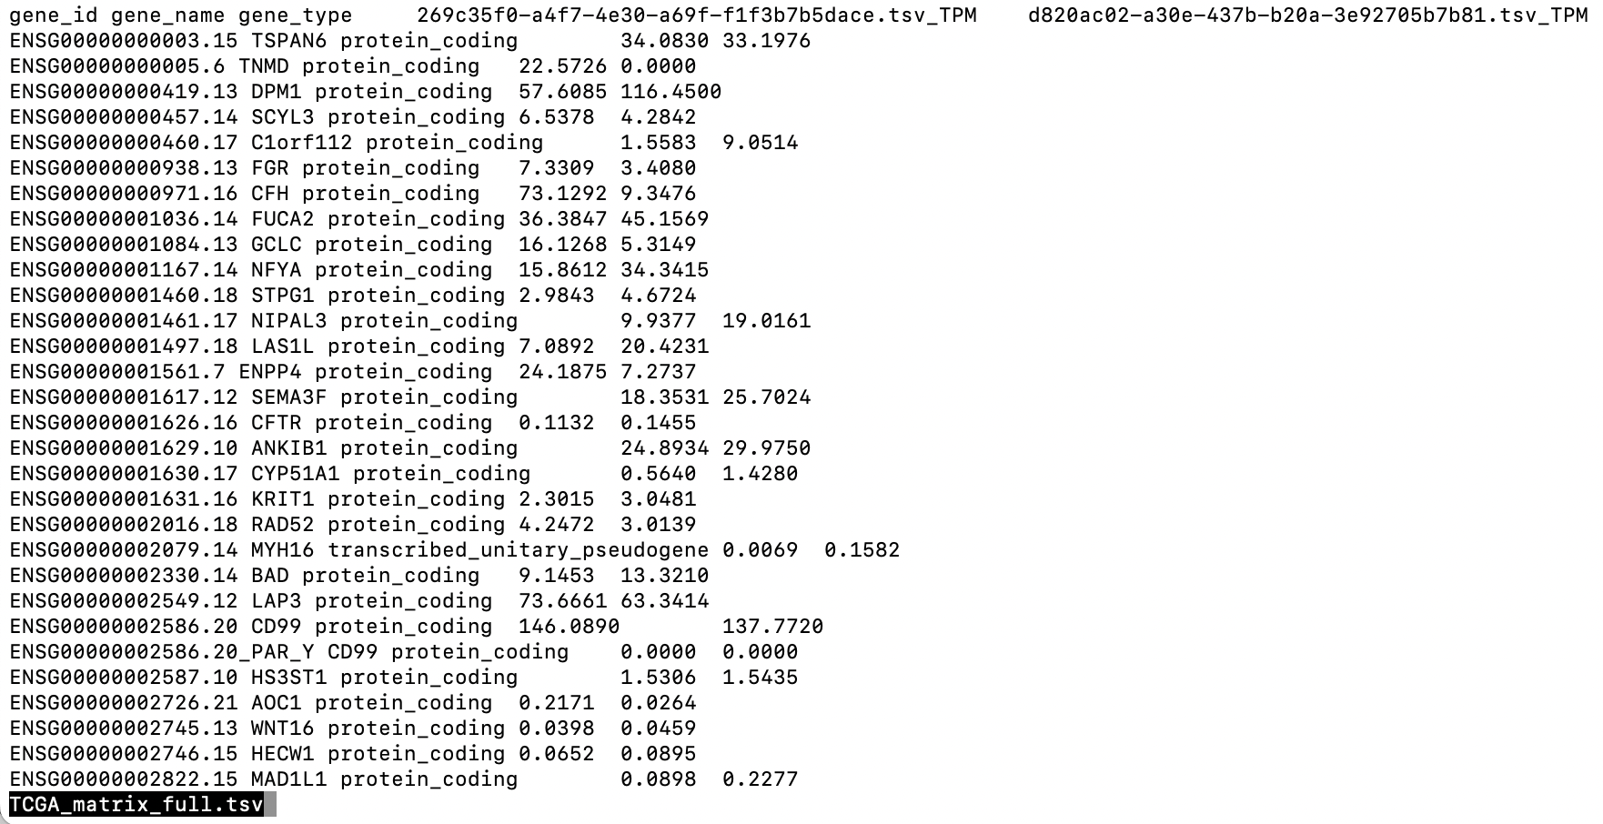
TCGA expression matrix
File: ”RT_align_TCGA/analysis/1_TCGA_matrix_full/TCGA_matrix_full.tsv”
$ wc -l TCGA_matrix_full.tsv
60661 TCGA_matrix_full.tsv
$ less TCGA_matrix_full.tsv

Slide 12
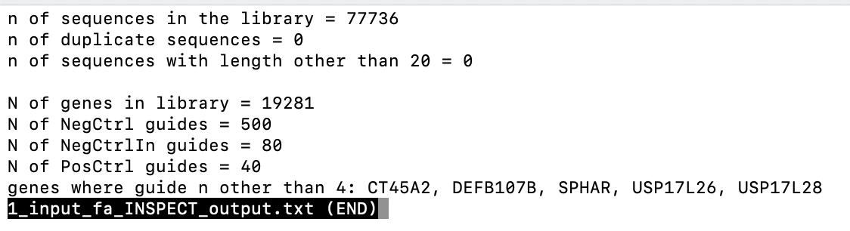
PART 2: Inspect library.fa file
Script: ”2_inspect_fa_file.py”, provide data_dir and output_dir as command line arguments
See next slide for example BLAT align

Slide 13
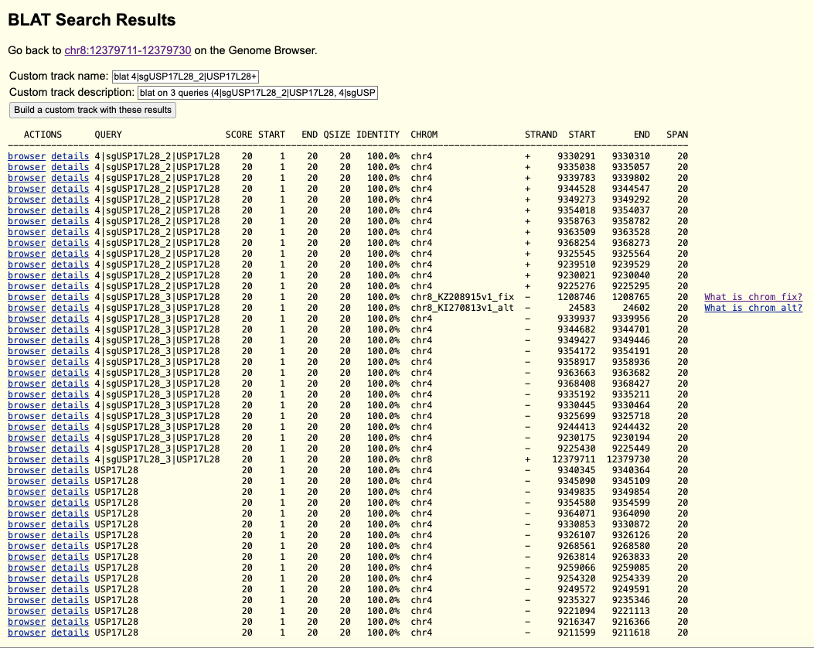
BLAT alignment for fasta sequence
Example align, here for USP17L28 (guide sequences align to multiple chromosomal locations, and more than one chromosome)
Guides map to multiple chromosomal locations

Slide 14
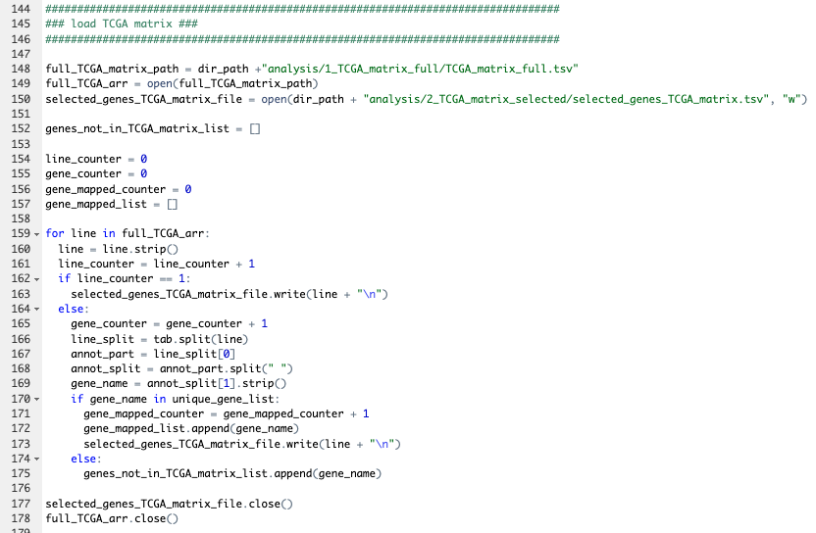
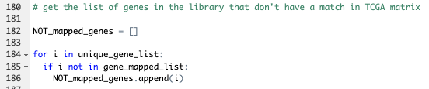
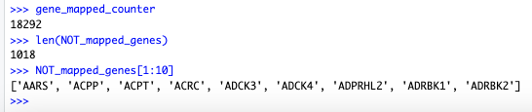
PART 3: Select TCGA rows for genes in the library.fa file
Script: ”2_inspect_fa_file.py”, provide main dir_path as command line argument

