Slide 1


ADVANCED TOPICS IN SIGNAL PROCESSING
PRESENTATION ON
ESPNET
FASTSPEECH2 TTS
(HINDI TEXT)
BY - JUSWANTH T (EE21B063)

Slide 2

CONTENT
01
THE FLOW
02
DATA FORMATTING
03
DATA PREPARATION
04
DATA SPLIT AND PARAMETERS
05
RESULTS
06
VOCODER
07
INPUTS AND OUTPUTS

Slide 3
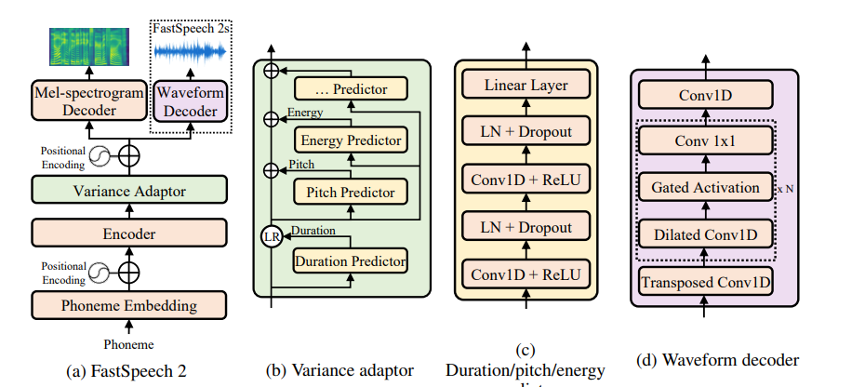

THE FLOW
Fastspeech2 helps to prevent one-many problem (multiple possible speech sequences can correspond to a text sequence due to variations in speech, such as pitch, duration, sound volume and prosody)
TWO STAGE PIPELINE
Preprocess the text input and give it to FastSpeech2 Model, it generates Mel Spectrogram out of it.
The generated Mel Spectrogram is given to Vocoder, which gives the audio output.
The encoder converts the phoneme embedding sequence into the phoneme hidden sequence, and then the variance adaptor adds different variance information such as duration, pitch and energy into the hidden sequence, finally the mel-spectrogram decoder converts the adapted hidden sequence into mel-spectrogram. The variance adaptor effectively helps to prevent overfiting and gives a good generalization of the data.

Slide 4

DATA FORMATTING
Each language has a parser and dictionary using which we can generate convert character based text to phoneme based text
Character Based
train_hindimale_00001 प्रसिद्द कबीर अध्येता, पुरुषोत्तम अग्रवाल का यह शोध आलेख, उस रामानंद की खोज करता है.
train_hindimale_00002 किन्तु आधुनिक पांडित्य, न सिर्फ़ एक ब्राह्मण रामानंद के, एक जुलाहे कबीर का गुरु होने से, बल्कि दोनों के समकालीन होने से भी, इनकार करता है.
Phone Based
train_hindimale_00001 prasidd kabIr aधyEtA, puruषottam agrawAl kA yah शoध AlEख, us rAmAnaqd kI खoj kartA hऐ.
train_hindimale_00002 kintu Aधunik pAqडitya, na sirf Ek brAhmaण rAmAnaqd kE, Ek julAhE kabIr kA guru honE sE, balki donoq kE samkAlIn honE sE BI, inkAr kartA hऐ.

Slide 5

DATA PREPARATION
wav.scp
train_hindifullmale_00001 /home/batch2/EE21B063/mono/Read_speech/wav/train_hindifullmale_00001.wav
utt2spk
train_hindifullmale_00001 hindimale
spk2utt
hindimale train_hindifullmale_00001 train_hindifullmale_00002....
Here I have used only one speaker, So same speaker for all audio files
Duration files
FastSpeech2, a neural text-to-speech (TTS) model, relies on a special file type called a "duration file." It is used to represent the durations of phonemes in the input text. During the training of FastSpeech2, the model learns to predict these durations. Hybrid segmentation is used for getting the duration files.
Example:
train_hindimale_00001
18 4 3 3 10 3 10 5 10 4 6 13 3 6 14 2 5 6 15 39 5 4 4 3 13 5 5 5 2 9 3 9 3 2 6 10 9 3 4 13 1 2 15 8 10 6 12 7 14 13 36 9 12 4 9 8 4 5 5 7 5 9 9 7 9 10 4 4 6 4 7 9 12 22 0
They represent the number of mel frames in which each phoneme occurs

Slide 6
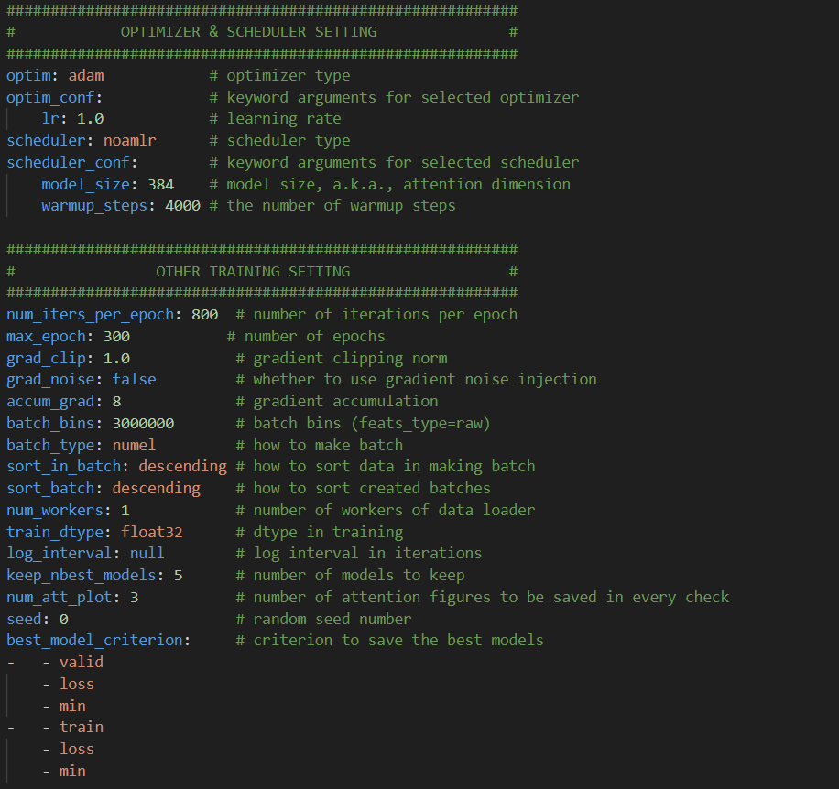
HYPER PARAMETERES
Data Set Split :
> Evaluation/Test : 39
> Train : 3861
> Validation/Development : 430
> Overall : 4330

Slide 7

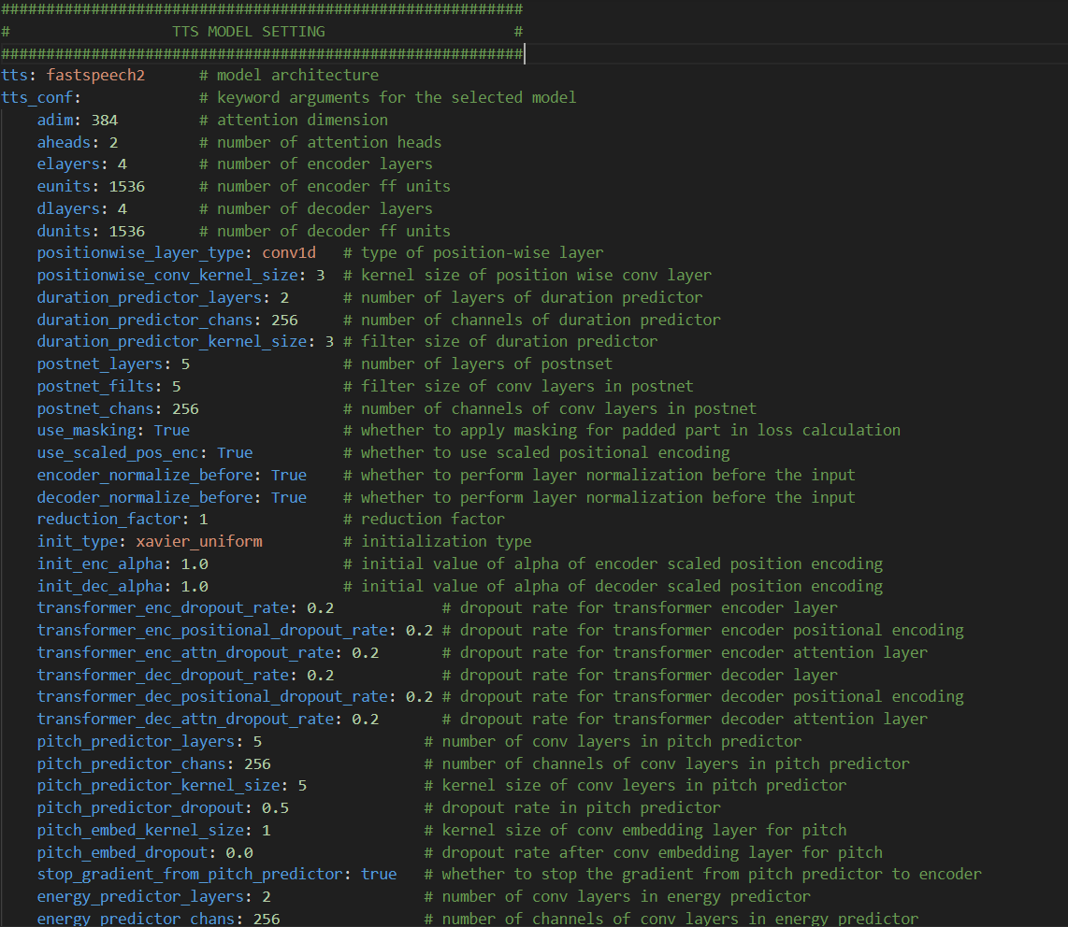
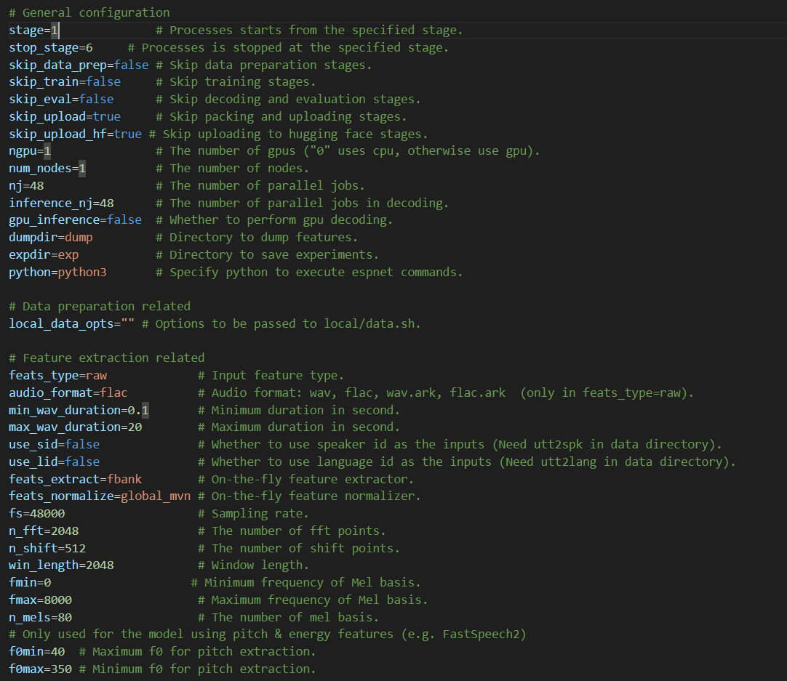

Slide 8
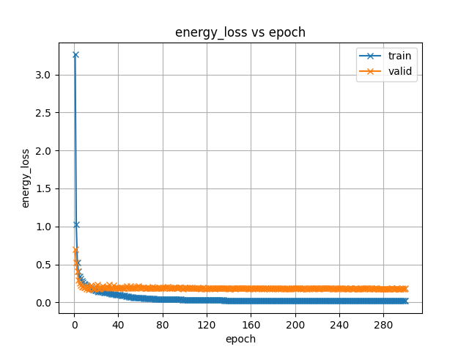

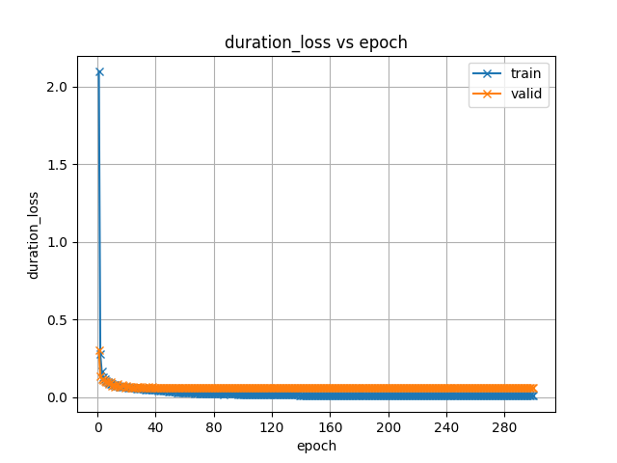
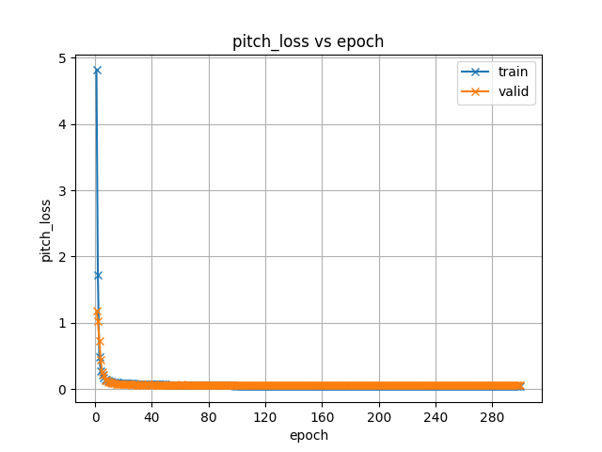
LOSS VS EPOCH
Mean Square Losses

Slide 9
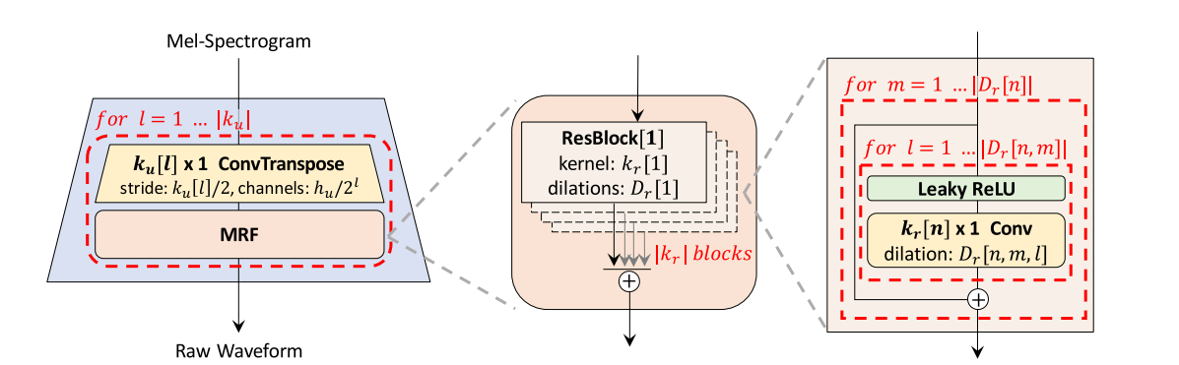
VOCODER
For generating WAV files from mel-spectrograms, you can use a vocoder of your choice.
I have used HiFi-GAN Vocoder which contains one generator and 2 discriminators (multi-scale and multi-period). The generator network is tasked with creating realistic speech audio waveforms based on the mel-spectrogram it receives as input. Discriminators act as adversaries, trying to distinguish between real speech audio (from the training data) and the audio generated by the generator.

Slide 10

INPUT AND OUTPUTS
केकेआर ने कल डीसी के खिलाफ बड़े अंतर से जीत हासिल की
भारतीय एआई इंजीनियर Devika दुनिया के पहले 'एआई कोडर' Devin को चुनौती देने के लिए उभरीं

Slide 11

THANK YOU!

