Slide 1
Econometrics Data Translation Challenge
19 March 2021
Mikayla Davis, Glen Lewis, Andrew Nalundasun,
Jennifer Grosz, Arunima Roy

Slide 2
Background of the project
The focus of this project was to look at how the retail sector and the rest of the economy has been doing because of the COVID-19 pandemic.
We were asked to explore three different questions
How has COVID affected the health of the retail industry, as measured by employment?
How has retail fared relative to other industries?
Retail needs to worry about who has money to spend - what has changed about who is working and earning money?
Today, we will be focusing on question one and three

Slide 3
Question 1:
How has COVID affected the health of the retail industry, as measured by employment?

Slide 4
Variables Used
Variable Name & Common Name | Description
“whyunemp” – Reason_why | Specifies why respondents were unemployed
“occ2010” – occupation | Respondent’s occupation based on the Census Bureau’s scheme
“covidunaw” – covid_impact | Could respondent’s unemployment be attributed to COVID-19
“positive” – total_cases | The total positive COVID cases up to that date
lck_dwn_st | Date a particular state’s SAH went into affect

Slide 5
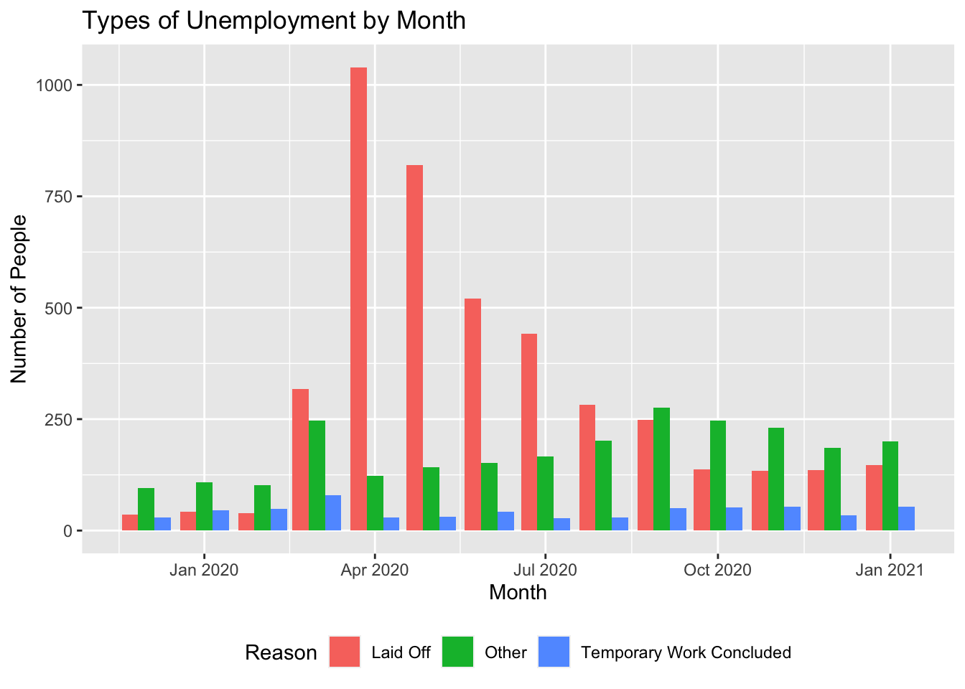
Analysis 1
We were able to identify unemployment trends potentially due to COVID-19.
It appears that the layoffs were the primary reason for unemployment at the beginning of the pandemic in the US which decreased after April.
Those who lost their job to “other” reasons have the highest unemployment rates starting in September as those who were laid off returned to work.

Slide 6
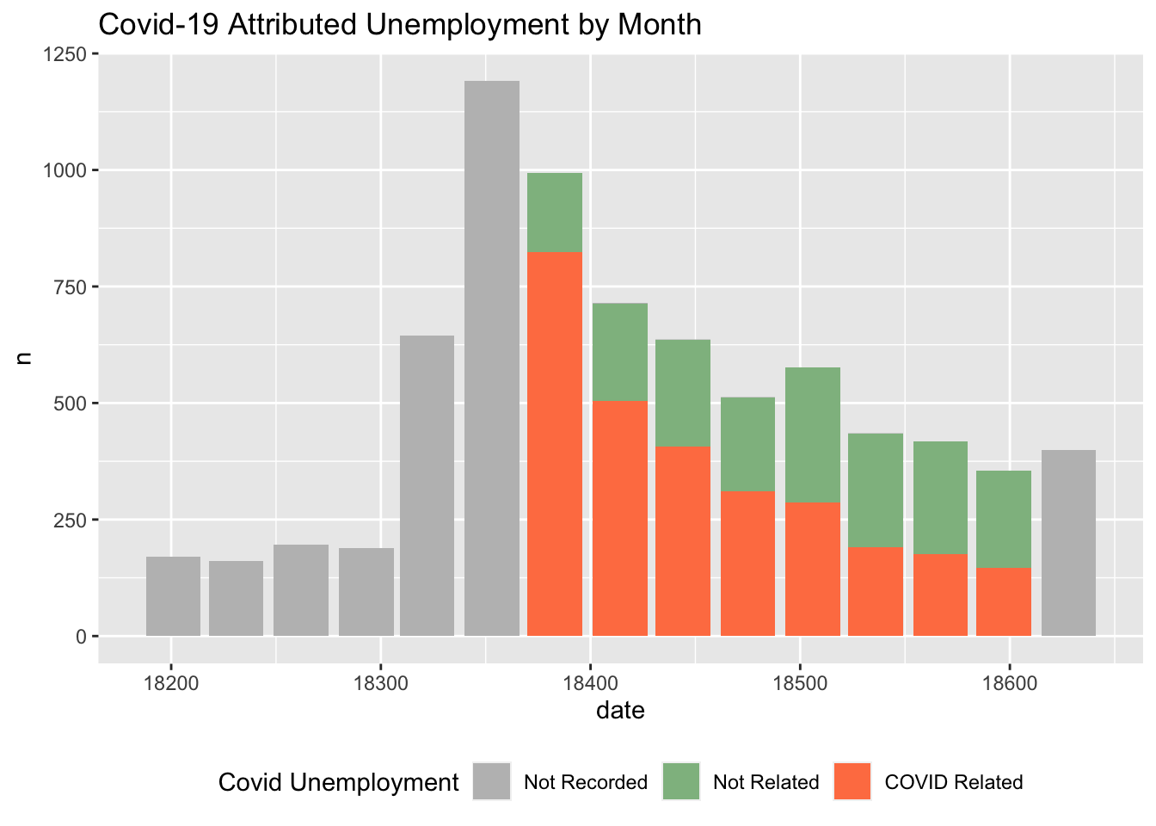
Analysis 2
We plotted the total number of unemployment cases reported and whether the reason behind unemployment was COVID related.
From this graph, we can see that the majority of unemployment reported in this time frame is due to COVID.

Slide 7
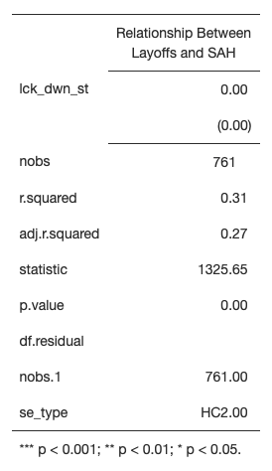
Regression 1
The following regression model assessed if there was a relationship between SAH start dates and unemployment.
The model included a LSDV factor for states to provide a fixed effect control for collective variables such as politics, which could have influenced COVID-19 policy implementation.
The model did not show a statistically significant relationship between the SAH start dates and unemployment rates. This is not surprising as the plot shows layoffs began to decline soon after the first SAH orders issued on March 18th, 2020.

Slide 8
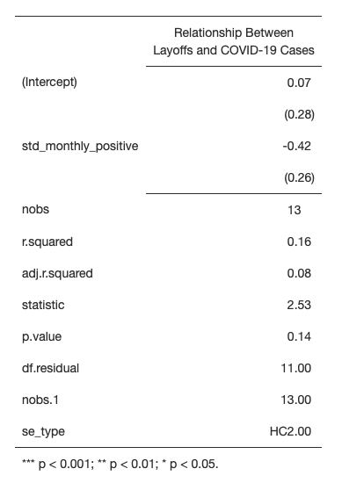
Regression 2
To understand what may have led to the sudden increase in unemployment in the the first quarter of 2020 we decided to look for another factor: the rise in COVID-19 cases.
For this analysis to occur we are assuming that the reported COVID-19 cases in the March, April time frame are accurate.
We are making this assumption because the total number of COVID cases could have been higher due to a number of issues ranging from the initial confusion in reporting metrics to the lack of available testing.

Slide 9
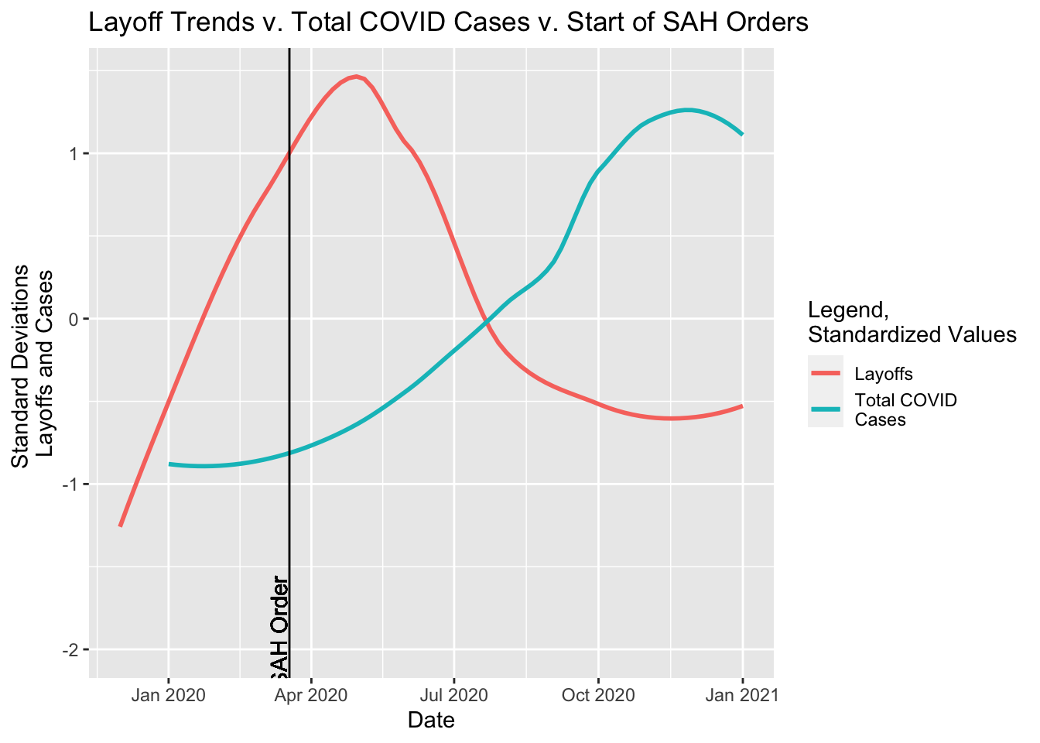
Analysis 3
Our new model showed a negative relationship between layoffs and cases, contrary to our hypothesis.
We interpret this as the retail industry’s health improving as COVID-19 cases rose.
Whether there is relationship present or not the Layoff Trends v. Total COVID Cases v. Start of SAH Orders plot does show a decline in unemployment while cases were still rising.

Slide 10
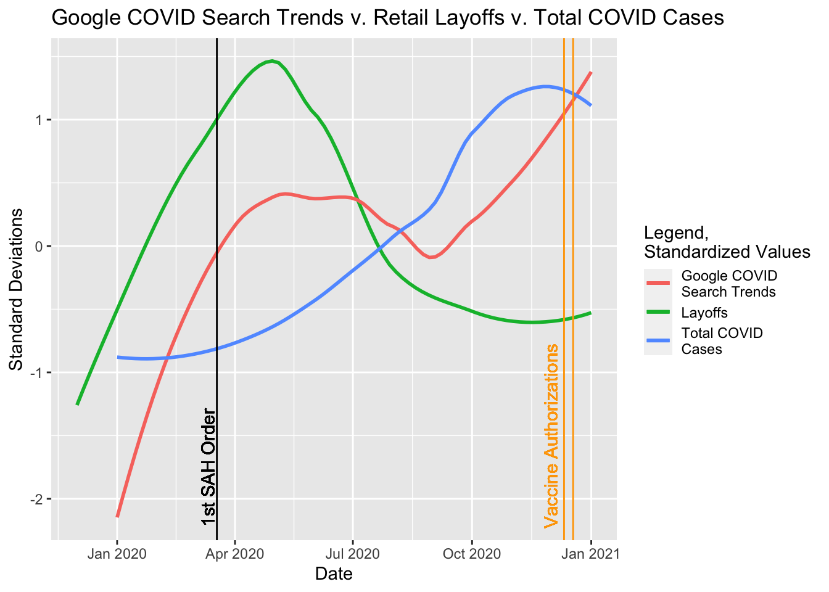
Analysis 4
Since Google searches for the term “COVID” seemed to have a positive correlation (0.12) with unemployment, we decided to run a linear model of the effect of Google searches and total positive reported COVID cases with unemployment, which was our final model.

Slide 11
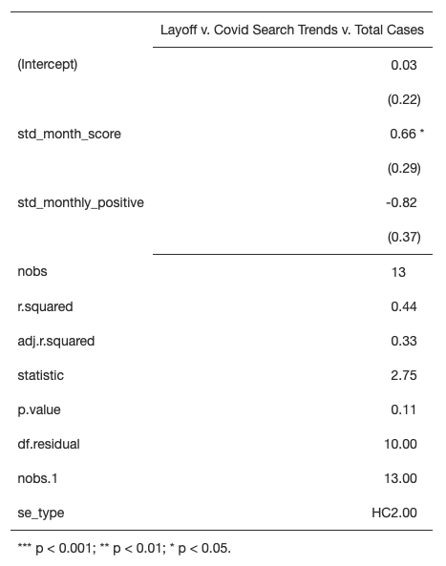
Regression 3
This model did show a positive, statistically significant relationship at the .05% confidence interval, between increases in google searches for covid and increases in unemployment due to layoffs.
It appears that information about covid found through google searches may have changed the behavior of retail shoppers leading to a decline in the health of the retail industry as indicated by increased layoffs.

Slide 12
Question 1: Results
COVID-19 did initially impact the retail industry’s health negatively as we saw a rise in unemployment in 2020.
We also see that unemployment was on the rise, even before states started implementing stay-at-home orders.
We also see that unemployment peaked and returned to much lower levels before positive cases began to spike upward.
Our conclusion is that internet searches early in the growth of the COVID-19 pandemic resulted in a change in behavior of shoppers that negatively impacted the health of the retail industry as indicated by unemployment.

Slide 13
Question 3:
Retail needs to worry about who has money to spend - what has changed about who is working and earning money?

Slide 14
Variables Used
Variable Name | Description
year | survey year in which the data was collected
month | survey month in which the data was collected
year_month | custom date variable in the form of “YYYY-MM”
wtfinl | final basic weight, used to weight the data accurately
ageGeneration | custom variable created to put the different ages in the appropriate generational group
RacialCategories | custom variable created from the ‘race’ variable
female | dummy variable to indicate female = 1 and male = 0
married | dummy variable to indicate whether you are married or other, married = 1 and other = 0
employed | dummy variable to indicate employment; employed = 1 and unemployed = 0
educationCategories | custom variable to group some of the highest education levels of the individuals
covid | dummy variable to indicate whether the associated data was collected on a date prior to April 2020 or after February 2020; Prior to April 2020 = 0, After February 2020 = 1
time | incrementally increasing variable to represent the passing of time measured in 1-month units

Slide 15
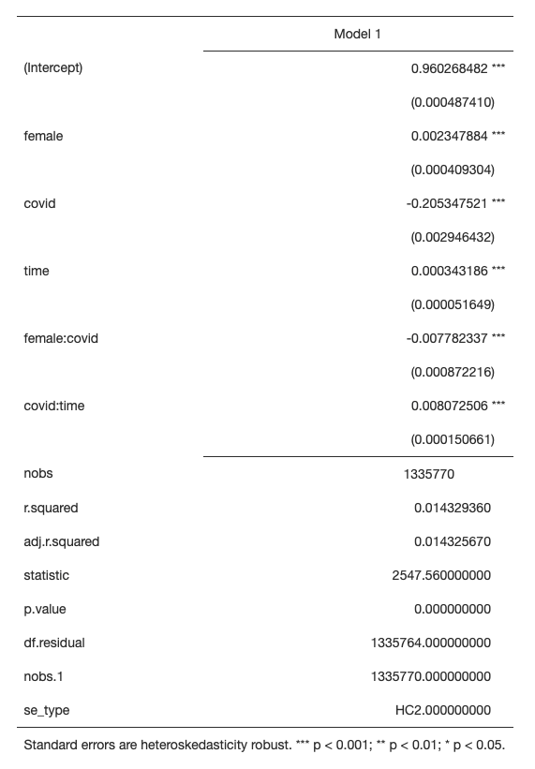
Regression 1
For this regression analysis, we focused on is the coefficient for the interaction between the female and COVID-19 variables in our model as that measures the effect of being female during the COVID-19 pandemic on the probability of being employed relative to being male.
Prior to the COVID-19 pandemic, we see the effect of being female is associated with approximately 0.23 percentage points higher in the probability of being employed relative to being male.
However, once the COVID-19 pandemic started, we see the effect of being female during the COVID-19 pandemic is associated with approximately 0.78 percentage points lower in the probability of being employed relative to males during the COVID-19 pandemic.
Notes:
The regression model we deemed most appropriate for this analysis was the linear probability model with different interactions between the COVID-19 and the various demographic variables including a control for the effect of time via an interaction element in the models between COVID-19 and time.

Slide 16
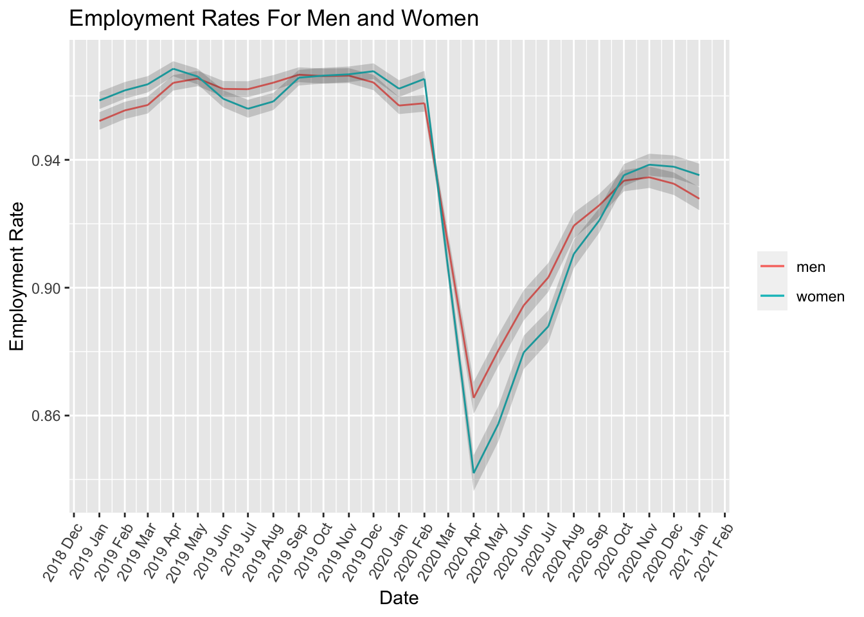
Analysis 1
At it’s worst, this sharp decline in employment rate was more severe for the employment rate of women compared to the employment rate for men, which properly reflects the findings from our linear probability regression analysis.
One significant take away from this visual is that females have an employment rate that is higher than the employment rate for males as of January 2021.

Slide 17
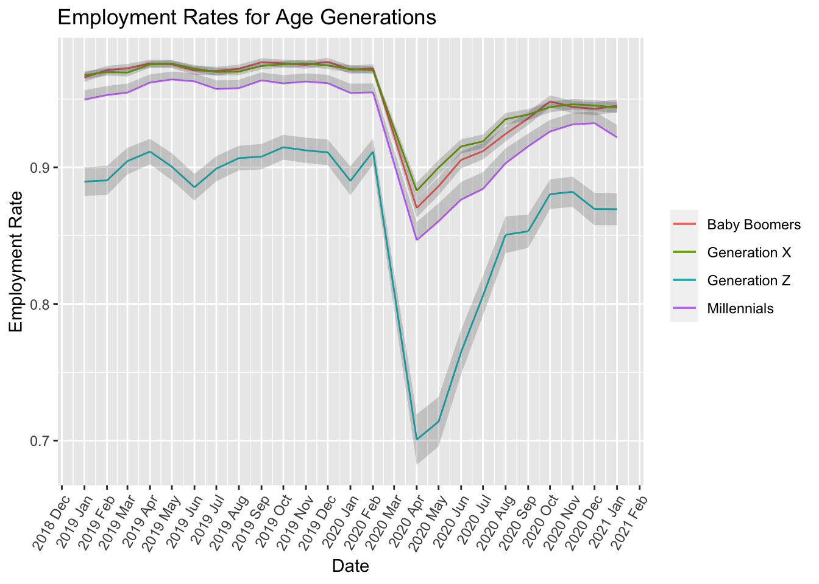
Analysis 2
The age group with the most significant employment rate decline during this time was Generation Z.
As of January 2021, this visual shows that the employment rates for Baby Boomers and Generation X are about the same, and the highest, followed by a slight downward trend in the employment rate for Millennials and finally the employment rate for Gen Z is the lowest.

Slide 18
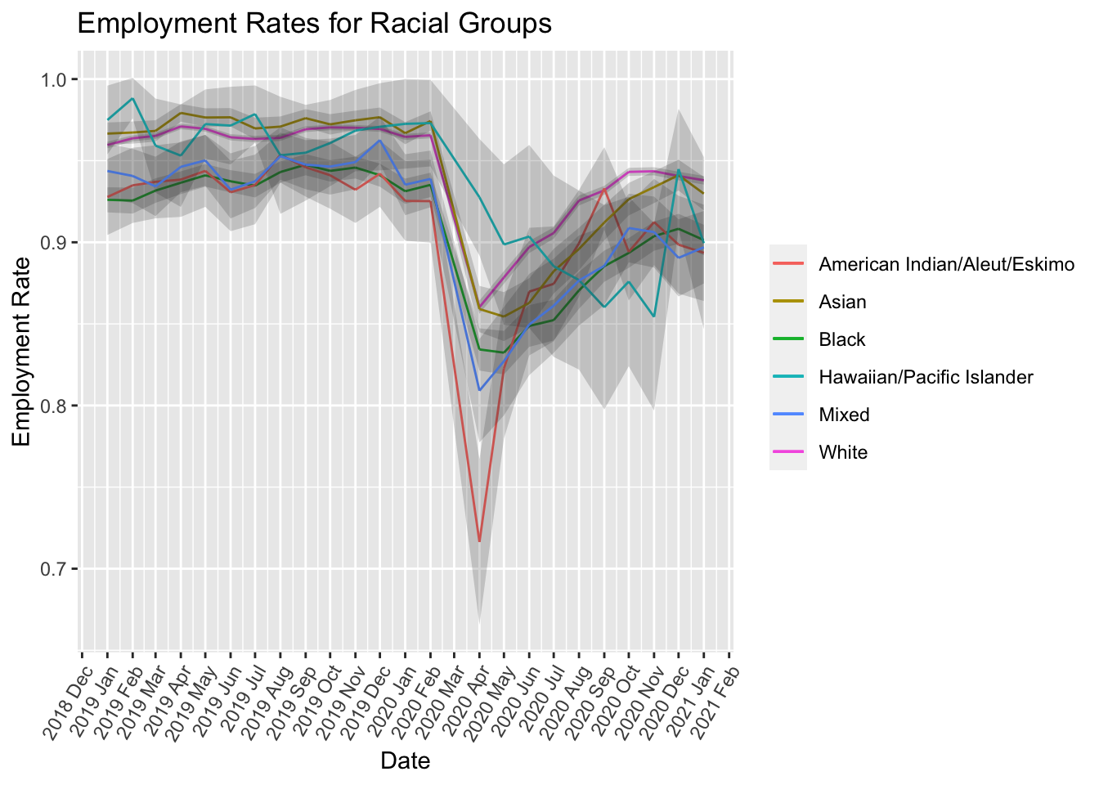
Analysis 3
When quarantine started due to COVID-19 in the US, which was in March 2020, there is an immediate decline in employment between individuals of all racial backgrounds.
The hardest hit group were individuals with an American Indian/ Aleut/ and Eskimo background.
With the latest 2021 data, it looks like racially, all the different groups are around the same employment rate, ranging between .85 and .95.

Slide 19
Question 3: Results
On average, over the year preceding February 2020 the following are our conclusions:
Women have historically been more likely to be employed than men, but employment rate trends show that this claim is true at times, but not always true. The employment rate for women can be seen occasionally dipping below the employment rate for men.
Married people have historically been more likely to be employed than non-married people, so nothing has changed in that regard and employment rate trends support this claim.
Baby Boomers and Gen X have historically been more likely to be employed than Millennials who have historically been more likely to be employed than Gen Z. Employment rate trends support this claim.
Historically, the higher educational attainment an individual has achieved, the more likely they are to be employed, so there is no change in that regard and employment rate trends support this this claim.
Historically, being Asian had the highest probability of being employed compared to all other racial categories pre-pandemic followed by Hawaiian/Pacific Islanders and then White people. However, this has changed as now being White has a higher probability than people who are Asian to be employed. Employment rate trends support this claim.
Across all demographics, the employment rates have not recovered to pre-pandemic employment rate levels.

Slide 20
Thank you

