Slide 1

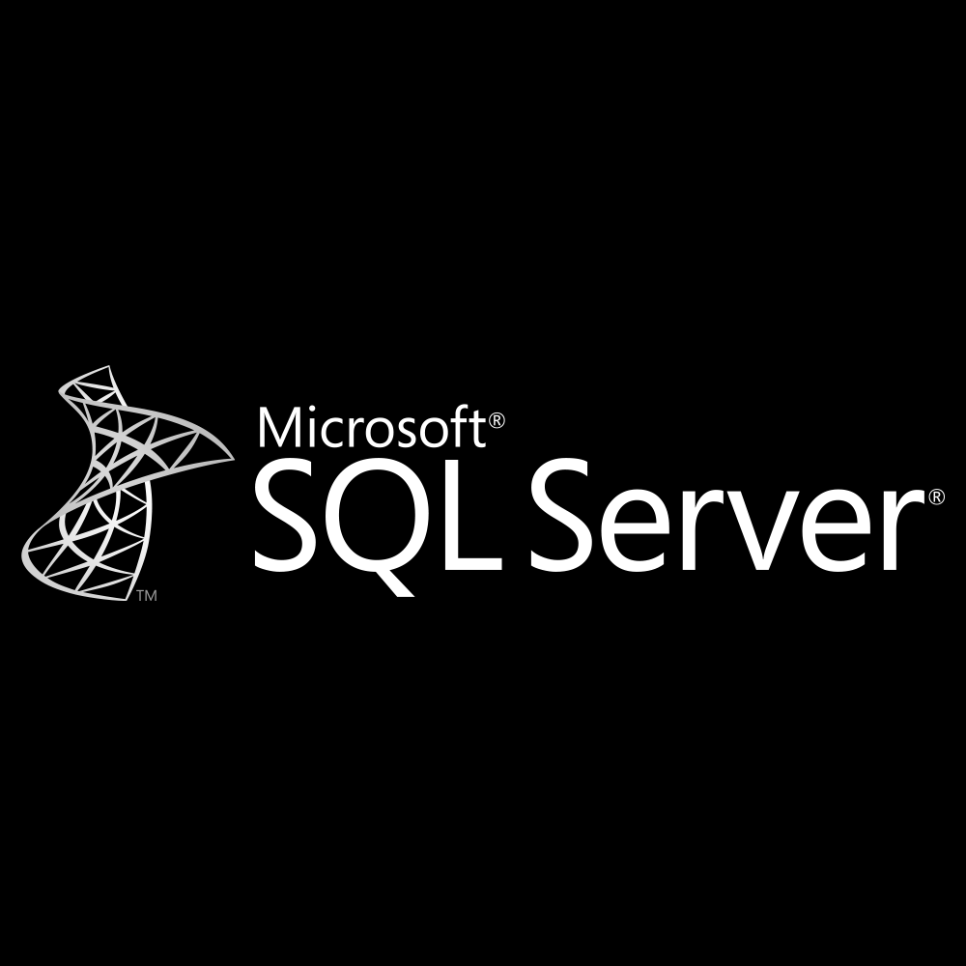



Slide 2

What we’ll do today?
How ASP.NET MVC works ?
Connect VB with SQL Server
Data Table
Insert, Update, Delete
Workshop (Option)

Slide 3

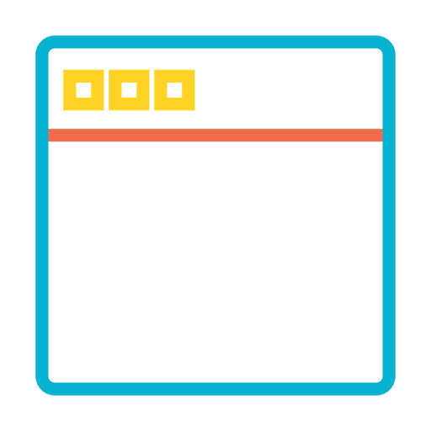
How ASP.NET MVC works ?
DB
Model
IIS
Controller
View
</>
User

Slide 4
Connect VB with SQL Server

Slide 5
DataTable

Slide 6
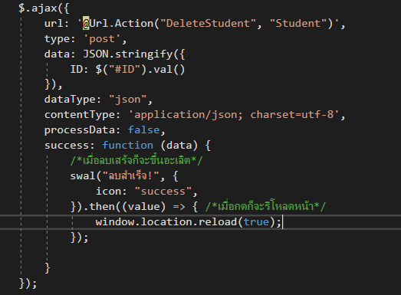
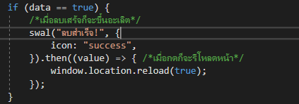
AJAX
Function Name
Controller Name
What you want to do if success

Slide 7
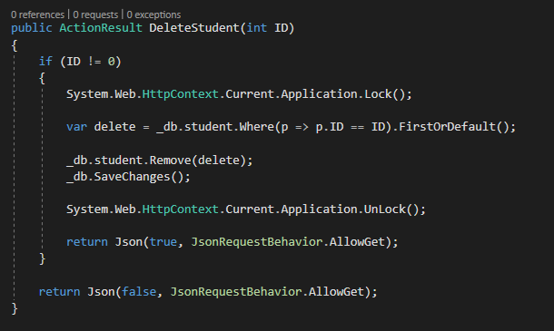
AJAX

Slide 8
Insert, Update, Delete

Slide 9
Workshop

