Slide 1
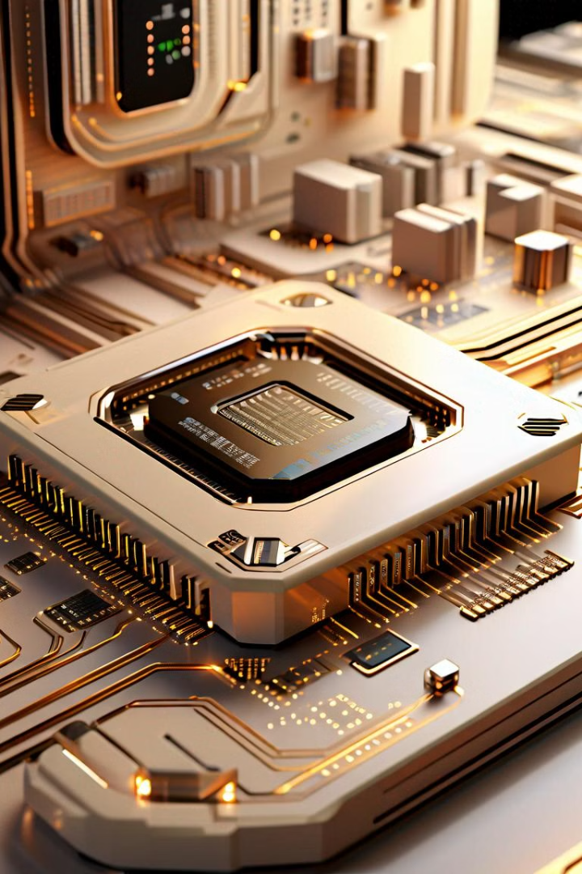

Virtual Memory: Unlocking the Potential of RAM
Virtual memory is a powerful concept in operating systems that allows programs to utilize more memory than is physically available in the system. By using disk storage as an extension of RAM, virtual memory enables efficient memory management and enhanced multitasking capabilities.
Ca
by Ch Juthvesh

Slide 2
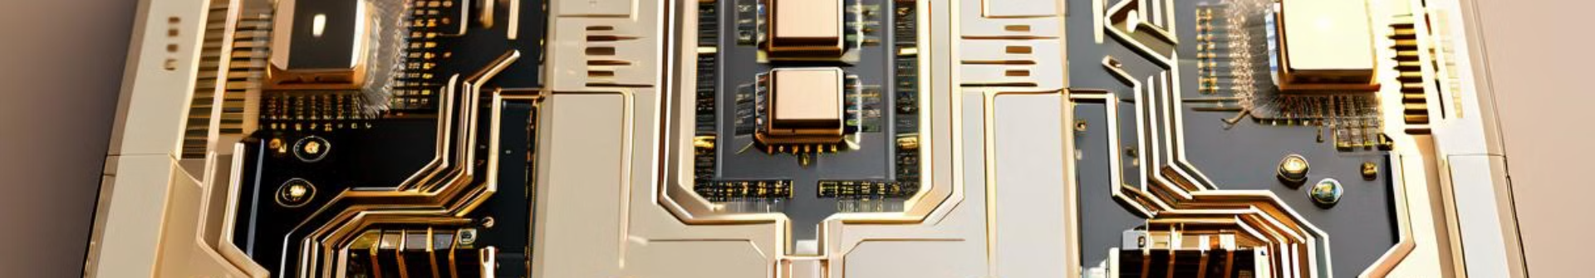
Advantages of Virtual Memory
1
Expanded Memory Capacity
2
Efficient Memory Utilization
3
Improved Multitasking
Virtual memory allows programs to access more memory than the physical RAM available, enabling them to handle larger datasets and more complex tasks.
By swapping pages between RAM and disk storage, virtual memory optimizes memory usage, reducing the need for costly hardware upgrades.
Virtual memory enables the operating system to effectively manage multiple running programs, switching between them as needed without running out of RAM.

Slide 3
Paging and Segmentation
Paging
Segmentation
Hybrid Approach
Paging is a virtual memory technique that divides the physical memory into fixed-size blocks called pages, which can be dynamically swapped between RAM and disk storage as needed.
Segmentation is an alternative virtual memory approach that divides the memory into variable-size blocks called segments, each with its own addressing and protection mechanisms.
Many modern operating systems employ a combination of paging and segmentation, leveraging the strengths of both techniques to optimize memory management.

Slide 4

Page Replacement Algorithms
1
FIFO
The First-In, First-Out (FIFO) algorithm replaces the page that has been in memory the longest.
2
LRU
The Least Recently Used (LRU) algorithm replaces the page that has been unused for the longest time.
3
Optimal
The Optimal algorithm replaces the page that will not be used for the longest time in the future.

Slide 5
Page Fault and Page Fault Handling
Page Fault
Page Fault Handling
A page fault occurs when a program attempts to access a page that is not currently in memory, requiring the operating system to fetch the page from disk storage.
The operating system's page fault handler is responsible for locating the required page, selecting a page to be replaced, and updating the page tables to reflect the new memory layout.
Performance Impact
Optimizations
Frequent page faults can significantly degrade system performance, as the disk access needed to fetch pages is much slower than RAM access.
Techniques like prefetching and caching can help minimize the impact of page faults and improve the efficiency of virtual memory management.

Slide 6



Thrashing and Its Causes
Insufficient Memory
High Page Fault Rate
Performance Degradation
When the working set of running processes exceeds the available physical memory, the system enters a state of thrashing, with constant page swapping and low productivity.
Thrashing is characterized by a high rate of page faults, as the operating system frantically swaps pages between memory and disk to keep up with demand.
Thrashing leads to a severe decline in system performance, as the CPU spends most of its time waiting for disk I/O operations to complete.

Slide 7




Memory Management Unit (MMU)
CPU Integration
Memory Management
Memory Protection
Hardware Acceleration
The MMU is closely integrated with the CPU, enabling efficient translation of virtual addresses to physical addresses.
The MMU manages the mapping between virtual and physical memory, handling tasks like page table updates and page fault detection.
The MMU enforces memory protection, ensuring that processes can only access the memory segments they are authorized to use.
The MMU's hardware-based address translation and memory management capabilities can significantly improve overall system performance.

Slide 8
Demand Paging and Its Benefits
Demand Paging
Reduced Memory Usage
Improved Performance
Demand paging is a virtual memory technique where pages are only loaded into physical memory when they are first accessed, rather than pre-loading all pages.
Demand paging allows the operating system to load only the necessary pages, reducing the overall memory footprint and making more efficient use of available RAM.
By avoiding the need to pre-load all pages, demand paging can significantly improve system performance, especially for applications with large memory requirements.

