Slide 1
SATELLITE AOD • GROUND PM2.5 • DHAKA, BANGLADESH
Can Satellite AOD Replace
Ground-Based PM2.5 Monitoring?
A baseline correlation analysis between MODIS Aerosol Optical Depth and DoE-CAMS ground-measured particulate matter (2014–2021)
Technical Presentation | Environmental Data Analysis

Slide 2
01 · PROBLEM STATEMENT
Ground data is sparse. Satellite data is abundant.
Do they agree?
Air pollution is an escalating public-health threat in Bangladesh, and effective, evidence-based policy depends on continuous air-quality data.
But ground monitoring stations suffer from technical limitations and human error — data is often missing or inconsistent.
Satellite-derived Aerosol Optical Depth (AOD) is proposed as a proxy — but its reliability against real ground measurements has not been quantified for this region.
OBJECTIVE
Quantify the baseline correlation between satellite-derived daily MODIS AOD and DoE-CAMS ground-measured PM2.5 concentrations.
Key question: Is AOD alone a statistically reliable stand-in for ground PM2.5 monitoring?
02

Slide 3
02 · ANALYSIS METHODS
Data Sources
G
Ground-Measured Data
S
Satellite-Derived Data
Air quality: PM2.5, PM10, NO2, SO2, CO, O3
Meteorology: temperature, RH, rainfall, wind speed & direction, solar radiation, barometric pressure
Resolution: hourly, station-based
Coverage: Nov 2012 – Dec 2021 (DoE-CAMS)
Parameter: MODIS Aerosol Optical Depth (AOD)
Resolution: daily
Coverage: Jan 2014 – Dec 2021
Station alignment: ground and satellite station grids differ — merges prioritize satellite-derived station locations.
03

Slide 4
02 · ANALYSIS METHODS
Preprocessing & Modeling Approach
1
2
3
4
Aggregate
→
Clean
→
Merge
→
Model
Hourly DoE-CAMS observations aggregated into daily averages to match AOD's daily resolution.
Blank and inaccurate records removed via Python (Jupyter). Minimum 18 valid hourly readings/station/day required.
Ground and satellite station grids reconciled, prioritizing satellite-derived station locations.
Three nested OLS regressions estimate PM2.5 as a function of AOD, meteorology, and both combined.
THREE NESTED OLS REGRESSION MODELS
Model 1 PM2.5 = β0 + β1·AOD + ε (AOD only)
Model 2 PM2.5 = β0 + β1T + β2RH + β3WS + β4R + β5BP + β6SR + β7VWS + ε (Meteorology only)
Model 3 PM2.5 = β0 + β1·AOD + β2T + … + β8VWS + ε (AOD + Meteorology)
04

Slide 5
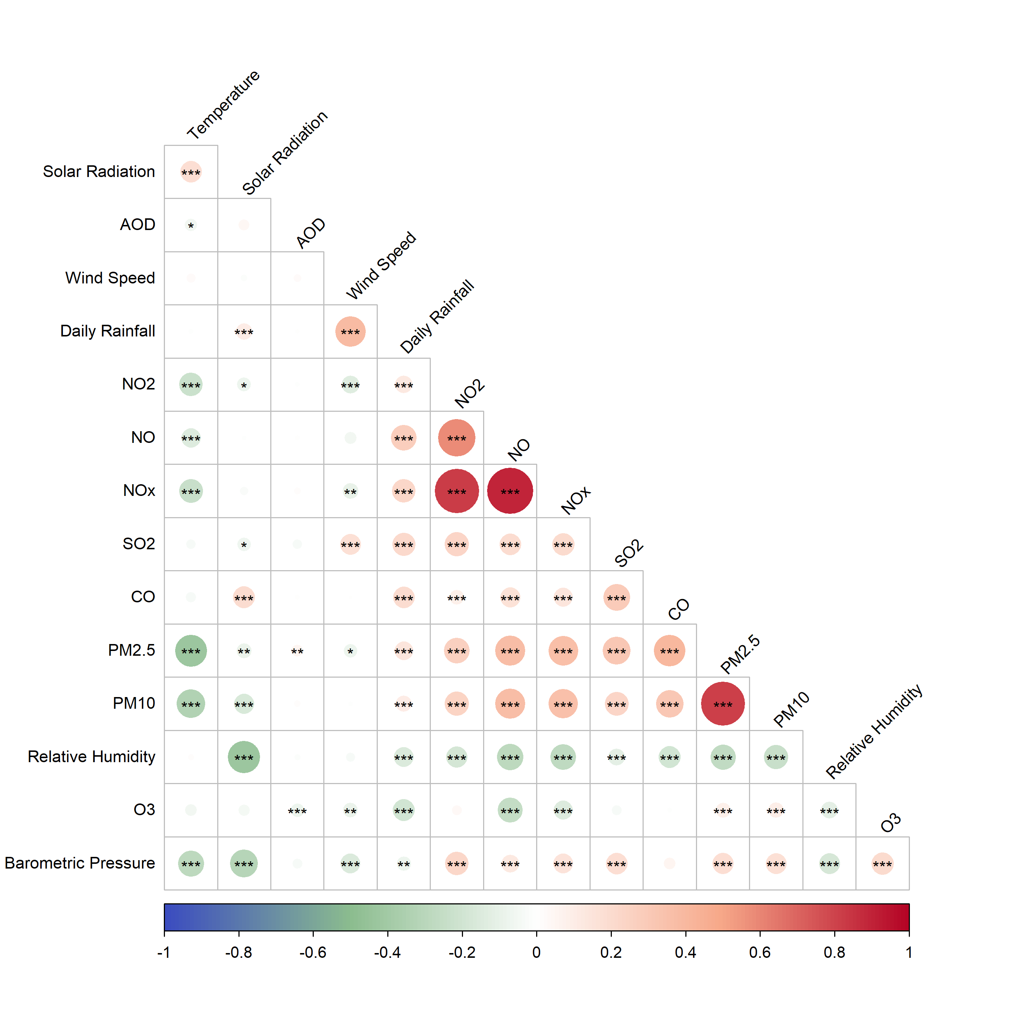
03 · RESULTS
Bivariate Correlation Structure
Spearman correlation matrix across pollutants and meteorological variables
PM2.5 ↔ PM10
rs = 0.82
Strong co-emission signal between particulate species.
PM2.5 ↔ Temperature
rs = −0.42
Higher temperatures promote dispersion, lowering PM2.5.
PM2.5 ↔ AOD
rs = 0.05
Near-zero — satellite AOD barely tracks ground PM2.5.
05

Slide 6
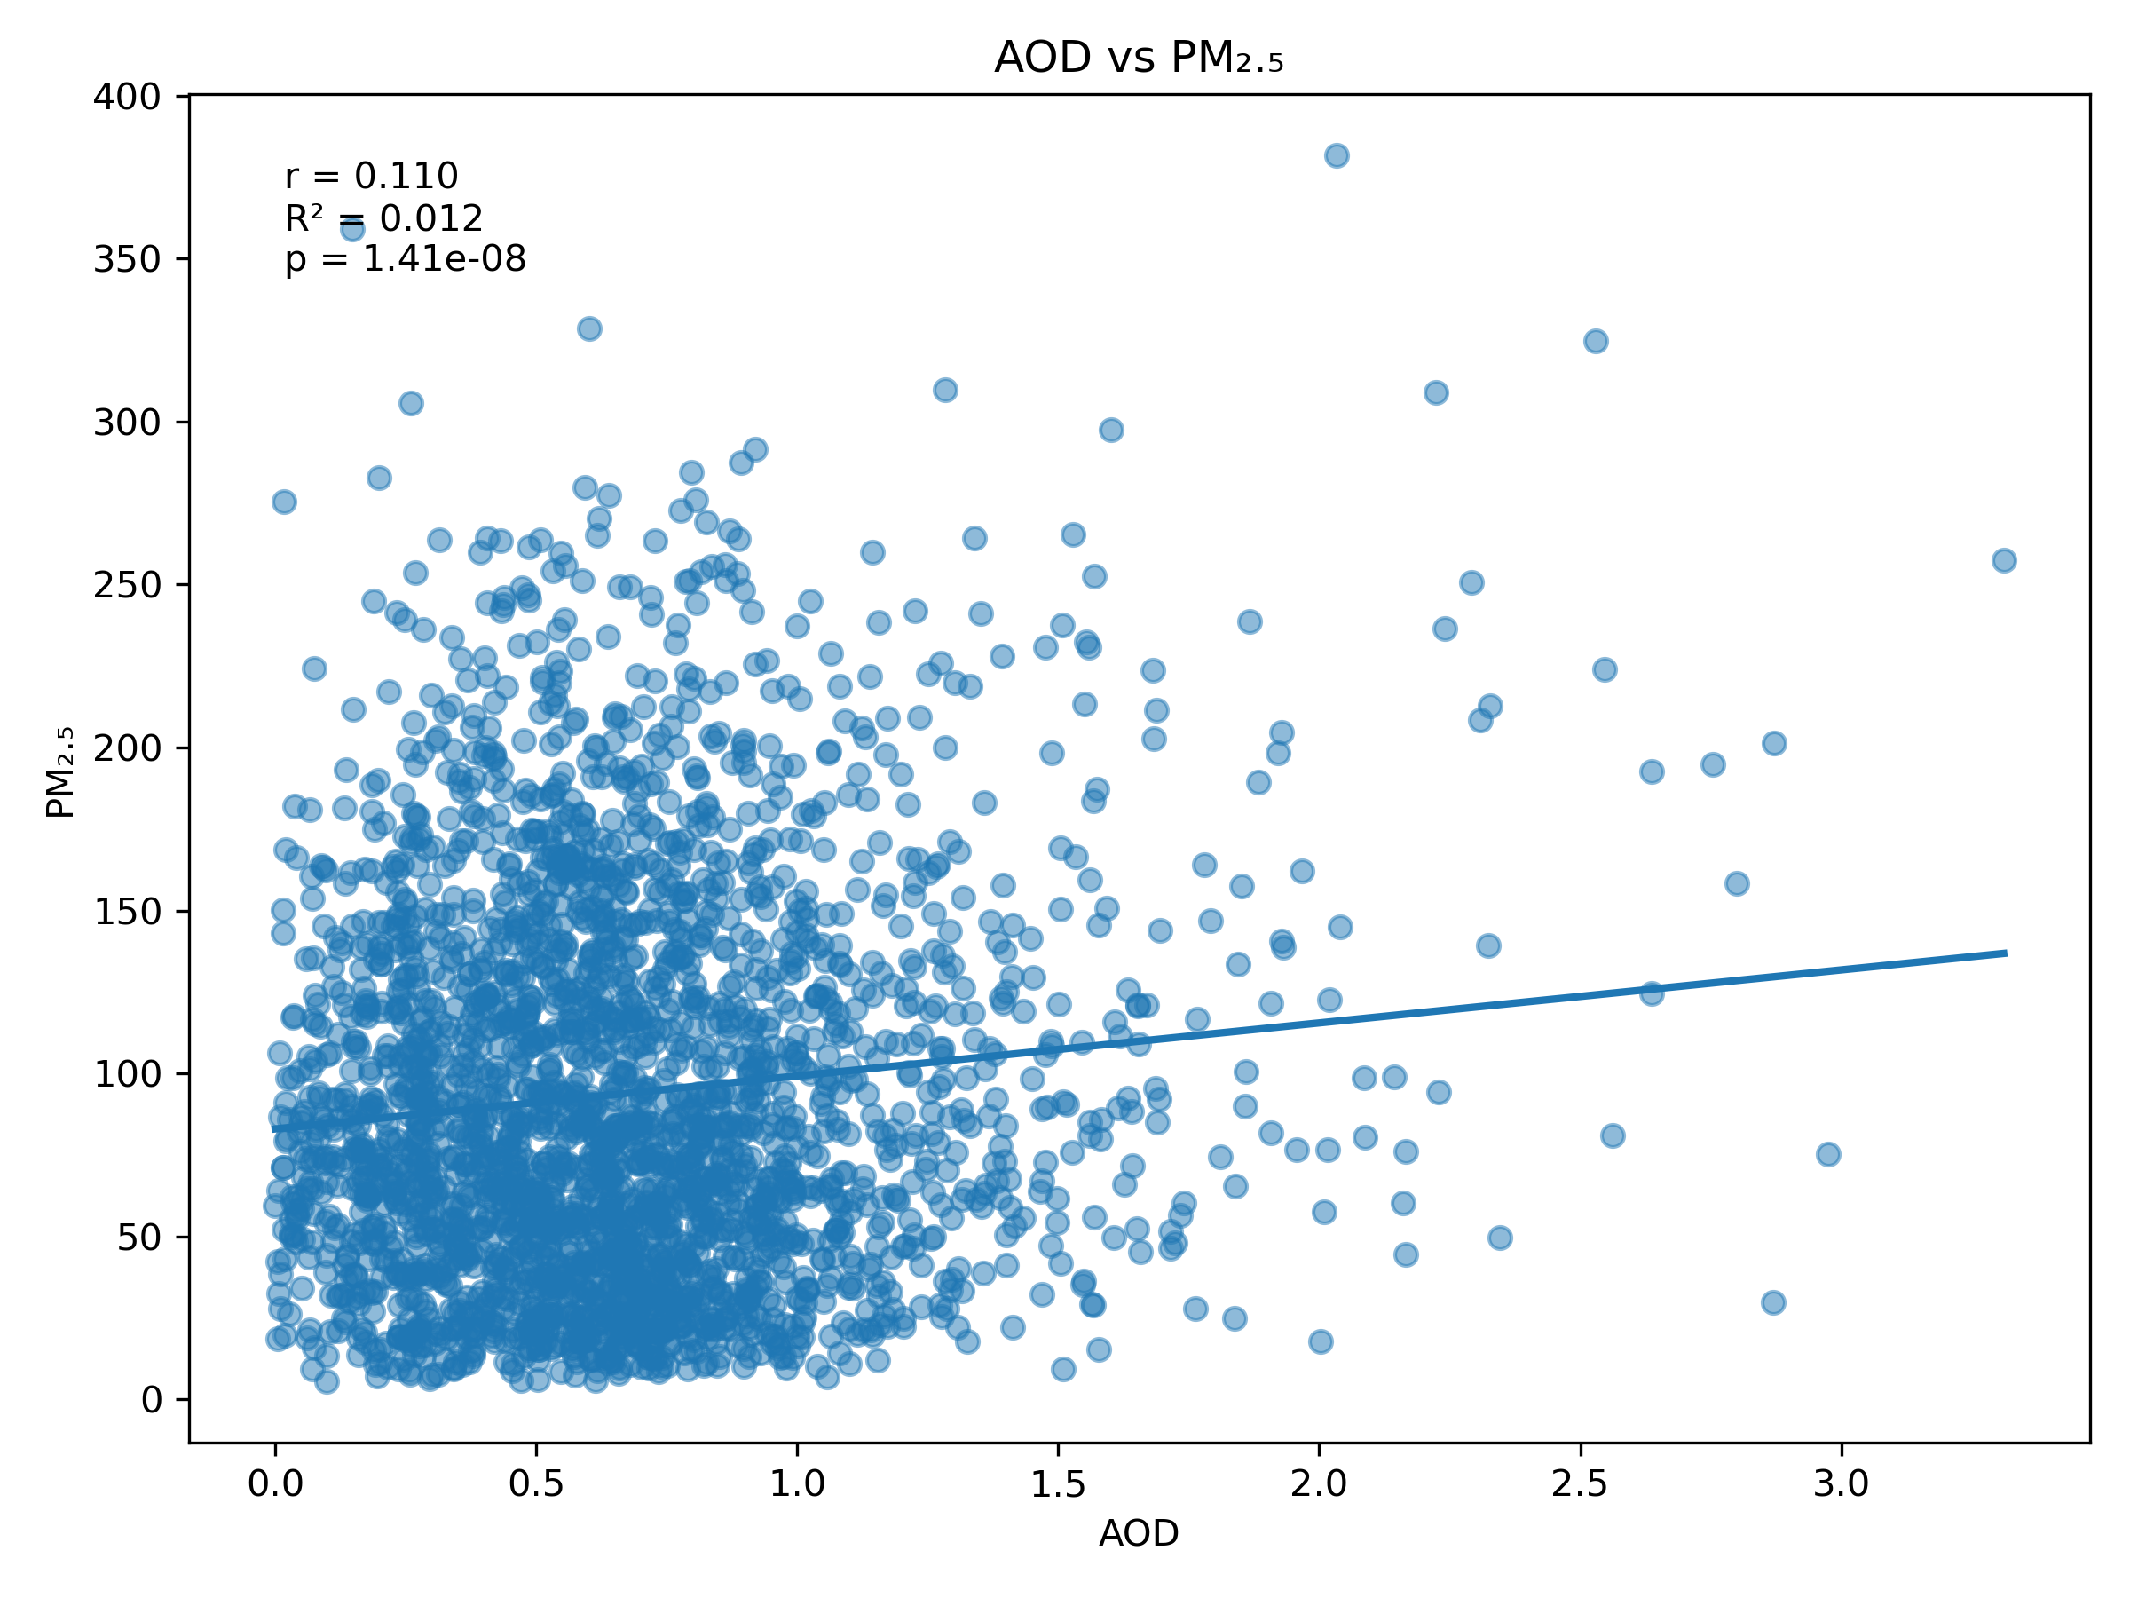
03 · RESULTS
AOD vs. PM2.5 — the Headline Relationship
r = 0.110
Pearson correlation
R² = 0.012
Variance explained
p < 0.001
Statistically significant, but practically weak
Wide scatter at every AOD level means AOD cannot distinguish clean days from heavily polluted ones at the surface.
06

Slide 7
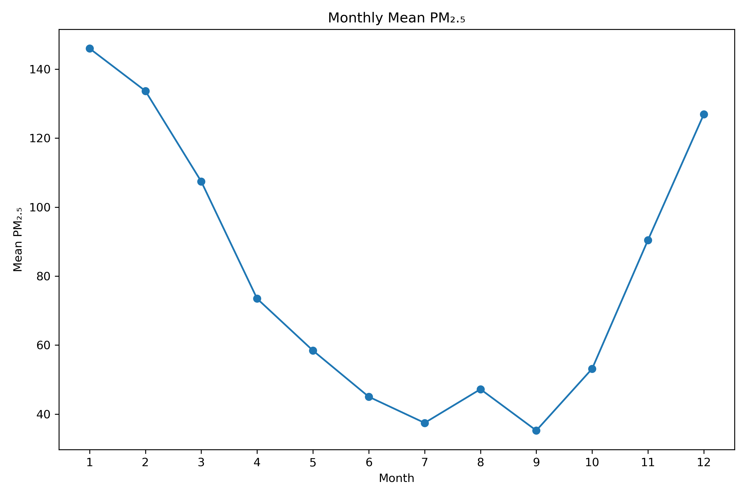
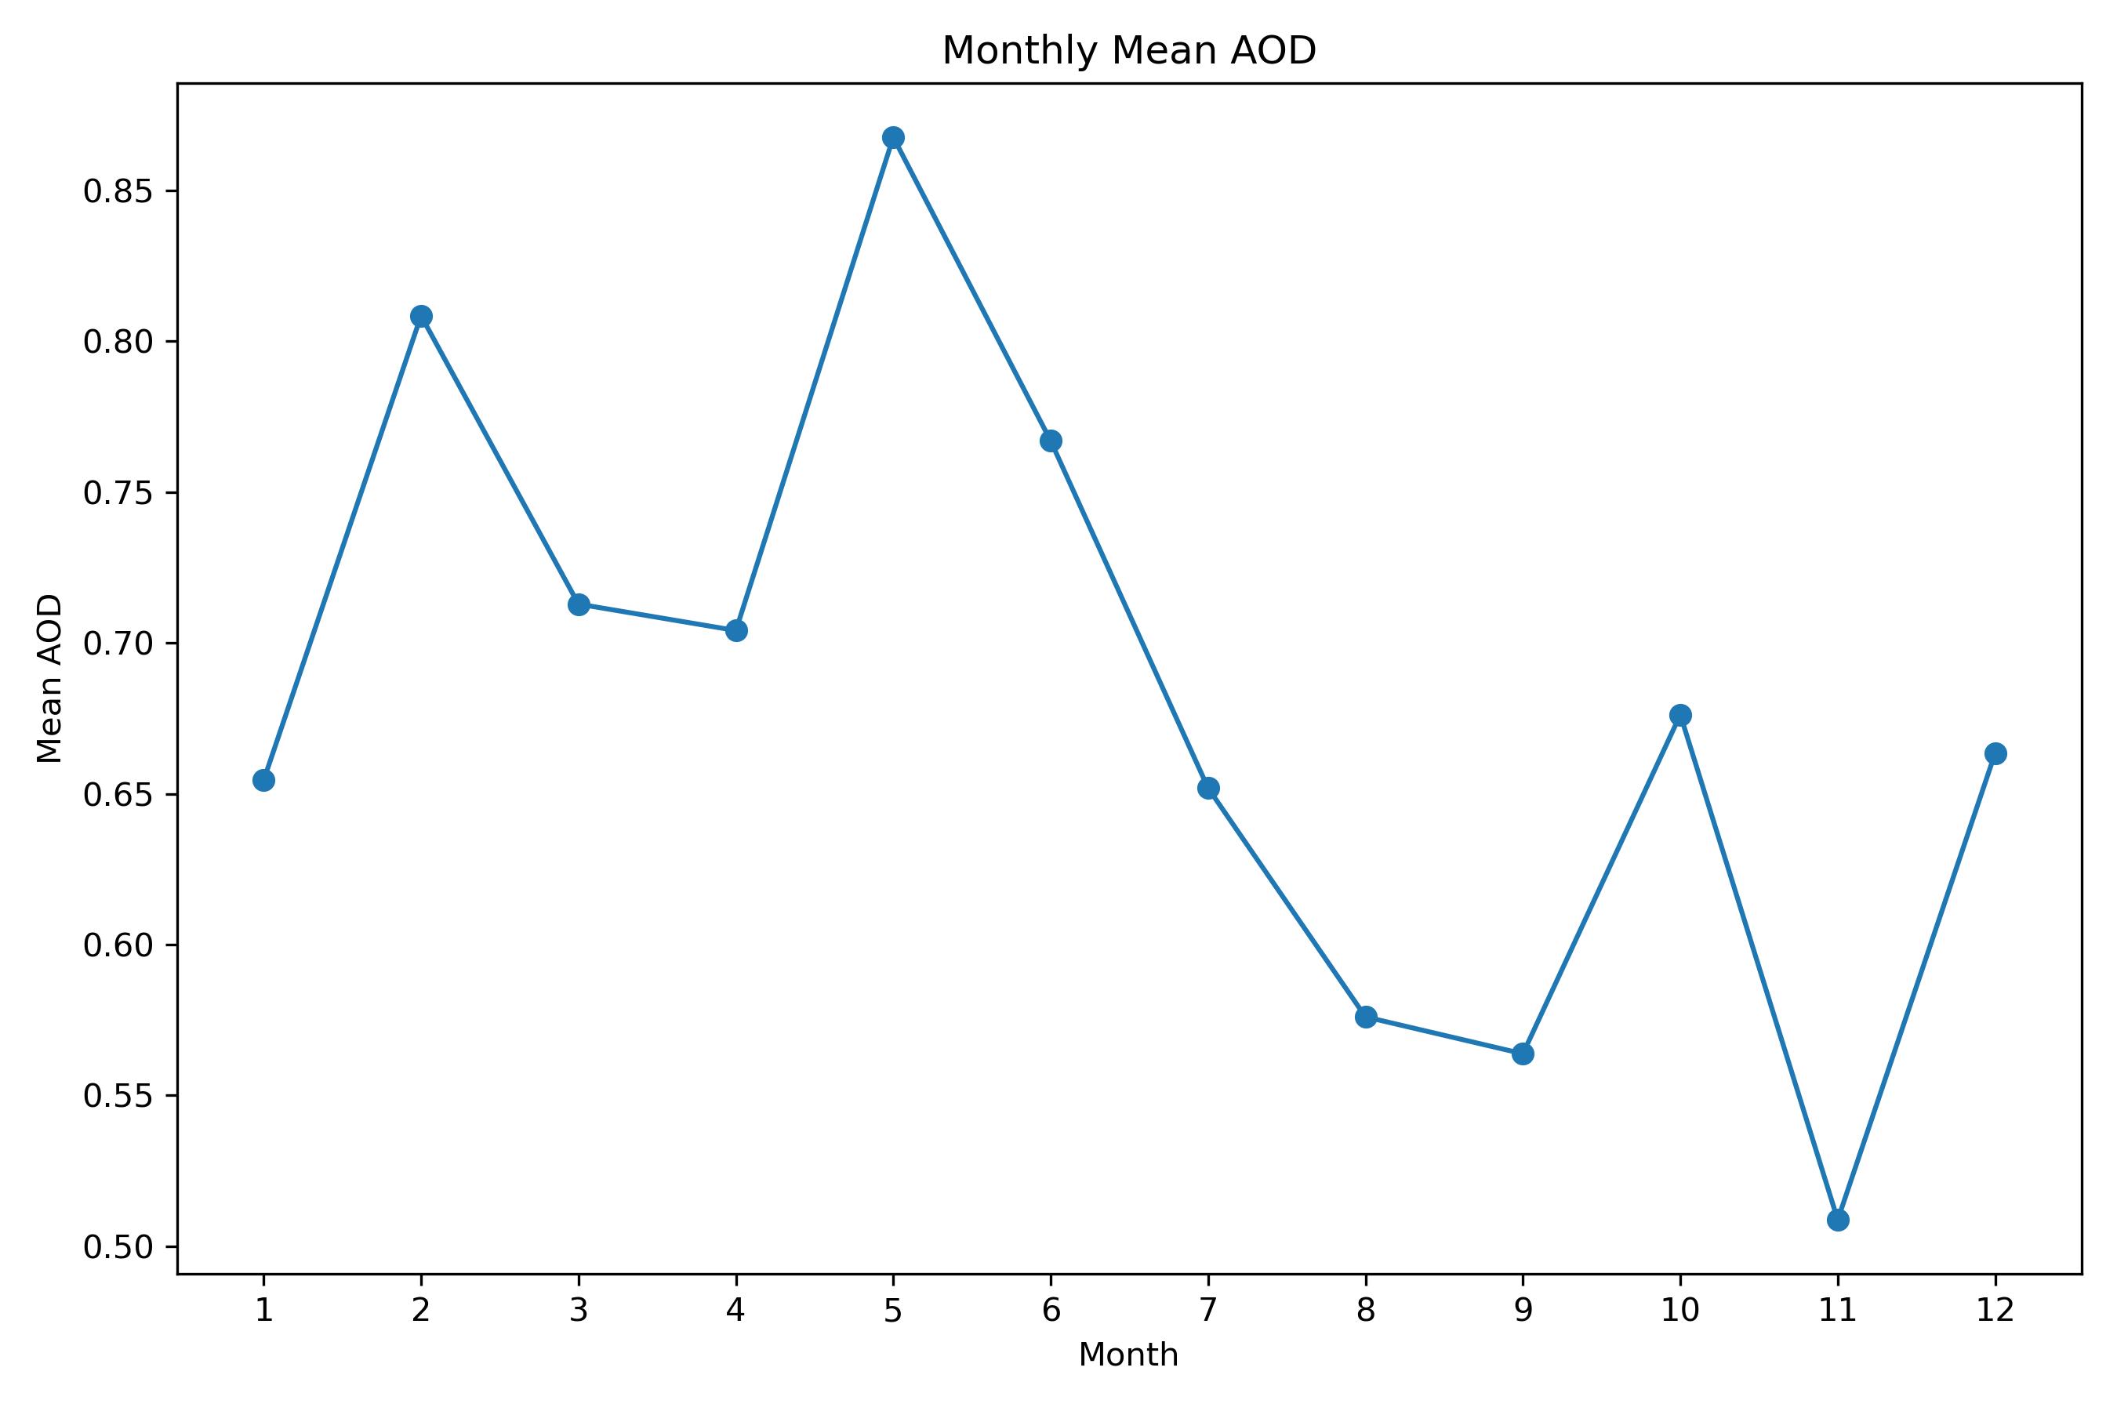
03 · RESULTS
Seasonal Patterns Diverge
Monthly mean PM2.5 peaks in the dry winter (Nov–Feb); monthly mean AOD peaks in the pre-monsoon (Mar–Jun) — the two signals are largely out of phase.
Ground PM2.5 — winter peak
Satellite AOD — pre-monsoon peak
07

Slide 8
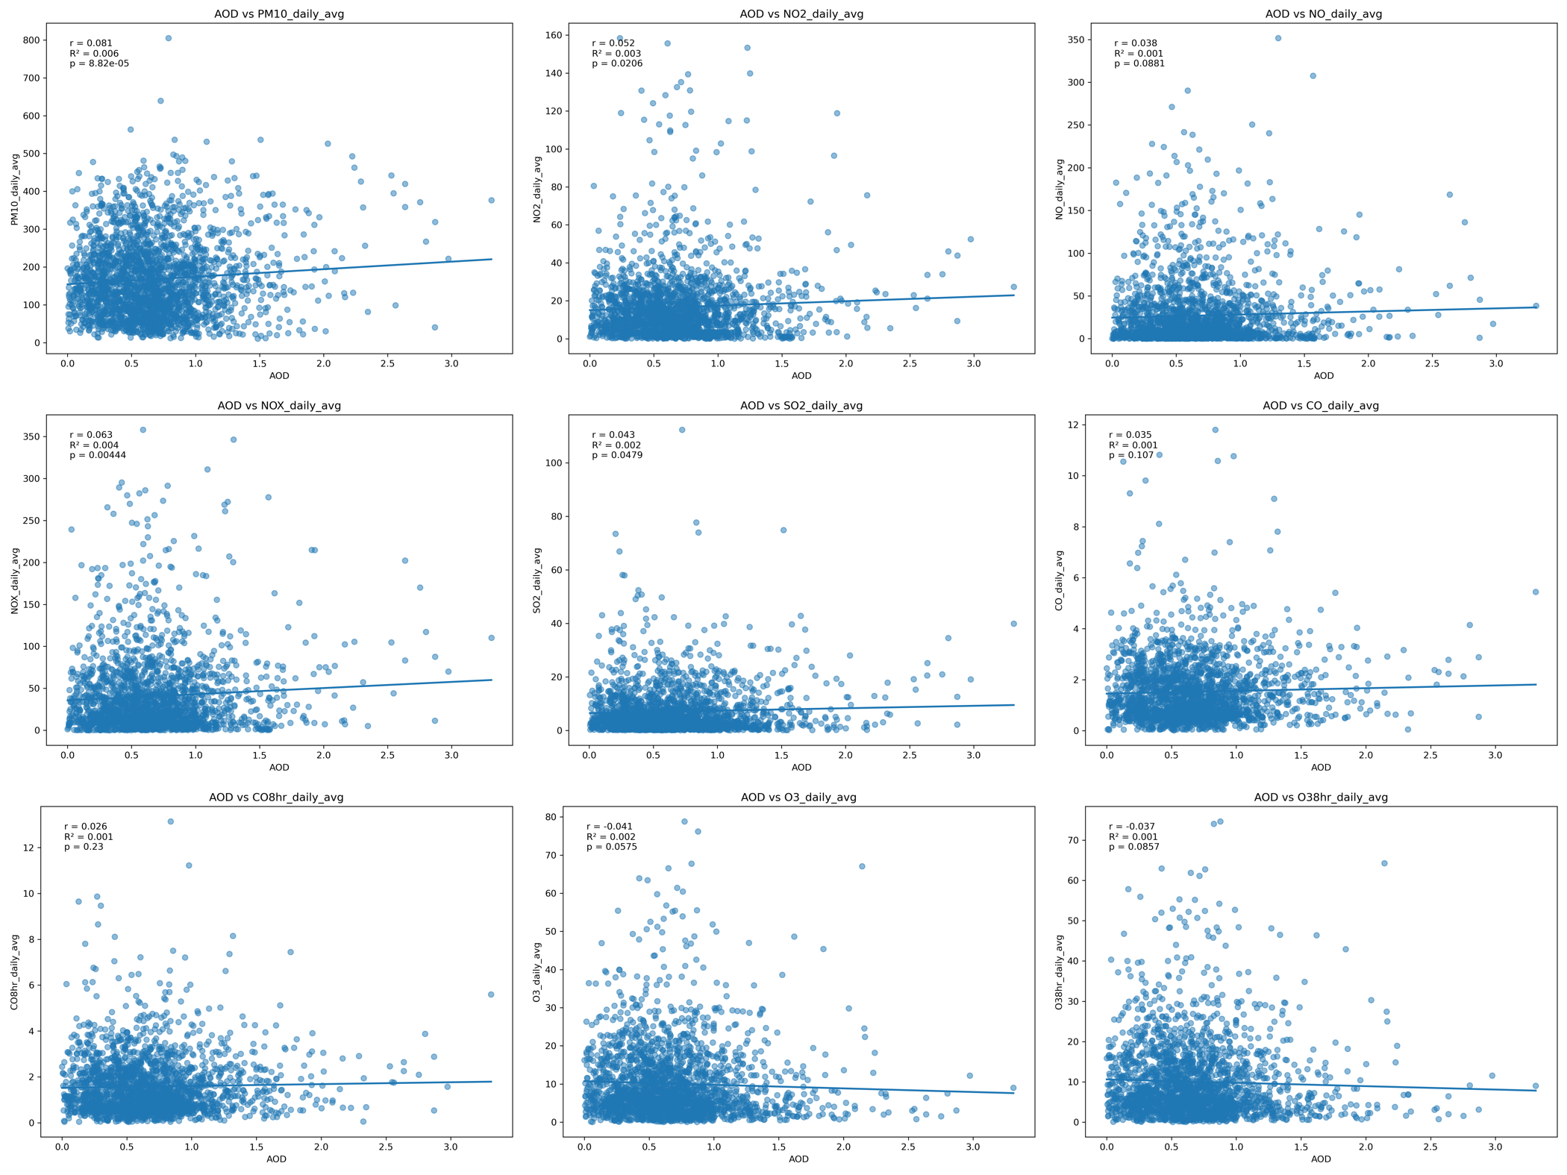
03 · RESULTS
The Weak Link Holds Across Pollutants
AOD vs. daily-average PM10, NO2, NO, NOx, SO2, CO, CO(8hr), O3, O3(8hr) — every pair returns r ≤ 0.11
08

Slide 9
03 · RESULTS
Regression Models: Meteorology Dominates, AOD Adds Nothing
Model | Predictors | R² | Adj. R² | AOD coefficient (p-value)
1 | AOD only | 0.009 | −0.021 | β = −17.68 (p = 0.591)
2 | Meteorology only (T, RH, WS, Rain, BP, SR, VWS) | 0.582 | 0.477 | — (not included)
3 | AOD + Meteorology | 0.582 | 0.458 ↓ | β = −5.00 (p = 0.873)
WHY THIS MATTERS
Meteorology alone explains 58% of PM2.5 variance
— temperature, wind speed and rainfall govern dispersion far more than aerosol loading does.
Adding AOD does not improve fit
— R² is unchanged and Adjusted R² falls, meaning AOD is penalized as unnecessary model complexity, not rewarded as a useful predictor.
09

Slide 10
04 · CONCLUSIONS
AOD Alone Is Not a Reliable PM2.5 Proxy — Yet
1
Very weak baseline link
2
Meteorology is the real driver
Spearman rs = 0.05 and OLS R² = 0.009 between MODIS AOD and ground PM2.5.
Temperature, wind and rainfall jointly explain 58% of PM2.5 variance — AOD adds none.
3
Seasonal mismatch
4
Path forward
PM2.5 peaks in dry winter; AOD peaks pre-monsoon — the signals move out of phase.
Meteorological adjustment, better spatial/temporal matching, and larger high-quality datasets are needed before AOD can proxy for surface PM2.5.
10

Slide 11
Thank You
Data: DoE-CAMS ground network & MODIS AOD (2012–2021) · Analysis: Python & OLS regression (statsmodels)
Questions & discussion welcome.
11

