Slide 1
MDE 2023/2024
The green slides are more relevant in terms of tests and exams.
Class 1 – Introduction to Data Modeling in Engineering (MDE), part 2
(04/03/2024) - (08/03/2024)

Slide 2
TOpics
Data formalisms
Tables
XML
JSON
YAML
Examples

Slide 3
Data formalism
Data formalism refers to the various ways in which data can be represented and structured using a formal language or notation. Some common types of data formalism are:
Relational data model (tables).
Object-oriented data model.
XML.
JSON.
YAML
RDF.
The choice of data formalism depends on the specific needs of the application or system and the type of data being represented (store information, transmit data, …)

Slide 4
Data modeling languages
Data modeling languages are used to create conceptual, logical, and physical models of data in a structured format. These models are used to represent the relationships, attributes, and constraints of data in a database or information system. Here are some of the commonly used data modeling languages:
XML schema definition
JSON
ebXML
Entity-Relationship Diagram (ERD).
Unified Modeling Language (UML).
Object-Role Modeling (ORM).
Structured Query Language (SQL).
Business Process Modeling and Notation (BPMN).
Overall, data modeling languages are important for creating clear and consistent representations of data structures in a way that is easily understandable by both technical and non-technical stakeholders (chatGPT).

Slide 5
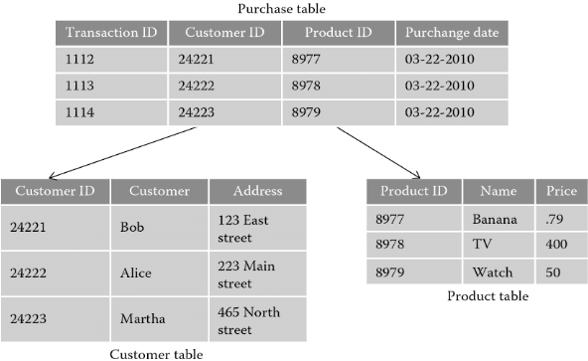
Relational Data formalism
Relational data model:
The relational data model is a formalism used to represent data in a tabular form, where each row represents a record, and each column represents an attribute of the record.
The relationships between records are represented using keys that connect tables together.

Slide 6
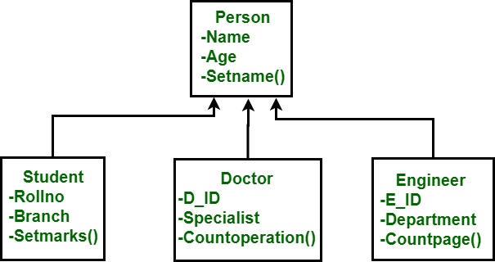
Object-oriented data model
Object-oriented data model
The object-oriented data model is a formalism used to represent data as objects with attributes and behaviors.
Objects are organized into classes and relationships between objects are represented using associations.
https://www.geeksforgeeks.org/basic-object-oriented-data-model/

Slide 7
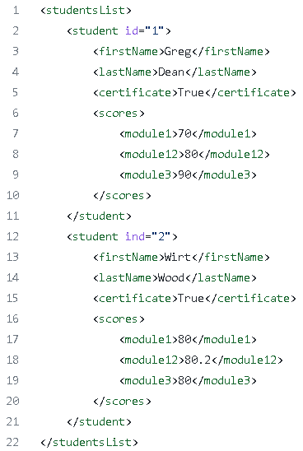
XML
XML (eXtensible Markup Language)
Is a markup language used to store and transport data in a structured format.
XML data is organized into elements, attributes, and values, and is widely used for data exchange between different systems and platforms.
https://github.com/sichkar-valentyn/XML_files_in_Python/blob/master/example.xml

Slide 8
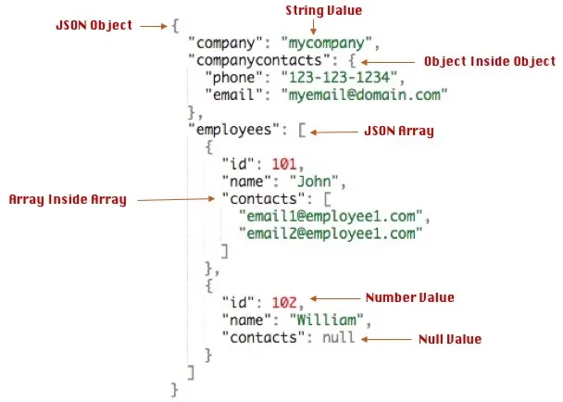
JSON
JSON: JSON (JavaScript Object Notation)
is a lightweight data-interchange format that is easy for humans to read and write and easy for machines to parse and generate.
JSON data is organized into key-value pairs and is widely used in web applications and APIs.
https://techeplanet.com/json-example/

Slide 9
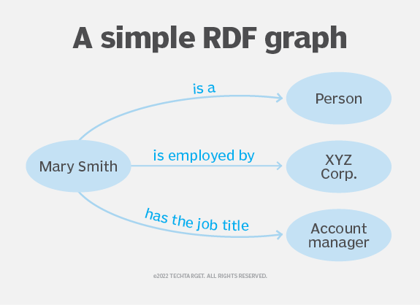
RDF
RDF: RDF (Resource Description Framework)
is a standard for modeling and sharing metadata and other types of data about resources on the web.
RDF data is organized into triples, which consist of a subject, predicate, and object, and is widely used for semantic web applications and linked data.
Represented initially using XML, standards for encoding RDF statements now include the following three syntaxes:
Turtle is the most popular text syntax for RDF statements. The W3C describes it as a "compact and natural text form" that includes abbreviations for commonly used patterns.
JSON-LD uses the JSON syntax for RDF statements.
N-Triples is a subset of the Turtle syntax, designed to be a simpler text-based format for RDF statements for improved ease of use by humans writing statements. The simpler format also makes it easier for programs to create and parse RDF statements.
https://www.techtarget.com/searchapparchitecture/definition/Resource-Description-Framework-RDF

Slide 10
Example
MySQL schema for a sales database. It should comprise the following tables:
customers(id, name, ...),
suppliers(id, name, ...),
products(id, reference, description, stock, unit_price, ...),
invoice(id, bill_number, date, customer_id, total_value, ...),
invoice_details( id, product_id, quantity, unit_price, ...). (INVOICE DOCUMENT IN NEXT SLIDE)
As exercise, define additional details such as and missing tables or attributes.
The name of the primary key attribute in each table should be id;
The pattern name for foreign keys is name_of_dominant_table_id, e.g. like the product_id in the bill_detais table.

Slide 11
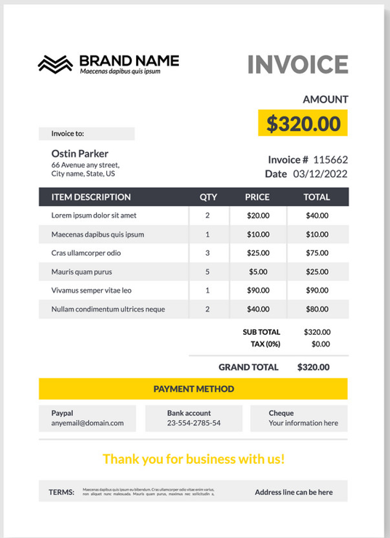
Invoice Example
We are going to create a digital representation of the invoice in XML, JSON

Slide 12
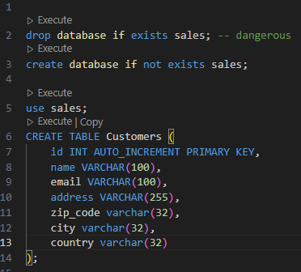
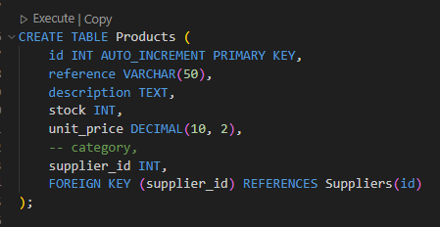
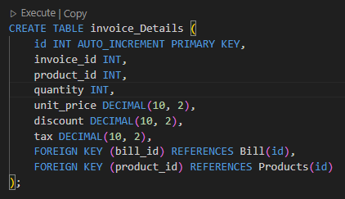
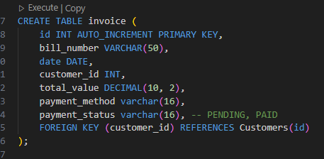
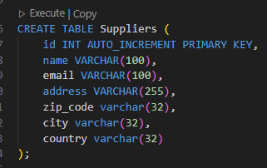
Solution
For the source-code, click on the ZIP link and extract.

Slide 13
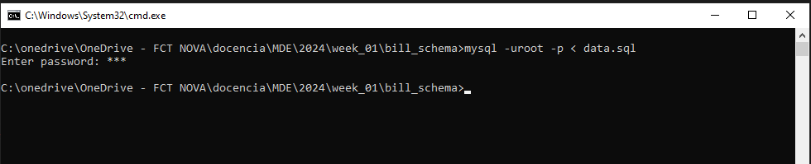
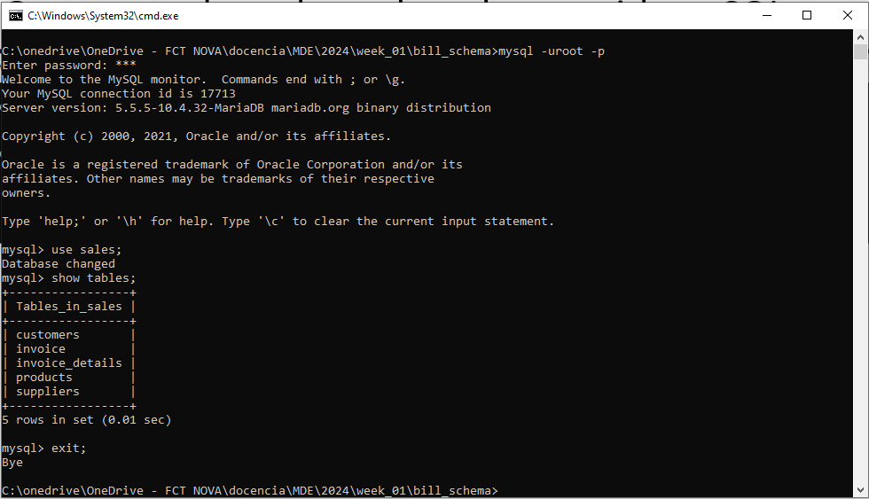
Schema creation
Open console and run the schema with mySQL.

Slide 14
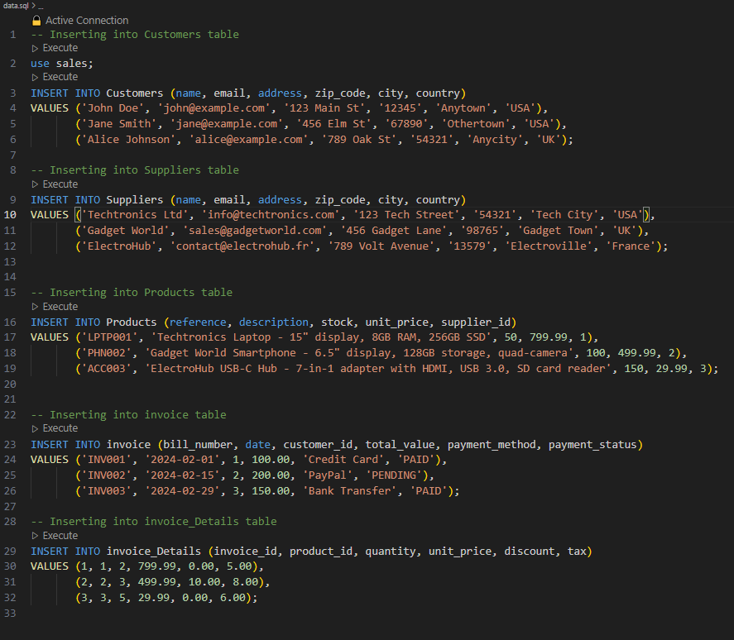
Populate tables with data

Slide 15
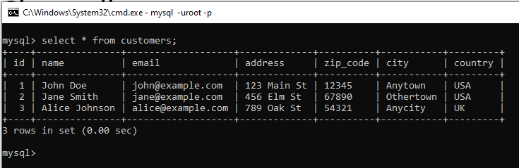
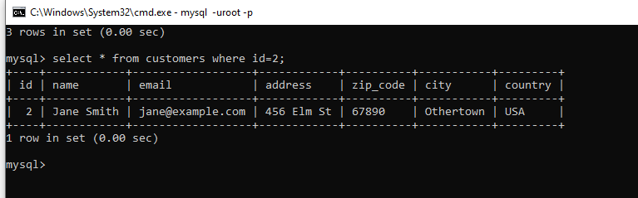
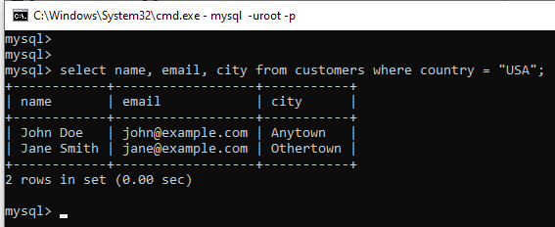
Queries
Show all customers:
Select customer id=2:
Select name, email and city of customers from USA:

Slide 16
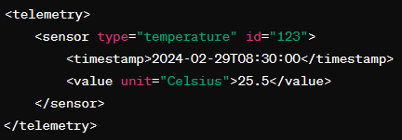
XML
element
attributes
XML (Extensible Markup Language) is a markup language designed to store and transport data in a structured way.
It provides a flexible and extensible way to represent information in human-readable text, organized into <tags>, which describe the content and structure of the data.
XML is made up of elements, attributes, and text. Elements are defined by <tags> whether they involve data or other elements. Attributes are additional information associated with elements specified within the <tags>. The text within the elements provides the content of the data.
One of the most important features of XML is its ability to define custom tag sets, allowing for creating specific data formats for different purposes. This makes XML a common choice for representing a wide variety of data in many contexts, such as software configurations, exchanging data between applications, and storing information in databases.
Additionally, XML is platform-agnostic and can be processed by many programming languages and software tools, making it widely adopted in distributed and interoperable information systems.

Slide 17
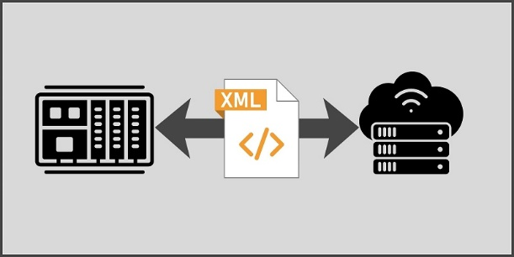
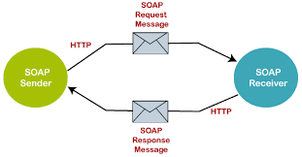
Typical XML applications
Neutral data exchange between distinct systems.
Interoperability
Software configuration.
Structured documentation
Web services (SOA), using SOAP message
Structured data in databases.

Slide 18
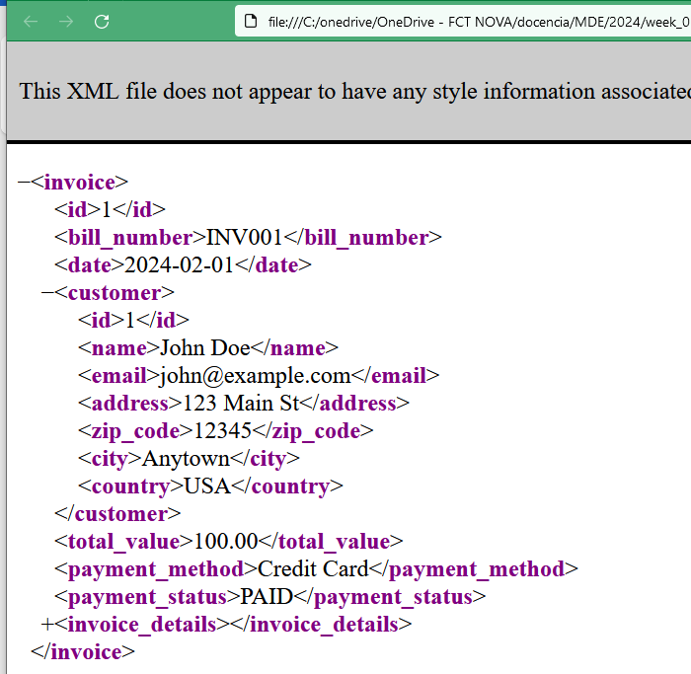
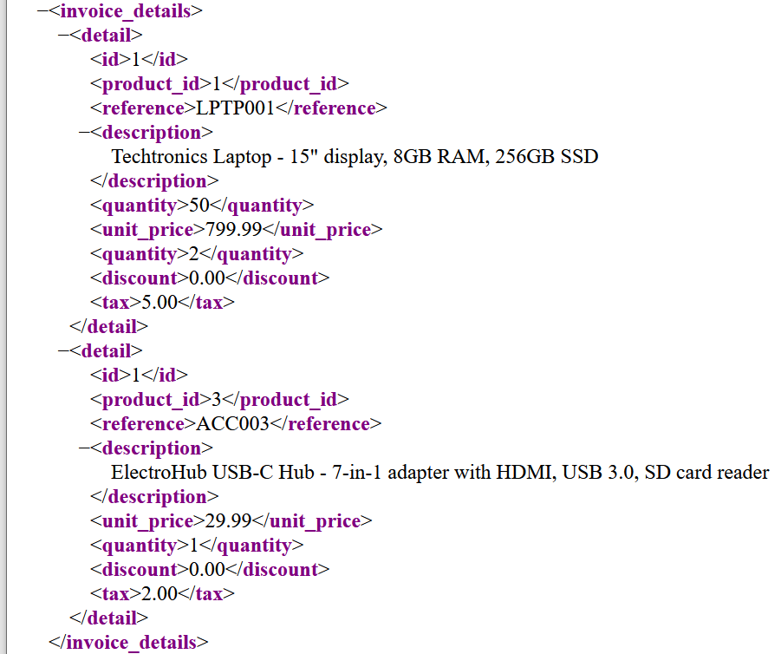
XML format
XML representation of the invoice:

Slide 19
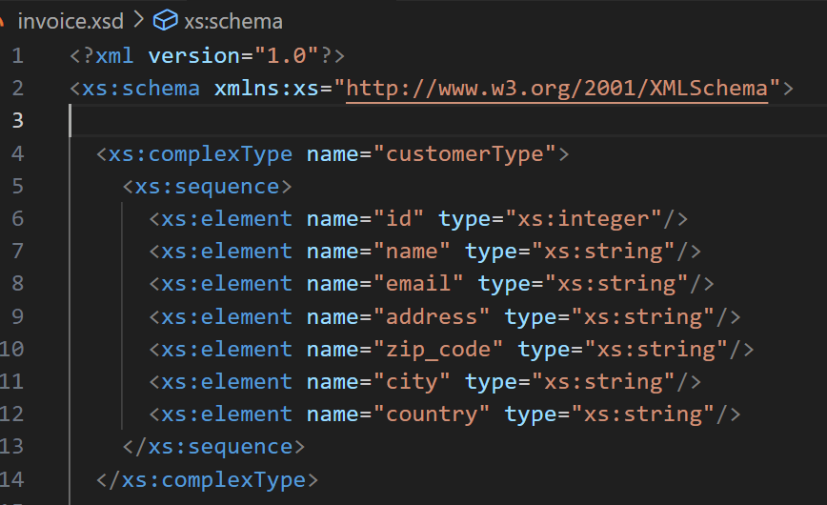
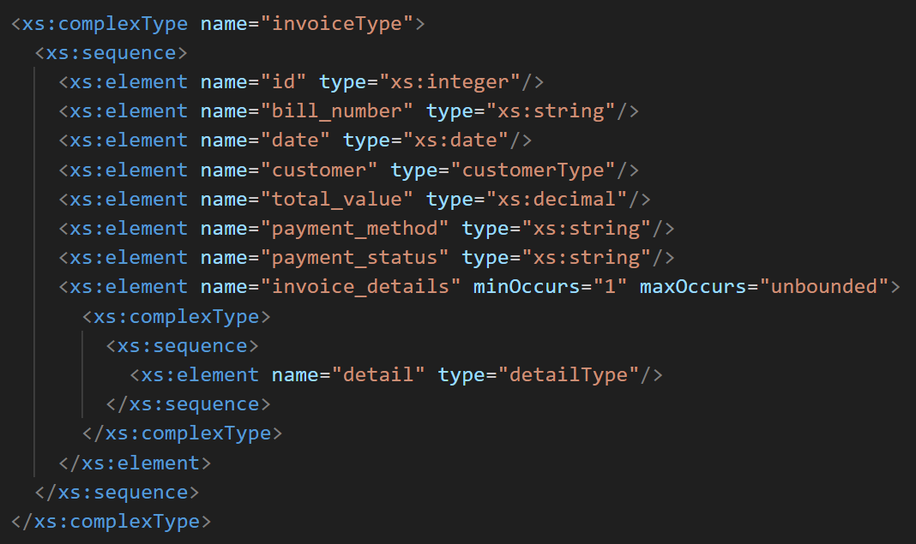
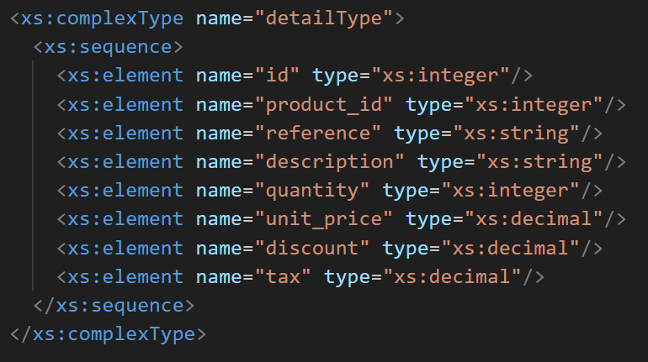
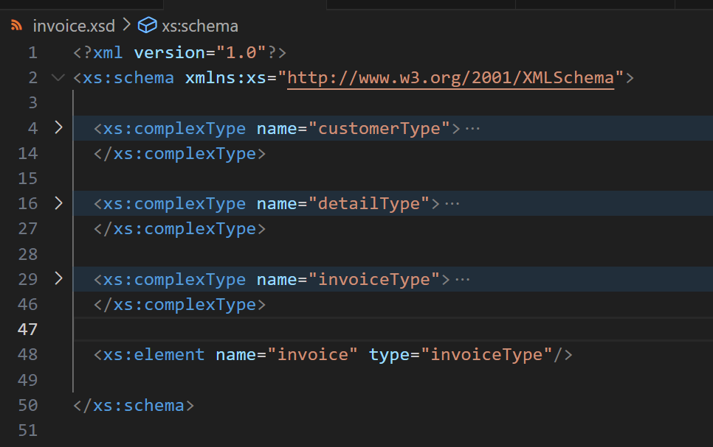
Schema validation
To validate invoice documents

Slide 20
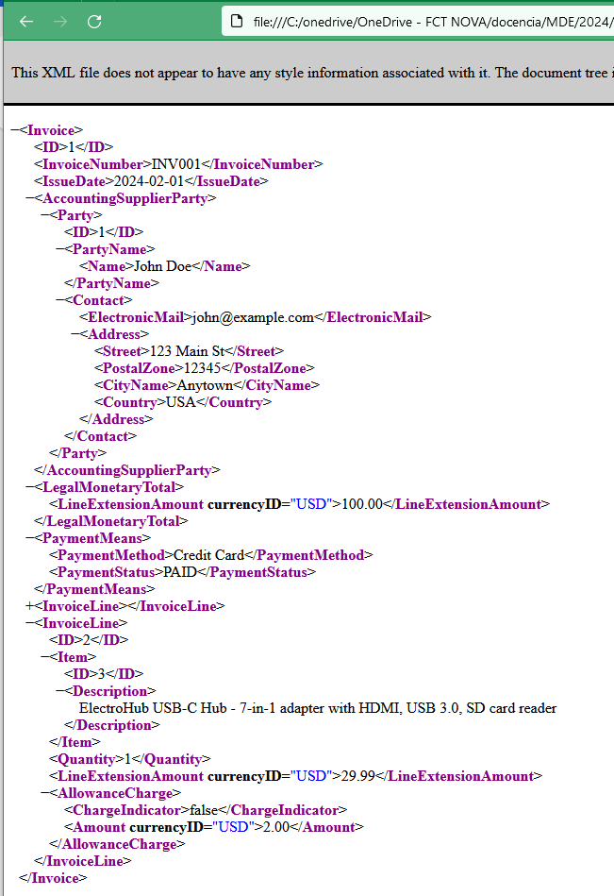
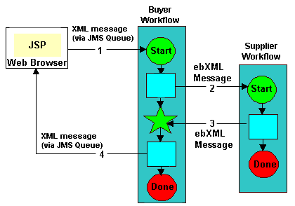
ebXML
ebXML: Electronic Business XML.
It is an XML-based standards framework designed to facilitate the electronic data exchange between companies.
It is designed to address the challenges of business systems integration and business process automation in heterogeneous and distributed environments.

Slide 21
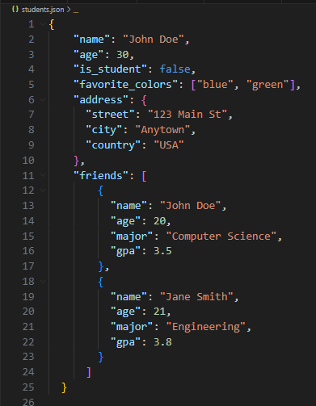
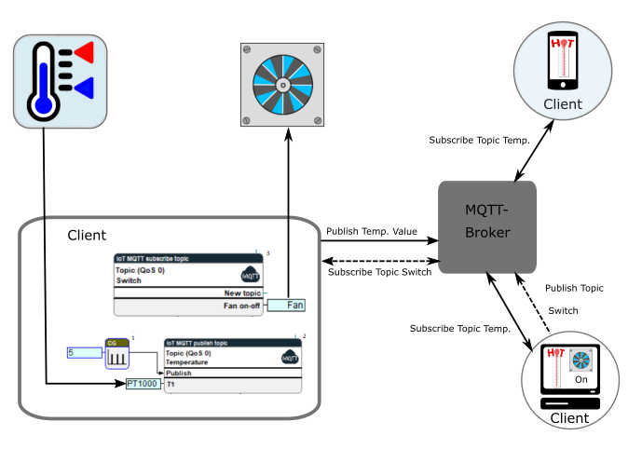
JSON
JSON (JavaScript Object Notation) is a lightweight data-interchange format that is easy for humans to read and write and for machines to parse and generate. It is based on a subset of the JavaScript programming language but is language-independent, meaning it can be used with virtually any programming language.
JSON is often used as an alternative to XML for transmitting data between a server and a web application.
It is commonly used in web development for APIs (Application Programming Interfaces) and AJAX (Asynchronous JavaScript and XML) requests because of its simplicity and ease of use.
JSON data is organized into key-value pairs, where keys are strings and values can be strings, numbers, arrays, objects, booleans, or null. JSON objects are enclosed in curly braces {}, and arrays are enclosed in square brackets [].

Slide 22
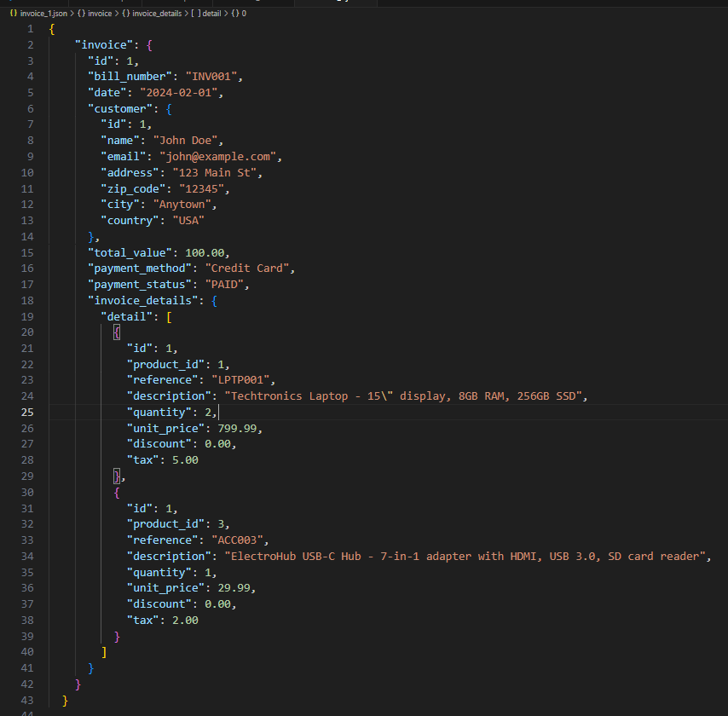
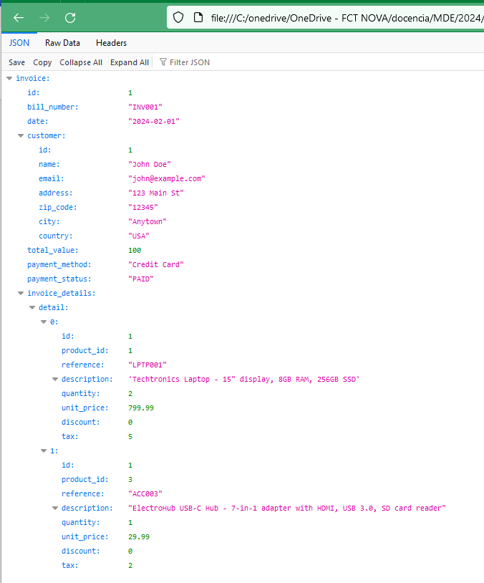
JSON representation of the invoice

Slide 23
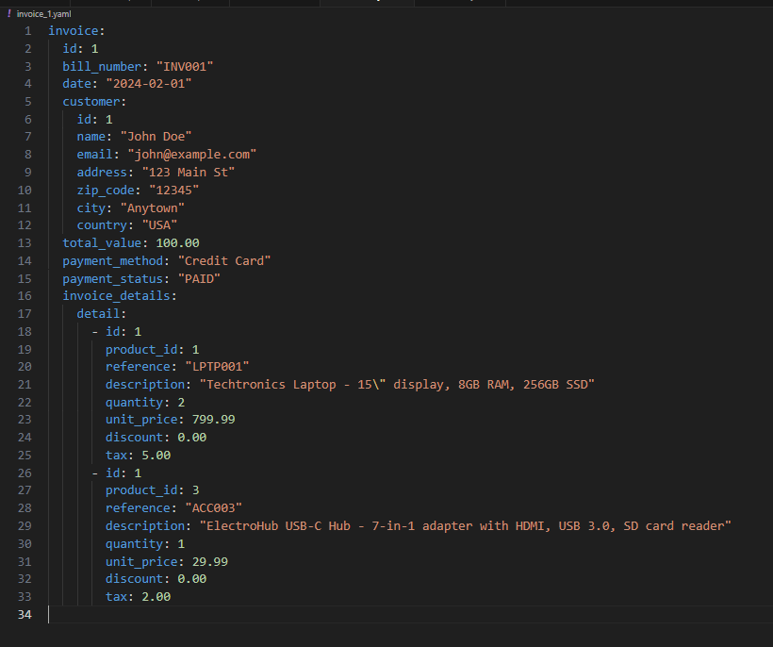
YAML representation of invoice 1
YAML (YAML Ain't Markup Language) is a human-readable data serialization format commonly used to configure files, exchange, and structure data in various programming languages.
It aims to be simple and easy to read, focusing on human readability and expressiveness.
YAML uses indentation and whitespace to structure data, making it easy to read and understand without relying on special characters or syntax.
YAML is often used in applications where humans need to read or write configuration files directly, such as in software development, system administration, and data processing pipelines.

Slide 24
Solution
Schema and data
XML formats.

