Slide 1
Modelação de dados em Engenharia
MDE – 2024-03-[18-22]

Slide 2
Index
SQL
Queries DDL / DML
Join queries
PL/SQL
Procedures
Functions
Triggers
Indexes

Slide 3

SQL
http://uiipa.org/wp-content/uploads/2014/09/Big-SQL_27224636.jpg

Slide 4
SQL - Structured Query Language
SQL – “Structured Query Language (SQL) is the language used to manipulate relational databases. SQL is tied very closely with the relational model”
Four components:
Data Definition Language (DDL): já abordado antes
Data Manipulation Language (DML)
Data Control Language (DCL)
Transaction Control Language (TCL)
http://cisnet.baruch.cuny.edu/holowczak/oracle/sqlplus/

Slide 5
Data Definition
CREATE TABLE – create new tables in the database.
ALTER TABLE –to change the structure of existing tables.
ALTER TABLE ADD column – add one or more columns to an existing table
ALTER TABLE MODIFY column –change the definition of existing columns in a table.
Drop columns –to drop one or more columns from a table.
DROP TABLE –to delete tables from the database.
TRUNCATE TABLE – delete all data from a table faster and more efficiently.
RENAME table – renaming a table and handling its dependent objects.
Virtual columns – columns with values calculated from other columns.

Slide 6
Data Definition (2)
ALTER TABLE ADD column:
ALTER TABLE customers ADD birth_date DATE NOT NULL;
ALTER TABLE MODIFY column:
ALTER TABLE accounts
MODIFY email VARCHAR( 100 ) NOT NULL;
Drop columns:
ALTER TABLE suppliers DROP ( email, phone );
TRUNCATE TABLE:
SET FOREIGN_KEY_CHECKS = 0;
TRUNCATE TABLE quotations CASCADE;
SET FOREIGN_KEY_CHECKS = 1;

Slide 7
Example
Creation of table customers
CREATE TABLE IF NOT EXISTS customers (
customer_id INT(11) NOT NULL auto_increment,
name VARCHAR(255) NOT NULL,
address VARCHAR(255) NULL DEFAULT NULL,
website VARCHAR(255) NULL DEFAULT NULL,
credit_limit DECIMAL(8,2) NULL DEFAULT NULL,
PRIMARY KEY (customer_id))
ENGINE = InnoDB
DEFAULT CHARACTER SET = utf8mb4

Slide 8
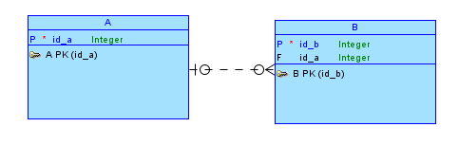

Related tables (relationships from the ERD)
Caso uma linha da tabela A seja removida/alterada, pode-se indicar o que vai acontecer às linhas da tabela B: Cascade, “set Null”, Restrict.
DataModeler
CREATE TABLE B
(
id_b INTEGER NOT NULL ,
id_a INTEGER,
CONSTRAINT B_PK PRIMARY KEY ( id_b ),
CONSTRAINT B_A_FK FOREIGN KEY(id_a) REFERENCES A(id_a) _
);
ON DELETE CASCADE
ON DELETE SET NULL
ON DELETE RESTRIC
ON UPDATE CASCADE
ON UPDATE SET NULL
ON UPDATE RESTRICT

Slide 9
Example
The implementation of a relationship between two tables is made through the specification of a constraint.
CREATE TABLE supplier (
supplier_id decimal(10) not null,
supplier_name archar(50) not null,
contact_name varchar(50),
CONSTRAINT supplier_pk PRIMARY KEY (supplier_id)
);
CREATE TABLE products (
product_id numeric(10) not null,
supplier_id numeric(10) not null,
CONSTRAINT fk_supplier FOREIGN KEY (supplier_id) REFERENCES supplier(supplier_id)
);

Slide 10
"On delete cascade" restriction EXAMPLE
In this example, whenever an item from the "supplier" table is deleted, all the supplied products are also deleted from the "products" table.
If the primary key of the strong entity (or dependent entity) is changed, the foreign keys of the dependent entities are changed.
To prevent that from happening, we can specify as:
ON DELETE RESTRICT
ON UPDATE RESTRICT
With the RESTRICT specifier, changing change a supplier with associated products is denied by the database.
CREATE TABLE supplier (
supplier_id decimal(10) not null,
supplier_name archar(50) not null,
contact_name varchar(50),
CONSTRAINT supplier_pk PRIMARY KEY (supplier_id)
);
CREATE TABLE products (
product_id numeric(10) not null,
supplier_id numeric(10) not null,
CONSTRAINT fk_supplier FOREIGN KEY (supplier_id) REFERENCES supplier(supplier_id)
ON DELETE CASCADE
ON UPDATE CASCADE
);

Slide 11
Virtual columns
Columns inside tables with values computed from other columns.
CREATE TABLE parts(
part_id INT,
part_name VARCHAR(50) NOT NULL,
capacity INT NOT NULL,
cost DEC(15,2) NOT NULL,
list_price DEC(15,2) NOT NULL,
gross_margin DEC(15,2) generated always AS ((list_price - cost) / cost),
PRIMARY KEY(part_id)
);
ALTER TABLE parts
ADD capacity_description varchar(12) generated always AS (
CASE
WHEN capacity <= 8 THEN 'Small'
WHEN capacity > 8 AND capacity <= 16 THEN 'Medium'
WHEN capacity > 16 THEN 'Large'
END);

Slide 12
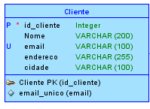
Restrição “unique identifiers”
São atributos cujo valor só se repete uma vez na tabela
CREATE TABLE Cliente
(
id_cliente INTEGER NOT NULL ,
Nome VARCHAR(200) ,
email VARCHAR(100) ,
endereco VARCHAR(255) ,
cidade VARCHAR(100)
) ;
ALTER TABLE Cliente ADD CONSTRAINT Cliente_PK PRIMARY KEY ( id_cliente ) ;
ALTER TABLE Cliente ADD CONSTRAINT email_unico UNIQUE ( email ) ;

Slide 13
Definir valores por defeito e gamas de valores
CREATE TABLE A
(
id_a INTEGER NOT NULL ,
tipo VARCHAR (10) DEFAULT '1' ,
gama INTEGER DEFAULT 4,
CONSTRAINT check_tipo CHECK ( tipo IN ('1', '2')),
CONSTRAINT check_gama CHECK ( gama BETWEEN 3 AND 5 OR gama BETWEEN 10 AND 20)
);
Insert into a(id_a, gama) values(1, 4);

Slide 14
Data Manipulation Language (DML)

Slide 15
Data Manipulation Language
Data Manipulation Language (DML) statements are used for managing data within schema objects. Some examples:
(para colocar/retirar/alterar dados das tabelas)
SELECT - retrieve data from the a database
INSERT - insert data into a table
UPDATE - updates existing data within a table
DELETE - deletes all records from a table, the space for the records remain
MERGE - UPSERT operation (insert or update)
CALL - call a PL/SQL or Java subprogram (scripts)
EXPLAIN - explain access path to data
LOCK TABLE - control concurrency

Slide 16
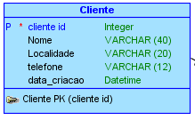
Exemplo “insert” com um tipo Date
Oracle:
Insert into cliente values(1,’Jose Esteves’, ’Lisboa’, ’+351213395422’, str_to_date('2013/03/10', ‘%Y/%c/%d'));
MySQL:
Insert into cliente values(1,’Jose Esteves’, ’Lisboa’, ’+351213395422’, str_to_date('2013/03/10', ‘%Y/%m/%d'));
Insert into cliente values(1,’Jose Esteves’, ’Lisboa’, ’+351213395422’, '2013-03-10);

Slide 17
Query “update”
Dar um aumento de 5% a todos os funcionarios:
update employees set salary = 1.05*salary;
Dar um aumento ao funcionario nº 100:
Update employees set salary = 1.05*salary
where employee_id=100;
Dar aumento aos funcionarios com vendas acima de $100 000:
Update employees
set salary = 1.05*salary
where sales_year>=100000;
Alterar endereço e telefone do funcionario 100:
Update employees
set address = ‘Lisboa’, telefone=‘123456789’
where employee_id=100;

Slide 18
Query: DELETE
Apagar todos os funcionarios:
Delete from employees;
Apagar o funcionario nº 101
Delete from hr.employees
where employee_id=101;
Apagar todos os funcionarios do departamento 60 e com volume de vendas igual a zero
Delete from employees
where department_id=60 and sales_year=0;
Apagar vários funcionarios
delete HR.employees
where employee_id>=120 and employee_id<=160;
Apagar todos os funcionários duma especialização:
delete from HR.employees where job_id=‘IT_PROG’;

Slide 19
Query: SELECT
As possibilidades são infinitas
SELECT [distinct|all] {*| [column_expression [as new_name]][, …]}
FROM table_name [alias][,…]
[WHERE condition]
[GROUP BY column_list] [having condition]
[ORDER BY column_list];
//left join, right join, inner join,
// union, intercept

Slide 20
Select duma tabela
Select * from employees;
Select * from employees where manager_id=103
Select department_id from employees; /* repete os resultados */
Select distinct department_id from hr. employees; /*não repete os resultados */

Slide 21
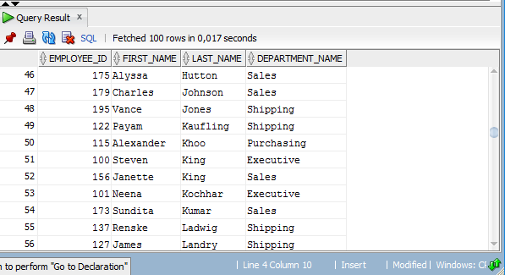
Select de várias tabelas
SELECT employee_id,
first_name,
last_name,
department_name
FROM EMPLOYEES, DEPARTMENTS
WHERE EMPLOYEES.DEPARTMENT_ID = DEPARTMENTS.DEPARTMENT_ID
ORDER BY last_name, department_name;

Slide 22
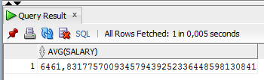
Funções de agregação (AVG, MAX, MIN, …)
select avg(salary) from employees;
-- não está bem: department_name is in departments
select department_id, avg(salary) as media
from employees
group by(department_name);
-- está bem
select department_name, avg(salary) as media
from employees, departments
where employees.department_id = departments.DEPARTMENT_ID
group by(department_name);
-- ORACLE
select department_name, to_char(avg(salary), 'fm9999999.90') as media
from employees, departments where employees.department_id = departments.DEPARTMENT_ID
group by(department_name);

Slide 23
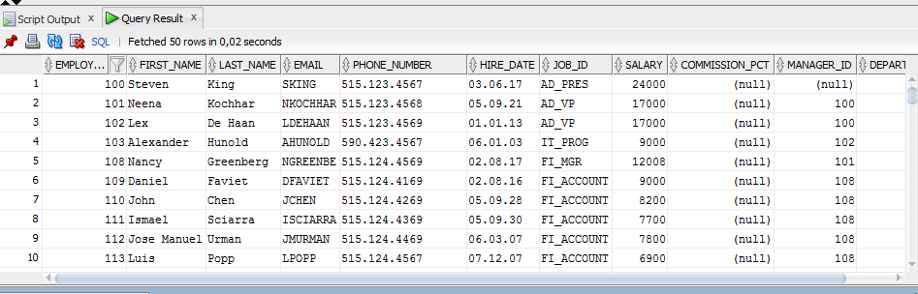
Empregados com salários acima da média ☺
select avg(salary) from employees;
AVG(SALARY)
---------------------------------------
6461, 8317
SELECT *
from employees
where salary > (select avg(salary) from employees);

Slide 24
Numero de empregados com salário abaixo da média
Select count(*) from employees;
COUNT(*)
----------------------
107
Select count(*) as abaixo_media
from employees
Where salary< (select avg(salary) from employees);
Abaixo_media
----------------------
56

Slide 25
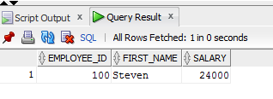
Empregado com salário mais baixo/alto
Select max(salary) from employees;
MAX(SALARY)
----------------------
24000
Select min(salary) from employees;
MIN(SALARY)
----------------------
2100
select employee_id, first_name, salary
from employees
where salary = (
select max(salary) from employees
);

Slide 26
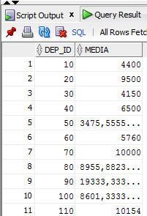
Media de salários por departamento
select department_id as dep_id, avg(salary) as media
from employees
group by (employees.department_id)
order by dep_id;

Slide 27
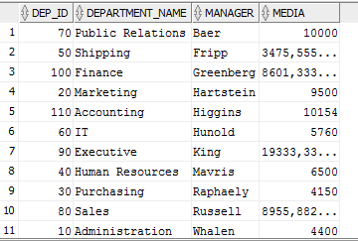
Media de salários por departamento e com nome do departamento e nome do manager
select dep_id, department_name, last_name as manager, media
from
(
select employees.department_id as dep_id, avg(salary) as media
from employees
group by (employees.department_id)
), departments, employees
where dep_id = departments.department_id and departments.MANAGER_ID = employees.employee_id;

Slide 28
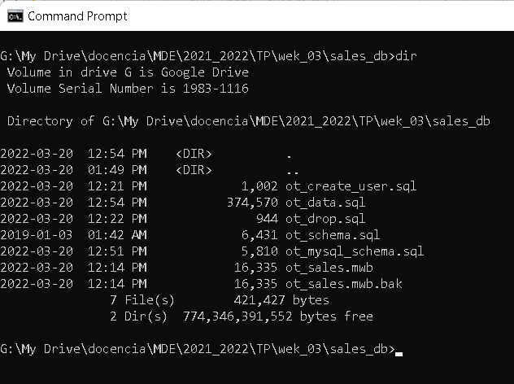
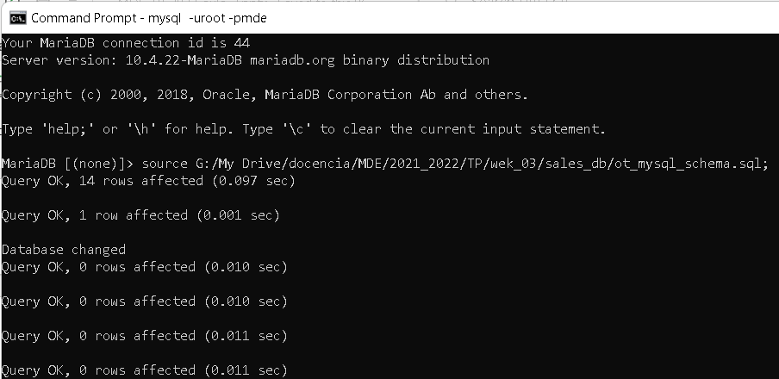
Execution of scripts

Slide 29
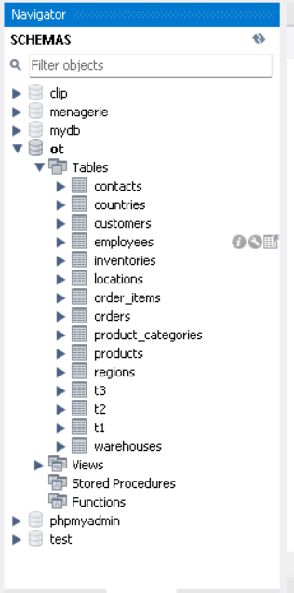
Resulting schema

Slide 30
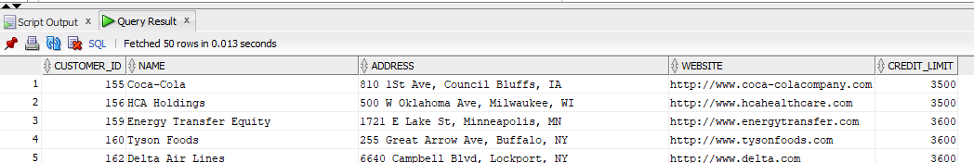
CRUD on several entities (revisions)
Insert into OT.CUSTOMERS (CUSTOMER_ID,NAME,ADDRESS,CREDIT_LIMIT,WEBSITE) values (9999,'United Holdings','2904 S Salina St, Syracuse, NY',5000,'http://www.unitedcontinentalholdings.com');
Update OT.CUSTOMERS set address= '123 Sesame Street' where customer_id=9999;
Delete from OT.CUSTOMERS where customer_id=9999;
SELECT customer_id, name, address, website, credit_limit
FROM customers
where credit_limit> 2500;
…/… other entities

Slide 31
Recalling select statement (revisions)
Select: to obtain data from tables.
Distinct: eliminate duplicate results from the output of a query
Where: specify conditions for rows in the result set returned by a query.
AND, OR: combine two or more Boolean expressions and return true, used to specify conditions.
Order by: sort the results
Fetch: limit rows returned by a query using row limiting clause
IN: determine if a value matches any value in a list or subquery.
Like: perform matching based on specific patterns.
IS null, is not null: check if an expression or values in a column is null or not.

Slide 32
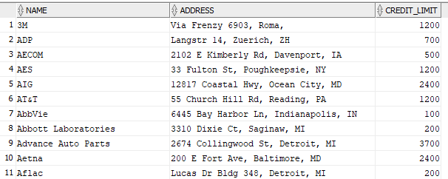
Query with order by
SELECT column_1, column_2, column_3, …
FROM table_name
ORDER BY
column_1 [ASC | DESC] [NULLS FIRST | NULLS LAST],
column_1 [ASC | DESC] [NULLS FIRST | NULLS LAST],
SELECT name, address, credit_limit
FROM customers
ORDER BY
name ASC;

Slide 33
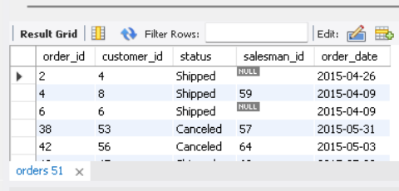
Query with where conditions
List all the orders between two dates
select *
from orders
where order_date between '2015-01-01' and '2015-06-30';

Slide 34


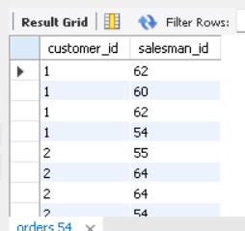
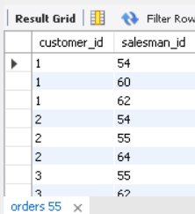
Select distinct
Used in a SELECT statement to filter duplicate rows in the result set.
It ensures that rows returned are unique for the column or columns specified in the SELECT clause.
SELECT
DISTINCT column_1, column_2, column_3
FROM table_name;

Slide 35

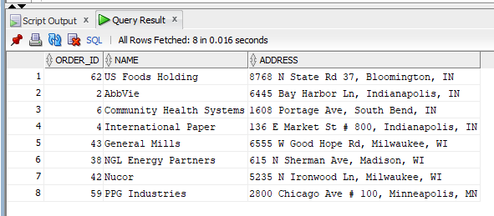
Between (for mySQL remove to_date call)
List all the orders between two dates together with the name of the customer and address
=> expression [ NOT ] BETWEEN low AND high

Slide 36
JOINS:
INNER JOIN – show how to query rows from a table that have matching rows from another table.
LEFT JOIN – select rows from the left table that have or don’t have the matching rows in the right table.
RIGHT JOIN – Query rows from the right table that have or don’t have the matching rows in the left table.
FULL OUTER JOIN – query data from two tables.
CROSS JOIN – make a Cartesian product from multiple tables.
Self-join – query hierarchical data or compare rows within the same table.

Slide 37
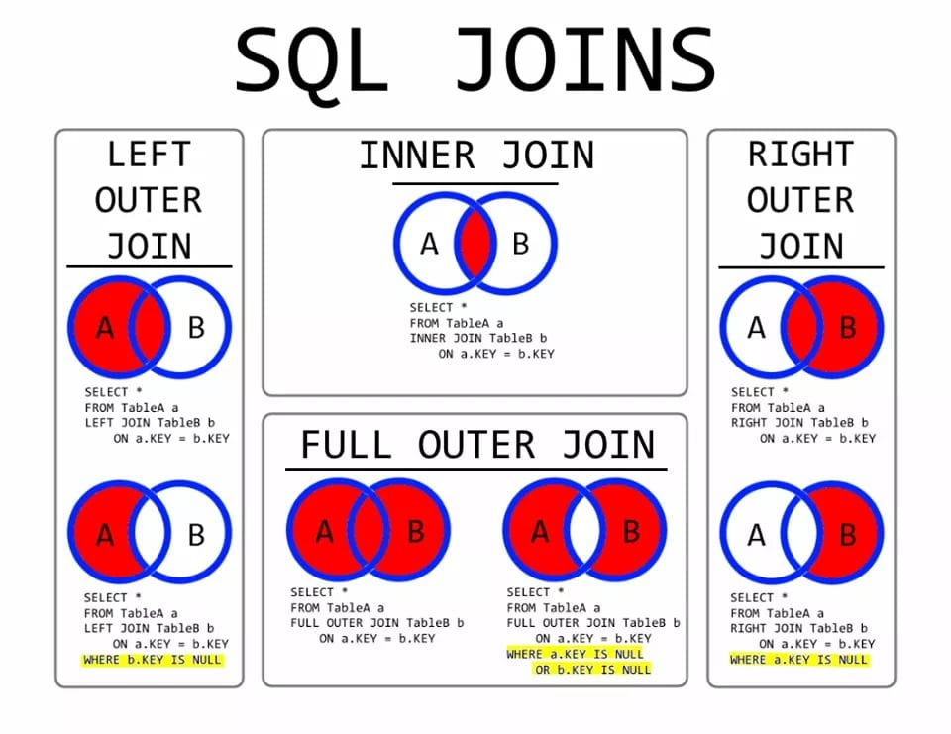
Inclusive Left/Right/full
Exclusive Left/Right/full (yellow CLAUSES)
https://www.facebook.com/CollabUXWebSolutions/photos/sql-joins/1160323134121580/

Slide 38
What is JOIN Clause?
A join is used to query data from multiple tables and returns the combined result from two or more tables through a condition. The condition in the join clause indicates how columns are matched between the specified tables.

Slide 39
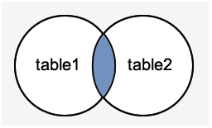
Inner Join
The Inner Join is used to returns only those results from the tables that match the specified condition and hides other rows and columns.
We can understand it with the following visual representation where Inner Joins returns only the matching results from table1 and table2:

Slide 40

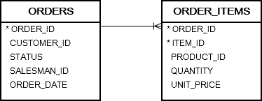
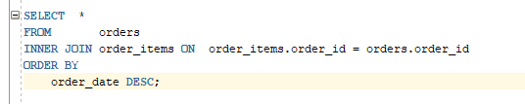
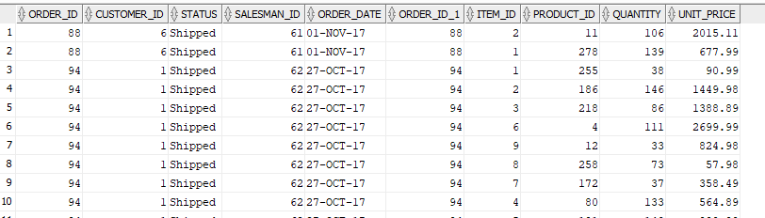
INNER JOIN
To retrieve rows from a table that have matching rows from other tables.

Slide 41
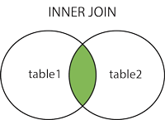
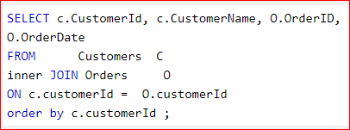


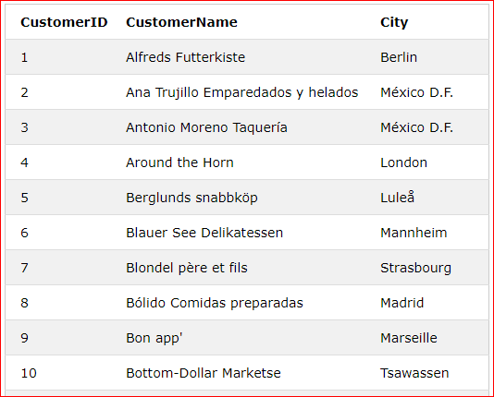
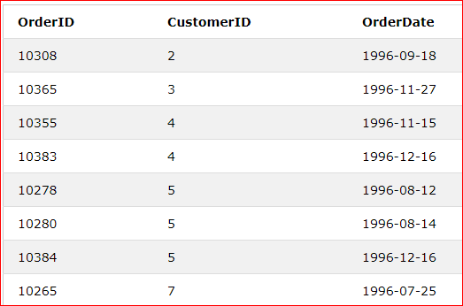
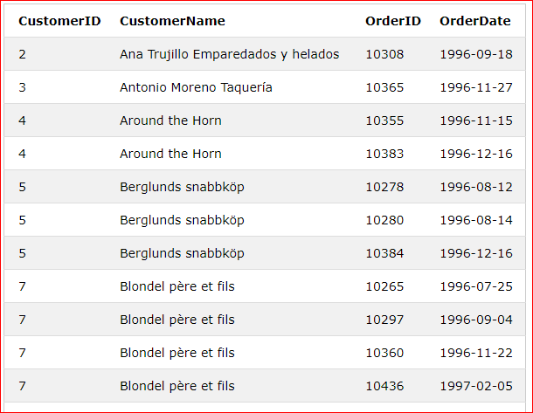
Select all from table 1 and table 2 (both) satisfying clause “ON condition”
https://www.w3schools.com/sql/sql_join_left.asp

Slide 42
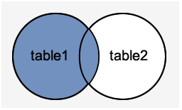
What is the LEFT JOIN Clause?
The Left Join clause joins two or more tables and returns all rows from the left table and matched records from the right table or returns null if it does not find any matching record. It is also known as Left Outer Join. So, Outer is the optional keyword to use with Left Join.
We can understand it with the following visual representation:
https://www.javatpoint.com/mysql-left-join-vs-right-join

Slide 43

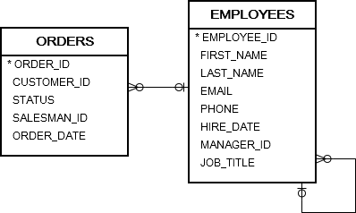
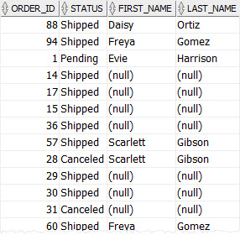
LEFT JOIN
select rows from the left table that have or don’t have the matching rows in the right table.
SELECT order_id, status, first_name, last_name FROM orders
LEFT JOIN employees ON employee_id = salesman_id ORDER BY order_date DESC;

Slide 44
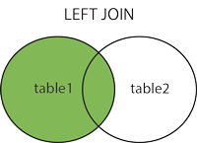
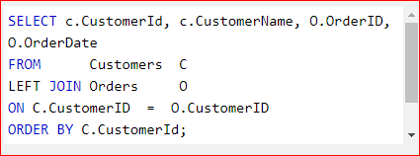
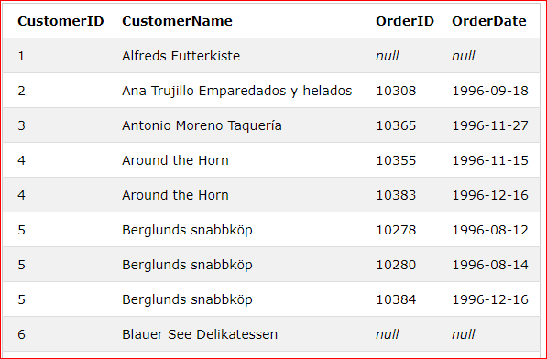
Select all from table 1 and those from table 2 satisfying clause “ON condition”
https://www.w3schools.com/sql/sql_join_left.asp

Slide 45
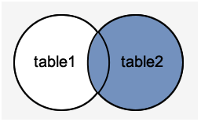
What is the RIGHT JOIN Clause?
The Right Join clause joins two or more tables and returns all rows from the right-hand table, and only those results from the other table that fulfilled the specified join condition. If it finds unmatched records from the left side table, it returns Null value. It is also known as Right Outer Join. So, Outer is the optional clause to use with Right Join.
We can understand it with the following visual representation.
https://www.javatpoint.com/mysql-left-join-vs-right-join

Slide 46

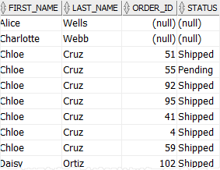
RIGHT JOIN
to query rows from the right table that have or don’t have the matching rows in the left table.
SELECT first_name, last_name, order_id, status
FROM orders
RIGHT JOIN employees ON employee_id = salesman_id
WHERE job_title = 'Sales Representative’
ORDER BY first_name, last_name;

Slide 47
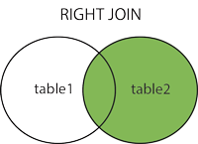
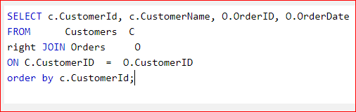
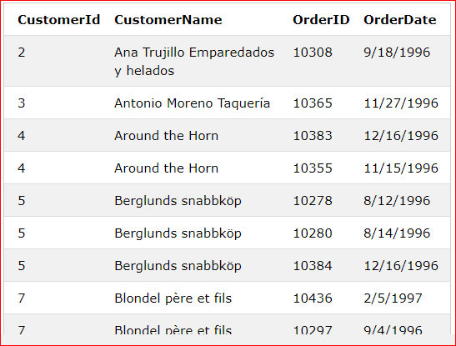
Select all from table 2 and those from table 1 satisfying clause “ON condition”
https://www.w3schools.com/sql/sql_join_right.asp

Slide 48
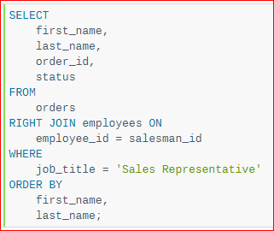
Right join (2)

Slide 49
Difference between Left Join and Right Join
SQL has mainly two kinds of joins named LEFT JOIN and RIGHT JOIN.
The main difference between these joins is the inclusion of non-matched rows.
The LEFT JOIN includes all records from the left side and matched rows from the right table, whereas RIGHT JOIN returns all rows from the right side and unmatched rows from the left table.
We are going to know the popular differences between LEFT and RIGHT join. Before exploring the comparison, let us first understand JOIN, LEFT JOIN, and RIGHT JOIN clause in SQL.
https://www.javatpoint.com/mysql-left-join-vs-right-join

Slide 50
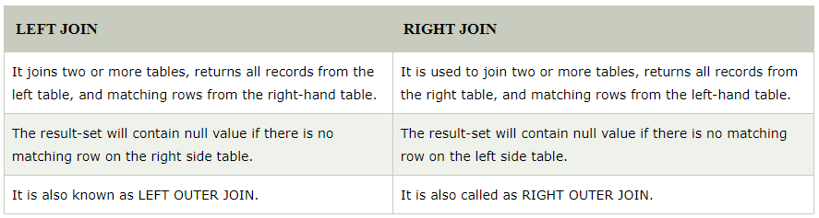
LEFT JOIN vs. RIGHT JOIN
The following comparison table explains their main differences in a quick manner:
https://www.javatpoint.com/mysql-left-join-vs-right-join

Slide 51

FULL JOIN
Full join of each row from A and B.
For each row in A table
IF rows from both tables meet the joint condition, the columns from both rows are included in the result.
IF a row from A does not have a matching row from B, columns from A are included in the result; columns from B are set to null
IF a row from B does not have a matching row from A, columns from B are included in the result; columns from A are set to null
MySQL does not support full join.

Slide 52
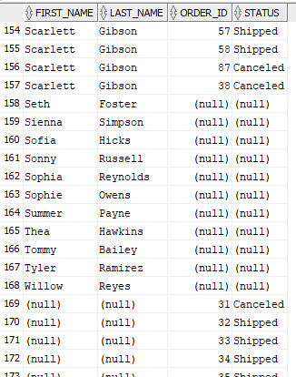
FULL JOIN example (MySQL does not support full join)
When an order has a sales_representative, columns from both are set.
When an employee has no sales, order_id and status are NULL;
When an order has no sales_representative, first_name and last_name are null.
SELECT first_name, last_name, order_id, status
FROM orders
FULL JOIN employees ON employee_id = salesman_id
ORDER BY first_name, last_name;
SOLUTION: Use a left join UNION with a right join.
SELECT order_id, employees.employee_id, status, first_name, last_name
FROM orders
left JOIN employees ON employee_id = salesman_id
UNION
SELECT order_id, employees.employee_id, status, first_name, last_name
FROM orders
right JOIN employees ON employee_id = salesman_id
ORDER BY first_name, last_name;

Slide 53
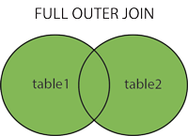
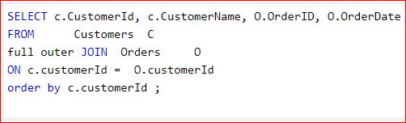
Select all from table 1 OR from table 2 satisfying “ON condition” clause
FULL OUTER JOIN can potentially return very large result-sets!
https://www.w3schools.com/sql/sql_join_full.asp

Slide 54
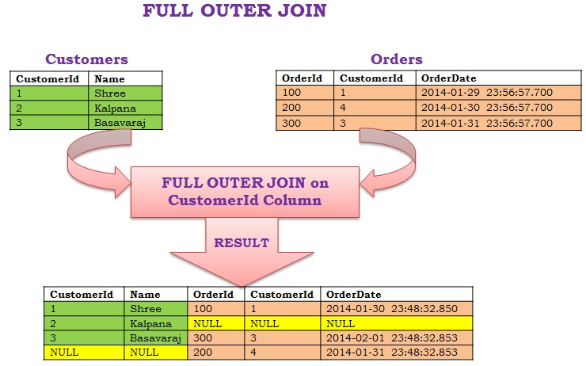
Full outer join (2)
http://serkansakinmaz.blogspot.com/2015/11/apache-pig-join-operator-2-full-outer.html

Slide 55
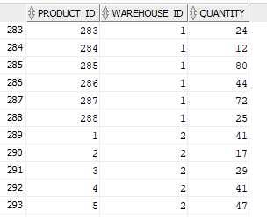
CROSS join
In Mathematics, given two sets A and B, the Cartesian product of A x B is the set of all ordered pair (a,b), whicha belongs to A and b belongs to B.
Unlike other joins such as INNER JOIN or LEFT JOIN, CROSS JOIN does not have the ON clause with a join predicate.
Example: “generate” (fake) inventory as testing data (just to illustrate)
SELECT product_id, warehouse_id, ROUND( dbms_random.value( 10, 100 )) quantity
FROM products
CROSS JOIN warehouses;

Slide 56
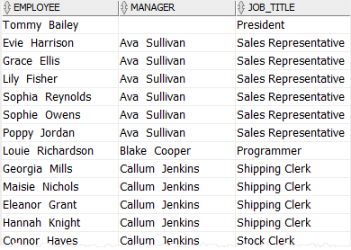

SELF join
A self join is a join that joins a table with itself. A self join is useful for comparing rows within a table or querying hierarchical data.
SELECT (e.first_name || ' ' || e.last_name) employee,
(m.first_name || ' ' || m.last_name) manager,
e.job_title
FROM employees e
LEFT JOIN employees m ON m.employee_id = e.manager_id
ORDER BY manager;
… <--- same query here
Where e.first_name='Ava’
ORDER BY manager;

Slide 57
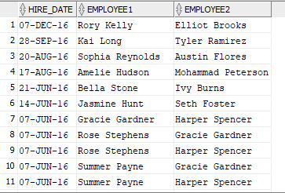
SELF join (example)
Show employees with the same hire date:
SELECT
e1.hire_date,
(e1.first_name || ' ' || e1.last_name) employee1,
(e2.first_name || ' ' || e2.last_name) employee2
FROM
employees e1
INNER JOIN employees e2 ON
e1.employee_id > e2.employee_id
AND e1.hire_date = e2.hire_date
ORDER BY
e1.hire_date DESC,
employee1,
employee2;
Note: if the condition operator was <>, the results would appear twice (repeated)

Slide 58
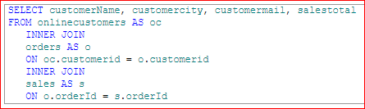
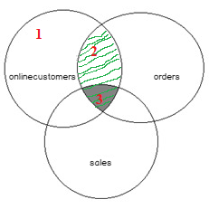
SQL multiple joins
1
2
3
1
customerName | customerCity | customerMail | salesTotal
2
customerName | customerCity | customerMail | salesTotal
3
customerName | customerCity | customerMail | salesTotal
https://www.sqlshack.com/sql-multiple-joins-for-beginners-with-examples/

Slide 59
Aggregation functions
In SQL, aggregate functions are functions that operate on a set of values and return a single value that is calculated based on the values in the set. They are commonly used in SQL queries to summarize data from a table or group of tables.
Here are some of the most common aggregation functions in SQL:
COUNT(): Returns the number of rows in a result set.
SUM(): Calculates the sum of the values in a column.
AVG(): Averages the values in a column.
MIN(): Returns the smallest value in a column.
MAX(): Returns the largest value in a column.
These functions are often used in conjunction with the GROUP BY clause, which groups the rows of a table based on common values into one or more columns, allowing aggregate functions to be applied to each group separately.

Slide 60
Example
Select
sum(total_paid)
from orders
Group by (customer_id);
CREATE TABLE Orders (
order_id INT PRIMARY KEY,
customer_id INT,
total_paid DECIMAL(10, 2)
); -- relationship to customers table not specified
INSERT INTO Orders (order_id, customer_id, total_paid) VALUES (1, 101, 50.00);
INSERT INTO Orders (order_id, customer_id, total_paid) VALUES (2, 102, 75.00);
INSERT INTO Orders (order_id, customer_id, total_paid) VALUES (3, 101, 30.00);
INSERT INTO Orders (order_id, customer_id, total_paid) VALUES (4, 103, 100.00);
INSERT INTO Orders (order_id, customer_id, total_paid) VALUES (5, 102, 60.00);
INSERT INTO Orders (order_id, customer_id, total_paid) VALUES (6, 101, 45.00);
customer_id | total_amount_paid
-------------------------------
101 | 125.00
102 | 135.00
103 | 100

Slide 61


Group by
The GROUP BY clause is used in a SELECT statement to group rows into a set of summary rows by values of columns or expressions. The GROUP BY clause returns one row per group.
The GROUP BY clause is often used with aggregate functions such as AVG(), COUNT(), MAX(), MIN() and SUM(). In this case, the aggregate function returns the summary information per group. For example, given groups of products in several categories, the AVG() function returns the average price of products in each category.
SELECT customer_id, COUNT( order_id )
FROM orders GROUP BY customer_id
ORDER BY customer_id;
SELECT name, COUNT( order_id )
FROM orders
INNER JOIN customers USING(customer_id)
GROUP BY name
ORDER BY name;

Slide 62

HAVING
The HAVING clause is an optional clause of the SELECT statement.
It is used to filter groups of rows returned by the GROUP BY clause.
This is why the HAVING clause is usually used with the GROUP BY clause.
SELECT order_id, SUM( unit_price * quantity ) order_value
FROM order_items
GROUP BY order_id
HAVING SUM( unit_price * quantity ) > 1000000
ORDER BY order_value DESC;

Slide 63

Subqueries
A subquery is a SELECT statement nested inside another statement such as SELECT, INSERT, UPDATE, or DELETE. Typically, you can use a subquery anywhere that you use an expression.
-- show the most expensive products
SELECT product_id, product_name, list_price
FROM products
WHERE list_price =
( SELECT MAX( list_price ) FROM products );

Slide 64
MySQL Views
A view consists of a query (like the others already seen) with a name.
So by definition, a view is a “virtual” table whose data is the result of a stored query, which is derived each time when you query against the view.
A view is a virtual table because it can be used like a table in SQL queries.
Unlike a table, a view does not store any data. To be precise, a view only behaves like a table. And it is just a named query stored in the database.
When you query data from a view, Oracle uses this stored query to retrieve the data from the underlying tables.

Slide 65
When to use views
You can use views in many cases for different purposes. The most common uses of views are as follows:
Simplifying data retrieval.
Maintaining logical data independence.
Implementing data security.

Slide 66

When to use views
Simplifying data retrieval: build a complex query, test it carefully, and encapsulate the query in a view. Access the data of the underlying tables through the view instead of rewriting the whole query again and again.
Example: sales amount per year:
CREATE OR REPLACE VIEW customer_sales
AS
SELECT name AS customer, SUM( quantity * unit_price ) sales_amount, EXTRACT(YEAR FROM order_date) YEAR
FROM orders
INNER JOIN order_items USING(order_id)
INNER JOIN customers USING(customer_id)
WHERE status = 'Shipped'
GROUP BY name, EXTRACT( YEAR FROM order_date );
Select * from customer_sales
where year =2015;

Slide 67
When to use views
Maintaining logical data independence:
expose the data from underlying tables to the external applications via views. Whenever the structures of the base tables change, you just need to update the view. The interface between the database and the external applications remains intact. The beauty is that you don’t have to change a single line of code to keep the external applications up and running.
Java:
String statement=“Select * from customer_sales where year =2015”
On this example, sales, customers, … may change structurally, but if the same fields on the view remain, the applications (Java, Web, C#, …) are not affected.

Slide 68
When to use views
Implementing data security:
Views allow you to implement an additional security layer. They help you hide certain columns and rows from the underlying tables and expose only needed data to the appropriate users.
Oracle provides you the with GRANT and REVOKE commands on views so that you can specify which actions a user can perform against the view. Note that in this case, you don’t grant any privileges on the underlying tables because you may not want the user to bypass the views and access the base tables directly.

Slide 69

Drop view
CREATE or replace VIEW employees_contacts
AS SELECT first_name, last_name, email, phone
FROM employees;
SELECT * FROM employee_contacts; -- where …
DROP VIEW employees_contact;

Slide 70
Other Views (oracle)
Updatable views:
can be used to perform insert, update, and delete queries on the underlying tables, provided that e.g. in the case of INSERT, columns with constraints not null are satisfied.
See e.g. https://www.oracletutorial.com/oracle-view/oracle-updatable-view/
Inline views:
Not views in fact, but subqueries in the FROM statements of SELECT queries

Slide 71
Materialized View (oracle)
A materialized view is a database object that contains the results of a query.
The FROM clause of the query can name tables, views, and other materialized views.
“The big advantage of a Materialized View is extremely fast retrieval of aggregate data, since it is precomputed and stored, at the expense of insert/update/delete. The database will keep the Materialized View in sync with the real data, no need to re-invent the wheel, let the database do it for you.” (KM, stackoverflow)
https://stackoverflow.com/questions/4218657/materialized-view-vs-tables-what-are-the-advantages

Slide 72
Index files (IMPORTANT for performance execution)
Used to boost the query performance.
We can create indexes on single column or more…
Create index name_idx on table_name(column1, column2, …)
Primary keys are indexed by default.
Foreign keys (FK) should be indexed to reduce the time in which tables with FK are locked.

Slide 73


Example
EXPLAIN
select product_id, sum(quantity*unit_price) total_sold
from order_items
where product_id=60
group by (product_id);
create index order_items_product_idx
on order_items(product_id);
For the explain statement, see:
https://dev.mysql.com/doc/refman/8.0/en/explain.html

Slide 74
Users & Privileges
Out of scope, but very important in business
Think of who is granted to access qualified informatiion in banks, insurances, government entities, …
CREATE USER – create a new user in the Oracle database.
GRANT – grant system and object privileges to a specific user.
REVOKE – describe how to revoke system and object privileges from a user.
ALTER USER –modify the authentication or database resource of a database user.
DROP USER – delete a user from the Oracle Database.

Slide 75
PL/SQL
PL/SQL: is a procedural language extension to SQL. Its purpose is to combine database language and procedural programming language. The basic unit in PL/SQL is called a block, which is made up of three parts: a declarative part, an executable part, and an exception-building part.
http://cisnet.baruch.cuny.edu/holowczak/oracle/sqlplus/

Slide 76
PLSQL, conditional control, loops,
if statement, case statement,
Loop statement, for loop, while loop, continue.
Cursors, cursor for loop,
Select into …
Procedure
Function
Create Triggers, enable triggers, disable triggers, drop triggers,
Raise exception

Slide 77
“Procedures”, “functions”, “triggers”
“Procedures”:
Usar quando o objectivo é modificar informação num esquema BD.
Usar quando é necessário utilizar mais que um parâmetro “OUT”.
Usar para se permitir o acesso indireto à informação e não às tabelas.
“Procedures” anónimos: bloco de código sem nome atribuído, executado imediatamente e não fica guardado na BD.
“Functions”:
Usar quando o objectivo é apenas obter informação da BD e efetuar cálculos. NÃO ALTERAR INFORMAÇÃO DA BD DENTRO DUMA FUNÇÃO.
Só um parâmetro de saída (com a instrução “return”).
Usar para se permitir o acesso indireto à informação e não às tabelas.
“Triggers”:
Usar para programar a resposta/reacção a eventos que ocorrem numa BD.
Garantir a integridade da informação, quando esta é difícil de garantir através do DER.

Slide 78
Procedures
Sintaxe
CREATE [OR REPLACE] PROCEDURE procedure_name [ (parameter [,parameter]) ] BEGIN
[declaration_section] % variaveis locais END [procedure_name];
Os parametros são opcionais. Existem três tipos de parâmetros:
IN,
OUT,
IN OUT

Slide 79

PL/SQL procedure (show how to handle errors)
delimiter $$$aaa
create PROCEDURE print_contact(in_customer_id integer )
BEGIN
declare l_first_name varchar(20);
declare l_last_name varchar(20);
declare l_email varchar(32);
-- get contact based on customer id
SELECT first_name, last_name, email INTO l_first_name, l_last_name, l_email
FROM contacts
WHERE customer_id = in_customer_id;
-- print out contact's information
select l_first_name, l_last_name, l_email;
END;$$$aaa
delimiter ;

Slide 80
Stored Procedures (can change/update) database
delimiter $$$
CREATE procedure SP_CIDADES ( vCOD_CIDADE INTEGER, vNOME VARCHAR(200), vUF CHAR, vOPR CHAR)
BEGIN
IF (vOPR = 'I') THEN
INSERT INTO CIDADES(COD_CIDADE, NOME, UF) VALUES (vCOD_CIDADE, vNOME, vUF);
ELSE IF(vOPR = 'A') THEN
UPDATE CIDADES SET NOME = vNOME, UF = vUF WHERE COD_CIDADE = vCOD_CIDADE;
ELSE IF(vOPR = 'D')THEN
DELETE FROM CIDADES WHERE COD_CIDADE = vCOD_CIDADE;
END IF;
END IF;
END IF;
END;
$$$
delimiter ;
create table cidades
(
cod_cidade integer,
nome varchar(200),
uf char(10)
);
call SP_CIDADES(1, 'COLATINA', 'ES', 'I');
https://www.devmedia.com.br/oracle-procedure-como-criar-uma-procedure-no-oracle/12660

Slide 81




Procedure with a while loop and calling other procedure
https://www.mysqltutorial.org/mysql-stored-procedure/mysql-while-loop/

Slide 82

Testing returning into clause
drop procedure if exists get_customer_details;
delimiter $$$
CREATE PROCEDURE get_customer_details(in_customer_id INT)
BEGIN
DECLARE l_name VARCHAR(30);
DECLARE l_address VARCHAR(30);
DECLARE l_credit_limit VARCHAR(30);
SELECT name, address, credit_limit
INTO l_name, l_address, l_credit_limit
FROM customers
WHERE customer_id=in_customer_id;
/* Do something with the customer record */
select l_name, l_address, l_credit_limit;
END;$$$
delimiter ;

Slide 83
Functions
Aggregate-functions
Create function
CREATE [OR REPLACE] FUNCTION function_name [ (parameter [,parameter]) ] RETURN return_datatype BEGIN
[declaration_section] executable_section END;
Os parametros são opcionais. Existem três tipos de parâmetros:
IN,
OUT,
IN OUT

Slide 84


Already existing (aggregate) functions
Count, avg, max, min, sum, …
SELECT SUM( quantity )
FROM order_items;
-- where …
SELECT product_id, SUM( quantity )
FROM order_items
GROUP BY product_id
ORDER BY SUM( quantity ) DESC;

Slide 85

Already existing (aggregate) functions
Count, avg, max, min, sum, …
SELECT category_name, COUNT( product_id ) FROM product_categories
LEFT JOIN products USING(category_id)
GROUP BY category_name
ORDER BY category_name;

Slide 86

Function example
select x.year_sales, get_total_sales(x.year_sales)
from
(select distinct year(order_date) as year_sales from orders) x;
delimiter $$$
CREATE FUNCTION get_total_sales(in_year integer)
RETURNS decimal(10,2)
BEGIN -- get total sales
declare l_total_sales numeric(10,2);
declare l_year numeric(10,2); -- not really necessary
SELECT year(order_date) as yyy, SUM(unit_price * quantity)
INTO l_year, l_total_sales
FROM order_items
INNER JOIN orders USING (order_id)
WHERE status = 'Shipped'
GROUP BY year(order_date)
HAVING yyy = in_year;
-- return the total sales
RETURN l_total_sales;
END;$$$
delimiter ;

Slide 87






Stored Function (can only observe, but not update, the database (oracle)
Procedure/function xpto(…) is
x varchar2;
begin
x:= get_complete_address(person_id)
….
end;
select person_id, last_name, get_complete_address(person_id) complete_address
from PERSON_INFO;
select * from PERSON_INFO;
https://mkyong.com/oracle/oracle-plsql-create-function-example/

Slide 88
Triggers
Uses of Triggers
Triggers supplement the standard capabilities of your database to provide a highly customized database management system. For example, you can use triggers to:
Automatically generate derived column values
Enforce referential integrity across nodes in a distributed database
Enforce complex business rules
Provide transparent event logging
Provide auditing
Maintain synchronous table replicates
Gather statistics on table access
Modify table data when DML statements are issued against views
Publish information about database events, user events, and SQL statements to subscribing applications
Restrict DML operations against a table to those issued during regular business hours
Enforce security authorizations
Prevent invalid transactions
https://docs.oracle.com/cd/B28359_01/appdev.111/b28370/triggers.htm#CIHHDEEJ

Slide 89
Triggers
Tipos de triggers
São procedimentos que existem dentro da base-de-dados e que se activam/correm automaticamente quando “algo” acontence:
Insert Triggers:
BEFORE INSERT Trigger
AFTER INSERT Trigger
Update Triggers:
BEFORE UPDATE Trigger
AFTER UPDATE Trigger
Delete Triggers:
BEFORE DELETE Trigger
AFTER DELETE Trigger
Drop Triggers:
Drop a Trigger
Disable/Trigger
DisableEnable Triggers:
Disable a all Triggers on a table
Enable a Trigger
Enable all Triggers on a table
Insert into orders(…) values(…);
Update …
Delete …

Slide 90

Trigger example: no credit changes between…
delimiter $$$
CREATE TRIGGER customers_credit_trg
BEFORE UPDATE ON customers for each row
BEGIN
DECLARE last_day_of_month integer;
set last_day_of_month = DAY(sysdate());
IF last_day_of_month BETWEEN 1 AND 16 THEN
signal sqlstate '45000' set message_text = 'Cannot update customer credit from 1th to 16st';
END IF;
END;$$$
DELIMITER ;
UPDATE customers
SET credit_limit = credit_limit * 1.10;

Slide 91


Trigger (oracle)
See the complete example in the link provided.
It shows how to perform
Data validation
Update values automatically
Data logging, or auditing
https://mkyong.com/oracle/oracle-plsql-before-update-trigge-example/?utm_source=mkyong.com&utm_medium=referral&utm_campaign=afterpost-related&utm_content=link3

Slide 92
Data Control Language
Data Control Language (DCL) statements. Some examples:
GRANT - gives user's access privileges to database
REVOKE - withdraw access privileges given with the GRANT command

Slide 93
Transaction Control Language
Transaction Control (TCL) statements are used to manage the changes made by DML statements. It allows statements to be grouped together into logical transactions:
COMMIT - save work done
SAVEPOINT - identify a point in a transaction to which you can later roll back
ROLLBACK - restore database to original since the last COMMIT
SET TRANSACTION - Change transaction options like isolation level and what rollback segment to use

Slide 94
Next class
PL/SQL (continuation)
Integration in Java and web Apps.
Other paradigms: NoSQL, BigData, Cloud Computing, Data Science.

