Slide 1
MDE 2023/2024
The green slides are more relevant in terms of tests and exams.
White ones are not relevant.
Class 1 – Introduction to Data Modeling in Engineering (MDE)
(04/03/2024) - (08/03/2024)
João Rosas

Slide 2
Class 1, part 1.
Welcome
Syllabus
Evaluation method
Introduction to MDE
Elements of engineering modeling
Requirement Analysis
Data formalisms

Slide 3
Sillabus
Unit 1: Introduction
Data definition, data modeling, data formalism, information systems
Unit 2: Database Modeling (Oracle, SQL, …)
Entity and relationships diagrams, SQL, DBMS, use in information systems, …
Unit 3: Knowledge Modeling in Prolog
Logic languages, Inference, Graph theory, Prolog, …
Unit 4: Modeling with “FRAMES” and UML
Frames, events, Class diagrams, Sequence diagrams, …

Slide 4
Evaluation
Theoretical: 60% [ 2 tests]
Test 1: 33.3% [Data modeling and BDs]
Test 2: 33.3% [Knowledge modeling]
Test 3: 33.3% [Frames + UML]
Lab. Works: 40% [3 labworks]
Lab work 1: 40%
Lab work 2: 40%
Lab work 3: 20%
Minimum score of 9.5 for each component (TP and P):
0.33*(Test1+ Test2+Test3) >= 9.5
w1*P1 + w2*P + w3*P3 >= 9.5

Slide 5
MDE
A MODELAÇÃO
What is modeling?
What’s the purpose?
DE DADOS
Data,
Information,
Knowledge
…
EM ENGENHARIA
Software engineer
Systems Engineer,
Data scientist,
Artificial Intelligence expert

Slide 6
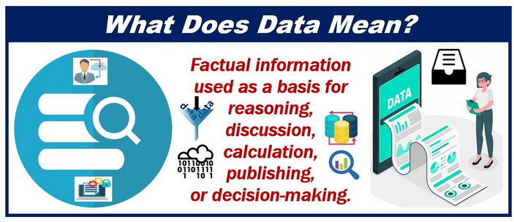
Data definition
Data means information, more specifically facts, figures, measurements and amounts that we gather for analysis or reference.
It encompasses descriptive information about things, plants, animals, and people.
We collect and store data typically through observation.

Slide 7
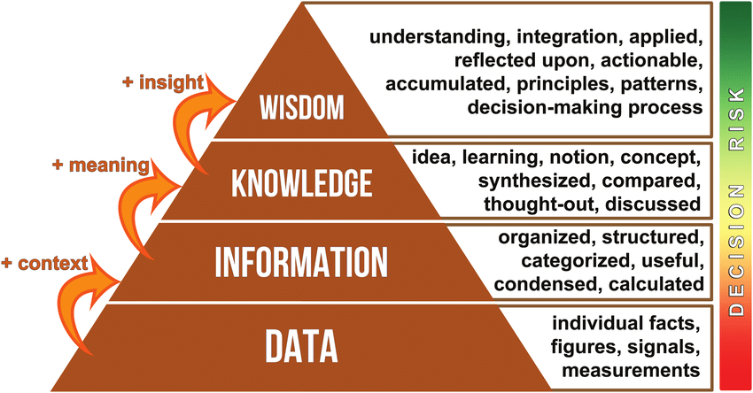
Information Pyramid (DIKW pyramid)
- Decision models
Human or human-like decision models, and eventual Expert systems, Bayesian Networks, and Decision trees,… which can retain expert knowledge from humans.
- Knowledge models
- Interpretation models:
Ontologies, semantic networks, expert systems, Bayesian Networks, decision trees…
- Classification Models:
ERD, conceptual, Logical and Physical Models, Taxonomies
- Data models:
Relational Models, SQL, NoSQL, document based, key-value, Json, XML, …
https://www.researchgate.net/publication/332400827_How_can_nutrition_models_increase_the_production_efficiency_of_sheep_and_goat_operations

Slide 8
Model definition
A three-dimensional representation of a person or thing or of a proposed structure, typically on a smaller scale than the original.
A simplified description, especially a mathematical one, of a system or process, to assist calculations and predictions (a statistical model used for predicting the survival rates of endangered species)
Devise a representation, especially a mathematical one, of a phenomenon or system (e.g. a computer program that can model the behavior of smoke)
(Oxford dictionary online, 2016)
12:30

Slide 9
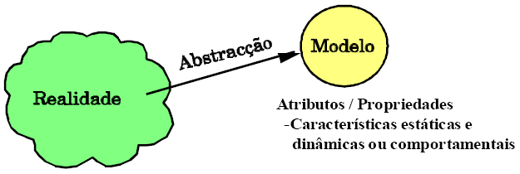
Abstration
“A model is an abstract representation of an environment, system, or entity in the physical, social, or logical world.”
(Camarinha-Matos, VE12.pdf).
Models are necessarily incomplete artifacts,
To intentionally ignore non-relevant details),
Reducing their complexity to levels appropriate to the purposes for which they are intended.
Relevant part (we are interested in) subjected to study.
ABSTRACTION (its a mapping from a)
“physical feature” → “model property”
© Camarinha-Matos
12:30

Slide 10



Mapping
“physical feature” → “model property”
Model properties
chest circumference
Neck circumference
Shoulder width
Arm length
Bicep circumference.
…
Heart rate
Body temperature
Respiration rate
Blood pressure
Cholesterol
…
Extracting relevant parts and ignoring (abstract from) others. But this depends on our aims/goals.
tailor
doctor
https://www.iconfinder.com/icons/3389876/casually_dressed_decent_man_father_handsome_person_human_avatar_icon
https://pt.123rf.com/photo_102927587_stock-illustration-female-doctor-or-medical-adviser-sits-hospital-bench-and-measures-blood-pressure-of-male-patient-iso.html

Slide 11
Model features
A good model should be
Abstract (ignore unnecessary details/aspects)
Unambiguous (formal/mathematical one, common understanding)
Standardized (everybody can use the model)
Facilitate good communication
Between humans
Between humans and machines
Between machines (interoperability)
Modifiable (to handle more aspects)
Necessary in the specification, development, verification, and validation of a system.

Slide 12
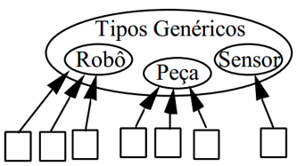
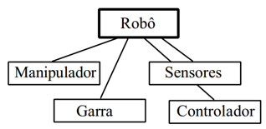
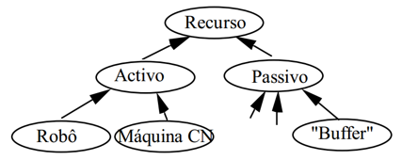
Abstraction Mechanisms
Classification:
… objects defined as occurrences or instances of generic types:
instance,
is-occurrence-of.
Aggregation or composition:
… type of objects or concepts specified from collections of components:
is-part_of
Has-sub-component
Generalization
… a type is related with other more generic types:
is-a => taxonomies
© Camarinha-Matos
12:30

Slide 13
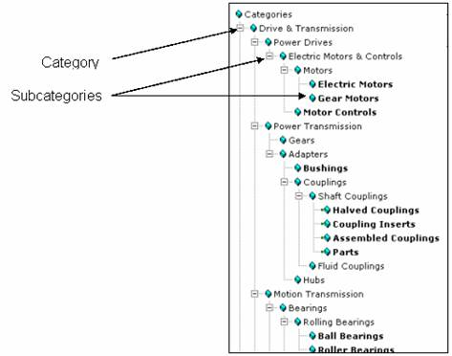
Taxonomies
A taxonomy is a general term for a classification scheme.
The purpose of a taxonomy is to group like things together into categories, usually based on a set of common, category-specific characteristics, or attributes.
A taxonomy is usually hierarchical, meaning that some categories are subcategories of other categories.
Most people are familiar, for example, with at least part of the hierarchical taxonomy used to classify animals, such as vertebrates → mammals → primates → chimpanzees, and so on.
https://help.sap.com/saphelp_gds20/helpdata/EN/43/6939daf55c30d9e10000000a11466f/content.htm?no_cache=true

Slide 14
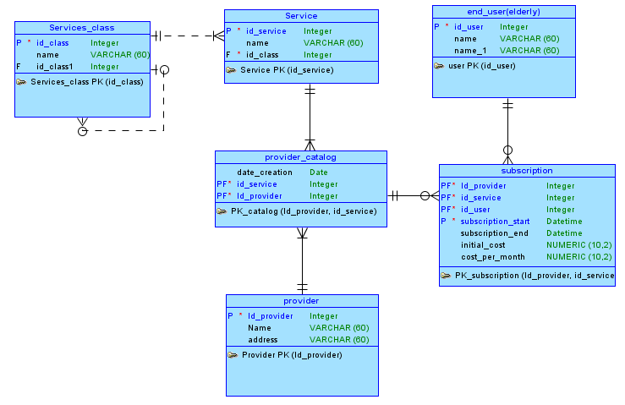
Entity and Relationships Diagrams (ERD)
Entity-Relationship Diagram (ERD):
is a graphical representation of entities and their relationships to each other.
It is widely used for designing and modeling relational databases. In an ERD, entities are represented as rectangles, relationships as diamonds, and attributes as ovals.

Slide 15
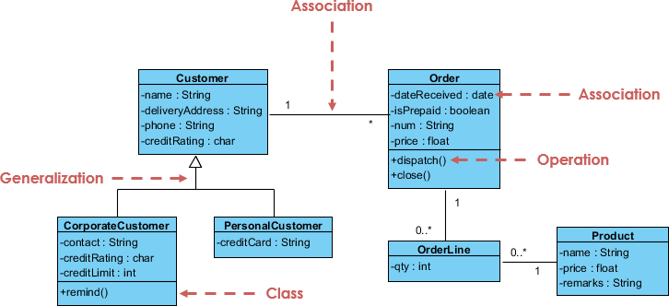
UML (data + systems)
Unified Modeling Language (UML):
is a general-purpose modeling language used in software engineering to represent objects, components, and systems.
It includes a data modeling component called class diagrams that are used to represent the data structures of an application.
The picture illustrates a class diagram.
https://www.visual-paradigm.com/guide/uml-unified-modeling-language/what-is-uml/

Slide 16
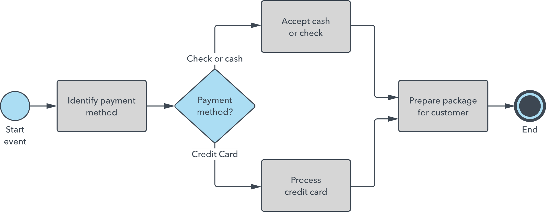
BPMN (processes)
Business Process Modeling and Notation (BPMN):
…is a graphical representation of business processes used to model workflows and business processes.
It includes data modeling constructs such as data objects, data stores, and associations.
https://www.lucidchart.com/pages/bpmn

Slide 17
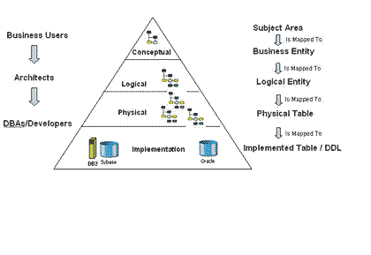
Model DB abstraction levels
http://www.theregister.co.uk/2007/06/14/data_modelling_layers/
12:30

Slide 18
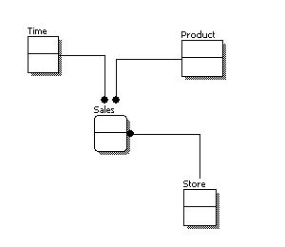
Conceptual Model
At this level, the objective is to identify the classes/entities and their relationships/ interactions between these classes/entities.
http://www.1keydata.com/datawarehousing/data-modeling-levels.html
12:30

Slide 19
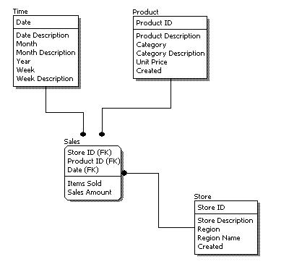
Logical Model
Specify the elements of the entities, without concern about how they will be implemented.
http://www.1keydata.com/datawarehousing/data-modeling-levels.html
12:30

Slide 20
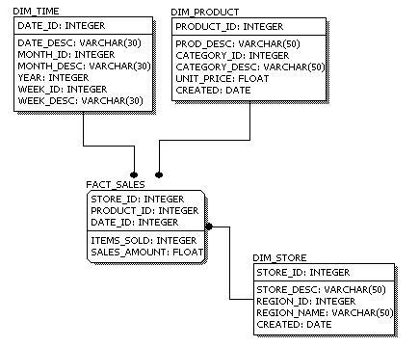
Physical model
Specify exactly how the model will be implemented in a data base
Definition of the fields (attributes) and their types, constraints, integrity rules.
http://www.1keydata.com/datawarehousing/data-modeling-levels.html
12:30

Slide 21
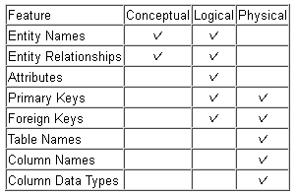
Abstraction levels
Conceptual
Better understanding
More intuitive
Conceptual (The what layer)
More abstract
Of the highest level
Greater readability
More intuitive
Transmitting the idea/essence of the problem (even to people outside the engineering field, e.g. managers).
Logical and physical (The how layer)
More concrete
More details in order to define exactly how to implement the specified model.
Machine software can read it.
Logical
More detailed
More complex
Understood by machines
Physical
12:30

Slide 22
“Engineer”?
“One versed in the design, construction, and use of machines”.
“One who employs the innovative and methodological application of scientific knowledge and technology to produce a device, system or process, which is intended to satisfy human needs”.
(American College Dictionary)

Slide 23
“Engineering design” definition
Engineering design is the process of devising a system, component, or process to meet desired needs. It is a decision-making process (often iterative), in which the basic sciences, mathematics, and engineering sciences are applied to convert resources optimally to meet a stated objective. Among the fundamental elements of the design process are the establishment of objectives and criteria, synthesis, analysis, construction, testing, and evaluation. [ABET]

Slide 24
Design Process
What is a design process?
It embodies the steps required to take an idea from concept to realization of the final system and are problem-solving methodologies that aim to develop a system that best meets a customer’s need within given constraints.
Two approaches
Prescriptive design process:
Descripive design process

Slide 25
Prescriptive design process
Prescriptive design process: algorithmic in nature and expressed on flow charts with decision logic.

Slide 26
Descriptive design process
Considers the iterative nature of design where team alternates between different phases as necessary.
Links allow transitions between all the distinct phases of the project design process, more commonly between adjacent phases.
Why? Because the customer’s needs may change in posterior phases of the design process; and fix mistakes that might turn up in any phase of a project.

Slide 27
Cost to implement changes

Slide 28
Design phase: problem statement and needs identification
Gather raw data from the users:
interview with key users, supervisors, focus groups, through interviews, dialogs and brainstorms;
Direct observation of a system that needs upgrade/modification
…
Interpret the raw data in terms of needs:
Raw data is translated into customer needs; the needs are express in terms of the system must do (a requirement)
Statements of customers’ needs are known as markting requirements or market specifications.
Organize needs into a hierarchy:
Marketing requirements are organized into a hierarchy of needs arranged from the most general to the most specific in successive levels of detail a required by the problem;
Organized by functional similarity, not as hierarchy of importance
Determine the relative importance of a need:
Compare the relative importance of each need
Use pairwise comparison the assign weights to each need.
Review the outcomes and the process
During the design process, there is a certain amount of subjectivity; the end result should be reviewed to determine if it makes sense;
The objective is to challenge assumptions, fully identify the problem, and make informed decisions.

Slide 29
Engineering Requirements

Slide 30
Engineering Requirements
Specification: a detailed and exact statement fully describing something to be built. E.g. a table with statements like:
The web app needs Users signup and login with password
Products catalog, basket, sell, …
Should provide several Payment methods
…
Requirements specification: fully identifies those requirements that the design must satisfy in order to be successful.

Slide 31
3.1 Overview of Process [IEEE-STD 1233]

Slide 32
Guide 1233-1998 - IEEE
Guidance for the development of the set of requirements, System Requirements Specification (SyRS), that will satisfy an expressed need is provided.
Developing an SyRS includes the identification, organization, presentation, and modification of the requirements.
Also addressed are the conditions for incorporating operational concepts, design constraints, and design configuration requirements into the specification.
This guide also covers the necessary characteristics and qualities of individual requirements and the set of all requirements.
https://ieeexplore.ieee.org/document/741940

Slide 33
Definitions
Marketing Requirement:
Identified needs from customers
Engineering Requirement:
Short statements that address a technical need of the design
Requirements Specification:
fully identifies those requirements that the design must satisfy in order to be successful

Slide 34
Engineering Requirement Properties
1) Abstract: The requirement should specify what a system will do, not how it will be implemented.
2) Verifiable: there should be a way to measure or demonstrate that the requirement is met in the final system realization. Doing so allows the system to be tested and verified against the requirements. If there is no way to verify that a requirement is met, then it should not be a requirement. Verifiability is used to answer the question “are we building the system correctly?”
3) Unambiguous: Each requirement should have a single unambiguous meaning and be stated with short complete sentences.
4) Traceable: Requirements should be traceable marketing requirements. If the design doesn’t satisfy the customer’s needs, it won’t be successful.

Slide 35
Example
Does the following requirement meet the four desirable properties? (abstract, verifiable, unambiguous, traceable)
“The robot must have an average forward speed of 0.5 feet/sec, a top speed of at least one foot/sec, and the ability to accelerate from standstill to the average speed in under one second.”
1) Abstractness: YES (we state what we need, not how we will implement them)
2) Verifiable: YES (we can observe and measure speed and acceleration during testing phase)
3) Unambiguous: YES (it gives clear bounds for speed and acceleration)
4) Traceable: YES/NO? (not enough information, we need to read the marketing requirements or customer’s needs).

Slide 36
Example
Does the following requirement meet the four desirable properties? (abstract, unambiguous, verifiable, traceable)
“The robot must employ IR sensors to sense its external environment and navigate autonomously with a battery life of one hour.”
1) Abstractness: NO (it already identifies parts of the solution, in terms of type of sensors and the need for batteries)
2) Verifiable: NO (because it is ambiguous, therefore, we don’t know exactly what to verify)
3) Unambiguous: NO (should specify what autonomy means; in terms the operating period, is it exactly 1 hour, or more is acceptable?)
4) Traceable: YES/NO? (not enough information, we need to read the marketing requirements or customer’s needs).
Correct one: “The robot must navigate autonomously, with the aid of only landmarks in the specified environment, for a period of at least one hour.”

Slide 37
A Fifth Property - Realism
IMPORTANT – The requirements of your project must also be REALISTIC.
=> You need to demonstrate that the target you have selected is technically feasible.
“The robot should move at speed of 1 000 000 km/h”
1) Abstractness: YES
2) Verifiable: YES
3) Unambiguous: YES
4) Traceable: YES
4) REALISTIC: NO

Slide 38
Constraints
Constraint = design decision imposed by the environment or a stakeholder that impacts or limits the design.
Example constraint: The system must use a PIC18F52 microcontroller to implement processing functions.
(this constraint specifies how the system will be implemented)

Slide 39
Standards
A standard is what?
A standard or established way of doing things that ensures interoperability.
Standards impact on the requirements and ultimately the design
Example: “Imagine that instead of using established protocols such as RS-232, TCP/IP and USB, every manufacturer would use their own communication standard.”
Question is, what standards are relevant to your project and how do you use them?
Different levels of usage
User
Implementation
Developer
Types: safety, testing, reliability, communication, data, documentation, design, …

Slide 40
Identifying Engineering Requirements
Structured workshops and brainstorming
Interviews and surveys
Observation of processes and devices in use
Benchmarking and market analysis
Prototyping and simulation
Research survey

Slide 41
Engineering Requirement Examples
Performance
The system should detect 90% of all human faces in an image.
The amplifier will have a total harmonic distortion less than 1%.
Reliability & Availability
The system will have a reliability of 95% in five years.
The system will be operational from 4AM to 10PM, 365 days a year.

Slide 42
Engineering Requirement Examples
Energy
The system will operate for a minimum of three hours without needing
Environmental
The system should be able to operate in the temperature range of 0°C to 75°C.
The system must be waterproof and operate while submersed in water.
to be recharged.
Many more examples in the book.

