Slide 1

Financial Fraud Detection Dashboard
Internship Task 4 · Power BI Analytics
DATA ANALYTICS
POWER BI
FRAUD DETECTION

Slide 2

Project Objective
This project leverages Power BI to transform raw financial transaction data into actionable intelligence — enabling faster detection of fraudulent activity and more informed decision-making.
Analyze Transaction Data
Identify Fraud Patterns
Build an Interactive Dashboard
Explore patterns and anomalies across millions of financial records.
Surface behavioral signals that distinguish legitimate from fraudulent transactions.
Design a Power BI dashboard with dynamic filters and visual summaries.

Slide 3
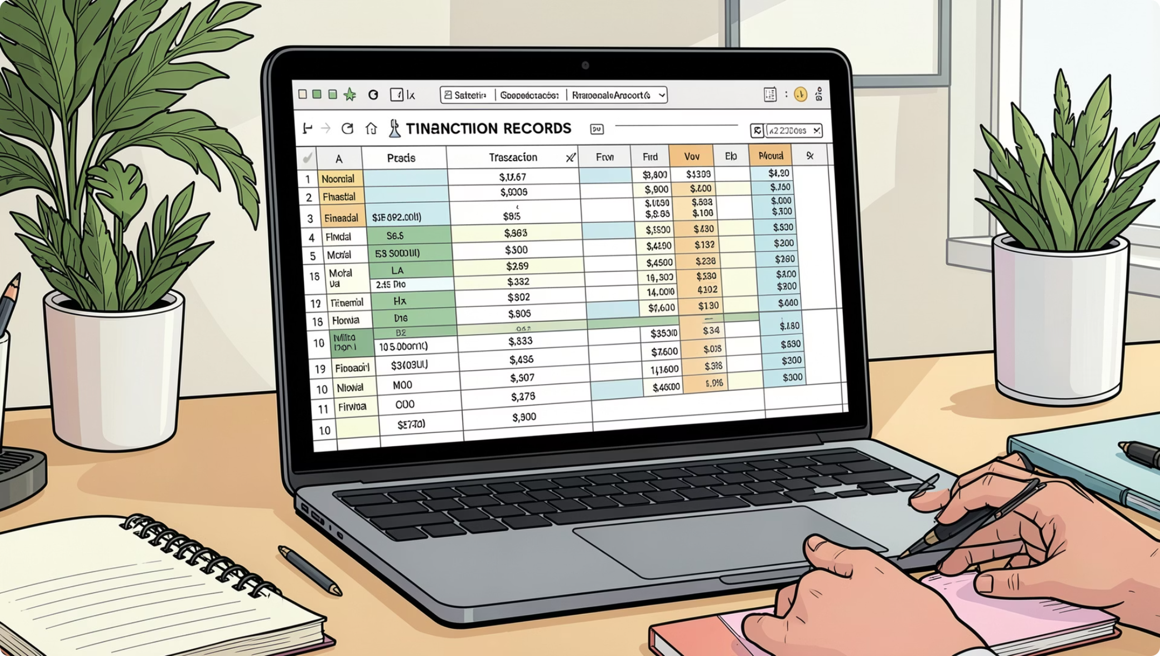
Dataset at a Glance
Financial Fraud Detection Dataset
A structured dataset capturing simulated mobile money transactions, widely used for fraud detection research and benchmarking.
Source
Scale
Context
Kaggle — Financial Fraud Detection Dataset
Over 6 million transaction records
Simulated mobile money transfers with labeled fraud outcomes

Slide 4
Key Data Columns
Each field plays a distinct role in profiling transaction behavior and flagging suspicious activity.
amount
type
isFraud
Transaction value — a primary indicator of financial exposure.
Transaction category: PAYMENT, TRANSFER, CASH_OUT, DEPOSIT, etc.
Binary label indicating confirmed fraudulent transactions.
isFlaggedFraud
oldbalanceOrg / newbalanceOrig
System-generated flag for suspicious activity requiring review.
Sender's balance before and after the transaction — critical for detecting balance manipulation.

Slide 5
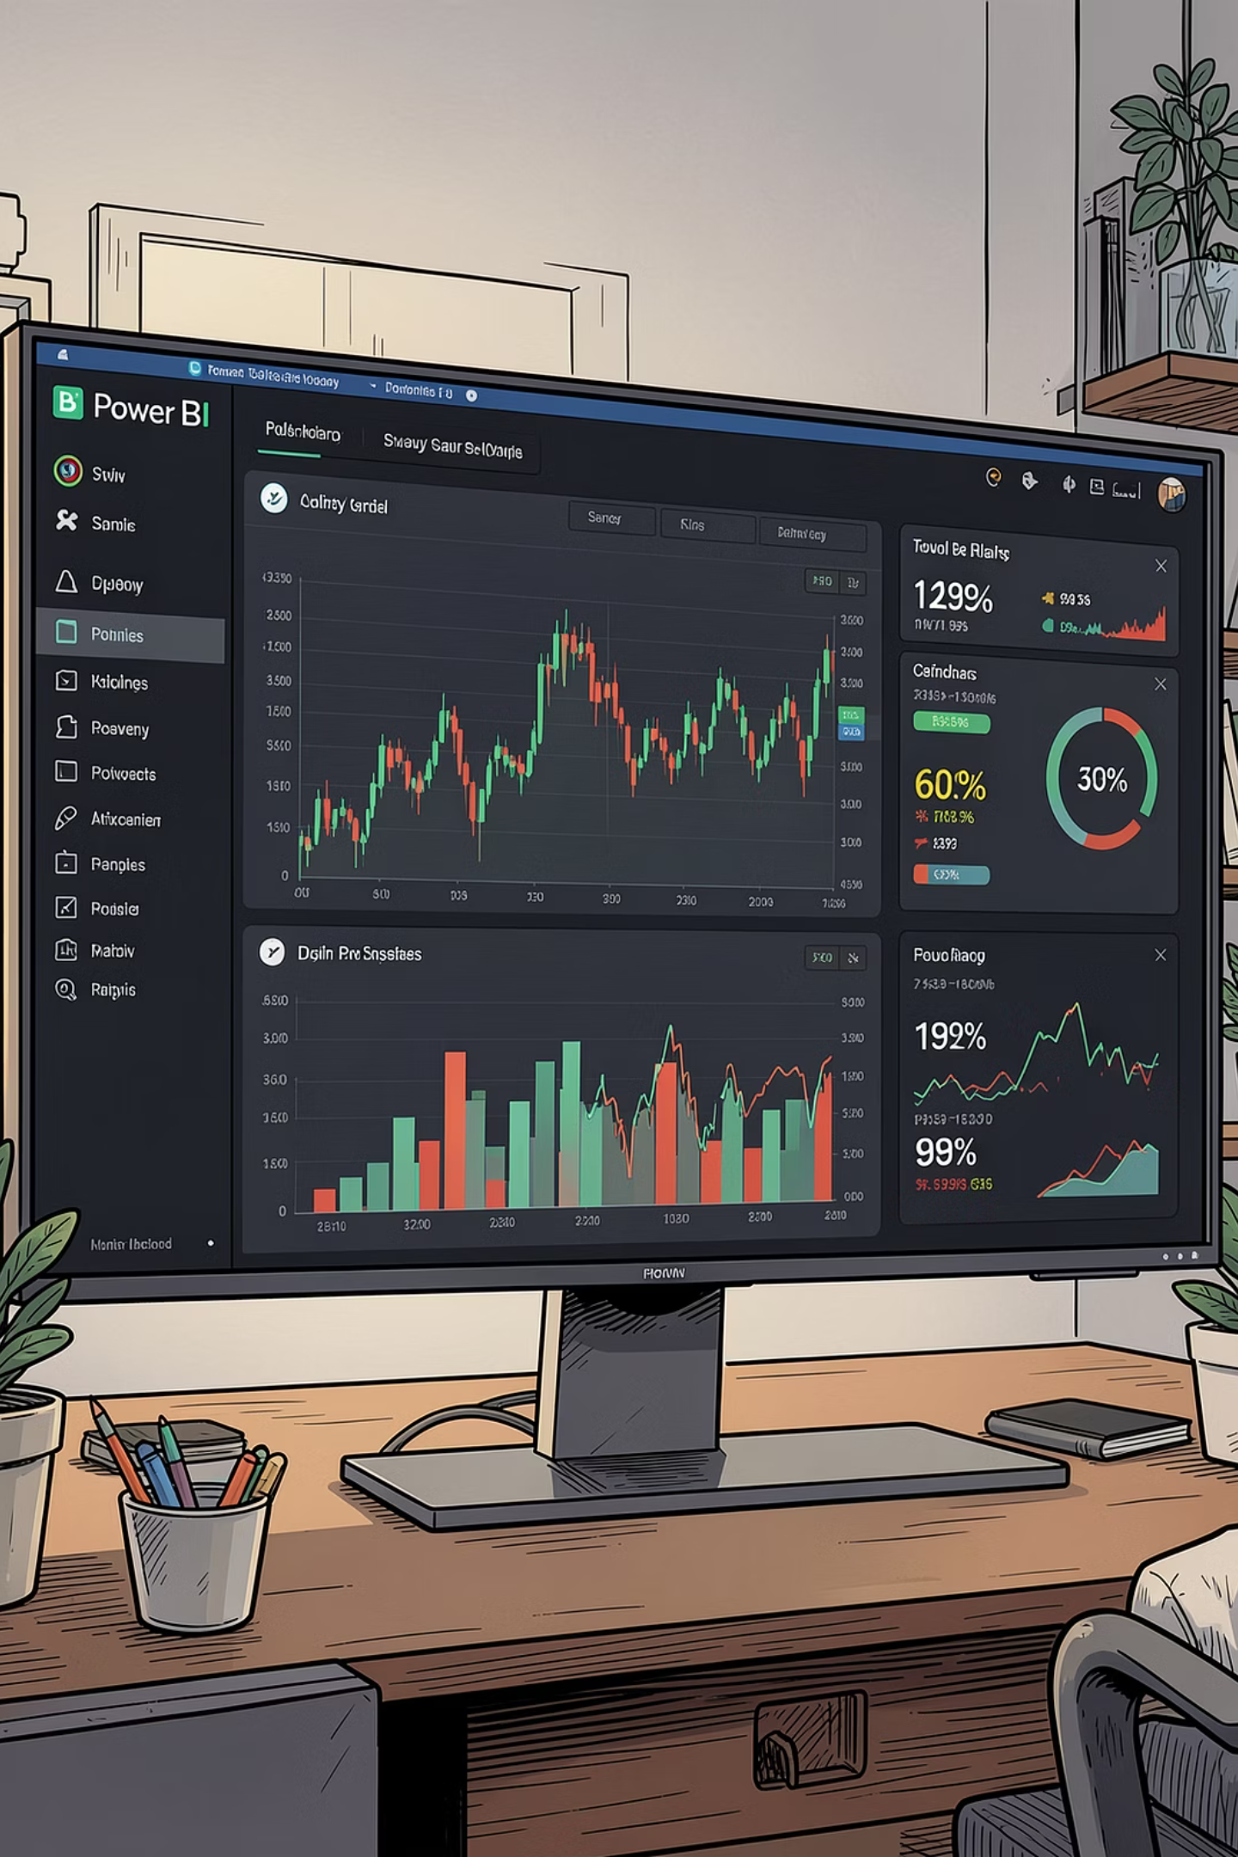
Dashboard Overview
The Power BI dashboard consolidates transaction metrics, fraud indicators, and interactive filters into a single analytical view — designed for rapid situational awareness.
KPI Cards
Visual Charts
Total transactions, fraud rate, and financial impact at a glance.
Transaction type distribution and fraud concentration by category.
Interactive Filters
Slice by transaction type, amount range, and fraud status.

Slide 6
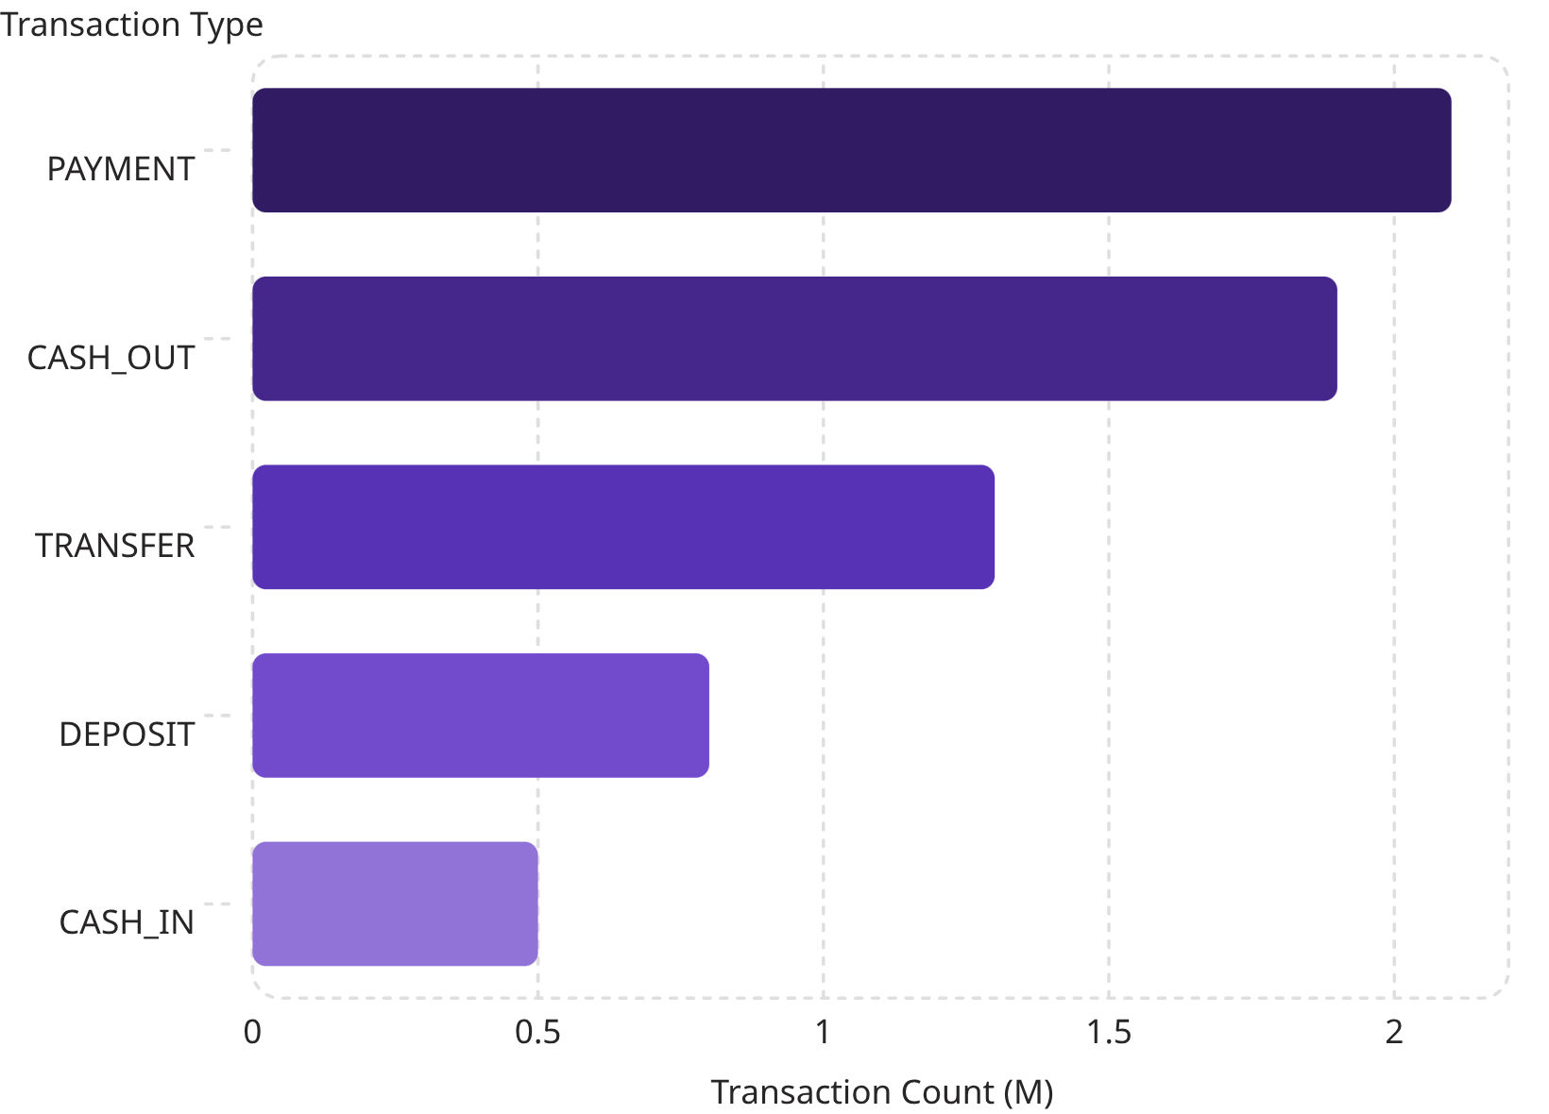

Transaction Type Distribution
PAYMENT & CASH_OUT Dominate Volume
Together, PAYMENT and CASH_OUT transactions account for the majority of all activity in the dataset, reflecting typical mobile money usage patterns.
While high-volume types are common, fraud risk is not proportional — TRANSFER and CASH_OUT carry disproportionately higher fraud rates.

Slide 7
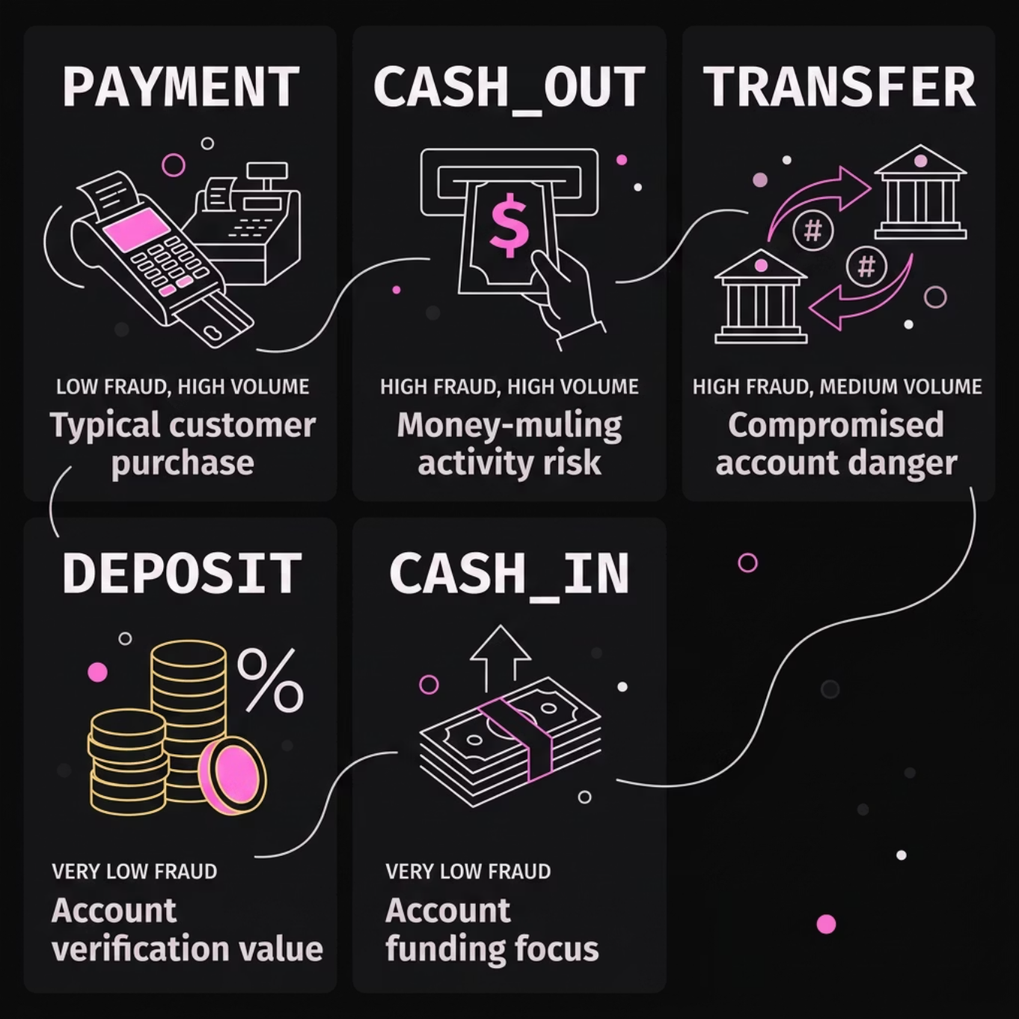
Fraud Concentration by Transaction Type
TRANSFER & CASH_OUT Are High-Risk
Despite lower overall volume, TRANSFER and CASH_OUT transactions are the primary vectors for fraudulent activity. These types enable rapid fund movement — a key characteristic exploited by fraudsters.
TRANSFER
CASH_OUT
Direct movement of funds between accounts — easily exploited for unauthorized transfers.
Withdrawal to external accounts — often the final step in a fraud chain.

Slide 8
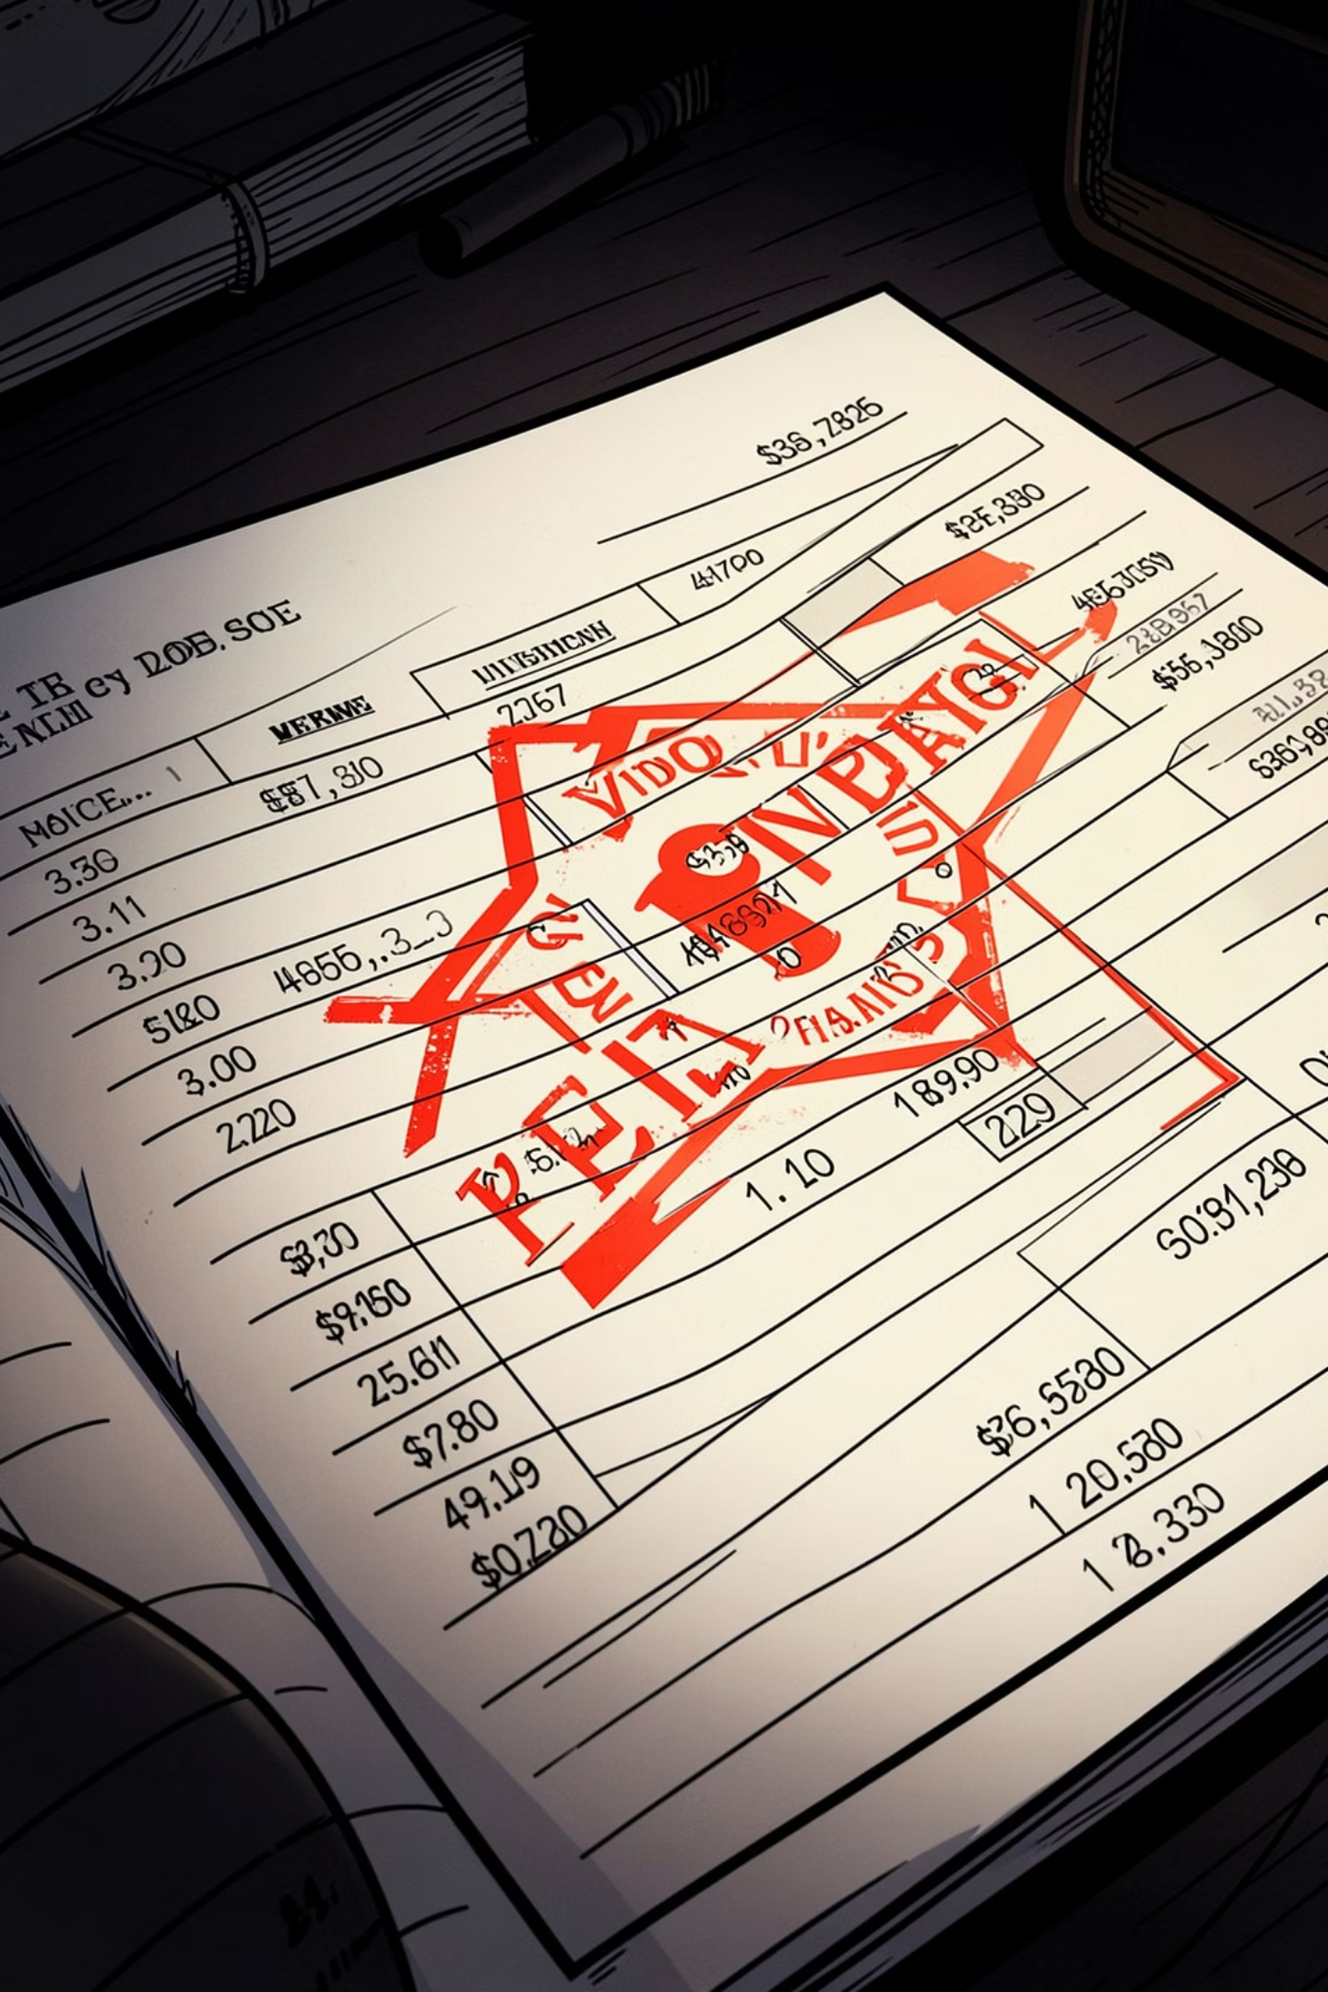
Fraud Is Rare — But Costly
Fraudulent transactions represent a small fraction of total activity, yet their financial impact can be severe. Early detection is critical to minimizing losses.
~0.1%
2
Fraud Rate
High-Risk Types
Fraudulent transactions are rare relative to total volume — but highly consequential.
TRANSFER and CASH_OUT concentrate the majority of confirmed fraud cases.
6M+
Records Analyzed
Dashboard insights are grounded in a large-scale, real-world transaction dataset.

Slide 9

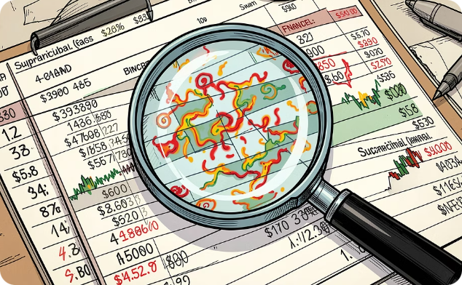

Why This Dashboard Matters
The dashboard transforms raw data into a decision-support tool — enabling analysts and stakeholders to act quickly and confidently.
Continuous Monitoring
Rapid Fraud Identification
Smarter Decisions
Track transaction behavior in near real-time to spot anomalies as they emerge.
Visual patterns and filters surface suspicious activity before it escalates into significant loss.
Interactive filters empower stakeholders to drill into specific segments and validate hypotheses on the fly.

Slide 10


Conclusion & Key Takeaways
What We Delivered
1
A structured analytical framework
Transaction data was cleaned, modeled, and visualized in Power BI for clear interpretation.
2
Targeted fraud insights
Fraud concentrates in TRANSFER and CASH_OUT — a finding that directly informs monitoring priorities.
3
Scalable dashboard design
Interactive filters and KPI visuals make the dashboard adaptable for ongoing fraud analysis workflows.
This project demonstrates how Power BI can turn financial transaction data into a proactive fraud detection tool.

