Slide 1
CPSC 331, Tutorial #16
Taken from CPSC 331 course material

Slide 2
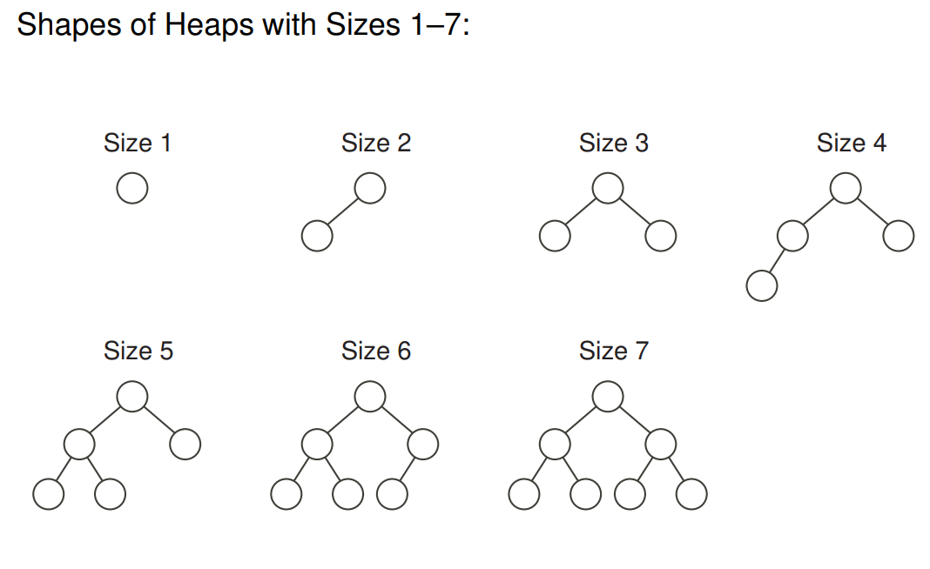
What is a heap? :-?
A binary tree
Every heap of the same size has the same shape.

Slide 3
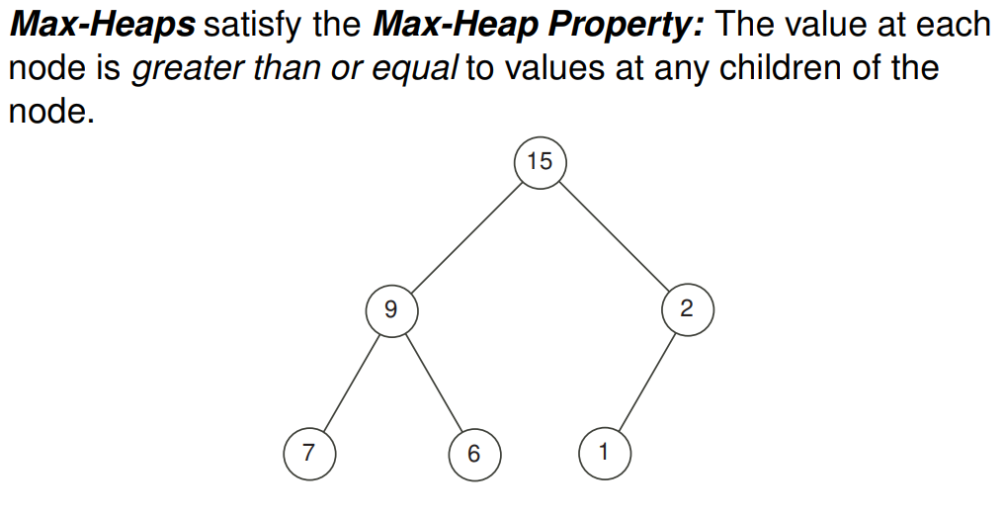
Max Heap

Slide 4
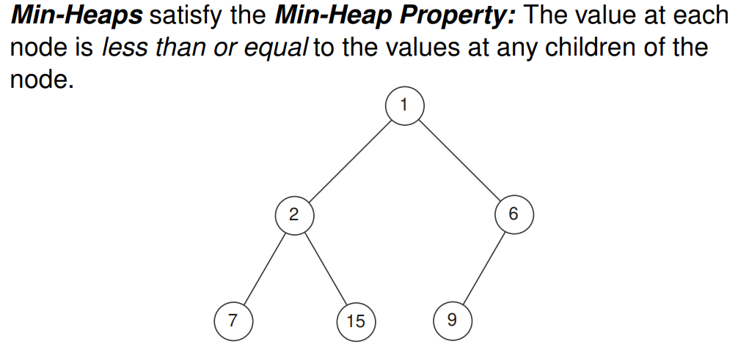
Min heap

Slide 5
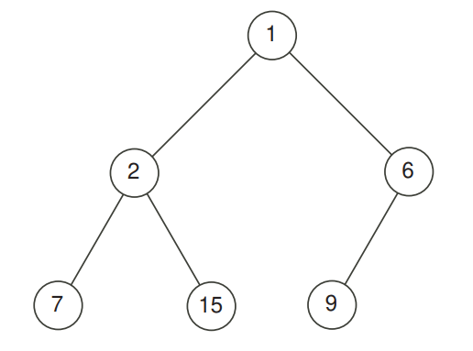
Inserting into a heap
Take this Min-Heap, we want to insert value 0 to it.
First to need to figure out the next available free space.

Slide 6
Inserting into a heap
Take this Min-Heap, we want to insert value 0 to it.
Our next node should become right child of node 6.
But this breaks the order!
0

Slide 7
Inserting into a heap
If the order is broken, we need to Bubble it up until order is restored!
Switch the inserted node with its parent until
0

Slide 8
Inserting into a heap
If the order is broken, we need to Bubble it up until order is restored!
Switch the inserted node with its parent until
0
6

Slide 9
Inserting into a heap
Order is now restored!
0
1
6

Slide 10
Deleting the root
Usually we are just interested in removing the root from heaps.
Take this heap: if we delete the root
we need to replace it with the most recently added node.
We need to know where is the most recently added node!

Slide 11
Deleting the root
Root is removed.
Now we will move the last added node to its place.

Slide 12
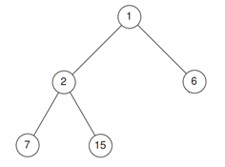
Deleting the root
Order is broken!
Bubble down this value: switch with the smallest child
9

Slide 13
Deleting the root
Order is broken!
Bubble down this value: switch with the smallest child
2
9

Slide 14
Deleting the root
Done!
2
7
9

Slide 15
Important note
In both deleting and inserting we needed to know the location of the most recently added node.

Slide 16
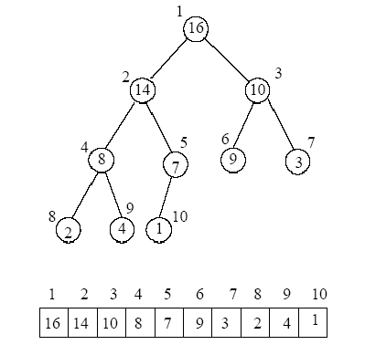
Important note
Using arrays to impalement a heap solves this problem using Math!
However using array might cause problems..

Slide 17
Tutorial 16
The goal of this exercise is to help you to implement an efficient unbounded binary heap using a tree structure instead of an array.
Why?
In order to ensure that all operations using a number of steps that is only logarithmic in the size of the heap, you should use a tree structure to implement this instead of an array or ArrayList.

Slide 18
Tutorial 16, Q1
1. Explain, briefly, why an array or ArrayList should not be used if operations are to be correctly performed using a number of steps that are logarithmic in the size of the heap in the worst case.
http://www.cse.hut.fi/en/research/SVG/TRAKLA2/tutorials/heap_tutorial/KekoTRAKLA-89_1.gif

Slide 19
Tutorial 16, Q1
1. Explain, briefly, why an array or ArrayList should not be used if operations are to be correctly performed using a number of steps that are logarithmic in the size of the heap in the worst case.
We had this case before, the array might reach its limit and then we need to copy every element in it to a bigger array

Slide 20
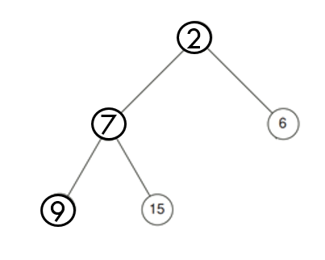
Heaps using trees
When maintaining a tree-based representation of a binary heap we maintain an additional data field, namely, (a reference to) the node that was most recently added and still exists.
This is the node whose data must be copied and which must be removed when a “deletion of largest element” operation is performed. Once this part of the deletion operation is completed, one must update the value of this, by turning into a reference that now points to the node that was most recently added before the addition of the node now deleted
After deleting the root
Notice our reference
is also updated

Slide 21
Q2: why each of the cases are “easy”?
Q2: explain why each of the following cases are “easy” when we are deleting from the heap tree: The reference can be updated quickly and one can move on to the next part of the operation described during Lecture #17:

Slide 22
Q2: why each of the cases are “easy”?
a) The reference to be updated was null before this operation began.

Slide 23
Q2: why each of the cases are “easy”?
Answer:
In this case heap was already empty so it should not be changed and a NoSuchElementException should immediately be returned.

Slide 24
Q2: why each of the cases are “easy”?
b) The reference was a reference to the root of the tree representing this binary heap.

Slide 25
Q2: why each of the cases are “easy”?
Answer:
In this case the binary heap had size 1 before this operation, so it should now be replaced with an empty heap:
The data at the root should be copied,
both the root of the tree and the reference being maintained should be set to null,
and the data that was at the root should be returned

Slide 26
Q2: why each of the cases are “easy”?
c) The reference was a reference to the left child of the root.

Slide 27
Q2: why each of the cases are “easy”?
Answer:
In this case the binary heap had size two before this operation, so that it be changed to a heap with size one:
After storing the data to be reported and copying data from the left child of the root to the root,
the reference should become a reference to the root and
the left child should be deleted.

Slide 28
Q2: why each of the cases are “easy”?
d) The reference was a reference to a node that is not the root and is the right child of its parent.

Slide 29
Q2: why each of the cases are “easy”?
Answer:
In this case, after storing and copying data as needed:
The reference should be updated by setting it be a reference to the sibling of the node that was originally pointed to— the left child of this node’s parent.

Slide 30
Leading to Q3 & Q4
The only remaining case is that the reference points to the left child of a node which is not the root of the tree representing the heap.
In this case, one can proceed by moving up the chain of ancestors of this node in search of a node which is the right child of its parent p instead of its left.
Two things can happen here: 1) No such ancestor exists, or 2) Such an ancestor exists.
Where should the reference point to after 9 is gone?

Slide 31
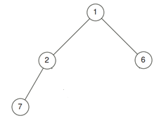
Q3) No such ancestor exists
Q3) If no such ancestor is ever found, then answer the following questions:
What does this mean?
How will the node that should now be referenced be found?
How many steps (to within a linear factor) are needed for this?

Slide 32
Q3) No such ancestor exists
Answers:
This means that every ancestor is the left child of a parent except for the root, which has no parent at all that the node. This also means the node you started with, is the leftmost node at the current level, and that the next node that would be deleted, after this, is the rightmost node at the level above.
After reaching the root during the search, suggested above, you should find this by moving from one right child to another until a node with no right child is found.
Since this involves moving up from one leaf to a root and then down another path from the root to another leaf, the cost of this will be linear in the depth of the heap, which is logarithmic in its size.

Slide 33
Q4) Such an ancestor exists
Q4) If such ancestor exists, then answer the following questions:
What does this mean?
How will the node that should now be referenced be found?
How many steps (to within a linear factor) are needed for this?

Slide 34
Q4) Such an ancestor exists
Answers:
This means that the node you started with this is not the leftmost node possible at its current level. The node you started with stores the smallest value in the right subtree of the ancestor that is the “parent” p, described above.
The node you are looking for is reached from this parent by moving to its left child and then following a path of right children until a node with no right child is found.
This also involves moving up a path from a leaf to some node in the heap and then moving down another path from that node to a different leaf. So, once again, the cost of this is at most linear in the depth of the heap, which is logarithmic in its size.

