Slide 1
student's effort
assignment released
assignment due date
time

Slide 2
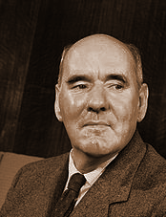
Parkinson's law
"Work expands so as to fill the time available for its completion."
Corollaries:
"If you wait until the last minute, it only takes a minute to do."
"In ten hours a day you have time to fall twice as far behind your commitments as in five hours a day."
"Programs expand to fill the memory available to them.

Slide 3
CPSC 457
Memory
Contains slides from Mea Wang, Andrew Tanenbaum and Herbert Bos

Slide 4
Overview
address spaces – logical vs physical
address binding
memory management unit
swapping
memory management
fixed/dynamic partitioning
placement algorithms
virtual memory & paging
pages, frames, demand paging, page tables
page faults, effective access time, TLBs
CPU registers
CPU cache
$$$, speed
RAM
disks
capacity, $/byte
tapes

Slide 5
Memory
programs need memory to run
we expect computers to run multiple programs simultaneously
we expect OSes to manage memory for processes

Slide 6
Common memory management issues
OS must give each process some portion of available memory (address space)
Which part of memory? How much?
OS needs to protect memory of a process from other processes
How?
what if a program requests more memory?
eg. by calling malloc() or new
if programmers do not know where the program will be loaded, how do they write/compile their code? (eg. how would they write JMP instruction?)

Slide 7
Working with physical addresses
example: two programs
both programs were compiled assuming they are located at address 0
where in memory do we place them?
RAM
0: | MOV
4: | MOV
8: | SUB
12: | JMP 20
16: | ADD
20: | MUL
24: | MOV
0: | ADD
4: | MOV
8: | CMP
12: | ADD
16: | ADD
20: | JMP 8
where?

Slide 8
Working with physical addresses
let's pick two different locations...
can you spot the problem?
0000: | ADD
0004: | MOV
0008: | CMP
0012: | ADD
0016: | ADD
0020: | JMP 8
load at 0
0: | MOV
4: | MOV
8: | SUB
12: | JMP 20
16: | ADD
20: | MUL
24: | MOV
0: | ADD
4: | MOV
8: | CMP
12: | ADD
16: | ADD
20: | JMP 8
...
1000: | MOV
1004: | MOV
1008: | SUB
1012: | JMP 20
1016: | ADD
1020: | MUL
1024: | MOV
load at 1000

Slide 9
Working with physical addresses
0000: | ADD
0004: | MOV
0008: | CMP
0012: | ADD
0016: | ADD
0020: | JMP 8
2nd program would not work, it would jump to the wrong address
...
1000: | MOV
1004: | MOV
1008: | SUB
1012: | JMP 20
1016: | ADD
1020: | MUL
1024: | MOV
another problem is lack of memory protection

Slide 10
Base and Limit Registers ― address protection in hardware
we can add an extra pair of registers to CPU
these can define the allowed range of addresses
base register = starting memory
limit register = size of memory
the base and limit registers can be modified only in kernel mode
CPU checks every memory access generated by a process
when process tries to access invalid address CPU generates SW interrupt ⟶ trapped by kernel
base & limit registers stored in PCB
0:
kernel
30020:
process 1
base=50000
50000:
process 2
limit=43050
93050:
free
128442:
process 3
262144:

Slide 11
Base and Limit Registers ― address protection in hardware
base
base + limit
memory
address
≥
yes
<
yes
CPU
no
no
trap to OS ― addressing error

Slide 12
Address binding
address binding is the process of mapping/converting addresses of a program from one space to another
mainly used to solve the problem "how to write a program if it's final destination is not known"
can happen at compile time, at load time, or at run time
0000: | ADD
0004: | MOV
0008: | CMP
0012: | ADD
0016: | ADD
0020: | JMP 8
...
1000: | MOV
1004: | MOV
1008: | SUB
1012: | JMP 20
1016: | ADD
1020: | MUL
1024: | MOV

Slide 13
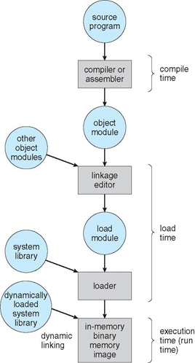
Binding of instructions and data to memory
at compile time / link time - slowest
if physical location is known a priori, absolute code can be generated and stored
must recompile code if physical location changes
not useful for multiprocessing systems
at load time - much faster
compiler/linker outputs relocatable code
binding is done by loader before program starts executing
we include position independent code (PIC) in this category, but it could be HW assisted via special register
at run time - fastest (with HW support)
if process can be moved during its execution, binding is done at run-time, dynamically
most flexible, but need hardware support for address maps (e.g., memory management unit)

Slide 14
Logical & physical addresses
we can achieve execution-time address-binding and memory-protection by 'virtualizing memory'
OS gives each process a logical address space (aka virtual address space)
it is a contiguous space [0 … max]
as process executes, addresses generated by the CPU are logical addresses
if logical address does not fall into the logical address space range → violation (trap)
physical address - a real memory address
logical addresses are mapped to physical addresses before reaching memory via hardware device called memory management unit (MMU)
physical address space of a process is the subset of RAM allocated to a process
physical address space does not need to be contiguous (depending on MMU type)

Slide 15
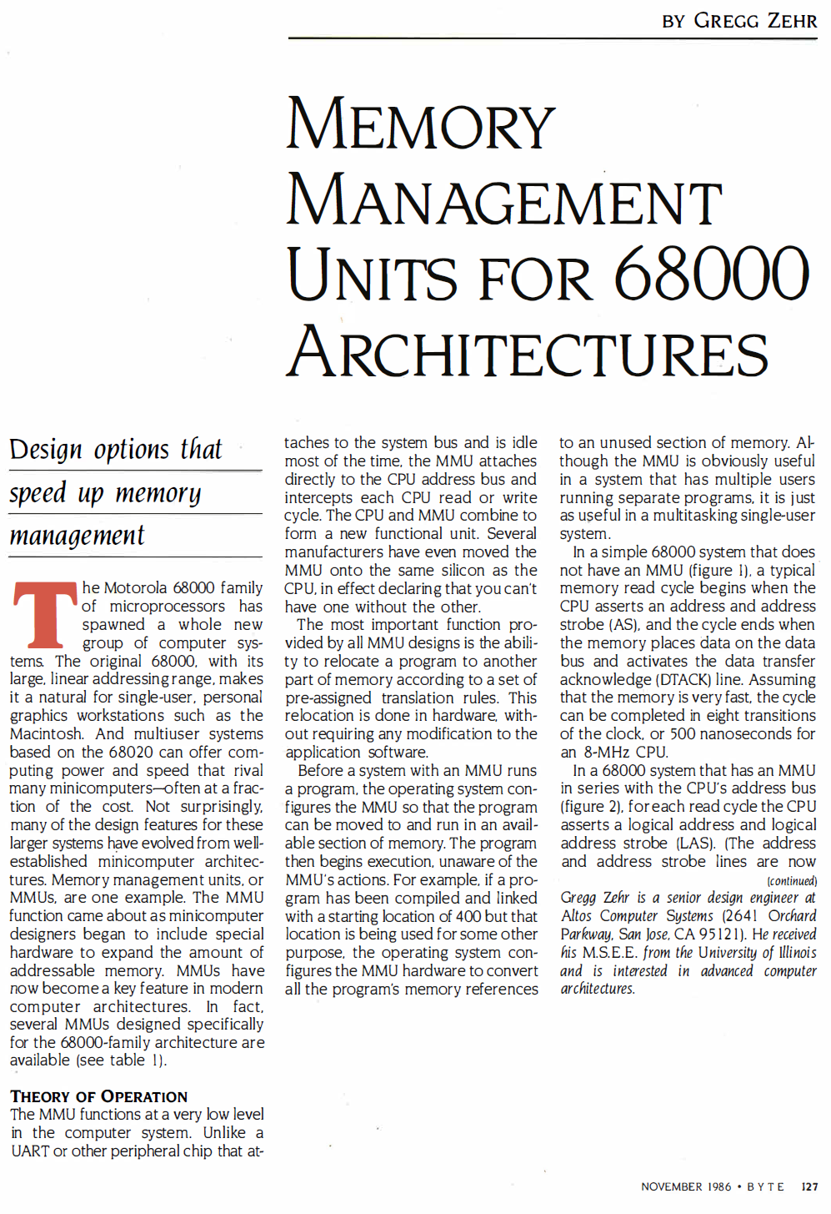
http://marc.retronik.fr/motorola/68K/68000/Memory_Management_Units_for_68000_Architectures_[BYTE_1986_9p].pdf

Slide 16
Memory-Management Unit (MMU)
MMU is a hardware device that maps virtual/logical addresses to physical addresses
needs to be super fast, so it is often part of the CPU
many possible implementations (in theory)
as CPU executes instructions, it sees logical addresses, it never sees real physical addresses
execution-time binding occurs automatically whenever memory reference is made
logical address
physical address
CPU
MMU
Memory

Slide 17
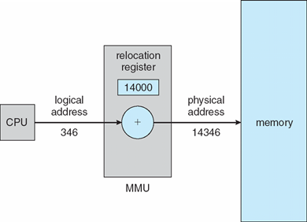
MMU ― Relocation Registers
a simple MMU implementation:
logical address space starts at 0, ie. programs are written/compiled assuming they start at address 0
CPU has a relocation register
value in the relocation register is added to every address generated by a CPU at the time it is sent to memory
but no memory protection ...

Slide 18
MMU ― Relocation and Limit Registers
combining relocation register and limit register
relocation (base) register = smallest allowed physical memory address
limit register = the size of the chunk of physical memory a process is allowed to use
achieves execution-time binding as well as memory protection
limit register
base + logical
memory
logical
address
<
yes
+
physical address
CPU
no
trap to OS ― addressing error

Slide 19
Hardware Support for Relocation and Limit Registers
0: | ADD
4: | MOV
8: | CMP
12: | ADD
16: | ADD
20: | JMP 8
0: | MOV
4: | MOV
8: | SUB
12: | JMP 20
16: | ADD
20: | MUL
24: | MOV
0: | ADD
4: | MOV
8: | CMP
12: | ADD
16: | ADD
20: | JMP 8
base register:
0
limit register:
512
...
1000: | MOV
1004: | MOV
1008: | SUB
1012: | JMP 20
1016: | ADD
1020: | MUL
1024: | MOV
base register:
1000
each process gets its own pair of base/limit registers
stored in PCB
limit register:
64
...

Slide 20
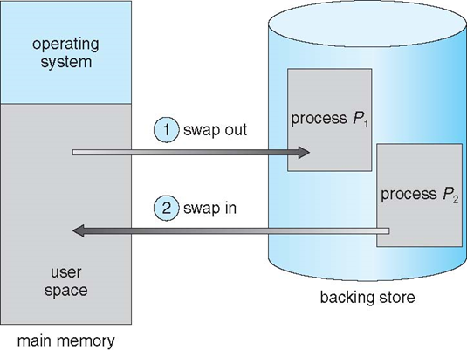
Swapping
a process can be swapped temporarily out of memory to a backing store, and then brought back into memory for continued execution
backing store – fast storage large enough to accommodate copies of all memory images for all processes
swapping allows the OS to load more processes than the available physical memory
why would we want that?!?

Slide 21
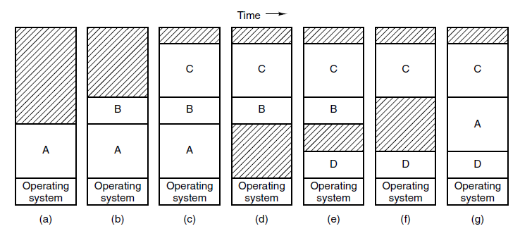
Swapping and memory
memory allocation changes as processes are swapped out and swapped in
the shaded regions are unused memory
A is swapped out
B is swapped out
A is swapped in

Slide 22
Swapping
does the swapped out process need to swap back into the same physical addresses?
depends on address binding method
much easier if MMU is used
must be careful with pending I/O, especially when using memory-mapped device registers
I/O results could be sent to kernel, then to the process (double-buffering)
context switch time can be extremely high
standard swapping not used in modern operating systems
note: Linux uses the term 'swapping' to mean paging
paging is similar to swapping, but paging can swap out parts of a process
we will discuss paging in lot more detail in the near future

Slide 23
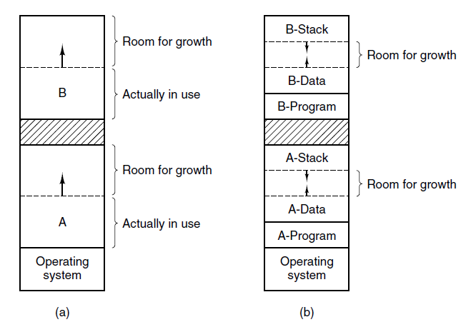
Memory allocation
how much memory should OS allocate to each process?
most programs increase their memory usage during execution
possible solution: swap process out, find a bigger free memory chunk, swap it back in
another improvement: OS proactively allocates extra memory for each process

Slide 24
Memory allocation
at some point OS needs to
find a free chunk of memory
then mark it as used
and later free it up
simple approaches can lead to memory fragmentation
lots of tiny free chunks of memory
but none of them big enough to satisfy any requests
OS needs to manage the memory in an efficient way
fast (searching, allocating, freeing, …)
minimize fragmentation
two general approaches: fixed partitioning and dynamic partitioning

Slide 25
Fixed partitioning
memory is divided into partitions of equal size
example:
total memory = 64MB, partition size = 8MB → 8 partitions
OS usually reserves some memory for itself, eg. 1st partition
let's load 3 processes: P1 (4MB), P2 (8MB), P3 (10MB)
8MB
8MB
8MB
8MB
8MB
8MB
8MB
8MB

Slide 26
Fixed partitioning
memory is divided into equal-sized partitions
example:
total memory = 64MB, partition size = 8MB → 8 partitions
OS usually reserves some memory for itself (eg. 1 partition, or 8MB)
let's load 3 processes: P1 (4MB), P2 (8MB), P3 (10MB)
Problems?
8MB
8MB
8MB
8MB
8MB
8MB
8MB
8MB
OS
P1 4MB
P2
8MB
P3
10MB

Slide 27
Fixed partitioning
memory is divided into equal-sized partitions
example:
total memory = 64MB, partition size = 8MB → 8 partitions
OS usually reserves some memory for itself (eg. 1 partition, or 8MB)
let's load 3 processes: P1 (4MB), P2 (8MB), P3 (10MB)
Problems:
internal fragmentation – memory internal to a partition becomes fragmented
leads to low memory utilization if partitions are big
8MB
8MB
8MB
8MB
8MB
8MB
8MB
8MB
OS
P1 4MB
P2 8MB
P3
10MB
Actual free memory: 34 MB
Usable free memory: 24 MB ☹️

Slide 28
Dynamic partitioning
create partitions that can fit requests perfectly
example:
total memory = 64MB, minus 8MB taken by OS
load 3 processes: P1 (4MB), P2 (8MB), P3 (10MB)
64MB
free

Slide 29
Dynamic partitioning
create partitions that can fit a request perfectly
example:
total memory = 64MB, minus 8MB taken by OS
load 3 processes: P1 (4MB), P2 (8MB), P3 (10MB)
no more internal fragmentation
but what if P2 finishes, and P4 (18MB) gets added?
OS
P1
4MB
P2
8MB
P3 10MB
34MB
free
Usable free memory: 34 MB
Actual free memory: 34 MB 😃

Slide 30
Dynamic partitioning
P2 finishes and P4 (18MB) gets added:
external fragmentation: the memory that is external to all partitions becomes increasingly fragmented, leading to low memory utilization
eg. P5 (17MB) could not start, despite having enough free RAM
OS
P1
4M
P2
8MB
P3 10MB
34MB
free
OS
P1
4M
8MB
free
P3
10MB
P4
18MB
16MB
free
Usable free memory: 24 MB
Actual free memory: 24 MB
Largest free chunk: 16 MB 😲

Slide 31
Memory compaction
memory compaction is a mechanism to deal with external fragmentation
from time to time, the OS re-arranges the used blocks of memory so that they are contiguous
goal: free blocks are merged into a single large free block
CPU intensive operation, not used*
OS
P1
8MB free
P3
P4
16MB free
OS
P1
P3
P4
24MB
free

Slide 32
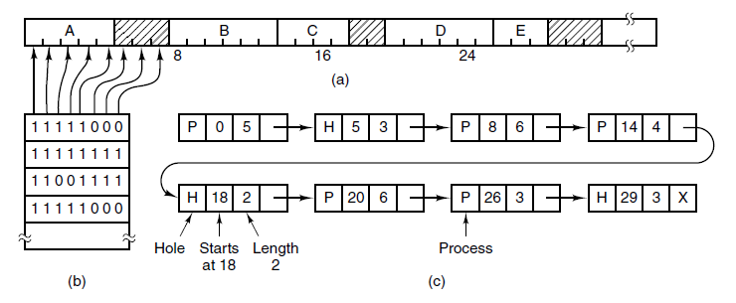
Implementing memory allocation algorithms
how do we keep track of free memory and allocated memory?
we need a data structure
that is efficient at searching free space
that is efficient at reclaiming free space
"deals" with fragmentation

Slide 33
Bitmaps & fixed partitions
memory is divided into equal partitions as small as few words and as large as several KB
OS maintains a bitmap, 1 bit per partition, where 0=free, 1=occupied
Problems:
searching is O(N), N = size of bitmap (number of partitions)
smaller partitions ⇒ less fragmentation, but larger bitmap
larger partitions ⇒ smaller bitmap, but more fragmentation
compromise between efficiency and fragmentation
note: larger bitmap also implies more wasted memory

Slide 34
Linked lists & dynamic partitioning
memory is divided into partitions of dynamic size
OS maintains a list of allocated and free memory partitions (holes), sorted by address
searching is O(N), where N = number of segments in the linked list
reclaiming free space can be O(1)
using doubly-linked lists and keeping linked-list pointers within segments

Slide 35
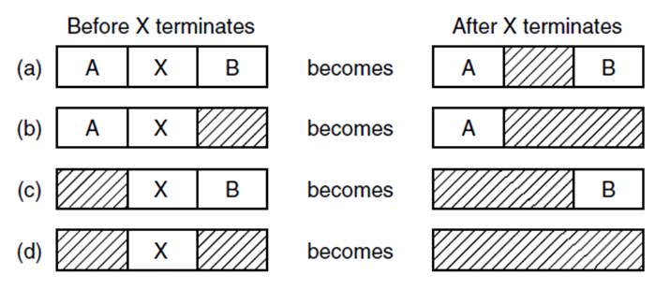
Memory management with linked lists - reclaiming space
two way merge
two way merge
three way merge

Slide 36
Memory allocation
algorithms for finding a free space (hole) in a linked list:
first fit - find the first hole that is big enough, leftover space becomes new hole
best fit - find the smallest hole that is big enough, leftover (tiny) space becomes new hole
next fit - same as first fit, but start searching at the location of last placement
worst fit - find the largest hole, leftover (big) space is likely to be usable
quick fit - maintain separate lists for common request sizes
leads to faster search, but more complicated management
example: request is to allocate memory for 2 units
hole
last placement
next fit
3
5
2
first fit
worst fit
best fit

Slide 37
Memory allocation simulation (dynamic partitioning)
init(180)
alloc(P1,10)
alloc(P2,30)
alloc(P3,10)
alloc(P2,20)
alloc(P1,10)
alloc(P2,50)
alloc(P1,10)
free(P2)
free 180
P1 10 | free 170
P1 10 | P2 30 | free 140
P1 10 | P2 30 | P3 10 | free 130
P1 10 | P2 30 | P3 10 | P2 20 | free 110
P1 10 | P2 30 | P3 10 | P2 20 | P1 10 | free 100
P1 10 | P2 30 | P3 10 | P2 20 | P1 10 | P2 50 | free 50
P1 10 | P2 30 | P3 10 | P2 20 | P1 10 | P2 50 | P1 10 | free 40
P1 10 | free 30 | P3 10 | free 20 | P1 10 | free 50 | P1 10 | free 40

Slide 38
Memory allocation simulation (dynamic partitioning)
free(P3)
P1 10 | free 30 | P3 10 | free 20 | P1 10 | free 50 | P1 10 | free 40
P1 10 | free 30 | free 10 | free 20 | P1 10 | free 50 | P1 10 | free 40
must merge adjacent free partitions into one
P1 10 | free 60 | P1 10 | free 50 | P1 10 | free 40

Slide 39
Memory allocation simulation (dynamic partitioning)
alloc(P7,20) # using first fit
P1 10 | free 30 | P3 10 | free 20 | P1 10 | free 50 | P1 10 | free 40
P1 10 | P7 20 | free 10 | P3 10 | free 20 | P1 10 | free 50 | P1 10 | free 40
alloc(P7,20) # using best fit
P1 10 | free 30 | P3 10 | free 20 | P1 10 | free 50 | P1 10 | free 40
P1 10 | free 30 | P3 10 | P7 20 | P1 10 | free 50 | P1 10 | free 40

Slide 40
Memory allocation simulation (dynamic partitioning)
alloc(P7,20) # using worst fit
P1 10 | free 30 | P3 10 | free 20 | P1 10 | free 50 | P1 10 | free 40
P1 10 | free 30 | P3 10 | free 20 | P1 10 | P7 20 | free 30 | P1 10 | free 40
alloc(P7,20) # using next fit
P1 10 | free 30 | P3 10 | free 20 | P1 10 | free 50 | P1 10 | free 40
P1 10 | free 30 | P3 10 | free 20 | P1 10 | free 50 | P1 10 | P7 20 | free 20

Slide 41
Questions?

