Slide 1
COVID-19 Detection & Prevention
Project Supervisor: Md. Jamal Uddin Submitted by: Md. Juwel Mallick
Assistant Profesor Student ID: 18CSE018
Department of CSE, BSMRSTU Department of CSE, BSMRSTU

Slide 2
Presentation Outline
Introduction
Features
Objectives
Procedure
Advantage
Future look

Slide 3
Introduction
The Covid-19 Detection and Prevention project is essentially an Informative instructional project. The Covid-19 epidemic is described here.
Coronavirus disease (COVID-19) is an infectious disease caused by a newly discovered coronavirus SARS-CoV-2. It was previously referred to by its provisional name, 2019 novel coronavirus (2019-nCoV). Here described about the symptoms, detection, prevention and also the coronavirus(SARS-CoV-2).

Slide 4
Features
Described about COVID-19 epdemic
How to be aware?
About responsible virus
The symptoms
Chatbot to detection positivity
How to prevent?

Slide 5
Objectives
Promoting accurate information
Increase public awareness
Promoting COVID-19 symptoms
Verify the possibility of infection
Providing instruction according to the rate of infection
Explain the strategy of prevention

Slide 6
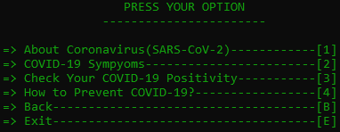
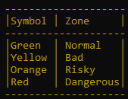
Procedure
After the first look of awareness the main menu will come. Then the main features of the project will show.
Through choice we can easily know the coronavirus, symptoms, detection and prevention of COVID-19.

Slide 7
Advantage
Easy to access
Gain knowledge about COVID-19 epidemics
For easily presentation of information they are devided into 4 zones
Easily identify COVID-19 possibilities
After identify we can know what to do
Find out about emergency unit and hotline
All information collected from secured sources

Slide 8
Future look
I want to add more information about this diseases
I want to add Graph & Chart her
I want to add doctor and hospital info.
I want to add vaccine update.
I want to add graphics so that people can easily understand

