Slide 1
Learn Sunnah
Project Supervisor: Dr. Mrinal Kanti Baowaly Submitted by: Md. Juwel Mallick
Associate Professor Student ID: 18CSE018
Department of CSE, BSMRSTU Department of CSE, BSMRSTU

Slide 2
Introduction
Overview: Learn Sunnah is a social e-learning platform designed to help users lead a proper life by learning the teachings and behaviors of Sunnah.
Main 2 ways to learn:
Book
Questions

Slide 3
Features
Free Library with PDF book collection
Question and Answer section with categorized questions
User profiles with activity tracking
Three user types: Admin, Moderator, and General User

Slide 4
Objectives
To provide an interactive platform
Create a social learning platform (e-learning)
Offer a free library

Slide 5
Knowledge Acquisition
Post Questions
Search Functionality
News Feed
Library Reading

Slide 6
User Types
3 types of user
Admin
Moderator
General User

Slide 7
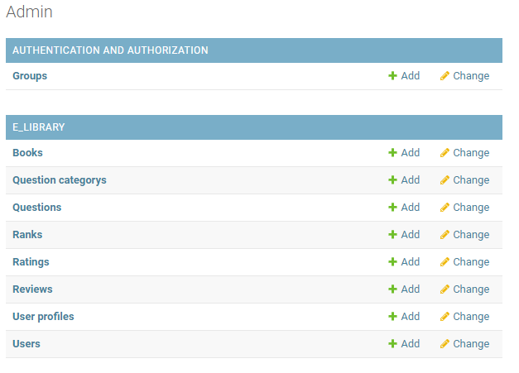
Admin & Moderator Privileges
Approve Publications
User Management

Slide 8
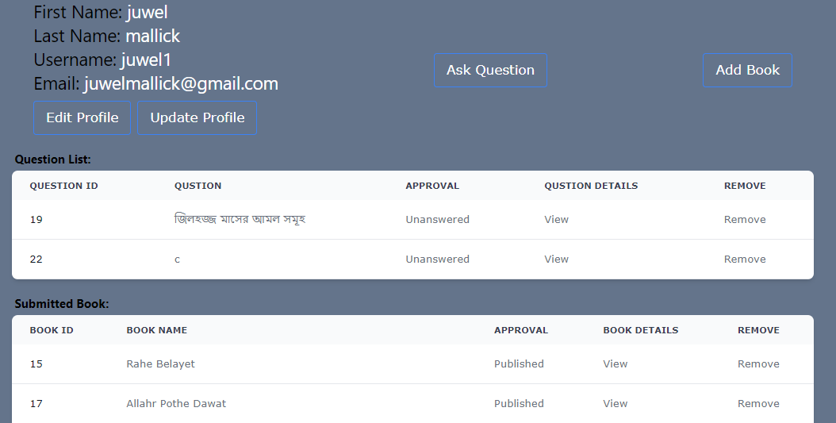
User Privileges
Library Access
Profile Management
Submitted Content
Update profile

Slide 9

Library
Access to a free PDF book collection
PDF reader

Slide 10
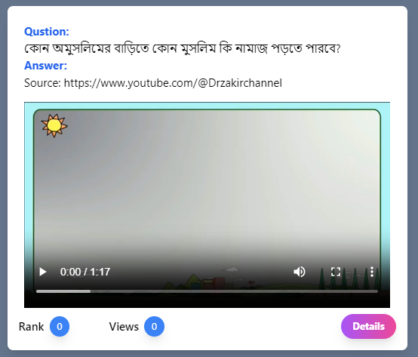
Posting
post questions & share knowledge
Content can be in text, video, or image format
Question public/private

Slide 11
User Benefits
Diverse Sunnah resources in the free library.
Community interaction and knowledge-sharing.
Expert guidance through Q&A section.
Categorized search for specific topics.
Stay updated with informative content.
Implement Sunnah for a guided life.

Slide 12
Limitation
No bookmark facility
Live service get from the moderator
No comments option
Users don’t give a vote for a rank
Lack of collection of books and question & answer
I will try to solve these limitations in future

Slide 13
THANK YOU

