Slide 1

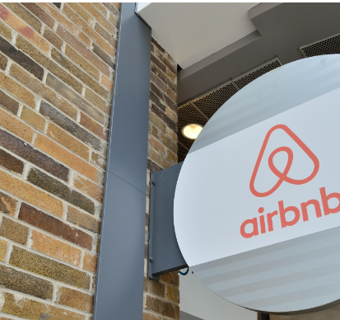
Data Analysis for Airbnb in New York

Slide 2
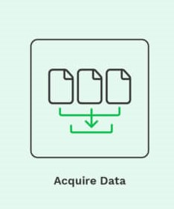

Data
Three datasets:
1. Airbnb_data_New_York.csv referred as Airbnb
2. Property_sales_data_New_York.csv referred as Sales
3. Weather data.xslx referred as Weather
Other sets of data produced
SalesnWeather
mergedata

Slide 3

Data and Libraries
At first, all three spreadsheets were loaded.
Libraries:
pandas
matplotlib
seaborn
Notes:
All three datasets are loaded using the read_csv function
Pandas: library used for data exploration and manipulation
Matplotlib and seaborn : libraries used for data visualization

Slide 4

Exploring , Cleaning & Transforming Data
Missing Values
Airbnb
name: 16 missing values
host_name: 21 missing values
last_review: 10052 missing values
reviews_per_month: 10052 missing values
Sales – 0
Weather - 0
Notes:
In the next step we explore the datasets for any missing values to understand the data quality and any other potential issues.

Slide 5
Airbnb
Handling missing Values
name: 16 missing values replaced with unknown
host_name: 21 missing values replaced with unknown
Notes:
The column, 'name' contains 16 missing values and column 'host' has 21 missing values. These may not have an impact on the analysis and can be substituted with the value 'unkown’ to maintain data integrity.

Slide 6
Deleting Unnecessary Columns
id: dropped (as unique identifier)
host_id: dropped (as unique identifier)
last_review: 10052 missing values dropped (not necessary)
reviews_per_month: 10052 missing values dropped (not necessary)
Notes:
Columns 'id’, 'host_id’, ‘last_review’, and ‘reviews_per_month’ are dropped because they are either unique identifiers or have a high number of missing values.

Slide 7
Weather
The first row in this dataset was removed because it contains header
information.
Rename the automatic headers:
aggregation to DATE
Maximum to MaxTemp
Minimum to MinTemp
Mean to MeanTemp
Notes:
The columns are renamed to obtain consistency and clarity, which will be required later when performing analysis.

Slide 8
Sales
Manipulate date columns in the Sales dataset in readiness for a
merge.
Change column headings:
SALE DATE to DATE in the Sales data
Change the column data to ‘date’ type.
Remove duplicates
In the Weather data – change ‘date’ column data to date type
Notes:
Duplicate entries are removed and the date column is converted to ‘date’ type to ensure accurate analysis.

Slide 9

Analysis and Visualization
1(a). Properties sold with zero price
Using the price column in the Airbnb data.
Change the column values to numeric
Equate the price column to zero to find the rows with zero price
Results
There were 11 properties sold at zero price
Notes:
Analyzing properties at zero price helps identify potential data quality issues or anomalies in the Airbnb dataset

Slide 10
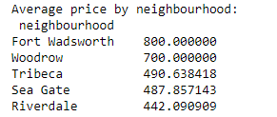
1(b). Average price for each neighbourhood to rent an Airbnb apartment
Using the price column in the Airbnb data.
Group the data by neighbourhood with respect to price then find the mean.
Results
In Fort Wadsworth, the average price of Airbnb apartments is 800.
With 221 neighbourhoods, we can have a broader view with the average price in relation to neighbourhood_group.

Slide 11
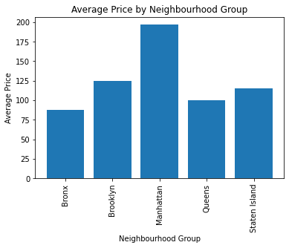
Further Analysis
What is the average Airbnb price in each neighbourhood_group?
This might give an insight on the cheapest neighbourhood_group (Bronx) or the most expensive neighbourhood_group (Manhattan) leading to the question, why? Location, no. of bnbs, proximity to large cities etc.

Slide 12
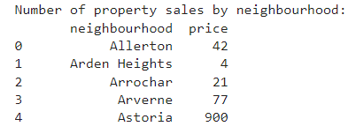
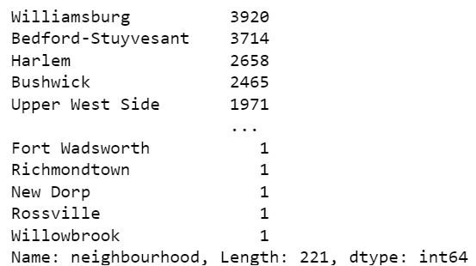
1(c). Number of sales of properties in each neighbourhood in NY
Using the price column in the Airbnb data.
Group the data by neighbourhood with respect to price then find the count.
Results
In Allerton, there were 42 properties on sale.
It is worth noting that Williamsburg had the highest number of sales of property. This could be linked to its popularity in art and scenery that attracts many tourists.

Slide 13
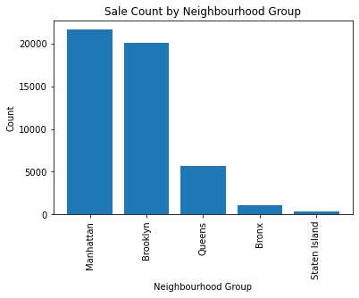
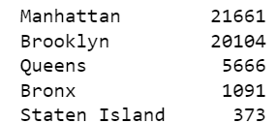
Further Analysis
The 221 neighbourhoods can be drilled up by grouping the data by neighbourhood_group.
What is the sale count of airnbnb apartments in each neighbourhood_group?
This might give an insight on the popularity of the neighbourhood_group.
For example, Manhattan is known to be a popular tourist destination which reflects directly on why it has the highest sale count.
Notes:
Analyzing the number of sales of properties in each neighbourhood and neighbourhood group provides insights into the market trends and popularity.

Slide 14
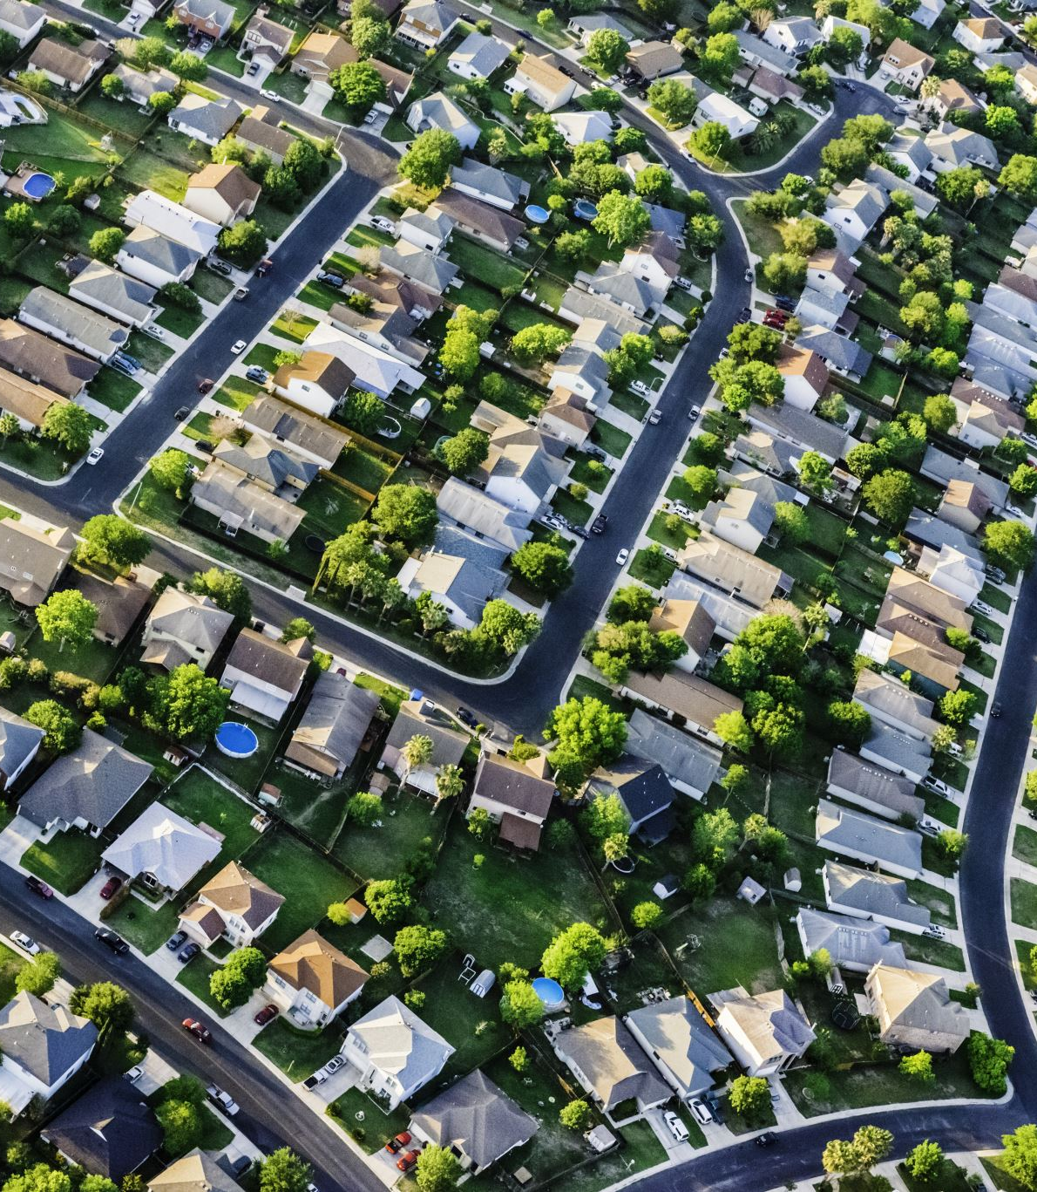
1(d). Are sales of properties in NY impacted by weather
Merge
1st Merge
Sales + Weather = SalesnWeather
The merge column was ‘Date’
The merge column was
‘neighbourhood’ for Airbnb renamed ‘NEIGHBORHOOD’ and all values of the column changed to uppercase, and,
NEIGHBORHOOD for SalesnWeather
2nd Merge
SalesnWeather + Airbnb = mergedata

Slide 15
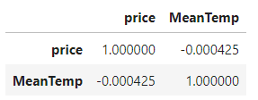
Using the merged data: mergedata
Find the correlation between temperature and price.
Results
A simple correlation table shows a correlation coefficient of -0.000425 which is very low and interprets a very weak correlation between the two variables.
Temperature (mean temperature) does not influence the sale of Airbnb apartments in New York.

Slide 16
Suppose… 2. If you were supposed to buy an apartment in New York, what would be your approach to find the best investment if you plan to use it for Airbnb?
Below are steps involved in my approach to find the best investment to buy an apartment in NY and use it for an Airbnb:
1.Budget: Determine your investment limit, including property costs, renovations, and ongoing expenses.
2.Research: Identify tourist-friendly neighborhoods with demand for short-term rentals.
3.Regulations: Understand local Airbnb regulations and legal requirements.
4.Profitability: Focus on areas with higher Airbnb rates than long-term rentals.
5.Agent: Engage a local real estate agent experienced in Airbnb investments.
6.Property Features: Seek properties near attractions, with good access and layout.
7.Condition: Assess property condition and potential renovation costs.
8.ROI: Calculate projected return on investment considering income and expenses.
9.Financials: Review property taxes, HOA (homeowners association)fees, and insurance costs.
10.Building Rules: Check for building restrictions on short-term rentals.
11.Management: Decide on self-management or hiring a property management company.
12.Legal and Tax: Consult legal and tax professionals for proper structuring.
13.Due Diligence: Conduct inspections, title searches, and contract reviews.
14.Negotiate: Work with the agent to negotiate a favorable purchase.
15.Listing: Create an attractive Airbnb listing for a great guest experience.
Lastly, it is important to stay adaptable and informed about market trends for a successful investment.

Slide 17

Thank You

