Slide 1
SANS FIND EVIL! 2026
Agentic-DART
Autonomous DFIR triage on a typed, read-only MCP surface —
where every finding is traceable to a tool call, and hallucination is structurally impossible.
73 read-only tools
hallucination = 0
architecture-first
A custom MCP server for Claude · 6 Python packages · full pytest suite green
Notes:
Open with the one-liner: this is an autonomous DFIR agent, but the headline is not autonomy — it's that the architecture makes fabrication impossible. Every finding traces to a tool call. 73 read-only tools, hallucination zero by construction. Set the tone: measured, traceable, honest about limits.

Slide 2
THE PROBLEM
An LLM can hallucinate persuasively — and in DFIR that is fatal
95%
Why demos don't transfer to real IR
A confident wrong finding is worse than no finding
an analyst acts on it
of a generated report can read perfectly plausible —
You cannot tell confirmed from inferred
and the remaining 5% is an invented IOC, a fabricated timestamp, a host that was never breached.
prose hides which is which
Nothing ties a claim back to evidence
no way to audit the chain
AGENTIC-DART
02 / 13
Notes:
The core problem: most agentic DFIR demos prove an LLM can produce a plausible report. But plausible isn't the bar — fabrication is the risk. A confident wrong finding gets acted on. You can't distinguish confirmed from inferred in prose. And nothing ties a claim back to the evidence. This is what we set out to make structurally impossible.

Slide 3
THE APPROACH
Don't ask the model to behave — remove the ability to misbehave
Claude is handed 73 typed, read-only forensic functions over a custom MCP server. It can read evidence, never write or execute. Every finding it reports must cite the audit_id of the tool call that produced it — or it is blocked before it reaches the report.
1
2
3
Typed read-only surface
Evidence-bound claims
Self-correcting loop
73 functions on the MCP wire. No shell, no eval, no write path. The boundary IS the function list.
Every finding carries an audit_id into a hash-linked chain. No citation → serializer blocks it.
A 10-phase playbook forces a contradiction check; the agent revises its own hypothesis.
AGENTIC-DART
03 / 13
Notes:
The thesis in one line: don't ask the model to behave — remove the ability to misbehave. Three pillars: a typed read-only surface where the function list IS the security boundary; evidence-bound claims where every finding needs an audit_id or it's blocked; and a self-correcting loop driven by a playbook that forces a contradiction check.

Slide 4
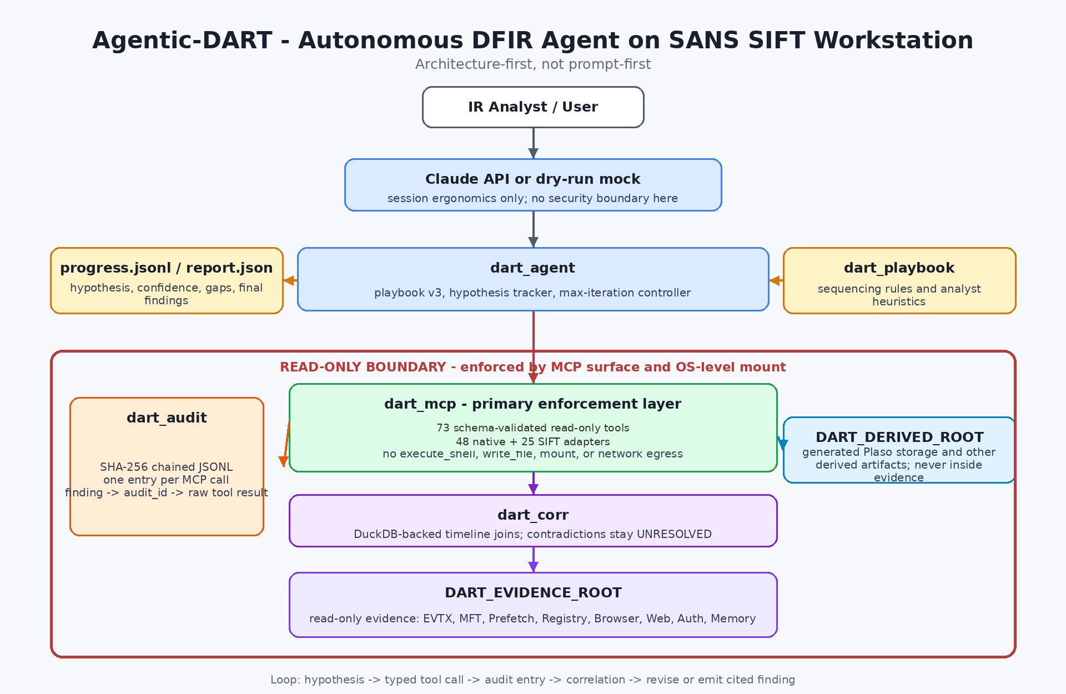
ARCHITECTURE
Architecture-first, not prompt-first
Where the boundary lives
Claude API
session ergonomics only — no security boundary here
dart_mcp
the read-only boundary, enforced by the surface itself
OS mount
evidence mounted read-only at the OS level
AGENTIC-DART
04 / 13
Notes:
The architecture diagram makes the key distinction explicit: the Claude API layer is session ergonomics — there is NO security boundary there. The boundary is dart_mcp, enforced by the function surface, plus the OS-level read-only mount. This is what 'architecture-first, not prompt-first' means: the guarantee doesn't depend on the model following instructions.

Slide 5
THE GUARANTEE
Read-only by construction — there is nothing to jailbreak
Destructive primitives do not exist in the registry
Tested for bypass on every push
There is no rule for the model to break and nothing to convince. Shell execution, file writes, deletion, mount, network egress, eval — every destructive operation is checked by name, by CI, on every commit. The registered surface is asserted as an exact set, so adding a tool can never silently widen the boundary.
Destructive names → ToolNotFound
at the dispatcher
Surface asserted as an exact set
positive + negative list
Path traversal / absolute / null-byte
blocked before any body runs
SQL-injection on the query engine
character allowlist + keyword block
Write probe outside evidence root
architectural — not prompt-based
resolves to zero
AGENTIC-DART
05 / 13
Notes:
This is the constraint-implementation slide. The guarantee is architectural: destructive primitives simply don't exist in the registry, so there's nothing to jailbreak. It's tested for bypass on every push — destructive names raise ToolNotFound, the surface is an exact set so a new tool can't silently widen it, path traversal and SQL injection are blocked, and a write probe outside the evidence root resolves to zero. Note: I deliberately don't cite a single count of destructive names here — the lists differ slightly across files, so the honest statement is 'every destructive operation', checked by CI.

Slide 6
HOW IT'S BUILT
Six packages, one read-only boundary
dart_mcp
dart_audit
dart_agent
73 typed read-only forensic functions — the MCP surface and the primary enforcement layer
SHA-256 hash-linked audit chain; every tool call sealed with prev/entry hash
the autonomous loop — hypothesis, tool calls, iteration, serializer that blocks un-cited claims
dart_corr
dart_playbook
SIFT adapters
DuckDB contradiction engine — emits UNRESOLVED records that are never auto-resolved
the 10-phase senior-analyst playbook that forces a contradiction check before a verdict
25 typed wrappers (Volatility 3, MFTECmd, EvtxECmd, PECmd, YARA, Plaso…) on the same boundary
AGENTIC-DART
06 / 13
Notes:
Six packages. dart_mcp is the surface and primary enforcement. dart_audit seals every call into a SHA-256 chain. dart_agent runs the loop and holds the serializer that blocks un-cited claims. dart_corr is the DuckDB contradiction engine — UNRESOLVED records never auto-resolve. dart_playbook is the 10-phase playbook forcing a contradiction check. And the SIFT adapter layer wraps 25 external tools on the same read-only boundary.

Slide 7
BREADTH
48 native functions + 25 SIFT adapters = 73 on one wire
48
25
native pure-Python forensic functions
SIFT Workstation tool adapters
Disk, registry, EventLog, MFT, Prefetch, USB, browser, auth, scheduled tasks, Kerberos, ADCS, DNS-tunneling — covering broad MITRE ATT&CK enterprise tactics.
Volatility 3, MFTECmd, EvtxECmd, PECmd, RECmd, AmcacheParser, YARA, Plaso — each a typed wrapper that inherits the exact same read-only guarantees as the native layer.
AGENTIC-DART
07 / 13
Notes:
Breadth comes from two layers on one wire. 48 native pure-Python functions cover disk, registry, EventLog, MFT, Prefetch, USB, auth, Kerberos, ADCS, DNS tunneling — broad ATT&CK coverage. Plus 25 SIFT adapters wrapping the community's standard tools — Volatility 3, the EZ tools, YARA, Plaso — each inheriting the same read-only guarantee. Total: 73, verified at runtime.

Slide 8
MEASURED — NOT CLAIMED
Honest accuracy: strong on our logic, lower on what we're still building
Read this honestly
Hallucination: 0
every finding traces to a tool call; low recall is missed coverage, never invention
External < self is not a regression
it's a paradigm gap we disclose — content-centric parsing is Phase 2, and external data tells us what to ship next
Live numbers: docs/benchmarks/ — regenerated from runs, not transcribed
AGENTIC-DART
08 / 13
Notes:
This is the measured-not-claimed slide — and the most important one for credibility. Green bars: self-evaluation across 8 cases, Opus reaching 89%. Amber bars: external third-party corpora across 3 cases, much lower. We show this deliberately. Hallucination is zero throughout — low recall means missed coverage, never invention. And external sitting below self is not a regression: it's an honestly disclosed paradigm gap. Content-centric parsing is Phase 2, and the external data is exactly what tells us which feature to ship next. The honest claim is not that we're perfect — it's that everything is measured, traceable, and the limits aren't hidden.

Slide 9
FORENSICALLY SOUND
Chain of custody, sealed end to end
SHA-256 pre / post
Hash-linked audit chain
every input file hashed before and after the run; integrity verified, not assumed
each tool call sealed with prev_hash → entry_hash; an unbroken, replayable chain
audit_id on every finding
Anti-spoliation test
confirmed vs unresolved vs false_positive is a typed field, not prose
asserts no input is mutated and any write outside the evidence root resolves to zero
AGENTIC-DART
09 / 13
Notes:
Forensic soundness. Every input is SHA-256 hashed before and after — integrity verified, not assumed. Every tool call is sealed into a hash-linked chain with prev and entry hashes, so the whole run is replayable and tamper-evident. Confirmed versus unresolved versus false-positive is a typed field, not prose. And an anti-spoliation test asserts no input is mutated and any write outside the evidence root resolves to zero. This is what makes the output admissible reasoning, not just plausible text.

Slide 10
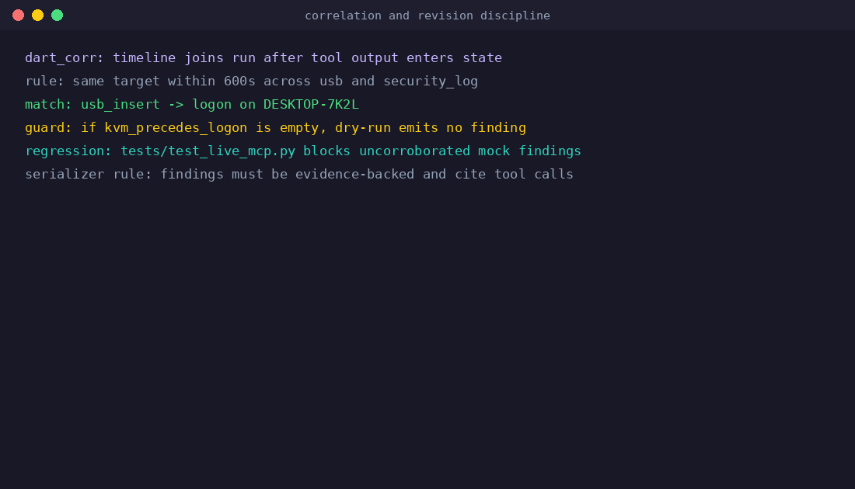
THE GRADED BEHAVIOUR
Self-correction — observable in the logs, not asserted
Two kinds, both in the logs
Hypothesis revision (live)
the agent raises explicit contradictions — after-hours logon vs daytime window, public-key SSH vs claimed password — and revises its chain instead of forcing the first theory. In another run it retracts a false 'attacker-created account' once the profile registry proves otherwise.
Parameter-adjusted re-run (reproducible)
in the committed reference run, analyze_usb_history is called with a default window, the gap is identified, then re-run with an explicit time window — a self-directed second pass judges can reproduce byte-for-byte.
AGENTIC-DART
10 / 13
Notes:
Self-correction is the tiebreaker criterion, and we show two kinds, both in the logs. Live hypothesis revision: the agent raises explicit contradictions — an after-hours logon against a daytime window, public-key SSH against a claimed password — and revises its chain; in another run it retracts a false attacker-created-account finding once the registry disproves it. And a deterministic, reproducible kind: in the committed reference run, the agent calls analyze_usb_history with a default window, sees the gap, and re-runs with an explicit time window — judges can reproduce it byte-for-byte. Not just getting it right; getting it wrong and fixing itself.

Slide 11
WHAT IT TOOK
The work behind the number
Accuracy didn't come from a prompt. It came from building the measurement, then chasing what it exposed.
1
2
3
4
Built the surface
Built the measurement
Went external
Let it reorder the work
73 typed read-only tools across native + SIFT layers, full pytest suite green on a fresh clone
recall / FPR / hallucination / evidence-integrity — reproducible from a single command
NIST CFReDS, Ali Hadi, Digital Corpora M57 — three independent authoring bodies, 10–20 yrs old
external data turned 'add registry parsing someday' into 'ship it next' — evidence over guesswork
AGENTIC-DART
11 / 13
Notes:
This is the effort slide — the honest story of what it took. The accuracy didn't come from a prompt. First we built the surface: 73 typed read-only tools, full suite green. Then we built the measurement itself — recall, false-positive rate, hallucination, evidence integrity, reproducible from one command. Then we went external — three independent corpora, decades old, that can't be training data. And critically, we let the external data reorder the roadmap: it turned 'add registry parsing someday' into 'ship it next.' Evidence over guesswork.

Slide 12
WHERE IT'S GOING
Phase 1 is architecturally complete and empirically validated
Phase 1 — Agentic DFIR
1
~95% complete
Typed read-only surface, audit chain, self-correcting loop, measured accuracy. This submission.
Phase 2 — Content-centric expansion
2
in planning
Broaden parsing (registry/journal/browser content) against community corpora; close the external gap.
Phase 3 — Supervised triage & response
3
design only
Human-in-the-loop triage, enrichment and response orchestration on the same audited foundation.
AGENTIC-DART
12 / 13
Notes:
The roadmap. Phase 1 — this submission — is architecturally complete and empirically validated: typed read-only surface, audit chain, self-correcting loop, measured accuracy. Phase 2 is content-centric expansion: broaden parsing against community corpora to close the external gap we just showed you honestly. Phase 3, design only, is supervised triage and response orchestration on the same audited foundation. Each phase builds on a guarantee that's already proven, not promised.

Slide 13
The honest claim isn't “we are perfect.”
It's that every number is measured, every finding is traceable, and the limits are not hidden.
Analysis speed is security.
github.com/Juwon1405/agentic-dart
Agentic-DART · SANS FIND EVIL! 2026 · thank you
Notes:
Close on the message that ties it all together: the honest claim isn't that we're perfect — it's that every number is measured, every finding is traceable, and the limits aren't hidden. That's what makes an autonomous DFIR agent trustworthy. Analysis speed is security. Thank you to SANS for the challenge.

