Slide 1
Fft - fast fourier transform with python
Christopher Pham - EE SJSU

Slide 2
Goals
Practical applications with FFT
Use Python to solve practical applications with FFT

Slide 3
References
But what is the Fourier Transform? A visual introduction.
https://www.youtube.com/watch?v=spUNpyF58BY
Demonstrations: Heart Sounds & Murmurs https://depts.washington.edu/physdx/heart/demo.html
Sample wav file comes from BBC fx sound - http://bbcsfx.acropolis.org.uk/
Computerized Heart Sounds Analysis https://www.intechopen.com/books/discrete-wavelet-transforms-biomedical-applications/computerized-heart-sounds-analysis
Fetal Heart Monitoring
https://www.hopkinsmedicine.org/health/treatment-tests-and-therapies/fetal-heart-monitoring#:~:text=Your%20healthcare%20provider%20may%20do,to%20conditions%20in%20your%20uterus.
Analyzing a Discrete Heart Rate Signal Using Python – Part 1
http://www.paulvangent.com/2016/03/15/analyzing-a-discrete-heart-rate-signal using-python-part-1/
Noise Removal For A Better Fast Fourier Transformation
https://medium.com/swlh/noise-removal-for-a-better-fast-fourier-transformation-284918d4250f
Convert .wav to .csv
https://sendeyo.com/onlineconverter/en/wav/text-csv
https://github.com/Lukious/wav-to-csv
Convert .csv to .wav https://gist.github.com/Pretz/1773870

Slide 4

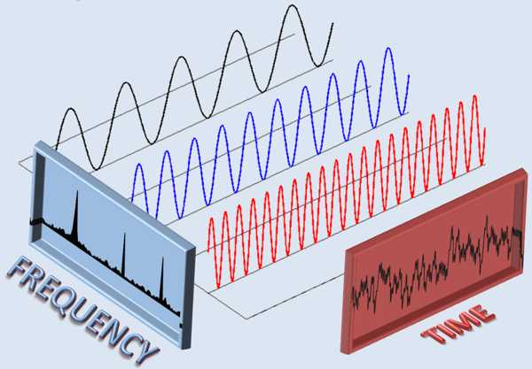

Let’s review FFT

Slide 5
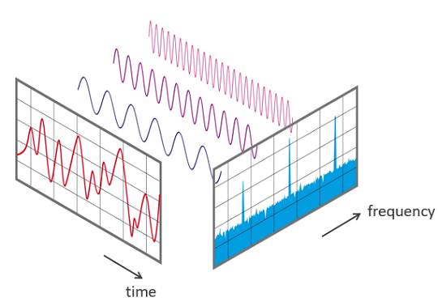
But what is the Fourier Transform? A visual introduction.
https://www.youtube.com/watch?v=spUNpyF58BY

Slide 6
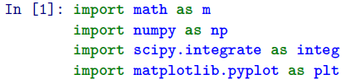
Import libraries

Slide 7
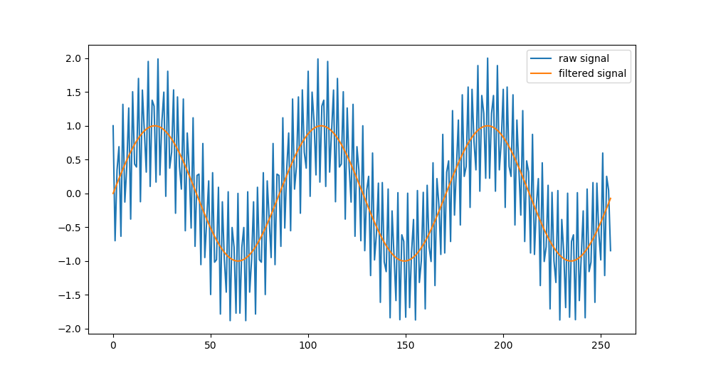
Remove a component of a signal
Example 1

Slide 8
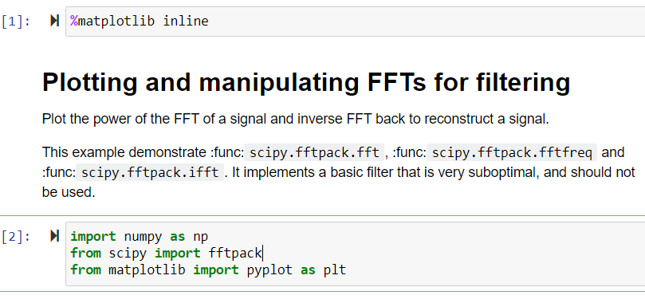
Removing a component of a signal using FFT
https://scipy-lectures.org/intro/scipy/auto_examples/plot_fftpack.html
Code:1_Filter_Frequency_of_a_SumOfSineWaves.ipynb

Slide 9
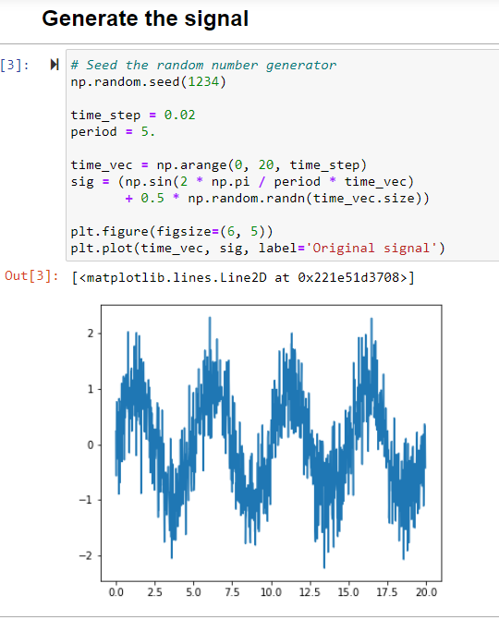

Slide 10
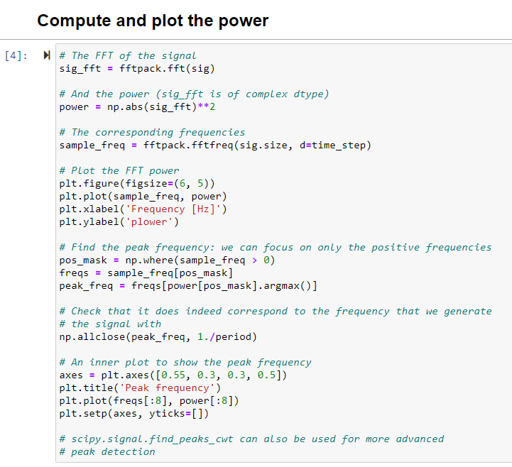
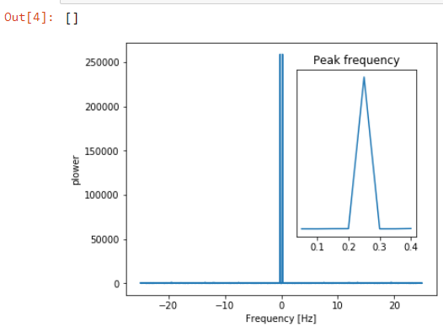

Slide 11
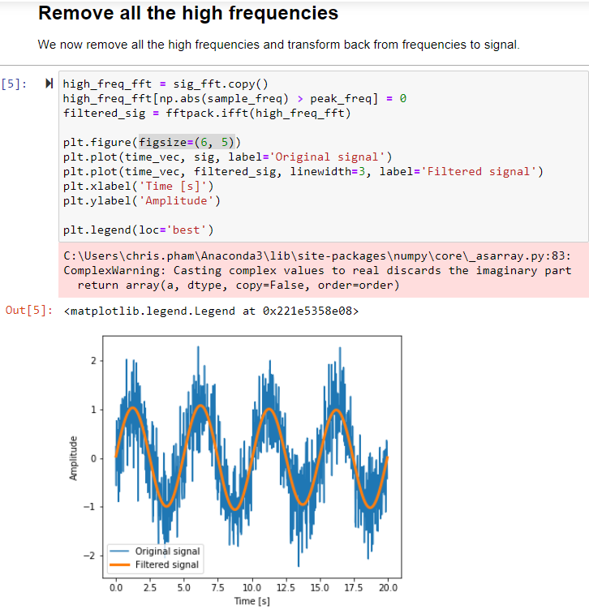
See next slide for how to remove the warnings

Slide 12
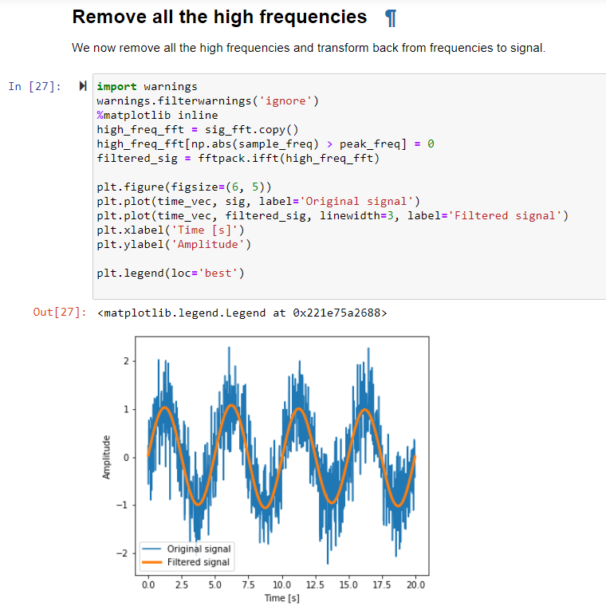
Remove warnings
Actually it is better to use SCIPY FILTER.
See next slides.

Slide 13
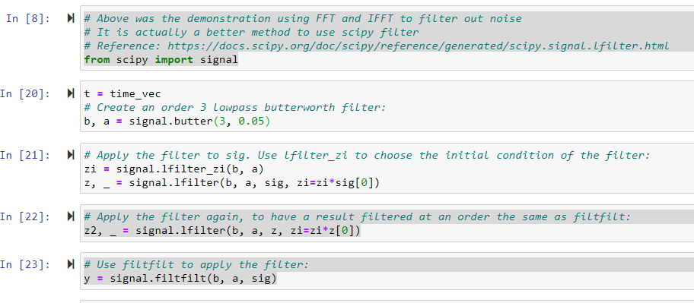
It’s better to use scipy filter

Slide 14
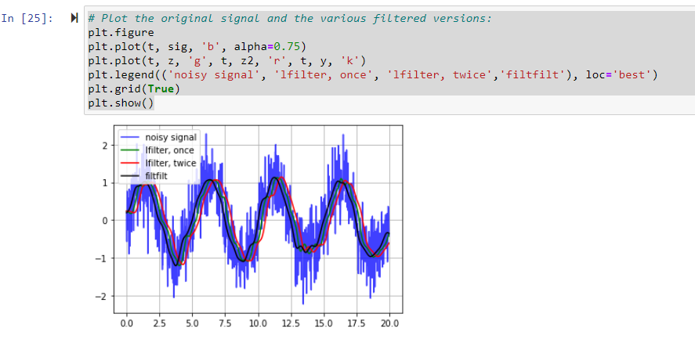

Slide 15
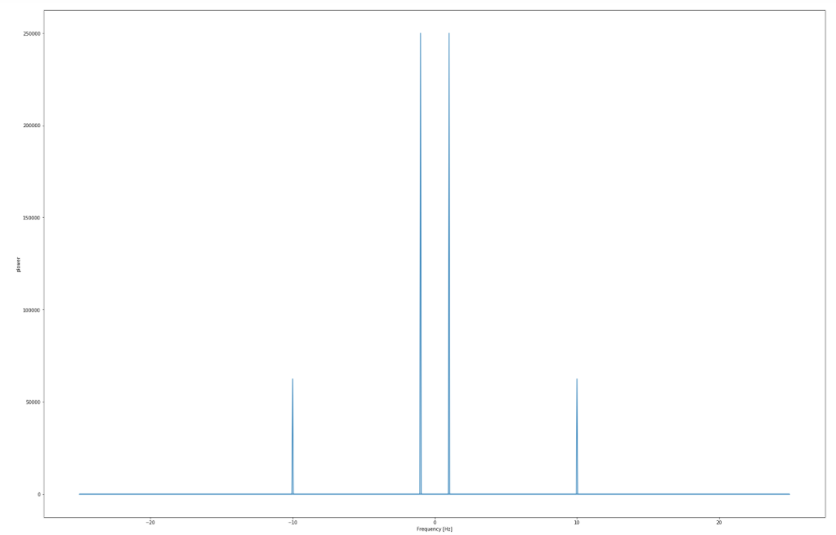
Remove a component of a signal
Example 2

Slide 16
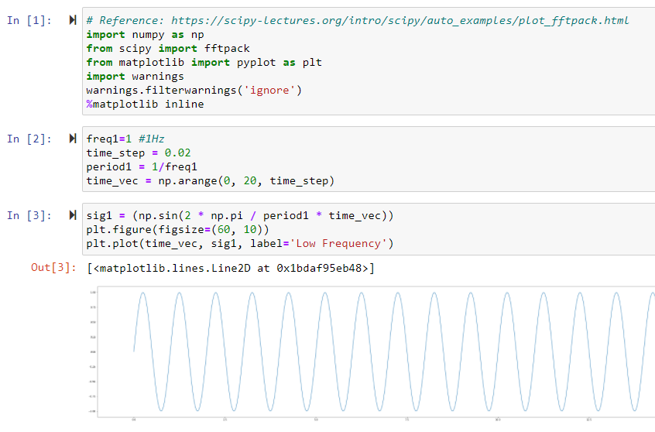
Let’s generate two sine waves and filter out one.
https://docs.scipy.org/doc/scipy/reference/tutorial/fft.html
https://gist.github.com/nipunbatra/0a3c6af8bfe08d3c0bb2a220b9c7a82a
Code: 1_RemoveOneSineWaveFromSumOfTwoSineWaves.ipynb

Slide 17
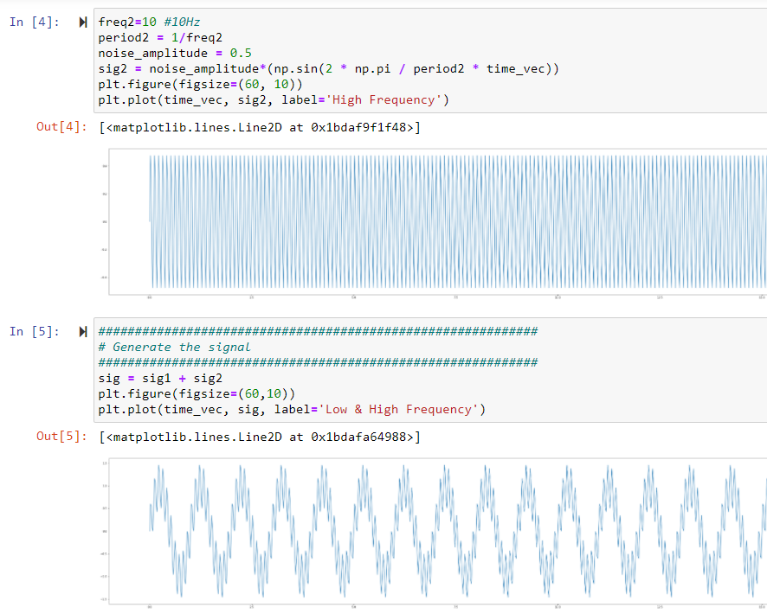

Slide 18
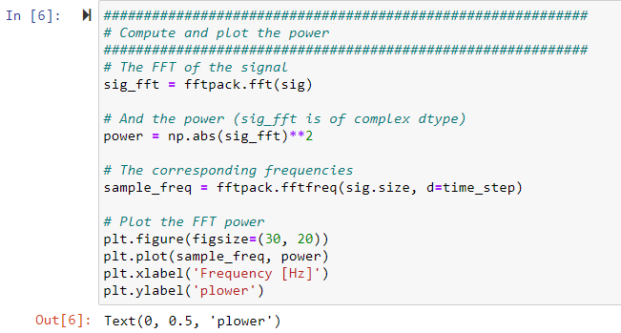
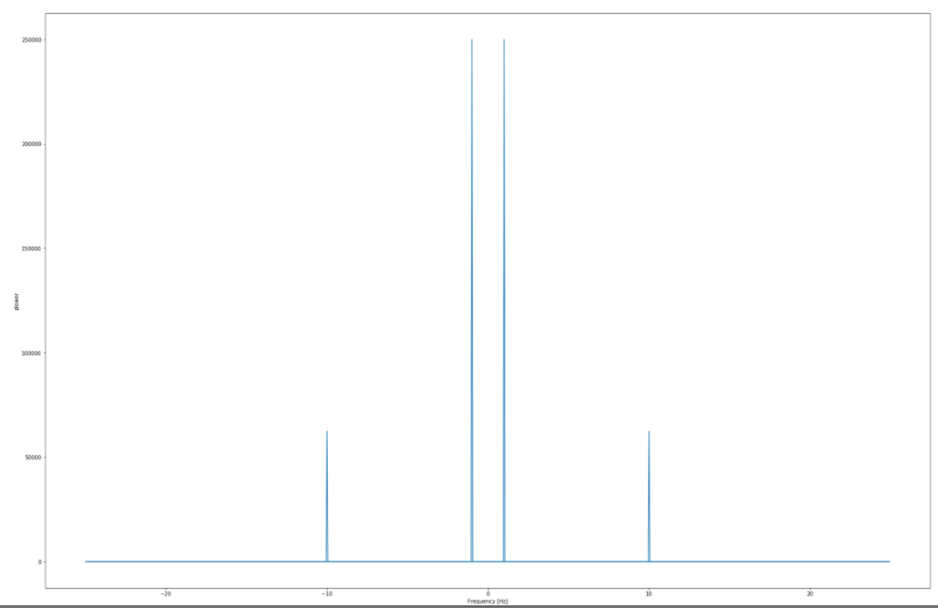

Slide 19
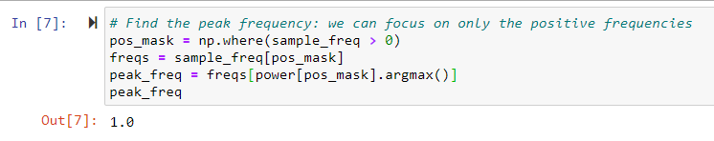

Slide 20
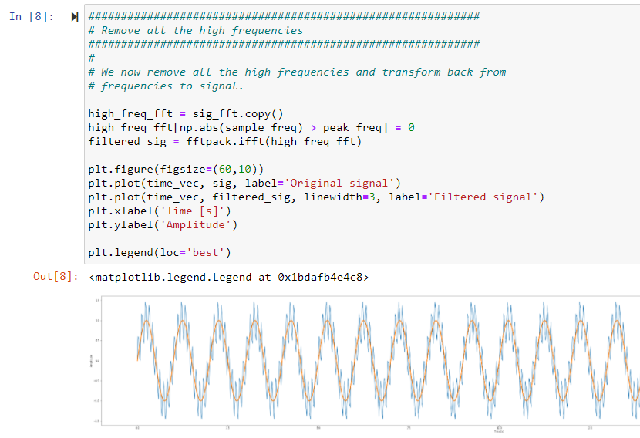

Slide 21
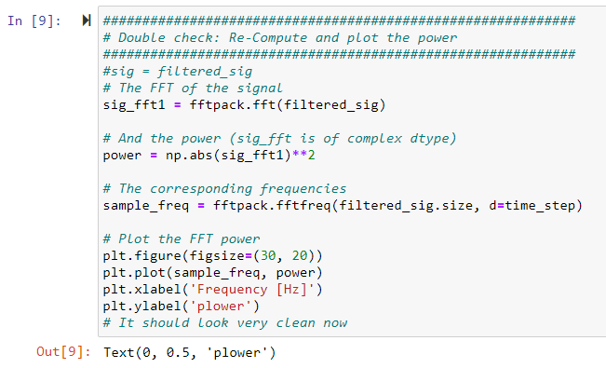
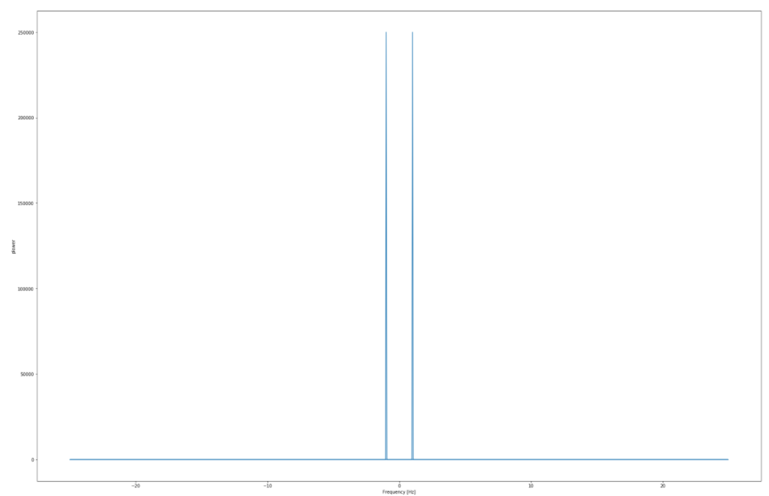
Filtered out!
Filtered out!

Slide 22
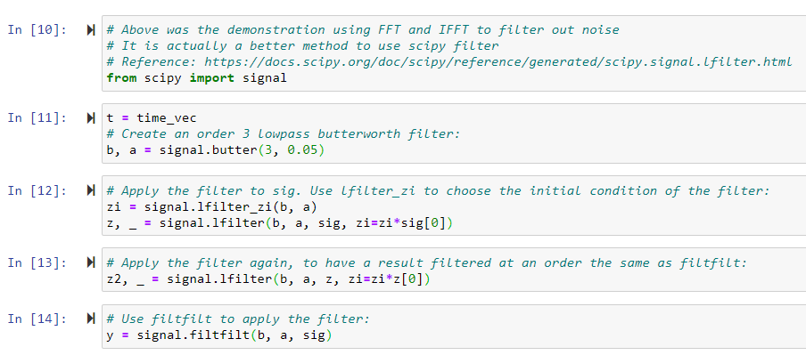
It’s better to use scipy filter

Slide 23
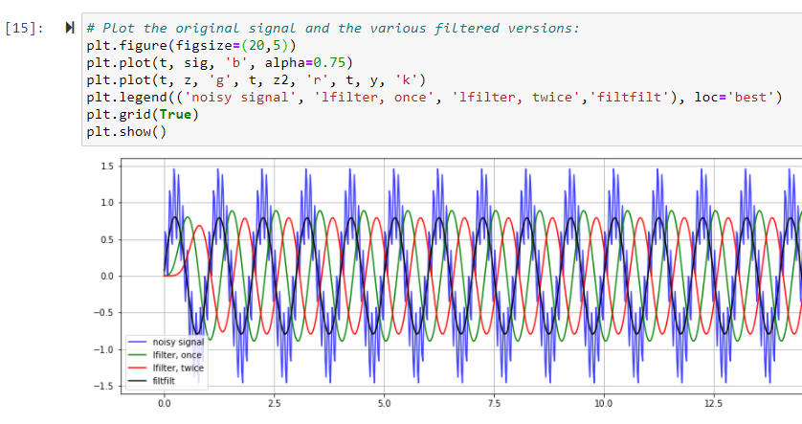

Slide 24
Practical engineering applications

Slide 25
Heart sound analyses
Demonstrations: Heart Sounds & Murmurs
https://depts.washington.edu/physdx/heart/demo.html
Computerized Heart Sounds Analysis https://www.intechopen.com/books/discrete-wavelet-transforms-biomedical-applications/computerized-heart-sounds-analysis
Analyzing a Discrete Heart Rate Signal Using Python – Part 1
http://www.paulvangent.com/2016/03/15/analyzing-a-discrete-heart-rate-signal-using-python-part-1/

Slide 26
Audio editing – removing high frequency noise

Slide 27
Utilities
Convert wav file to csv file https://sendeyo.com/onlineconverter/en/wav/text-csv
https://github.com/Lukious/wav-to-csv
Convert csv file to wav file
https://gist.github.com/Pretz/1773870

Slide 28
resources

Slide 29


