Slide 1
WALL-VR
Abel Henry-Lapassat

Slide 2

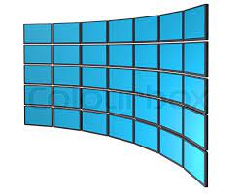

+

Slide 3



Motivations

Slide 4
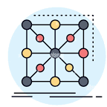
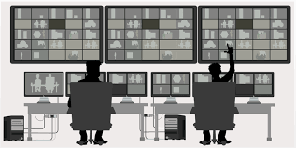


Slide 5
Wall Display (Photo)
VR headset (Image)
Cursors (Screenshots)
Dixits (Screenshots)

Slide 6
Used Tools
Unity (Icon)
New Input System
Photon Unity Networking (Icon)
OpenXR (Icon)

Slide 7
Functionning

Slide 8
Desktop

Slide 9
Virtual Reality

Slide 10
Wall

Slide 11
Thoughts & Questionnings

Slide 12
Improvements

Slide 13
Encountered Issues

