Slide 1

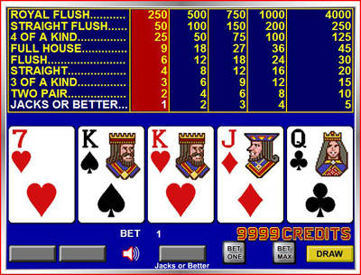
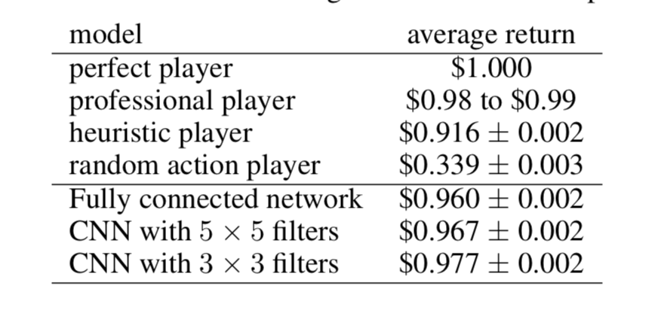
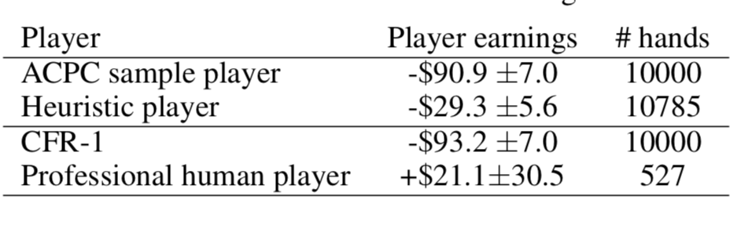
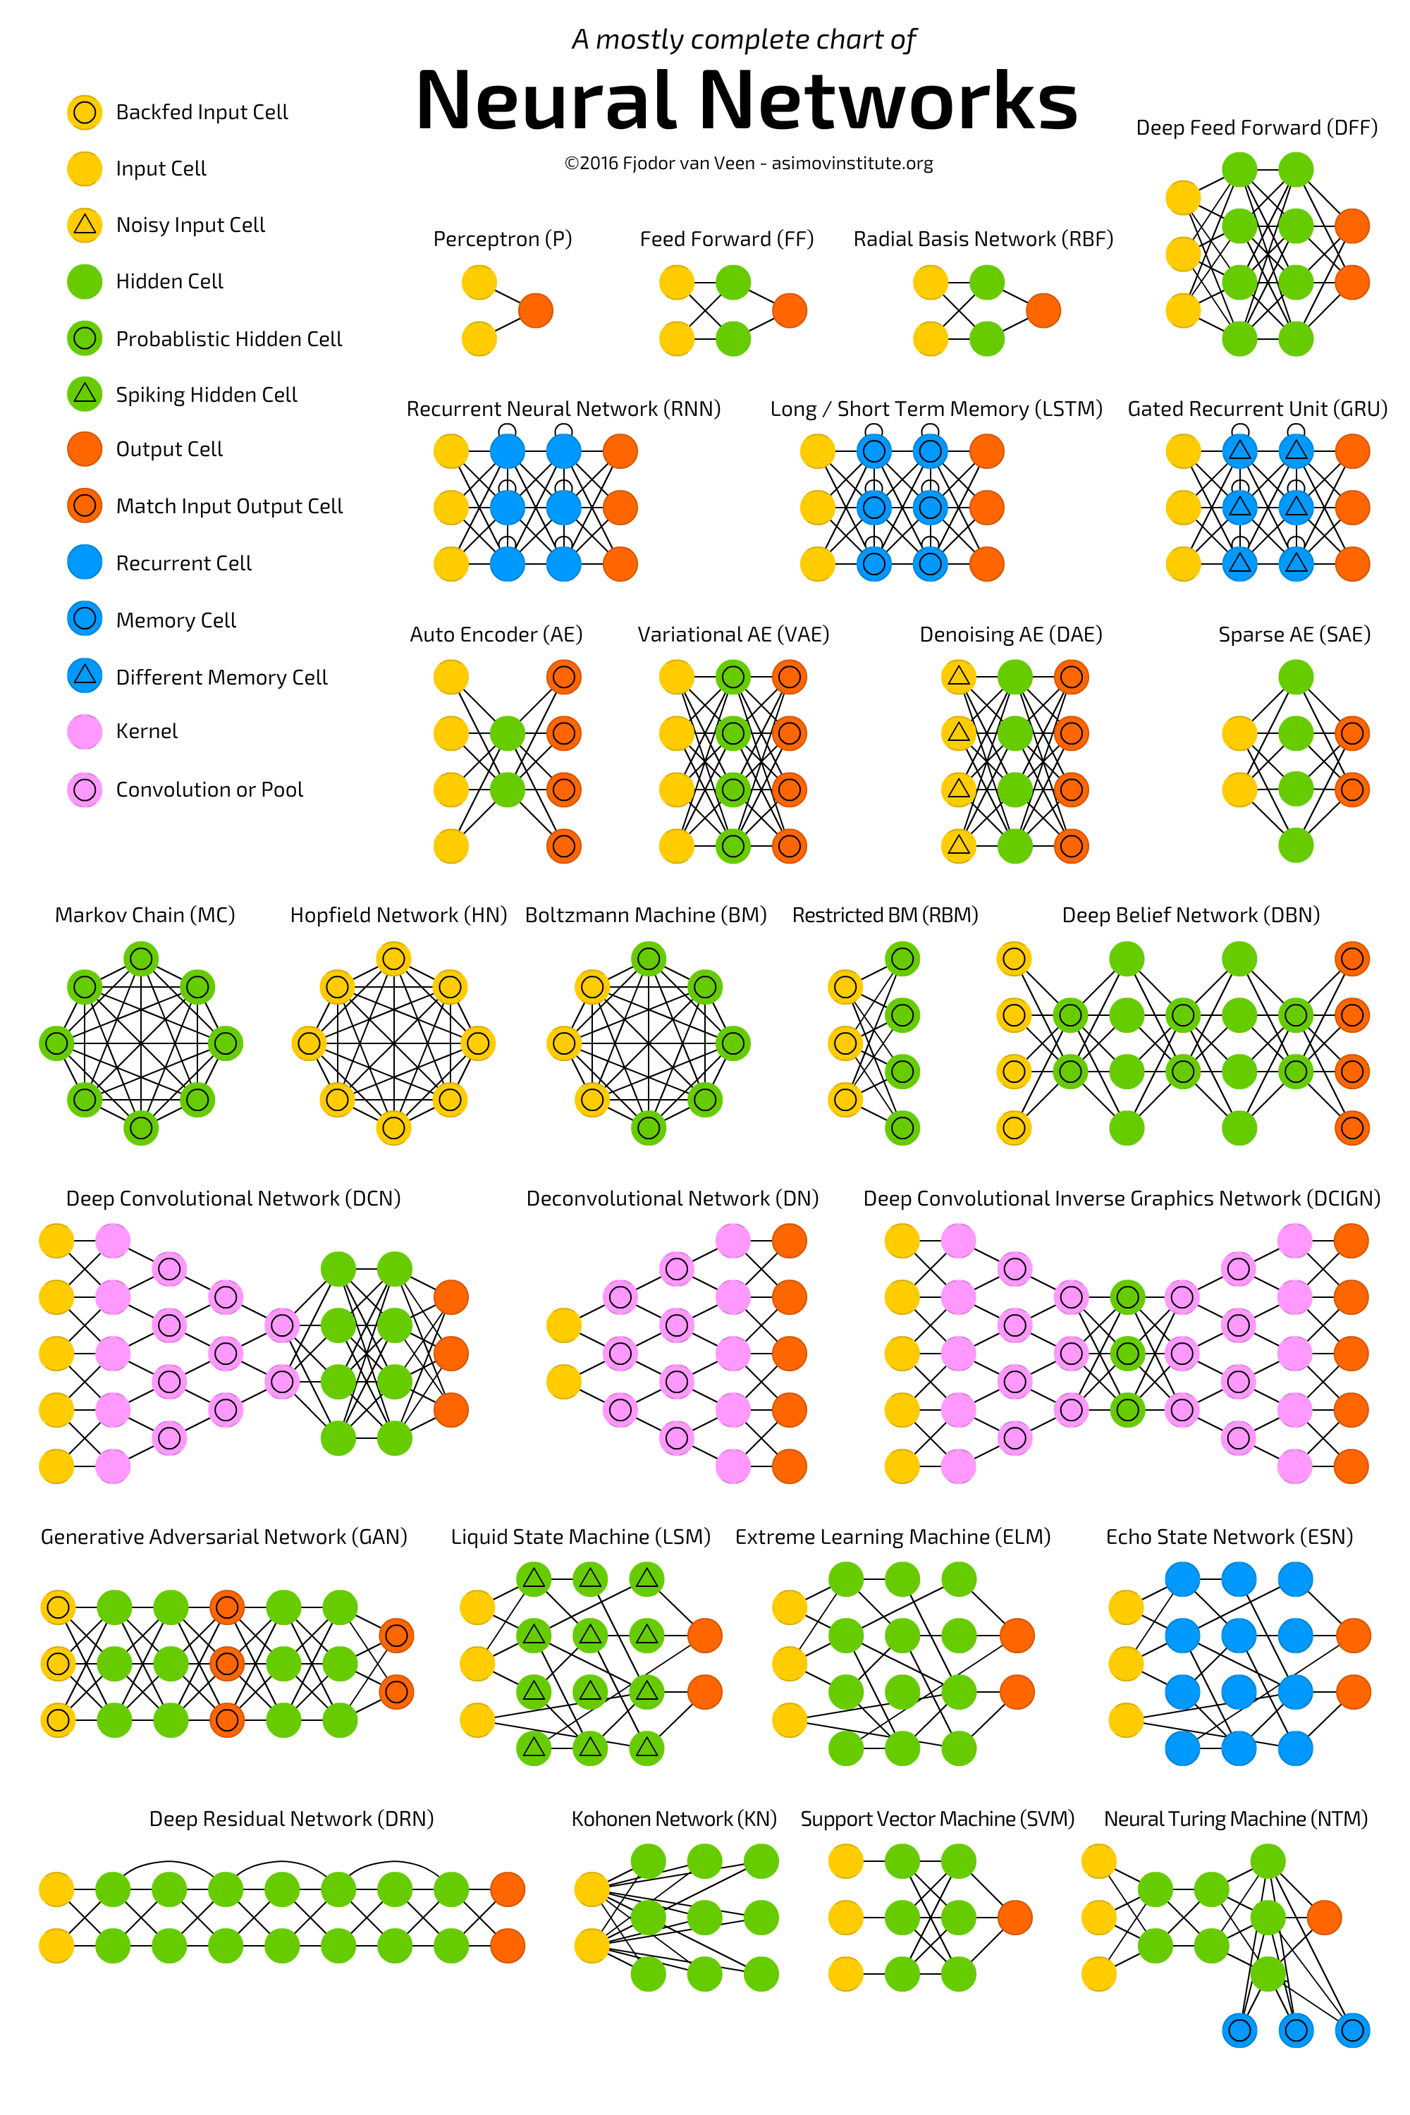
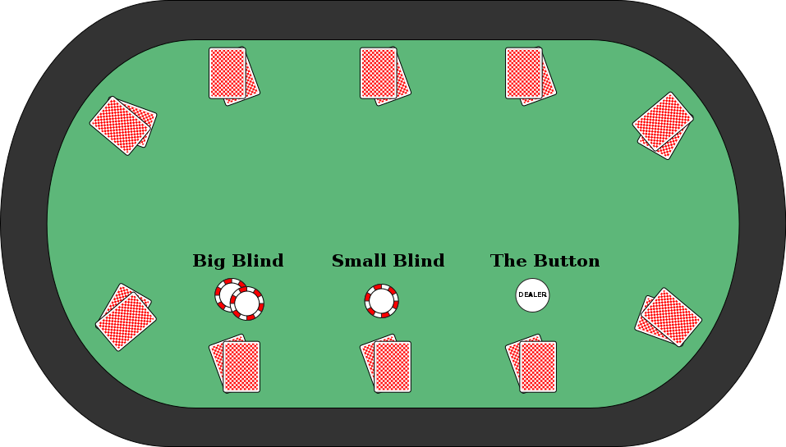
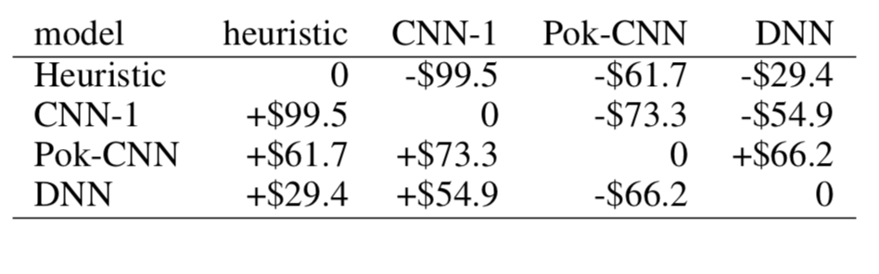

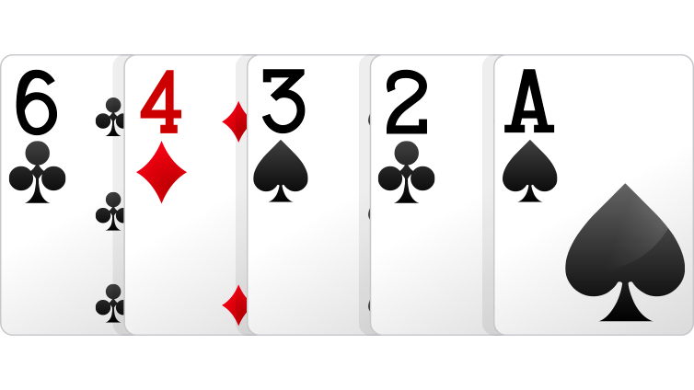
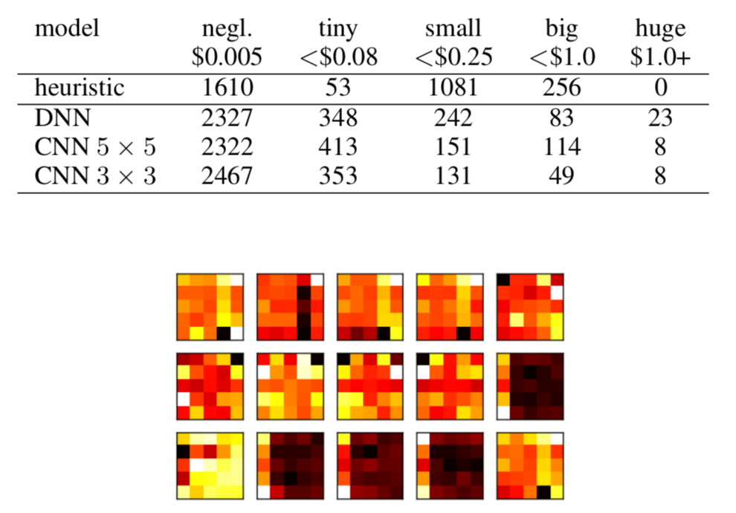
Convolutional Neural Networks for Pattern Matching in Poker-Type Games
James Vrionis
Introduction
Video Poker
Results
A novel representation for poker games, extend-able to different poker variations
A convolutional Neural Network (CNN) based learning model that can effectively learn the patterns in three different games.
A self-trained system that significantly beats the heuristic-based program on which it is trained, and our system is competitive against human expert players.
Single player video poker
Two-player Limit Texas Hold’em
Two-player 2-7 triple draw
Video Poker Results
Texas Hold’em Results
The objective of Video Poker is simple: match the best possible hand of five cards Given 32 possible choices, based on the players‚ final 5 cards where payout is calculated by a table of matches.
Convolutional Neural Network
Texas Hold’em (Heads-Up Limit)
2-7 Triple Draw (lowball)
Conclusion
For a heuristic trained agent, this really showed how a generalized self-learning model has room for improvement and could excel in all forms of this immensely large game state, given a Convolutional Neural Network. .
Both players have a fixed amount of money known as stack size at the start of each game. An ante is required to start every game and is considered the first round of Private and public cards are dealt and if the players make it through 3 more rounds a showdown will take place which is where both players end up showing each other their hands where there is only one winner.
2-7 Triple Draw (Lowball)
Neural Net Poker
Picture Reference websites
Multiple rounds of betting but in this game you can also choose to trash some number of your cards or keep them. Low card is high, in other words a low card straight would be the best hand
http://www.pokerstars.net/poker/games/,
http://www.asimovinstitute.org/neural-network-zoo/,
https://www.videopoker.com,
https://www.geek.com/news/ai-solves-texas-hold-em-poker-and-becomes-unbeatable-1613099/

Slide 2
Title of Poster in Calibri, Bold, 80-96 Points: Size Dependent on Length
Names of Authors in Calibri, 60 Points, Bold
Lab Logo
Institution Logo
Heading 1, Calibri, 54 points, bold
Text in Calibri, 40 points, Bold. Text in Calibri, 40 points, Bold. Text in Calibri, 40 points, Bold. Text in Calibri, 40 points, Bold. Text in Calibri, 40 points, Bold. Text in Calibri, 40 points, Bold. Text in Calibri, 40 points, Bold.
Key Image 3
Heading 4, Calibri, 54 points, bold
Text in Calibri, 40 points, Bold. Text in Calibri, 40 points, Bold. Text in Calibri, 40 points, Bold. Text in Calibri, 40 points, Bold. Text in Calibri, 40 points, Bold. Text in Calibri, 40 points, Bold. Text in Calibri, 40 points, Bold. Text in Calibri, 40 points, Bold.
Key Image 1
Key Image 5
Figure 3. Caption in Calibri, 36 points, bold.
Heading 3, Calibri, 54 points, bold
Text in Calibri, 40 points, Bold. Text in Calibri, 40 points, Bold. Text in Calibri, 40 points, Bold. Text in Calibri, 40 points, Bold. Text in Calibri, 40 points, Bold. Text in Calibri, 40 points, Bold. Text in Calibri, 40 points, Bold. Text in Calibri, 40 points, Bold. Text in Calibri, 40 points, Bold. Text in Calibri, 40 points, Bold.
Figure 1. Caption in Calibri, 36 points, bold.
Heading 2, Calibri, 54 points, bold
Text in Calibri, 40 points, Bold. Text in Calibri, 40 points, Bold. Text in Calibri, 40 points, Bold. Text in Calibri, 40 points, Bold. Text in Calibri, 40 points, Bold. Text in Calibri, 40 points, Bold. Text in Calibri, 40 points, Bold.
Figure 5. Caption in Calibri, 36 points, bold.
Heading 5, Calibri, 54 points, bold
Text in Calibri, 40 points, Bold. Text in Calibri, 40 points, Bold. Text in Calibri, 40 points, Bold. Text in Calibri, 40 points, Bold. Text in Calibri, 40 points, Bold.
Key Image 4
Key Image 2
Acknowledgments (Calibri, 40 points, bold)
Acknowledgments in Calibri, 32 points, bold--try to keep to one or two lines,
References (Calibri, 40 points, bold)
First reference in Calibri, 32 points, bold, with a reverse indent: alphabetical or numerical order.
Second reference in Calibri, 32 points, bold, with a reverse indent: alphabetical or numerical order.
Figure 2. Caption in Calibri, 36 points, bold.
Figure 4. Caption in Calibri, 36 points, bold.

Slide 3

Poster with Horizontal Layout: Title of Poster in Calibri, Bold, 60-80 Points
Sponsor Logo
Names of Authors in Calibri, 44 Points, Bold
Department in 40 points bold
Institution in 40 points bold
Institution Logo
Heading (Calibri: 44 Points, Bold)
The first section of the poster should define the topic and show its importance. A good test is whether the poster can orient the audience to these two aspects in 20 seconds. Shown in Figure 1 are two possible layouts for a poster. This section was set in Calibri, boldface, 36 points.
Heading (Calibri: 44 Points, Bold)
One section of a poster should present the results. Often the results can be depicted with graphs, such as for an experiment, or with drawings such as with a design.
Shown in Figure 3 are two more possible layouts for a poster. This section was set in Calibri, boldface, 36 points. Note that the amount of type in the sections affects the choice, size, and boldfacing of the typeface. No matter the type that you select for the sections, you should still use a bold sans serif for the headings.
Phrase Headline That Is Set in Initial Capital Letters
For posters that present one main result, a good design is to cast the title as a sentence that states the result
i
i
Phrase Headline That Is Set in Initial Capital Letters
For posters that present one main result, a good design is to cast the title as a sentence that states the result
i
Figure 1. Two possible layouts for poster (caption: 32 points, bold).
Heading (Calibri: 44 Points, Bold)
The second section of the poster might serve a number of purposes: background information, methods, or system design. An important point with posters is to rely on visuals rather than longs blocks of text to communicate. Figure 2 shows two more possible layouts for posters. This section was set in Calibri, boldface, 36 points.
Figure 3. Two more possible layouts for poster (caption: 32 points, bold).
Heading (Calibri 44 Points)
The final section of the poster generally provides conclusions and recommendations. This section was set in Calibri, boldface, 36 points. As with the first section, this section is read by most passers-by.
Phrase Headline That Is Set in Initial Capital Letters
For posters that present one main result, a good design is to cast the title as a sentence that states the result
Acknowledgments (Calibri, 36 points, bold)
In this template, acknowledgments are set in Calibri, 32 points. Try to keep the acknowledgments to one or two lines.
References (Calibri, 36 points, bold)
First reference in Calibri, 32 points, with reverse indent: alphabetical or numerical order.
Second reference in Calibri, 32 points, with reverse indent: alphabetical or numerical order.
Figure 2. Two other possible layouts for poster (caption: 32 points, bold).

Slide 4
Title of This Poster: Subtitle and so on
Name of Presenter
Affiliation
E-mail address
Conclusions
Summary
Acknowledgements

