Slide 1

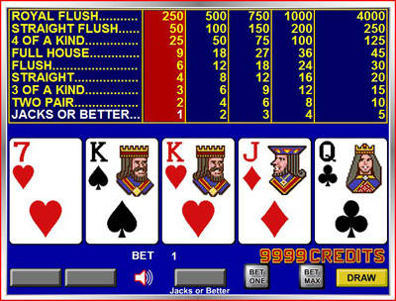
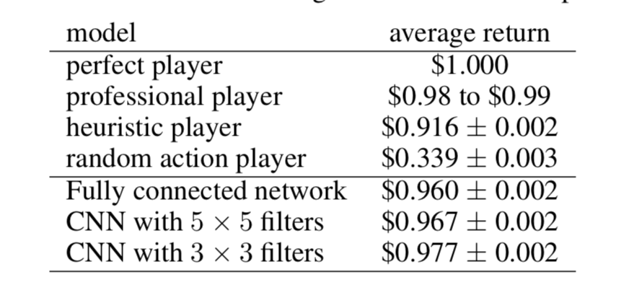
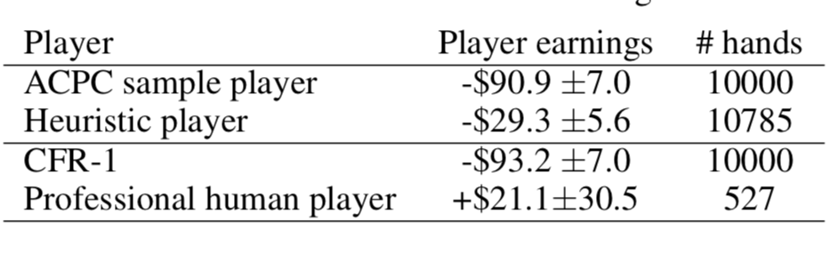
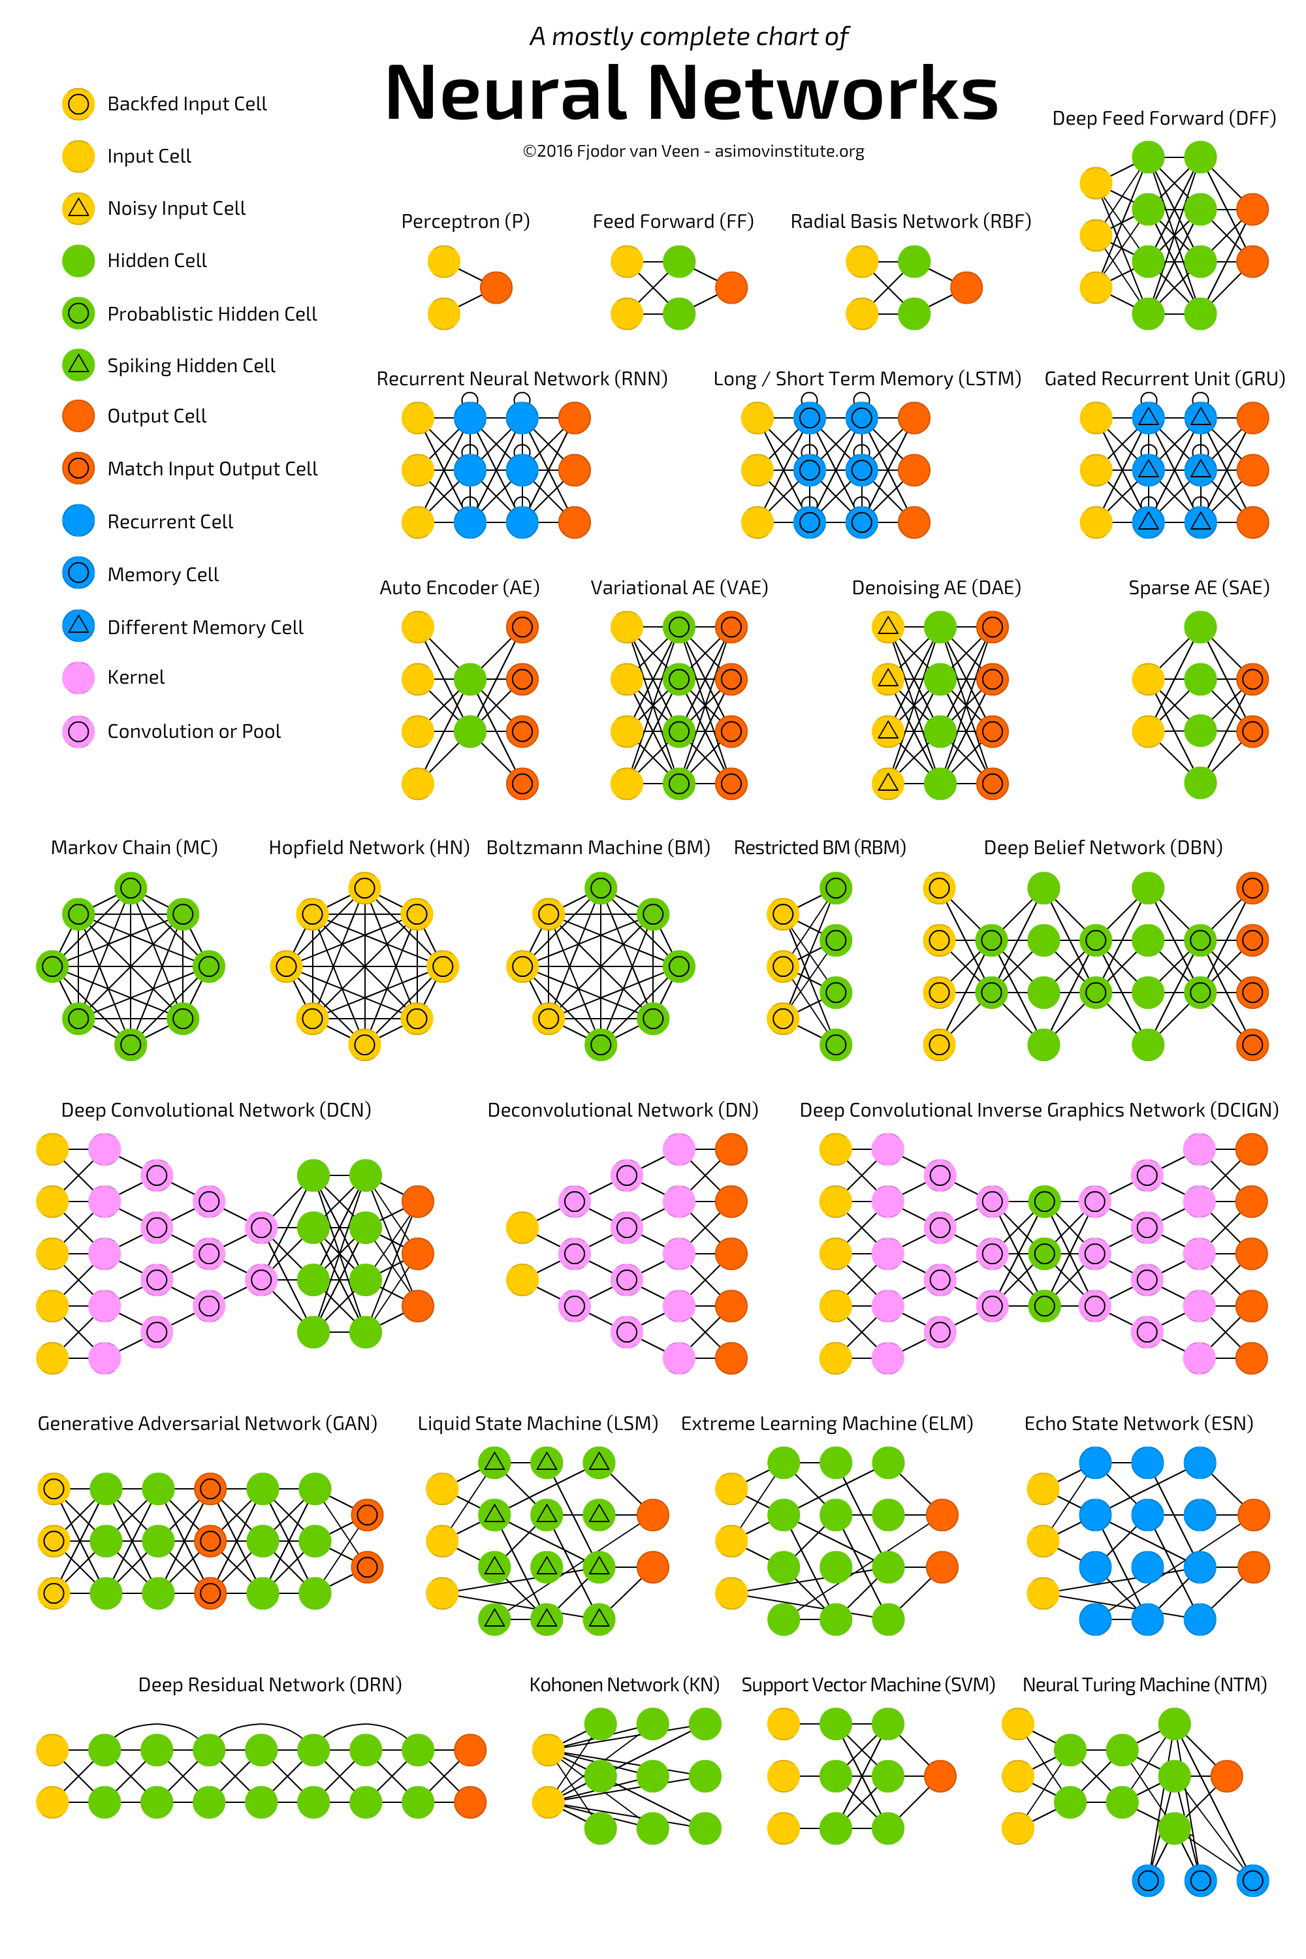
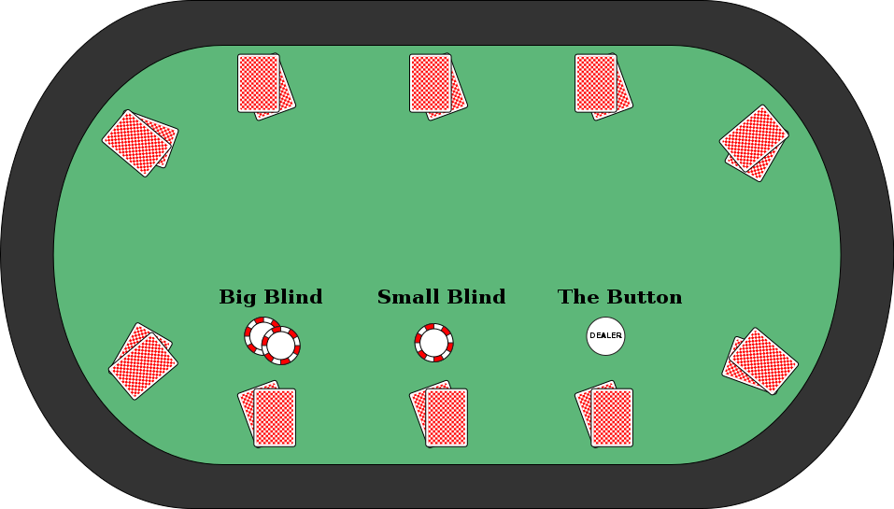
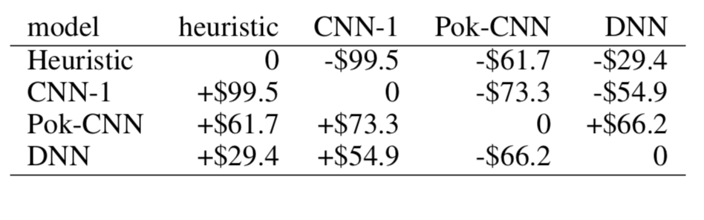

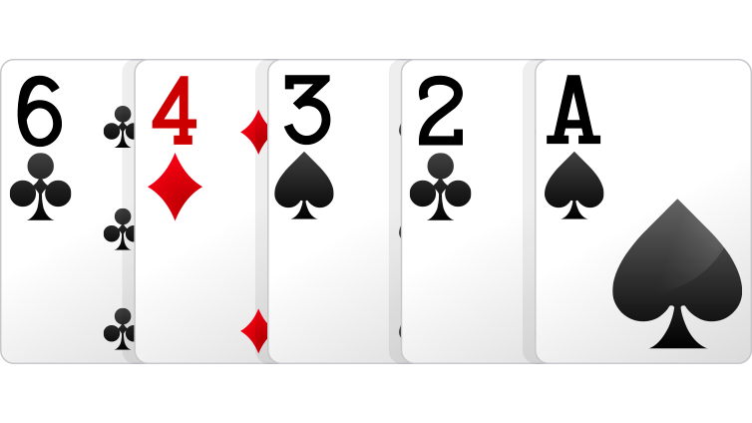
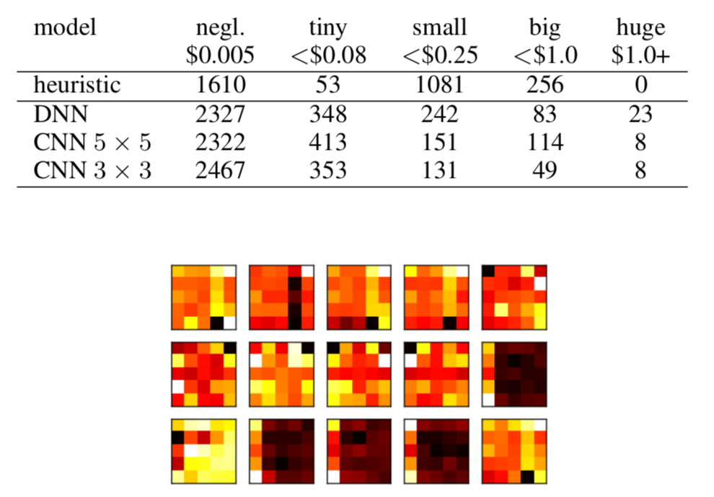
Convolutional Neural Networks for Pattern Matching in Poker-Type Games
James Vrionis
Introduction
Video Poker
Results
A novel representation for poker games, extend-able to different poker variations
A convolutional Neural Network (CNN) based learning model that can effectively learn the patterns in three different games.
A self-trained system that significantly beats the heuristic-based program on which it is trained, and our system is competitive against human expert players.
Single player video poker
Two-player Limit Texas Hold’em
Two-player 2-7 triple draw
Video Poker Results
Texas Hold’em Results
The objective of Video Poker is simple: match the best possible hand of five cards Given 32 possible choices, based on the players‚ final 5 cards where payout is calculated by a table of matches.
Convolutional Neural Network
Texas Hold’em (Heads-Up Limit)
2-7 Triple Draw (lowball)
Conclusion
For a heuristic trained agent, this really showed how a generalized self-learning model has room for improvement and could excel in all forms of this immensely large game state, given a Convolutional Neural Network. .
Both players have a fixed amount of money known as stack size at the start of each game. An ante is required to start every game and is considered the first round of Private and public cards are dealt and if the players make it through 3 more rounds a showdown will take place which is where both players end up showing each other their hands where there is only one winner.
2-7 Triple Draw (Lowball)
Neural Net Poker
Picture Reference websites
Multiple rounds of betting but in this game you can also choose to trash some number of your cards or keep them. Low card is high, in other words a low card straight would be the best hand
http://www.pokerstars.net/poker/games/,
http://www.asimovinstitute.org/neural-network-zoo/,
https://www.videopoker.com,
https://www.geek.com/news/ai-solves-texas-hold-em-poker-and-becomes-unbeatable-1613099/

