Slide 1
Employee burnout prediction using linear regression

Slide 2
Student Details
Name: Jakka vidya Sai sankar
Admission Number: AP22110011317
Email id: vidyasaisankar_jakka@srmap.edu.in
Degree: Btech
Year: 2nd Year
Branch: Computer Science Engineering
College/University: SRM University
Summer Internship: Intern under Edunet Foundation through SRM University

Slide 3
PROJECT TITLE/Problem Statement
Project Title:
Employee Burnout Prediction Using Linear Regression
Project Statement:
Now a days employees of the organization are feeling stressed and depressed because of the workload, deadlines and mental fatigue etc. Because of this reason they are unable to contribute their full pledged work to the organization and also leads to decrease in the growth of the organization

Slide 4
AGENDA
Project Title: Employee Burnout Prediction using linear regression
Data Cleaning
Data Preprocessing
Correlation techniques to know which features are best for predicting target variable
One-hot encoding
Linear Regression
Performance metrics

Slide 5

PROJECT OVERVIEW
Defining Employee Burnout
Employee burnout is a state of emotional, physical,
and mental exhaustion caused by prolonged or excessive
Stress. This condition can have detrimental effects on
Individual well-being and organizational productivity.
1)Emotional Exhaustion
Feeling emotionally drained, depicted and lacking
In energy.
2)Depression
Developing a cynical and detached attitude towards
work and colleagues.

Slide 6

3)Reduced Personal Accomplishment
Experiencing feelings of inadequacy and failure
in ones’ work.
4)Physical Symptoms
Burnout can manifest in physical symptoms
such as Headache , Fatigue and sleep disturbances.

Slide 7

WHO ARE THE END USERS of this project?
Human Resources Professionals.
Managers and Team Leaders.
Employees
Occupational Health Professionals.
Data Analysts.

Slide 8
YOUR SOLUTION AND ITS VALUE PROPOSITION
Our solution to the problem statement is to develop a model capable of predicting the burnout rate of employees using machine learning and linear regression techniques.
We have built our model using various Python libraries, including NumPy, pandas, matplotlib, seaborn, and sci-kit-learn. NumPy is utilized to create multi-dimensional arrays and perform operations on them. Pandas are employed for manipulating data within data frames. Matplotlib is used for plotting data, while Seaborn enhances the visualization of data in data frames. Scikit-learn is crucial for data preprocessing and model development.

Slide 9
How did you customize the project and make it your own
In this project, I customized several parts to make it fit my goals. I focused on dealing with outliers and tried different scaling methods to boost how well the linear regression model worked. Using both MinMaxScaler and StandardScaler helped me see big changes in how the model performed. I looked at things like Mean Squared Error (MSE), Root Mean Squared Error (RMSE), Mean Absolute Error (MAE), and R-squared (R²) values. I also changed the correlation analysis to get a better grip on how variables relate to each other. This meant adding and studying outliers in the data. It let me check how tough the model was and how it reacted to weird data points. These tweaks helped me fine-tune the linear regression model, which led to more accurate and trustworthy predictions.

Slide 10
MODELLING
First, we load the dataset into the IDE and create a data frame using pandas. We address null values and conduct data cleaning and preprocessing. Categorical values are converted into numerical values. We select the best features for predicting the target variable through correlation analysis. The model is developed by splitting the data into training and testing sets. Finally, we apply linear regression to predict the target variable and evaluate the model using performance metrics such as RMSE and MSE.

Slide 11
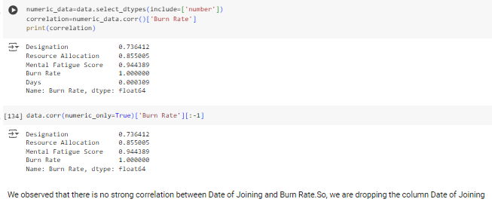
Results
Using correlation analysis to select the best features from the data frame for predicting the target variable (Burn Rate).

Slide 12
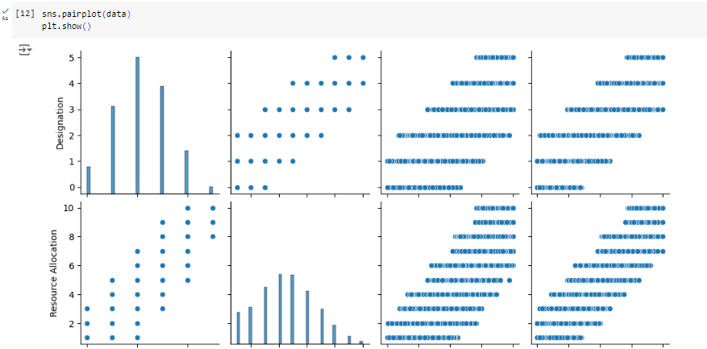
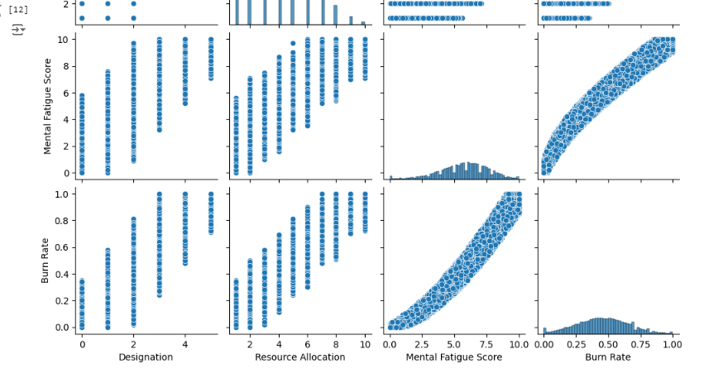

Slide 13
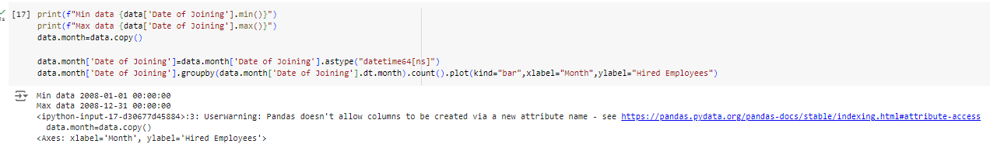
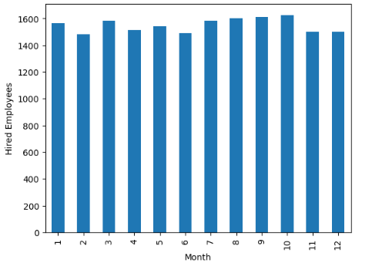
The bar graph displays the count of employees hired each month. The x-axis represents the months of the year, while the y-axis shows the number of employees hired. This visualization helps identify the hiring trends across different months, highlighting the periods with higher or lower recruitment activity.

Slide 14
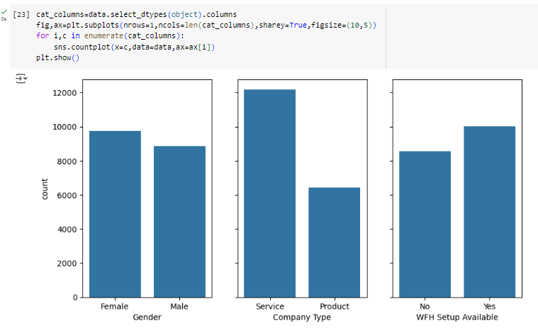
The count plots show the distribution of categorical variables in the dataset. Each subplot represents a different categorical column, illustrating the frequency of each category, allowing for easy comparison across variables.

Slide 15
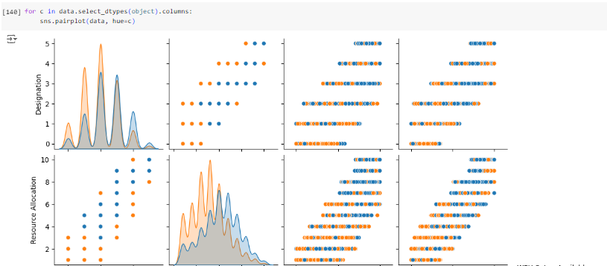
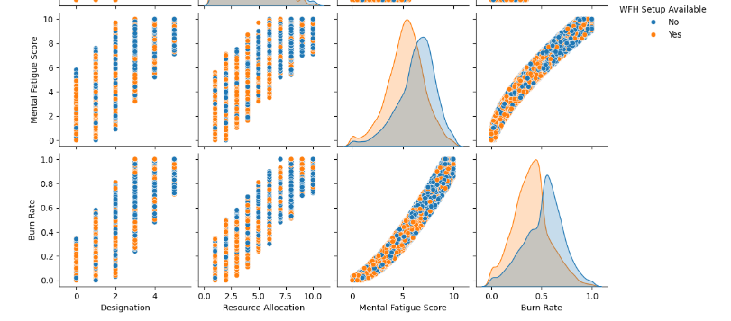

Slide 16

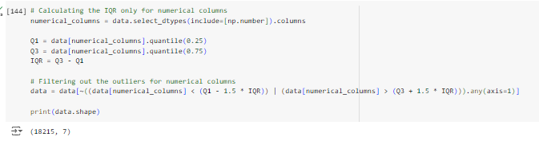
Initial Dataset
Final Dataset after outlier

Slide 17
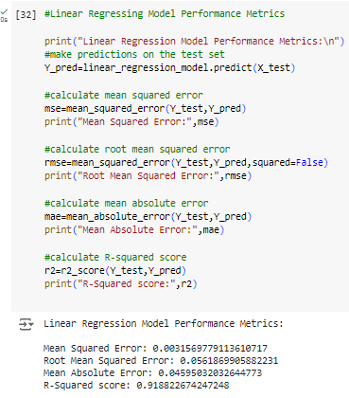
Linear regression:
As over here we can see the performance of the linear regression model is evaluated on the test set using standard scalar(gives all positive and negative values)

Slide 18
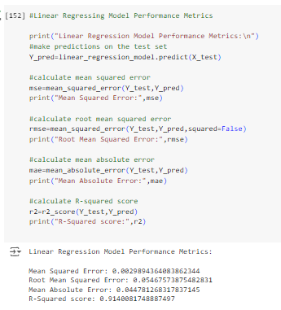
Linear regression:
As over here we can see the performance of the linear regression model is evaluated on the test set using minmax scalar(gives only values between 0 to 1 only positive)

Slide 19
Conclusion:
The effective prediction of employee burnout rates by linear regression model is done through the use of selected key features via correlation analysis. The effectiveness and dependability of the model are shown by performance metrics. This method can give organizations useful insights that can help them take preventive actions to reduce or eliminate job burnout among their employees.

Slide 20
links
https://github.com/Jvssankar/Employee_burnout_prediction

