Slide 1
Employee burnout prediction using linear regression

Slide 2

Student Details
Name: Jakka vidya Sai sankar
Admission Number: AP22110011317
Email id: vidyasai.vimal@gmail.com
Degree: Btech
Year: 2nd Year
Branch: Computer Science Engineering
College/University: SRM University
Summer Internship: Intern under Edunet Foundation through SRM University
Domain: Artificial intelligence and machine learning(01-06-2024 to 25-07-2024)

Slide 3
PROJECT TITLE/Problem Statement
Project Title:
Employee Burnout Prediction Using Linear Regression
Project Statement:
Now a days employees of the organization are feeling stressed and depressed because of the workload, deadlines and mental fatigue etc. Because of this reason they are unable to contribute their full pledged work to the organization and also leads to decrease in the growth of the organization

Slide 4
AGENDA
Project Title: Employee Burnout Prediction using linear regression
Data Cleaning
Data Preprocessing
Correlation techniques to know which features are best for predicting target variable
One-hot encoding
Linear Regression
Performance metrics

Slide 5
PROJECT OVERVIEW
Purpose
The purpose of this project is to develop a predictive model that can accurately forecast employee burnout levels based on various work-related and personal factors. By leveraging linear regression techniques, the project aims to identify key indicators of burnout, enabling organizations to proactively address and mitigate burnout, thereby improving employee well-being, productivity, and retention rates.
Scope
The project involves collecting data from employee surveys and HR records, focusing on key features such as job role, resource allocation, and mental fatigue scores. The data will be cleaned and preprocessed to handle missing values and normalized for consistency. A linear regression model will be developed and evaluated using metrics like Mean Absolute Error (MAE) and R-squared to ensure accuracy.

Slide 6

Objectives
The main objectives are to integrate relevant data sources and develop a highly accurate linear regression model for predicting employee burnout. The project aims to identify significant predictors of burnout, such as job role and mental fatigue, and enable early detection of potential burnout cases. This will facilitate timely and effective interventions, provide actionable insights for organizational improvements, and support strategies to enhance overall employee well-being and productivity.

Slide 7

WHO ARE THE END USERS of this project?
Human Resources Professionals.
Managers and Team Leaders.
Employees
Occupational Health Professionals.
Data Analysts.

Slide 8
YOUR SOLUTION AND ITS VALUE PROPOSITION
Our solution to the problem statement is to develop a model capable of predicting the burnout rate of employees using machine learning and linear regression techniques.
We have built our model using various Python libraries, including NumPy, pandas, matplotlib, seaborn, and sci-kit-learn. NumPy is utilized to create multi-dimensional arrays and perform operations on them. Pandas are employed for manipulating data within data frames. Matplotlib is used for plotting data, while Seaborn enhances the visualization of data in data frames. Scikit-learn is crucial for data preprocessing and model development.

Slide 9
Value Proposition Points
Early Detection: Predict employee burnout early, enabling timely interventions.
Data-Driven Insights: Provide precise insights into employee well-being using advanced machine learning techniques.
Enhanced Productivity: Improve employee satisfaction and productivity by addressing burnout proactively.
Reduced Turnover: Lower employee turnover rates through effective burnout management.

Slide 10
How did you customize the project and make it your own
In this project, I customized several parts to make it fit my goals. I focused on dealing with outliers and tried different scaling methods to boost how well the linear regression model worked. Using both MinMaxScaler and StandardScaler helped me see big changes in how the model performed. I looked at things like Mean Squared Error (MSE), Root Mean Squared Error (RMSE), Mean Absolute Error (MAE), and R-squared (R²) values. I also changed the correlation analysis to get a better grip on how variables relate to each other. This meant adding and studying outliers in the data. It let me check how tough the model was and how it reacted to weird data points. These tweaks helped me fine-tune the linear regression model, which led to more accurate and trustworthy predictions.

Slide 11
MODELLING
First, we load the dataset into the IDE and create a data frame using pandas. We address null values and conduct data cleaning and preprocessing. We select the best features for predicting the target variable through correlation analysis. Categorical values are converted into numerical values. The model is developed by splitting the data into training and testing sets. Finally, we apply linear regression to predict the target variable and evaluate the model using performance metrics such as RMSE and MSE.

Slide 12
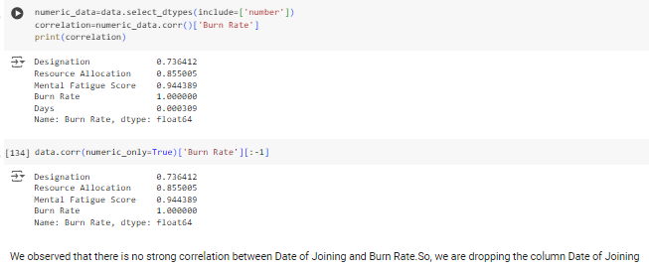
Results
Using correlation analysis to select the best features from the data frame for predicting the target variable (Burn Rate).

Slide 13
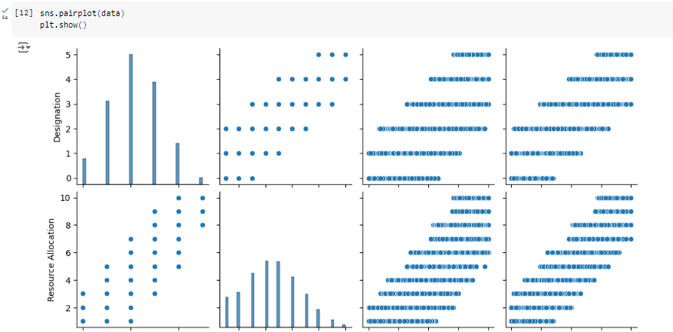
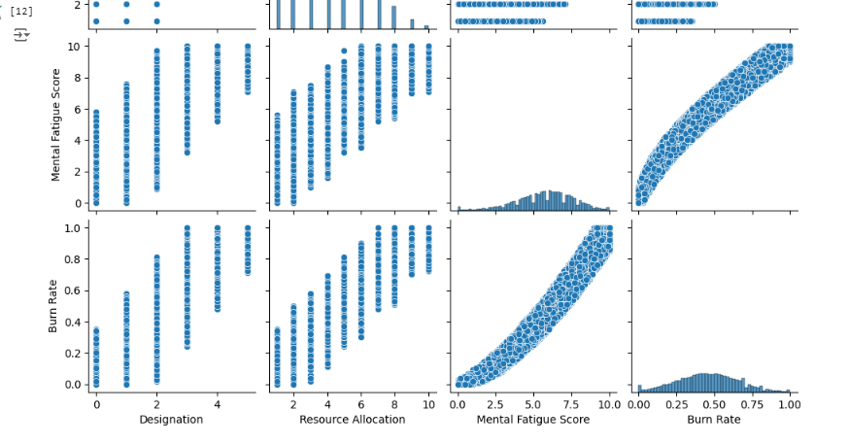

Slide 14
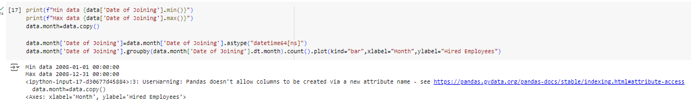
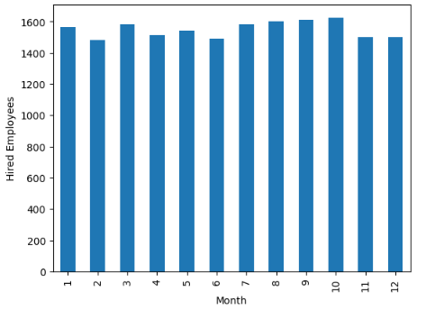
The bar graph displays the count of employees hired each month. The x-axis represents the months of the year, while the y-axis shows the number of employees hired. This visualization helps identify the hiring trends across different months, highlighting the periods with higher or lower recruitment activity.

Slide 15
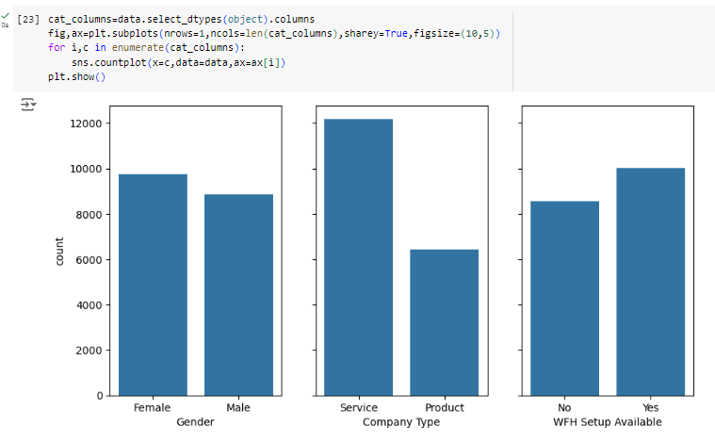
The count plots show the distribution of categorical variables in the dataset. Each subplot represents a different categorical column, illustrating the frequency of each category, allowing for easy comparison across variables.

Slide 16
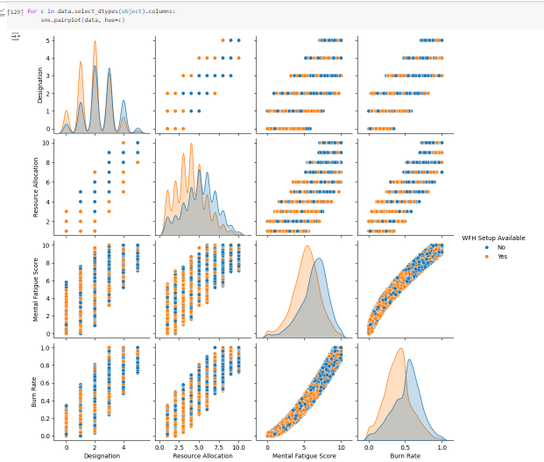
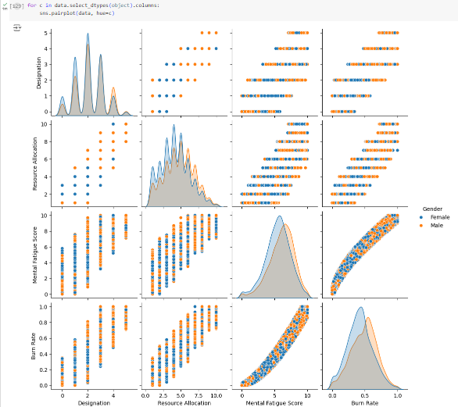

Slide 17
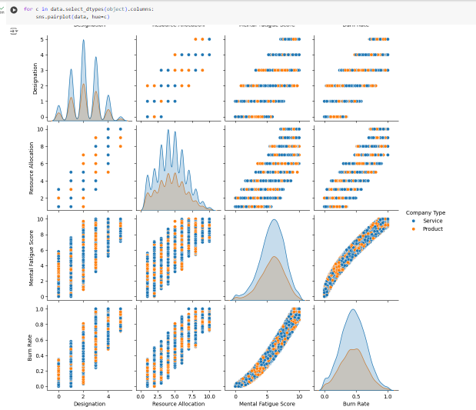
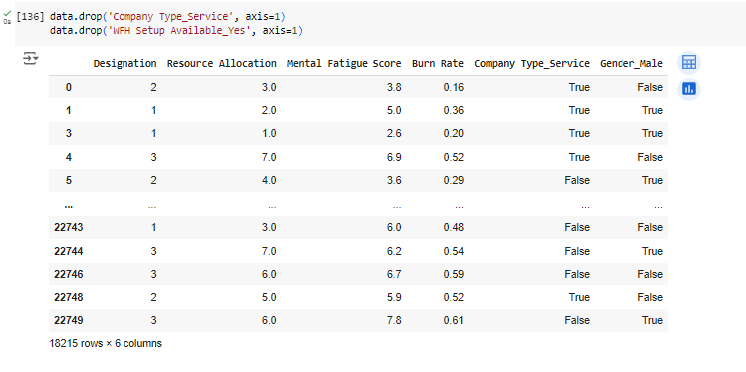

Slide 18

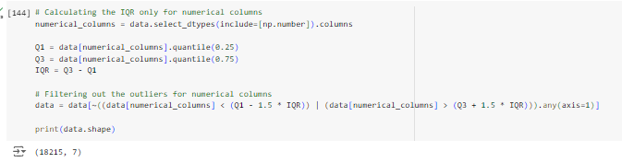
Initial Dataset
Final Dataset after outlier

Slide 19
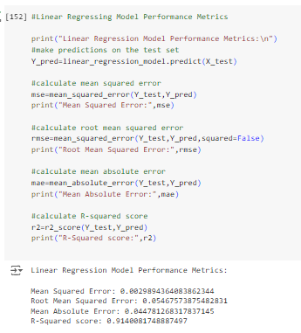
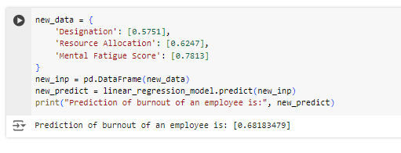
Linear regression model performance metrics:

Slide 20
Conclusion:
The effective prediction of employee burnout rates by linear regression model is done through the use of selected key features via correlation analysis. The effectiveness and dependability of the model are shown by performance metrics. This method can give organizations useful insights that can help them take preventive actions to reduce or eliminate job burnout among their employees.

Slide 21
links
https://github.com/Jvssankar/Employee_burnout_prediction
https://www.kaggle.com/datasets/blurredmachine/are-your-employees-burning-out?select=train.csv

