Slide 1

Bootcamp Final Project
Loan Prediction
Team #6
Michael Okoro
Ravish Sikha
Jeremy Wagerik

Slide 2

Topic and Description of Data
This project will be focused on identifying/predicting whether a participant might default on their loan. The goal of using this topic is to create a Supervised Machine Learning model trained on the loan status of the applicant data. Then we can use that model to predict whether a future applicant should be approved based on their specific input features.
The data used is from Lending Club for all loans issued in 2017, including the current loan status (Current, Late, Fully Paid, etc.) and latest payment information. The initial CSV file contained 122 columns and 96,779 rows. This included loan information for applicants in 49 states and had columns containing the type of loan as well as if it were a Joint or Individual account. The dataset also had features such as Debt to Income Ratio, number of other credit accounts the applicant had, any delinquency records, employment status, annual income and much more.
As many individuals and families struggle with financial decisions, we chose Loan Prediction as our topic so we can have a better understanding of the loan approval process. We wanted to explore what factors are most important when deciding to grant a loan and if there are any similar characteristics of applicants who default.

Slide 3

Project Questions
What are the main factors to consider when approving a loan? Do Joint Applicants have an easier time getting approved for loans than Individual applicants? Are they more likely to stay current? How does the credit grade affect the interest rate? What’s the most common type of loan taken? What type of loan has is the most risky? What is the correlation between Debt to Income Ratio(DTI) and Annual Income?

Slide 4




Technologies Used
Python Supervised Machine Learning - Logistical Regression(Oversampling), Decision Trees, Random Forest Classification SQL AWS – S3 bucket Tableau

Slide 5
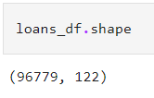
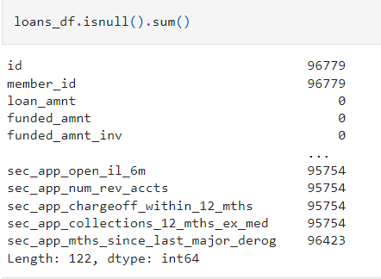
Data Exploration
During the initial data exploration, the following was discovered: The dataset shape was The id and member_id columns did not contain any values. 112 columns had mixed data types. Approximately 20 columns had excessive null values. There were many columns that contained repetitive or unnecessary information. Some column names needed to be changed to more easily represented the data they contained.

Slide 6
Data Cleaning
Actions taken during data cleaning process: The id column was dropped, and values were given to the member_id column with data type “int64”. Drop 20 columns that were not necessary to our story or model or were repetitive. Removed string value “months” from term column leaving only the integer value. Employee title and Employment Length columns had null values filled in with the word “None”. Joint Verification status column had null values filled in with “Not Applicable” for individual applications. Multiple columns with null values showing how many of a particular record the applicant had were filled in with a “0”. Example – Number of Charge-offs, if applicant did not have any, the cell was empty. In these cases, putting a zero would allow us to keep that column as a factor without skewing the result. There were 31 column names changed to be more descriptive of their values.

Slide 7
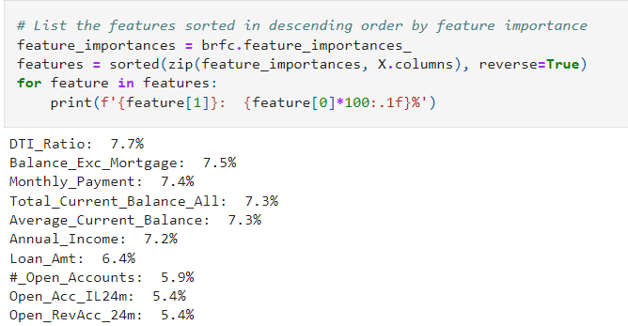
Important Factors
What are the main factors to consider when approving a loan?
The results showed that Debt to Income Ratio was the most important factor in the machine learning model at 7.7%.
The applicants Total Open Balance excluding their mortgage account was 2nd at 7.5%.
Monthly Payment was 7.4%
3 of the Top 5 Factors had to do with the applicants open balance information.
3 of the Top 10 referred to the number of open accounts the applicant had.

Slide 8
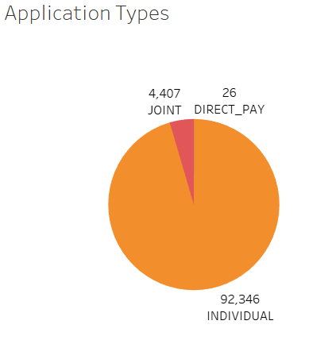
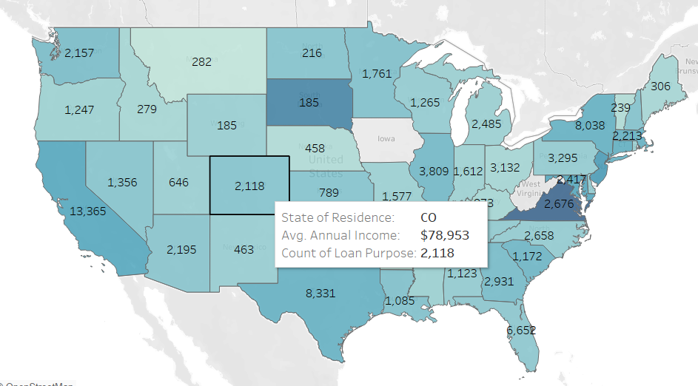
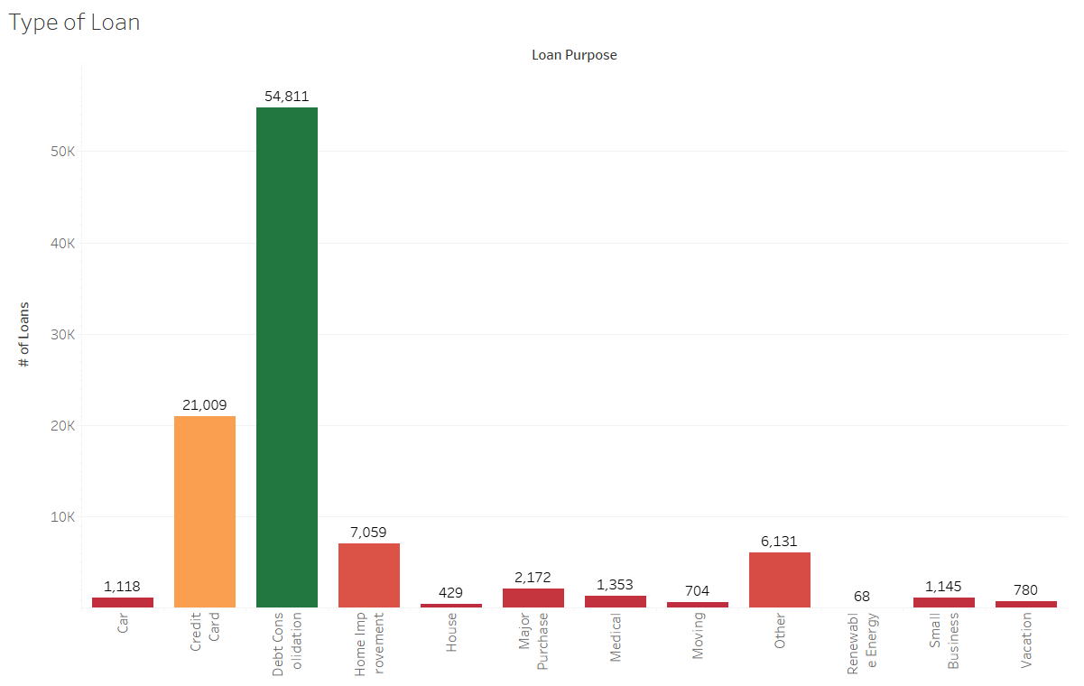
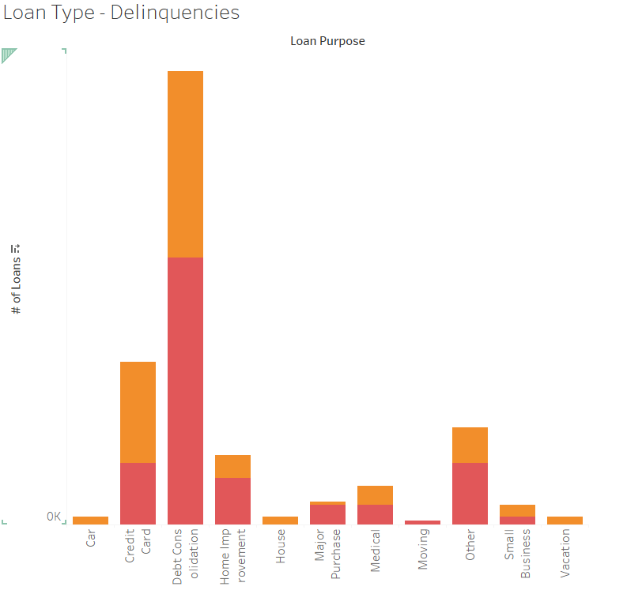
Dashboard Outline - Tableau
Pie Chart – Application Types Map – Loans by state Bar Chart – Type of Loan Stacked Bar – Loan Type - Delinquencies)
Each chart will have a filter as an interactive element

